Slide 1
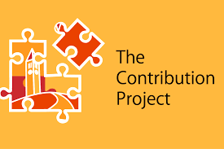
Youth Contribution as a Context for
Purpose Development
Presented by:
Christopher Davis, MS, LGPC
Notes:
<<add pretty background>>??? Update: pretty background added

Slide 2
Objectives and Overview
Discuss ways that youth typically engage in purpose development.
Introduce the idea that youth contribution may be a viable pathway for youth purpose development.
Explore feasible ways to promote youth contribution within our existing programs.

Slide 3
Purpose corresponds with greater health and wellbeing, but it needs to be cultivated.
Hill, P. L., Burrow, A. L., & Sumner, R. (2013). Addressing important questions in the field of adolescent purpose. Child Development Perspectives, 7(4), 232-236.

Slide 4
Q&A:
How do youth typically develop a sense of purpose in life?

Slide 5
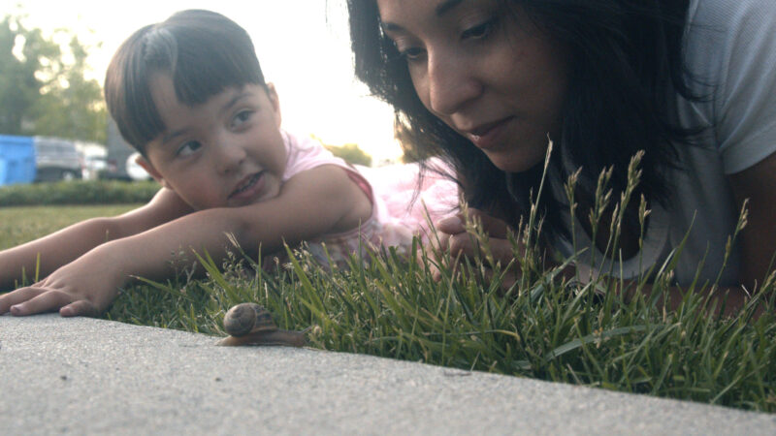
Pathways to Purpose
Reactive
-Reaction to an unexpected
experience or event.
-This may serve to uncover a life
direction of how one believes
they can be a service to
themselves or others.
Social Learning
-Observing purposeful others.
- By watching how committed
others are to their purpose in life,
one may internalize those
behaviors and efforts.
Proactive
-Sustained engagement in goals that one feels connected to.
- Through this, one may internalize
what goes on in these experiences
as personally meaningful, thus
uncovering a sense of purpose.
Hill, P. L., Sumner, R., & Burrow, A. L. (2014). Understanding the pathways to purpose: Examining personality and well-being correlates across adulthood. The Journal of Positive Psychology, 9(3), 227-234.
Notes:
***Preface by mentioning the clinical precedence of these types of models…. Try to bifurcate from goals…?

Slide 6
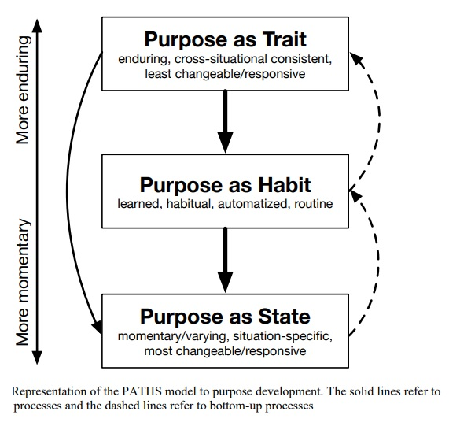
How will you reach you
target consumers?
PATHS Model to Purpose Development
Marketing Channel 2
How will you reach you
target consumers?
Hill, P., Pfund, G. & Allemand, M. (2023). The PATHS to Purpose: A New Framework toward Understanding Purpose Development. Current Directions in Psychological Science.

Slide 7
My pitch to you:
Youth contribution may be a worthwhile avenue to support youth purpose development!

Slide 8
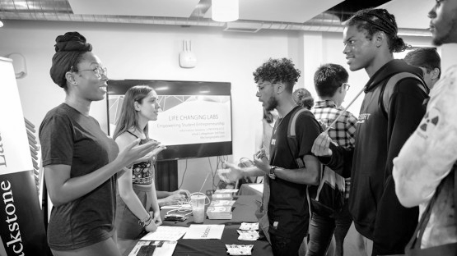
Background on Contribution

Slide 9
What is contribution?
A contribution is something that adds value to you and the community around you.

Slide 10
Psychosocial benefits of contribution
Health & Wellbeing
Social Connection
Goal-Setting
Sense of Purpose
Fuligni, A. J. (2019). The need to contribute during adolescence. Perspectives on Psychological Science, 14(3), 331-343.

Slide 11
Q&A:
What are some Common Barriers to Youth Contribution?

Slide 13
What is
The Contribution Project?

Slide 14
Who is it for?

Slide 15
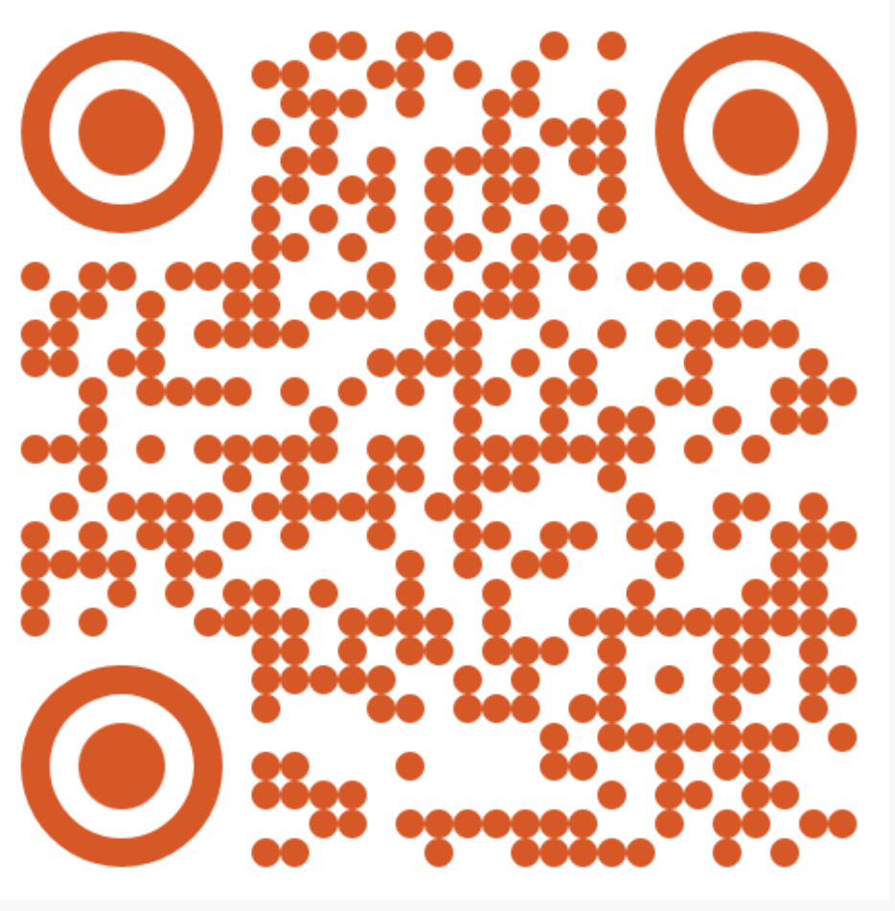
Who is it for? (cont.)

Slide 16
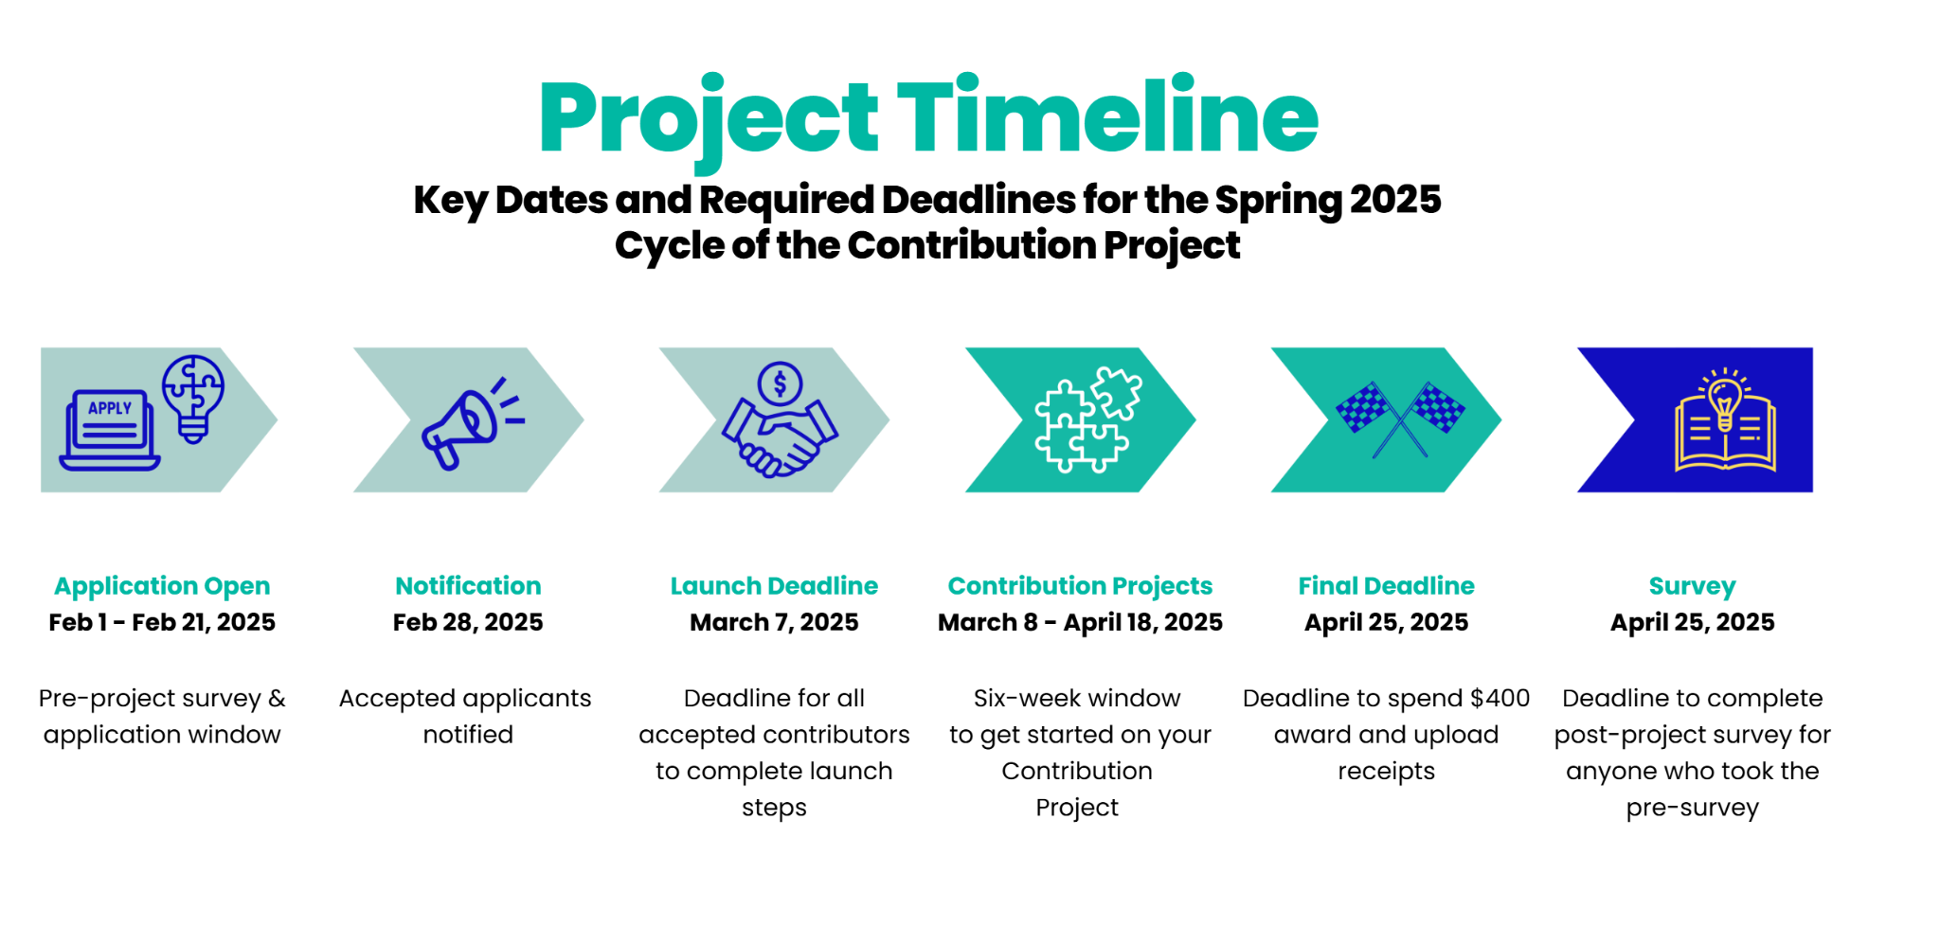
What Do Contributors Do?

Slide 17
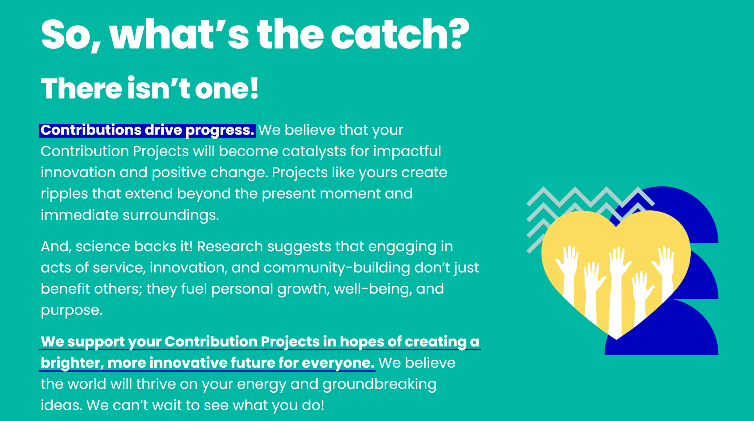
What’s the catch?

Slide 18
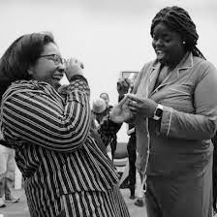
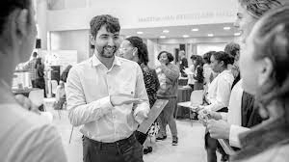
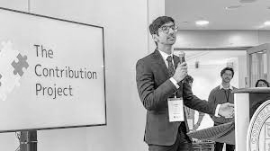
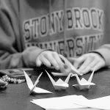
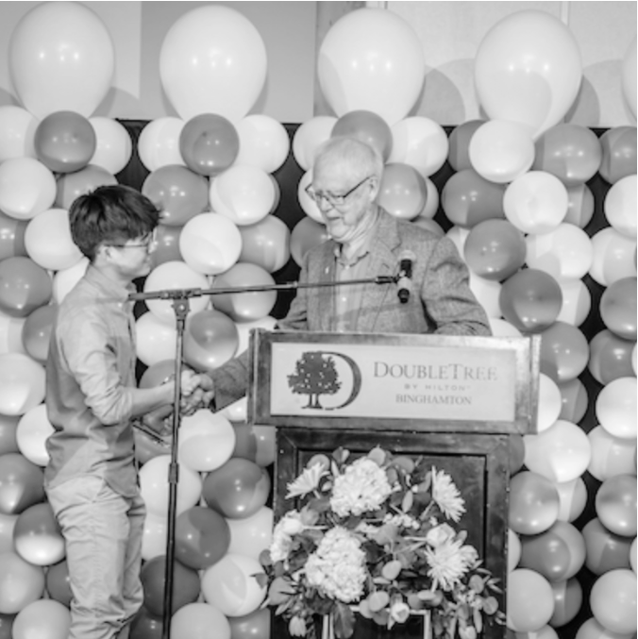
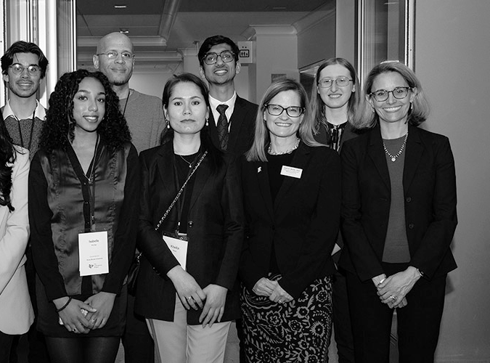
Preliminary Findings from a Past Contribution Project

Slide 19
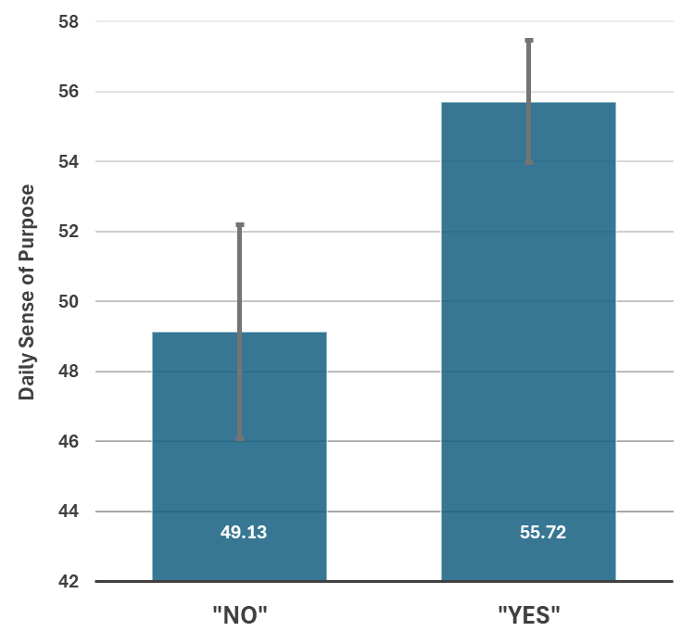
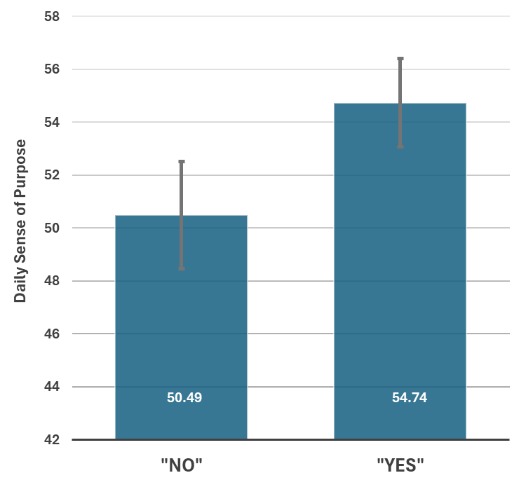
“Did you work on your contribution at all today?”
“Today, did you make any new contributions, apart from the main contribution you proposed for this project?”
***
**

Slide 20
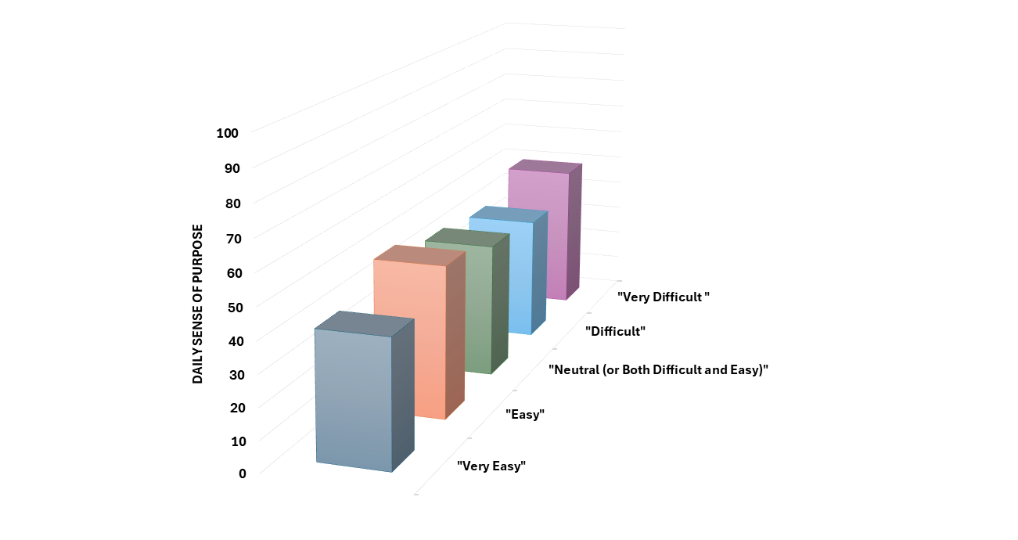
“How did it feel to work on your contribution today?”
ns

Slide 21
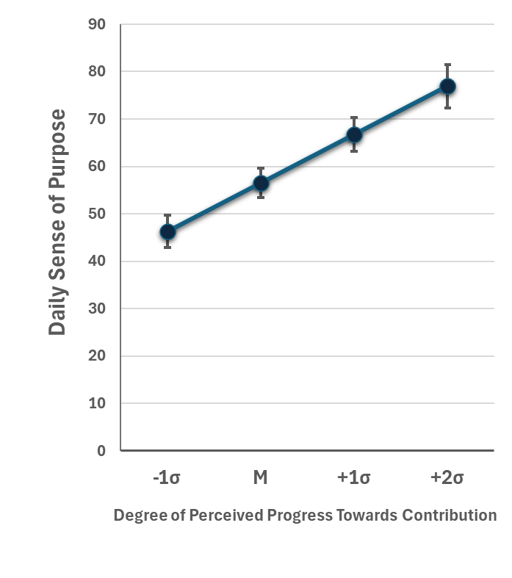
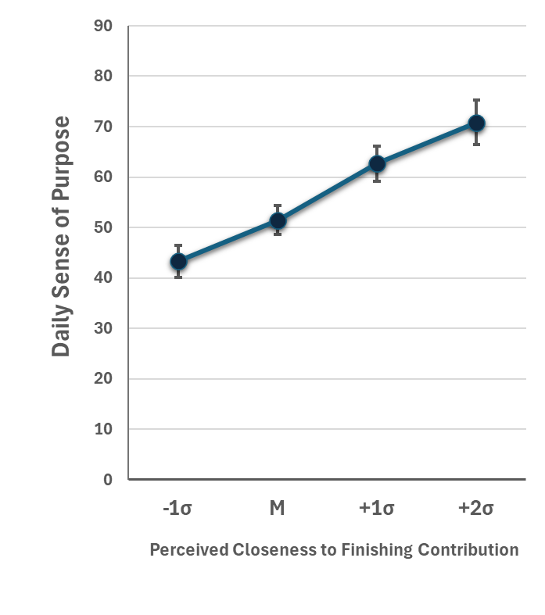
“How much progress do you feel you made on your contribution today?”
“How close do you feel you are to accomplishing the contribution you originally proposed?”
***
***

Slide 22
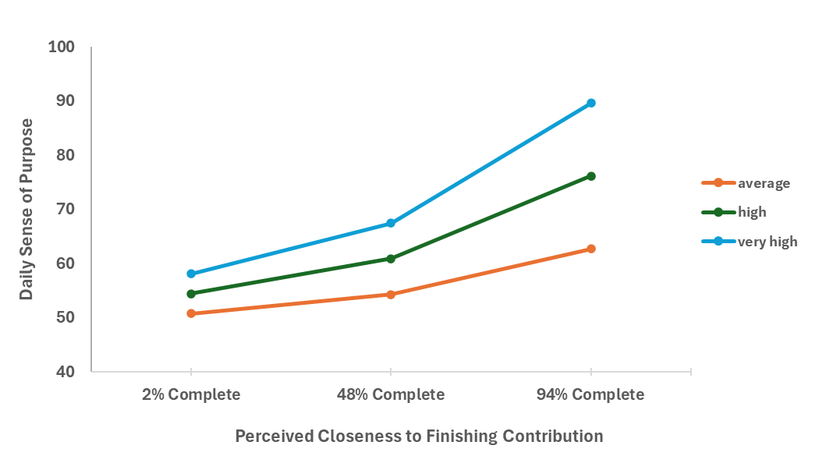
I’m Almost Finished and I’m Still Making Progress
*
Degree of Perceived Progress Towards Contribution

Slide 23
Brief Narratives of Past Participants

Slide 24
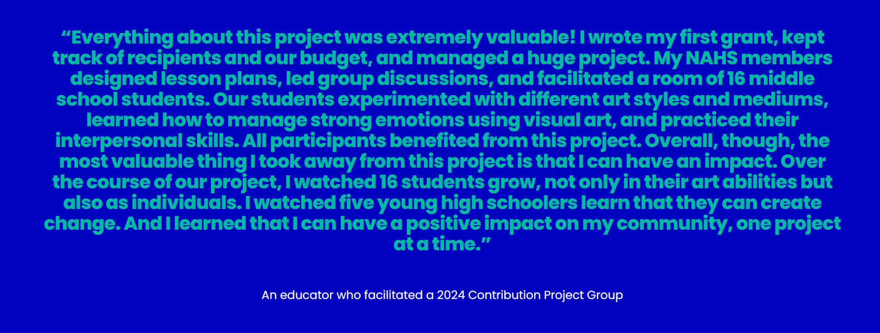
Brief Narratives of Past Participants

Slide 25
Summary of Findings
Contributors felt more purposeful:
on days that they worked on their contribution.
when they felt that they were making progress and nearing their overarching goal.
Degree of perceived difficulty regarding working on their contribution had no impact on their daily sense of purpose.
Qualitative narratives provided give a potential glimpse into why the quantitative data indicated a desirable relationship between daily purpose and their contribution efforts.

Slide 26
Breakout Group: Part 1
Think about your own organization and discuss the following with your group:
What are ways that youth are encouraged to contribute?
What might pose as barriers for youth to contribute?
How necessary are these barriers?

Slide 27
Breakout Group: Part 2
Think about your own organization and discuss the following with your group:
What are ways that the barriers which you identified may be mitigated?

Slide 28
Summary
Contribution may be seems like a viable avenue for youth purpose development.
Purpose is a cultivable resource.
There are actionable ways to incorporate youth contribution in our existing programmatic structures.

Slide 29
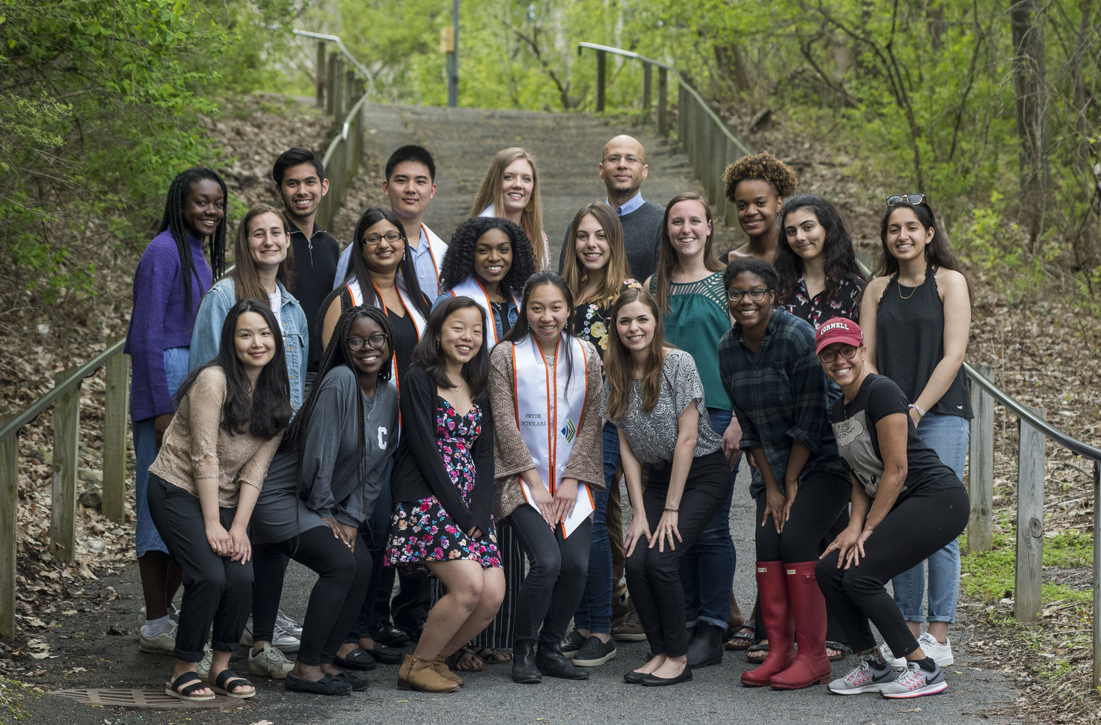
Thank You and Stay In Touch!
hello@contributionproject.org
Email
cjd248@cornell.edu
Social Media
@prydecornell
Call us
(607) 254-5125
Website
contributionproject.org

