Slide 1
Edgerton High School Mentoring Program

Slide 2
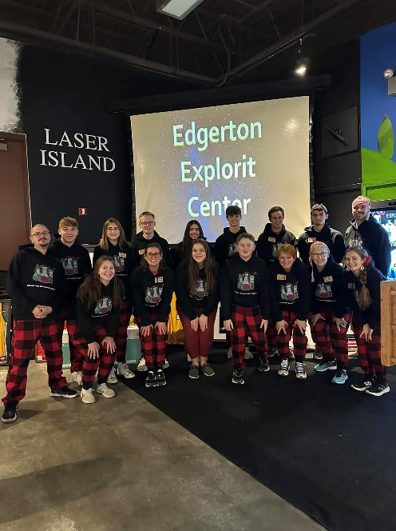
1. High school students whom we select through an interview
process or that have been through our program work as
mentors for our afterschool and summer camp programming.
2. High school students assist staff with
afterschool setup, programming and cleanup.
3. Seasoned high school students instruct afterschool sessions
and take on more responsibility as they grow in the program.
Edgerton Explorit Center High School Mentoring Program
How it works:

Slide 3
Edgerton Explorit Center High School Mentoring Program
From pool of afterschool helpers, our best high school students are selected to help with our summer camp program.
Students help select camps, write the curriculum, determine supply needs, help with camp setup,
instruct the camp and cleanup.
Staff mentor/senior student mentors are assigned to each student helper to be there to answer
questions, help with disciplinary problems and assist in any way that the student needs help.
For both afterschool and summer camp programming, team high school mentors up in groups of two or three. This builds teamwork and is a great way to give students additional support.

Slide 4
Edgerton student created curriculum is available on the Beyond School Bells Website
which includes single labs, entire camps and tracks.

Slide 5
Engaging High School Staff While Creating & Facilitating Clubs
Lilliauna Champion, Dawson Stolpe & Dominic Foged
Notes:
State your name, age, how you began working at the Edgerton & our experience over time

Slide 6
Create

Slide 7
Outline
Details
Explanation
Links
Notes:
DETAILS:
Title of activity
Time Frame
Date of camp
EXPLANATION:
Indepth of what the activity is
certain things to do while teaching like questions
LINKS:
Providing links to help user easily access the activity
Follow instructions as used on link

Slide 8
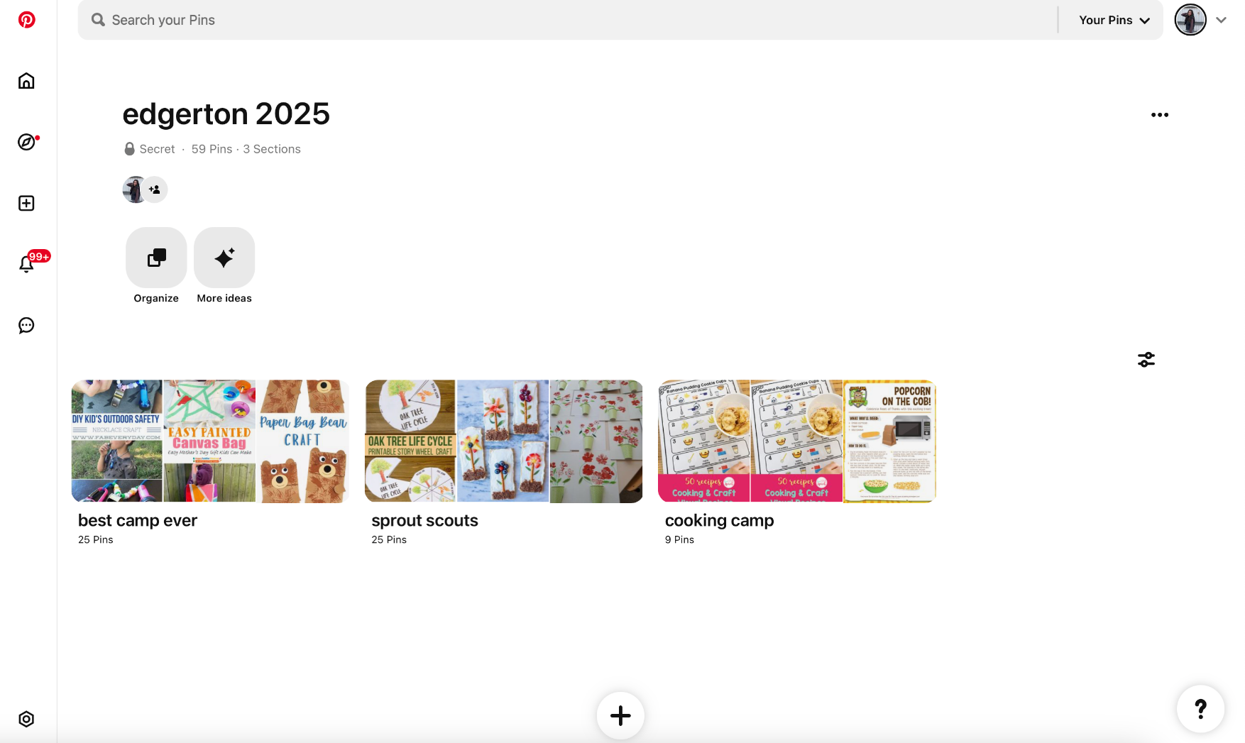
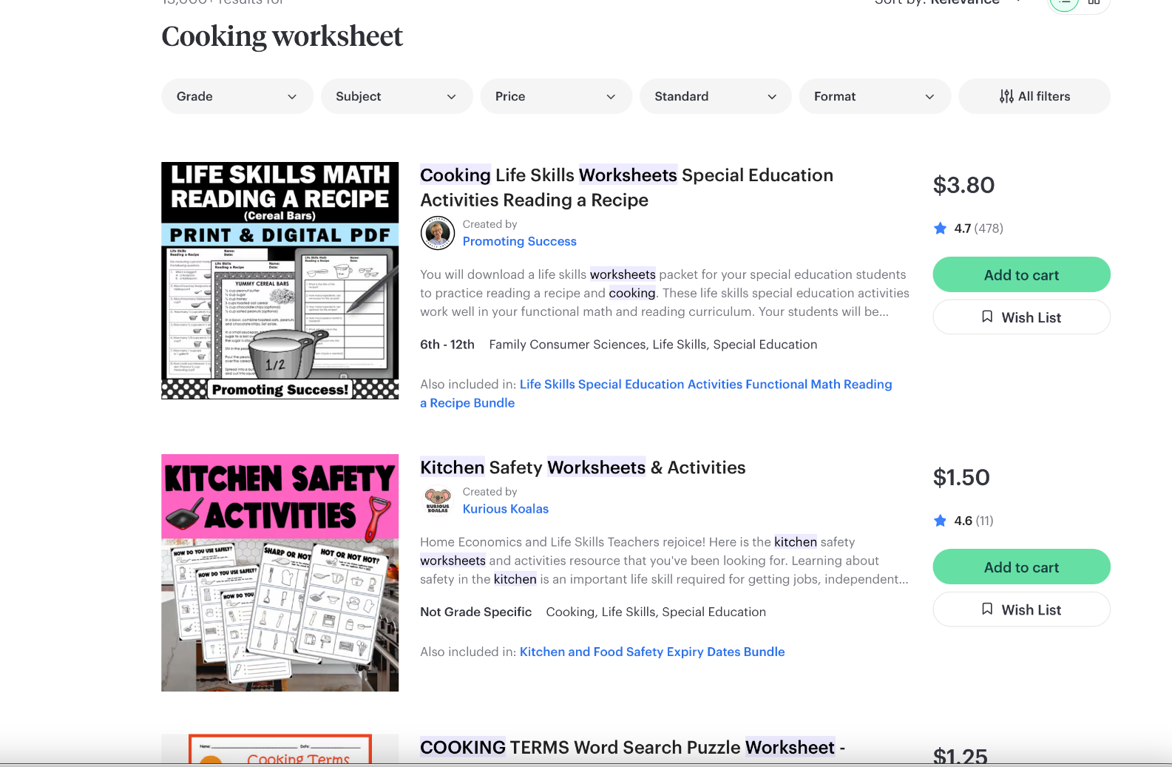
Resources
Reliability
Details
Relevant
Notes:
RELIABILITY:
Is there pictures included?
Is there step by step instructions?
If it is a video, how many views/ positive comments are on it?
What is their way of catching your attention?
DETAILS:
Do they give you steps that follow their end result?
If it is a kid only project is there basic instruction for the student to follow?
Is there advice/preferences the creator gives you to try?
RELEVANT:
How does this align with your activity?
What will a child learn from this?
Can you expand on this topic?
Is there activity to go along with this?

Slide 9
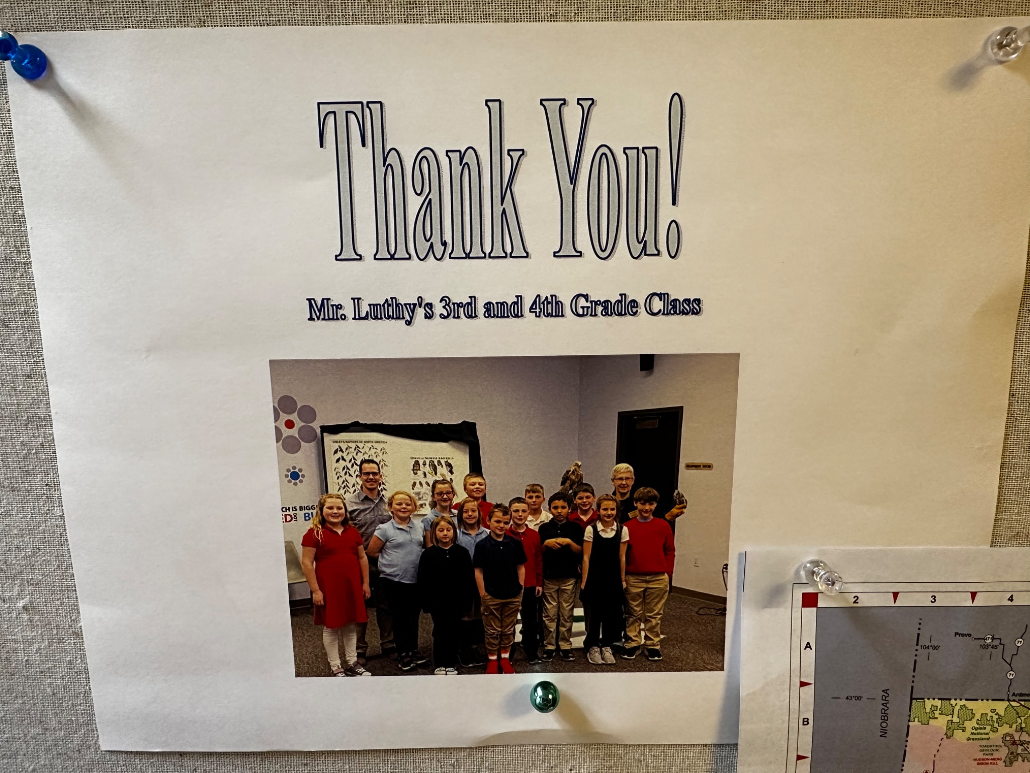
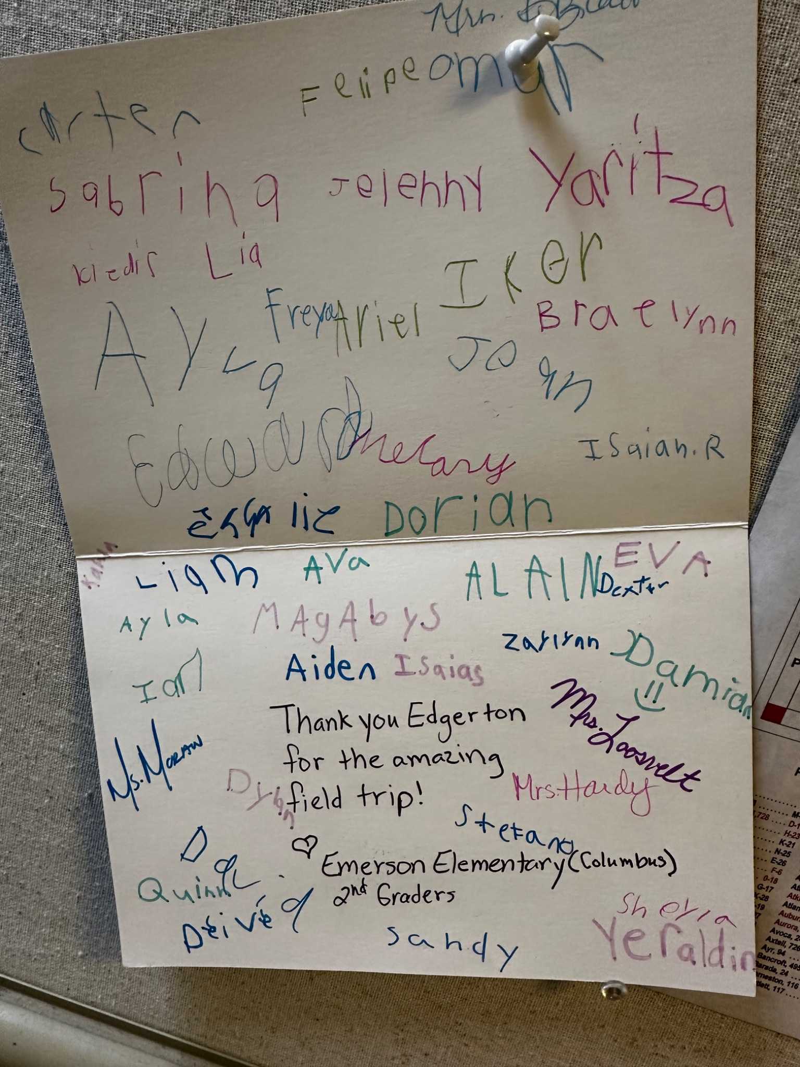
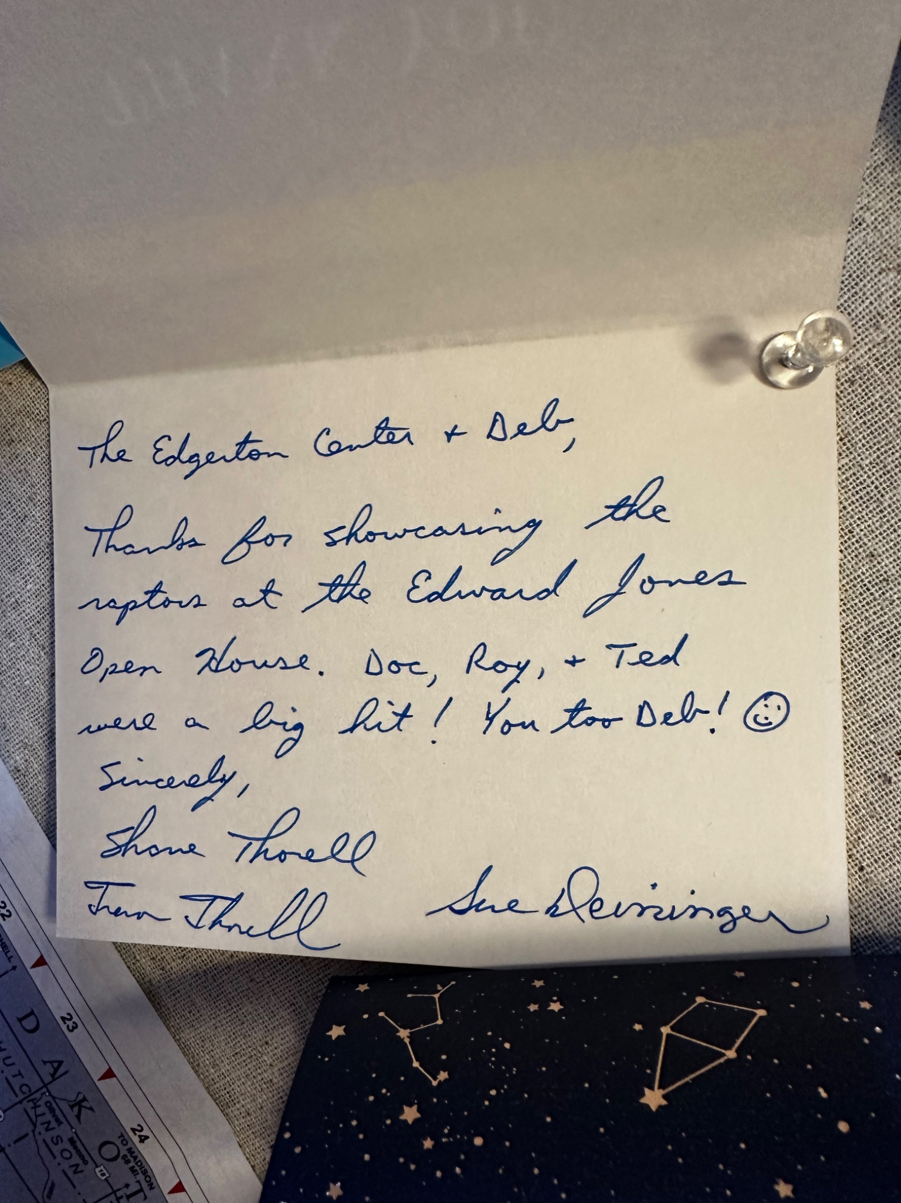
Feedback
Helpers
Students & Families
Community
Notes:
HELPERS:
After watching what can I do better
What to do in certain situations where a kid may be misbehaving
What have you done previously
STUDENTS & FAMILIES:
Asking what they liked best from the activity or camp
Seeing how well different ages, genders, and groups deal with activities
Watching body language
Posting surveys
Creating relationships with parents that make them comfortable to approach you
Looking at the number of students in different camps to see what was popular and what wasnt
See why something wasnt popular, maybe change a name, picture, or description

Slide 10
Facilitate

Slide 11
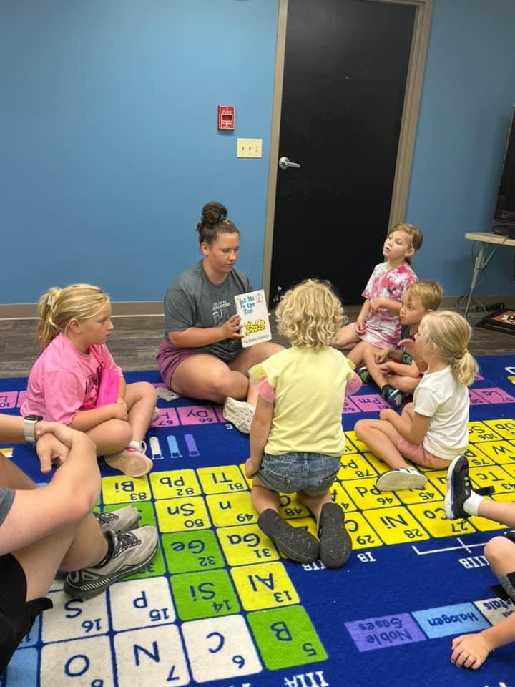
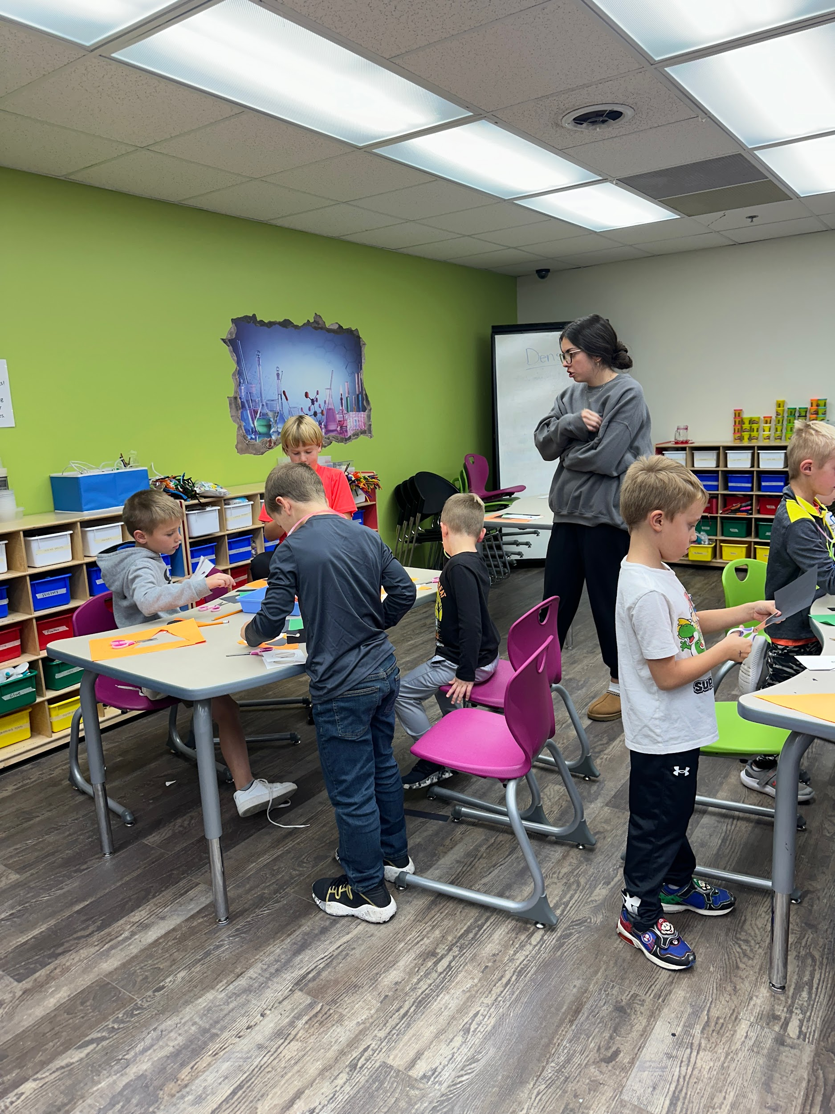
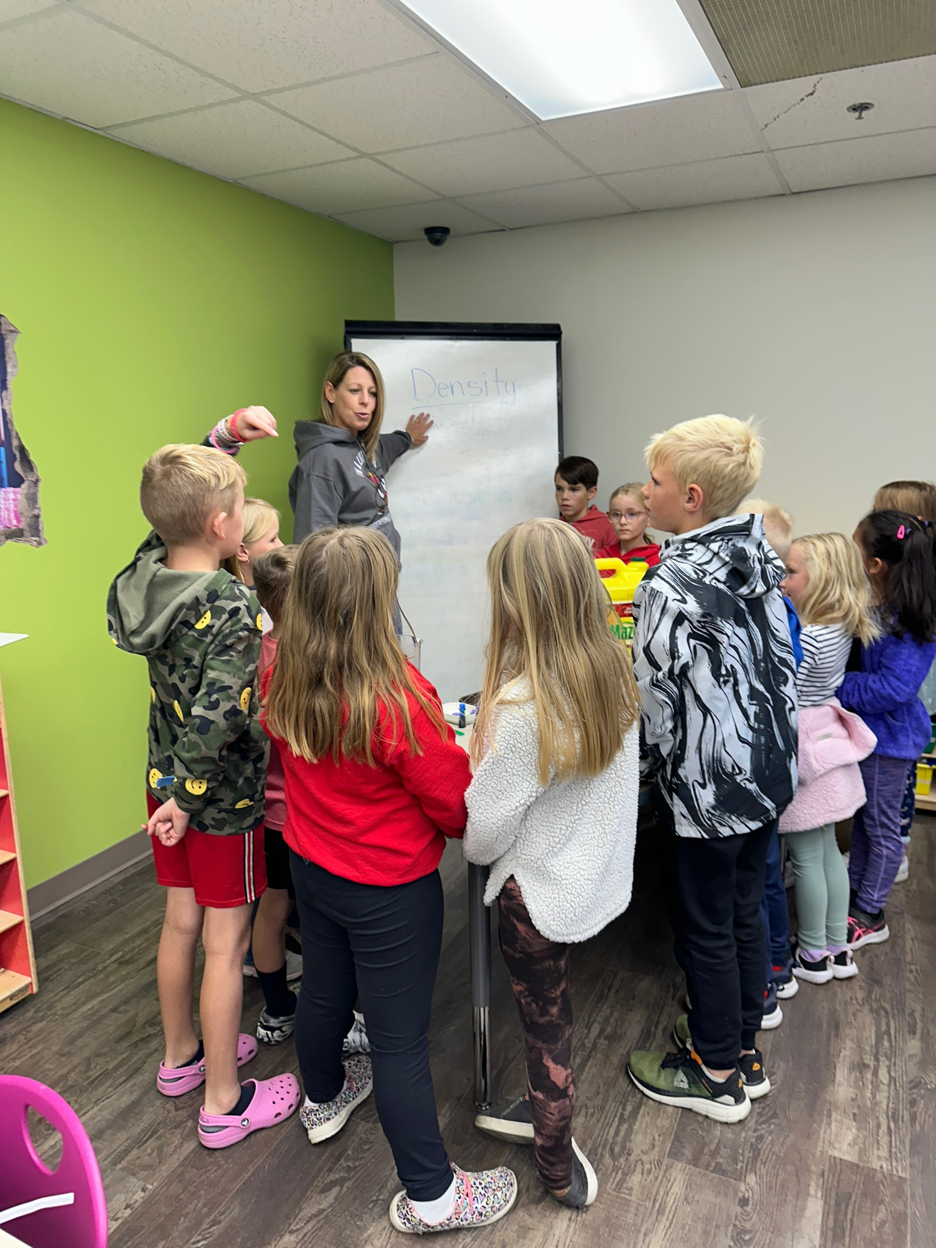
Test it Out Yourself
Check Your Understanding
Make an Example for Kids
Think of ways to simplify instructions if they are too complicated
Notes:
Check your understanding: Most instructions we get for our curriculum is from one of the resources that Lilli mentioned earlier. We usually read through the instructions thoroughly that way we can find areas that may seem confusing when trying to teach it.
Make an Example for Kids: After reading through the instructions and getting a basic understanding, we will follow the instructions and make examples. This helps with both following along to find parts that are more confusing, and having some examples for the kids to look at. Just be mindful of the examples and that it follows the same rules you but out for the students when teaching it.(Only so many cotton balls or tooth picks)
Think of ways to simplify instructions if they are too complicated: We try to look at the instructions one more time to find the spots that seemed confusing or too wordy and shorten them up or simplify them. Whether it is retyping all of the instructions ourselves in a way we feel is easier to follow for the kids, or just adding more pictures to show what the step should look like.
Bullet 2: After gaining an understanding of the activity make a few examples for the kids to see for themselves up close. Once they see what the final result should look like they’ll be more encouraged to keep going.
Bullet 3: If instructions seem too wordy, find ways to shorten it up without taking away too much.

Slide 12
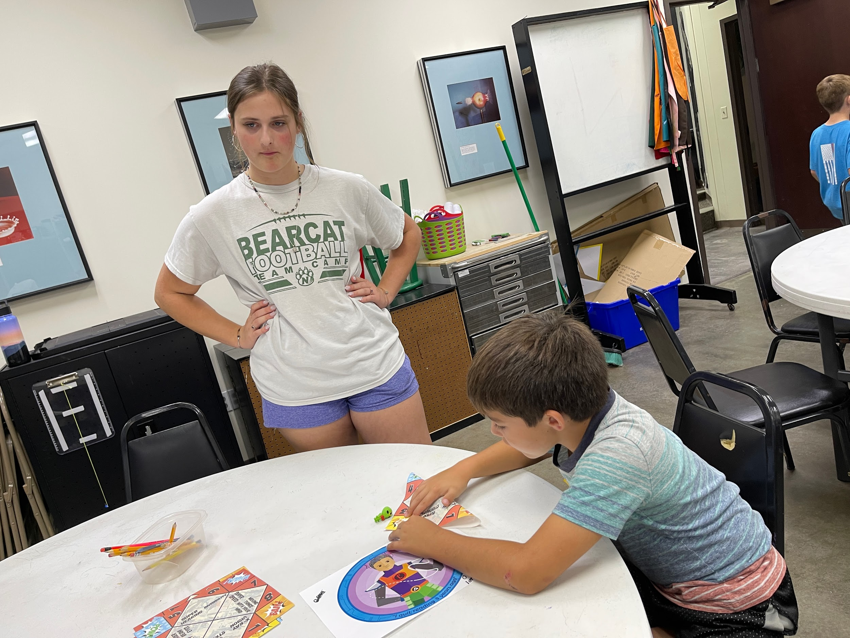
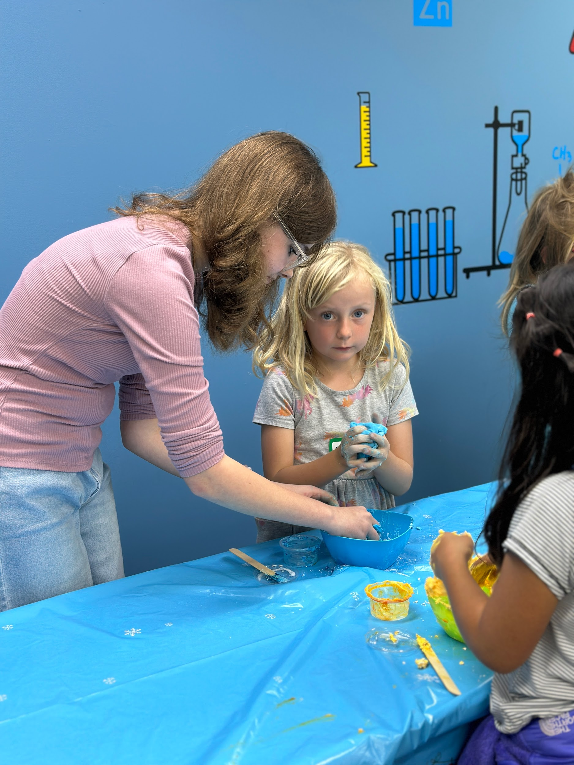
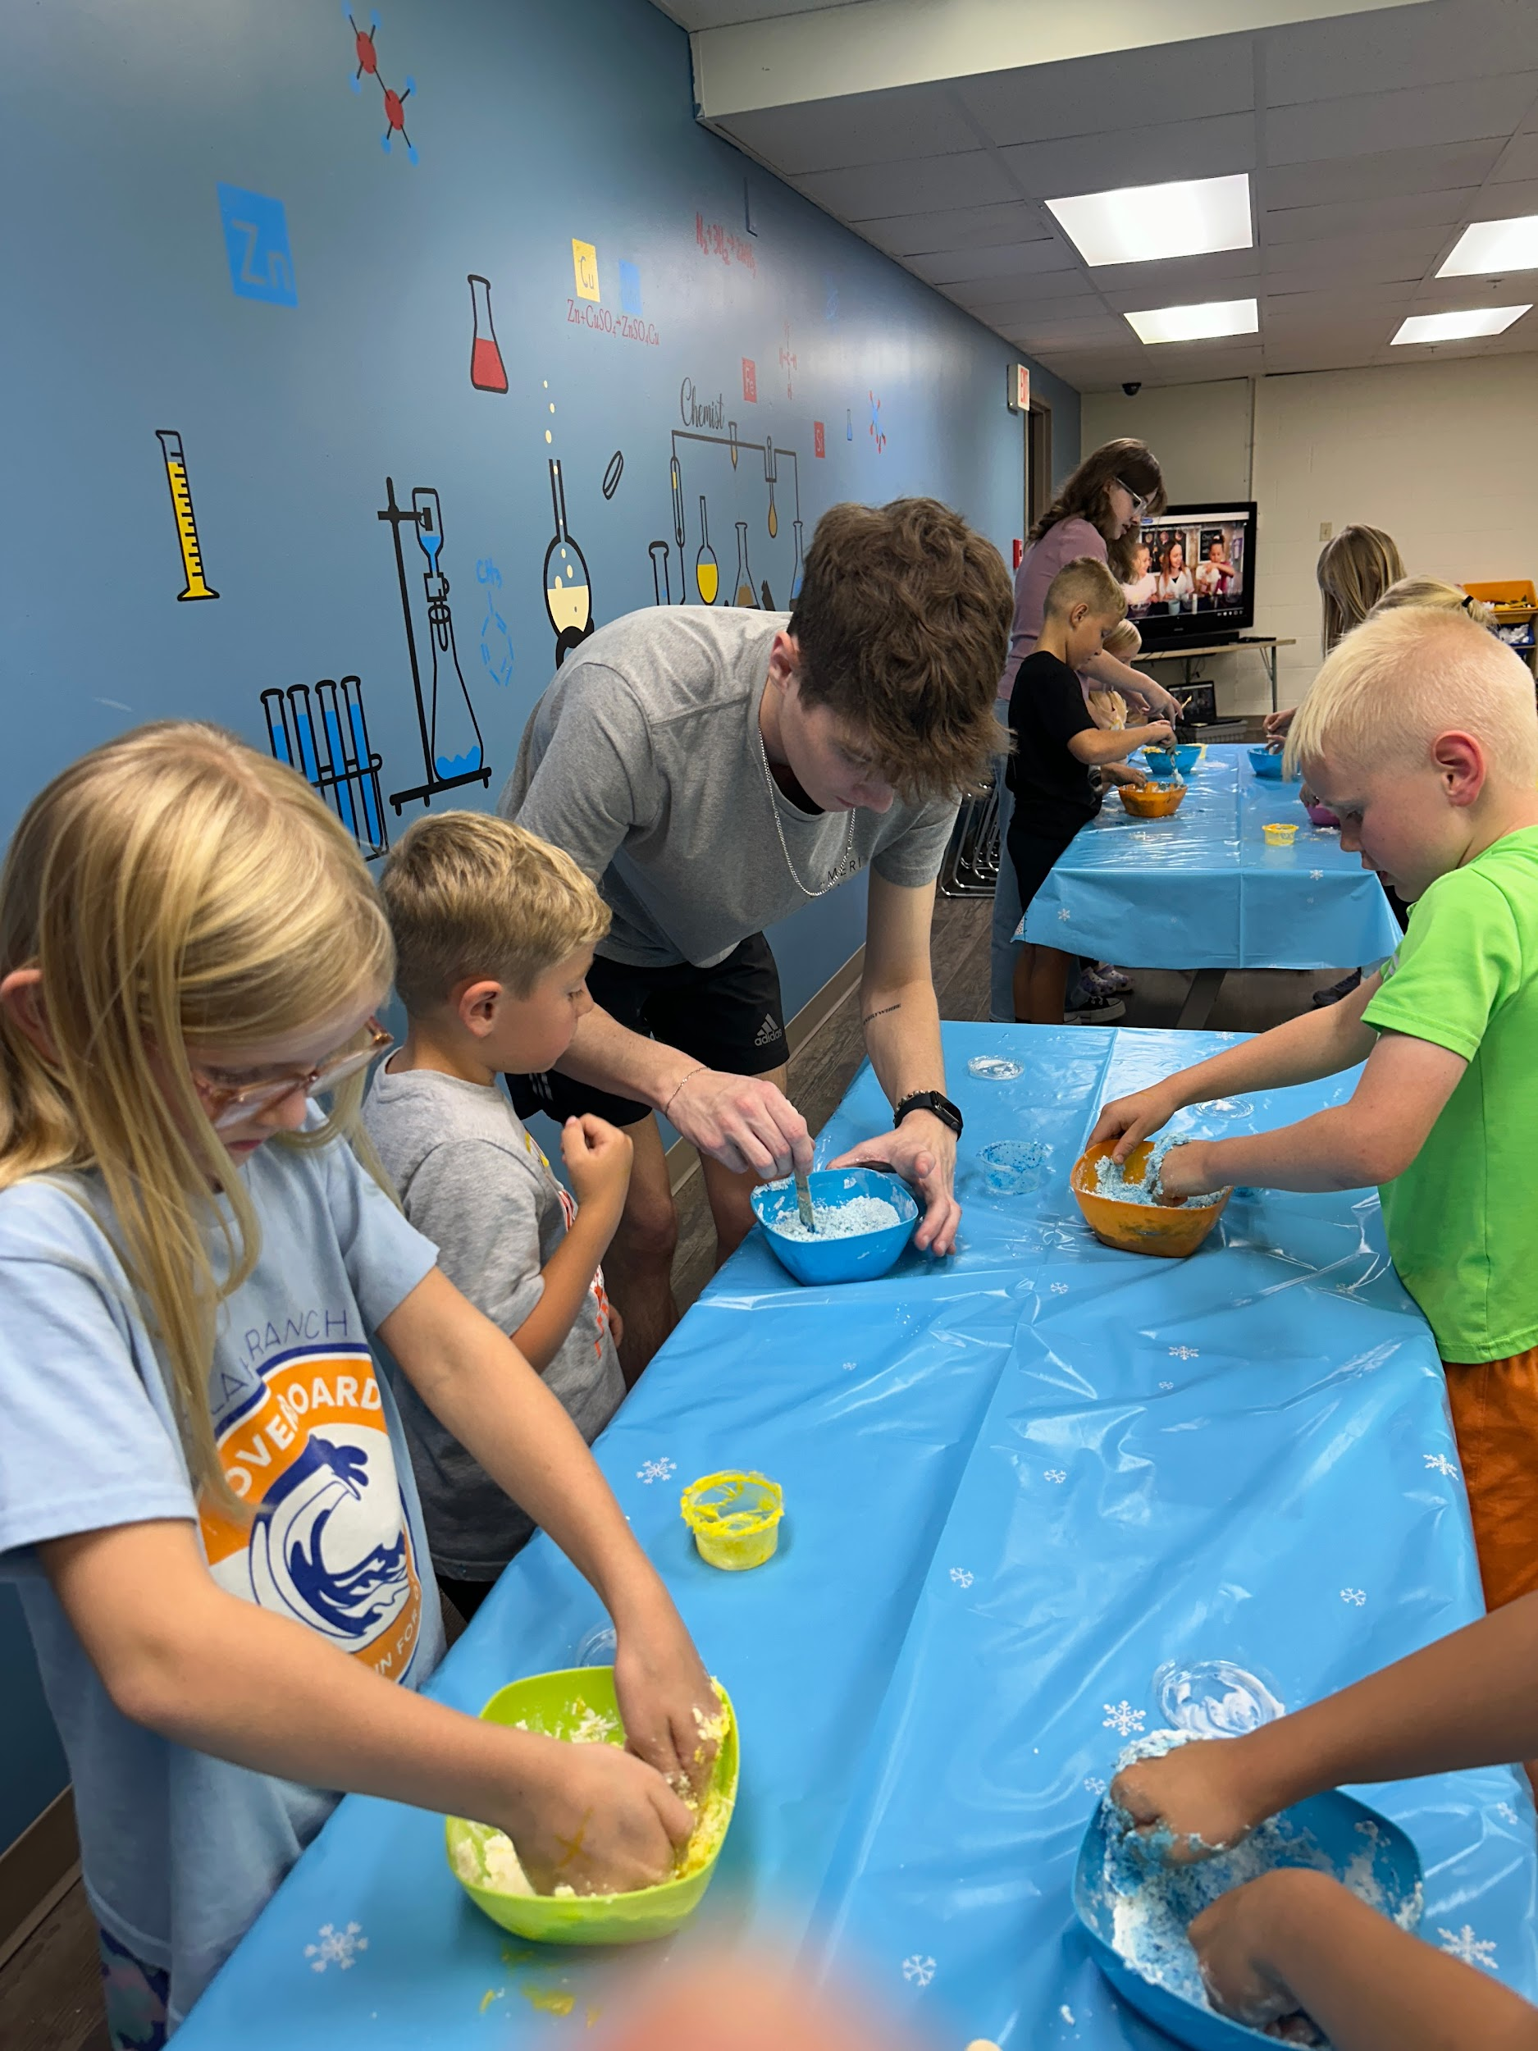
Try It With Another Person
Invite someone to test the experiment
Walk them through the experiment
Ask them how they felt
Notes:
Invite Someone to Test the Experiment: We encourage to try teaching this 1 on 1 with someone you know whether that is a co-worker or family member. We do this so that way we can gain the experience of teaching the experiment, and having someone else listen to the instructions.
Walk them through the experiment: Teach them like you would teach your class. Go step by step with the activity and make sure to take the same amount of time that you would with your class. Check to make sure that they understand the steps and are following along.
Ask them how they felt: With newer activities there is room for changes and criticism. Ask if there were spots that were confusing or hard to follow. If there were spots they thought were better than others, and how they think it should be explained in a different way. Most of the time it is just taking a bit more time to explain each step and switching a few things around.

Slide 13
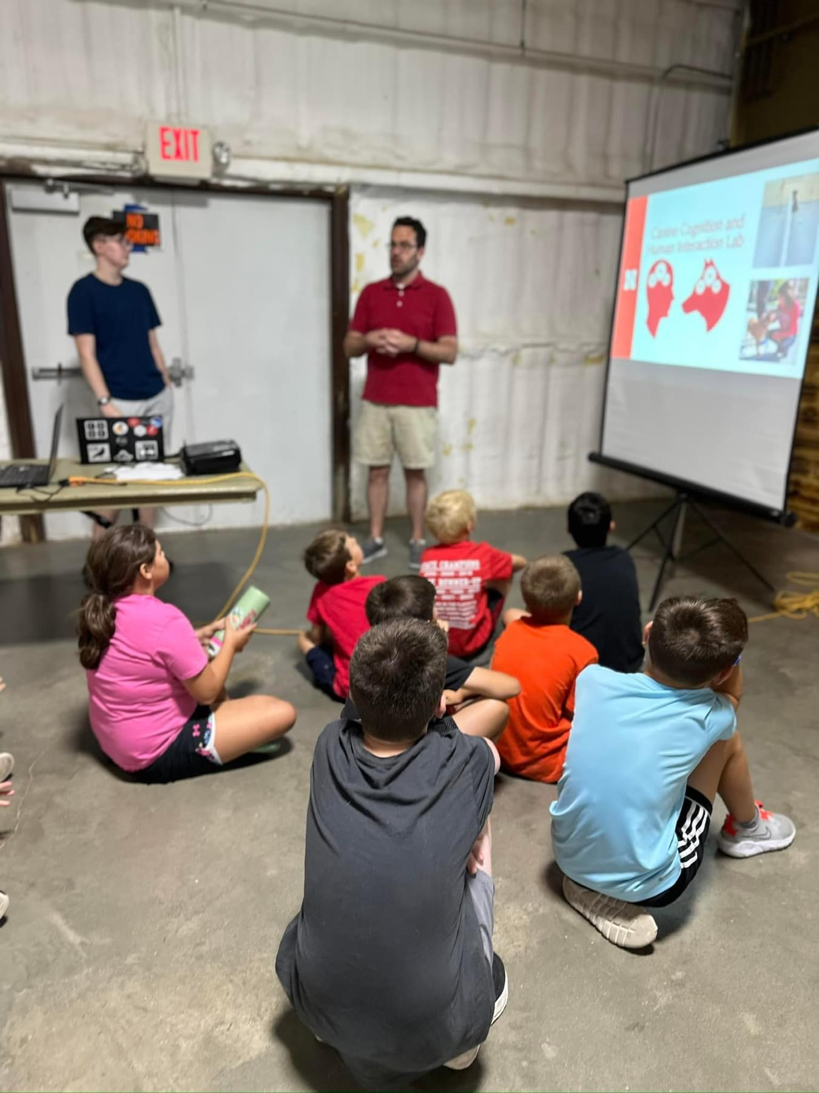
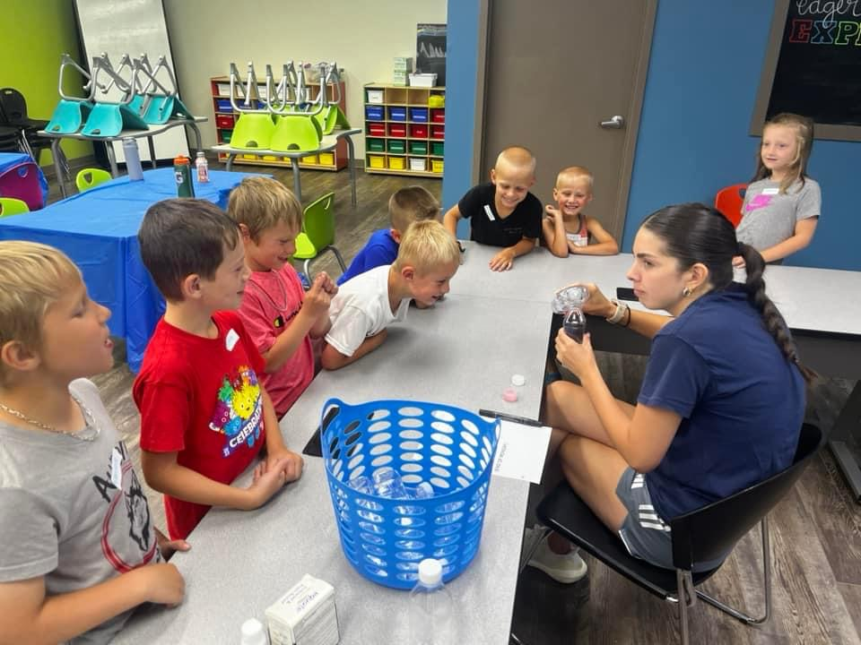
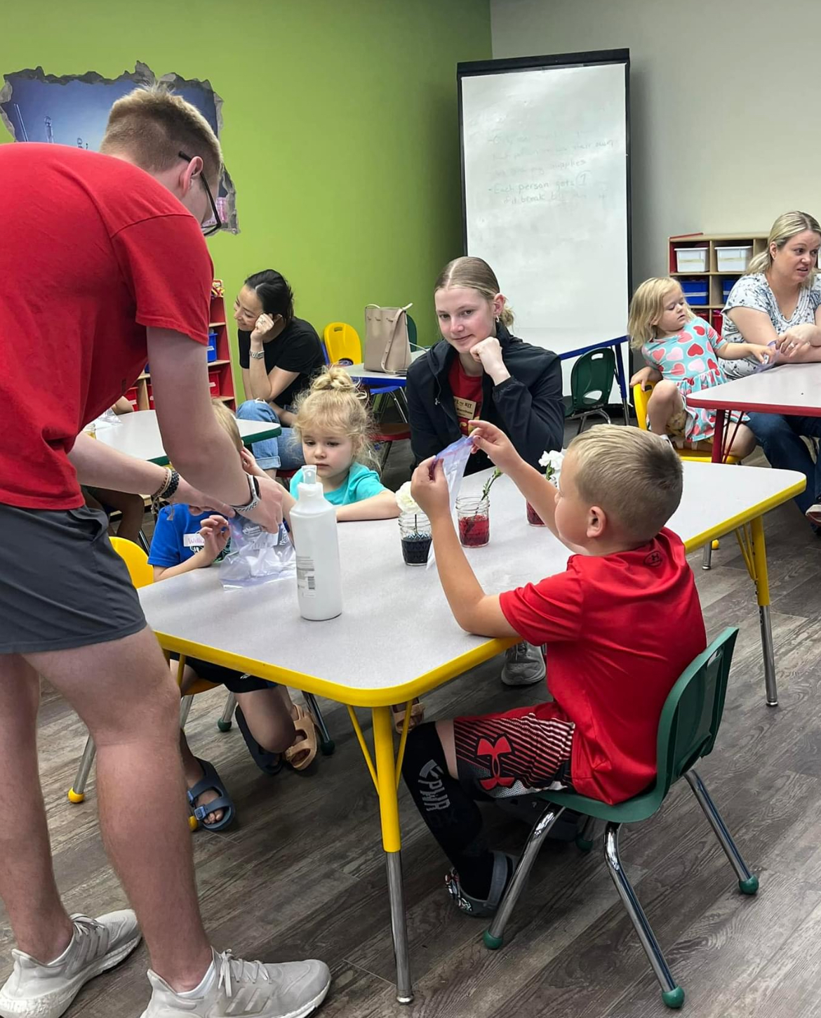
Adjust
Changing the Instructions
Acclimate to your teaching style
Notes:
Changing the Instructions: After getting feedback from someone else and reading through everything, we then adjust the instructions. Instructions can get too wordy so we take out everything that isn’t needed to leave what is necessary for the activities to still be successful.
Acclimate to your Teaching Style: We all approach teaching our curriculum differently. Lilli, Dawson, and I don’t have the same teaching style and that’s okay. We make our curriculum in a way that is easy to adjust to your style. Our curriculum isn’t a step by step instruction of how you have to run the program, we make them as a guide that can be adjusted in anyway.

Slide 14
Engage

Slide 15
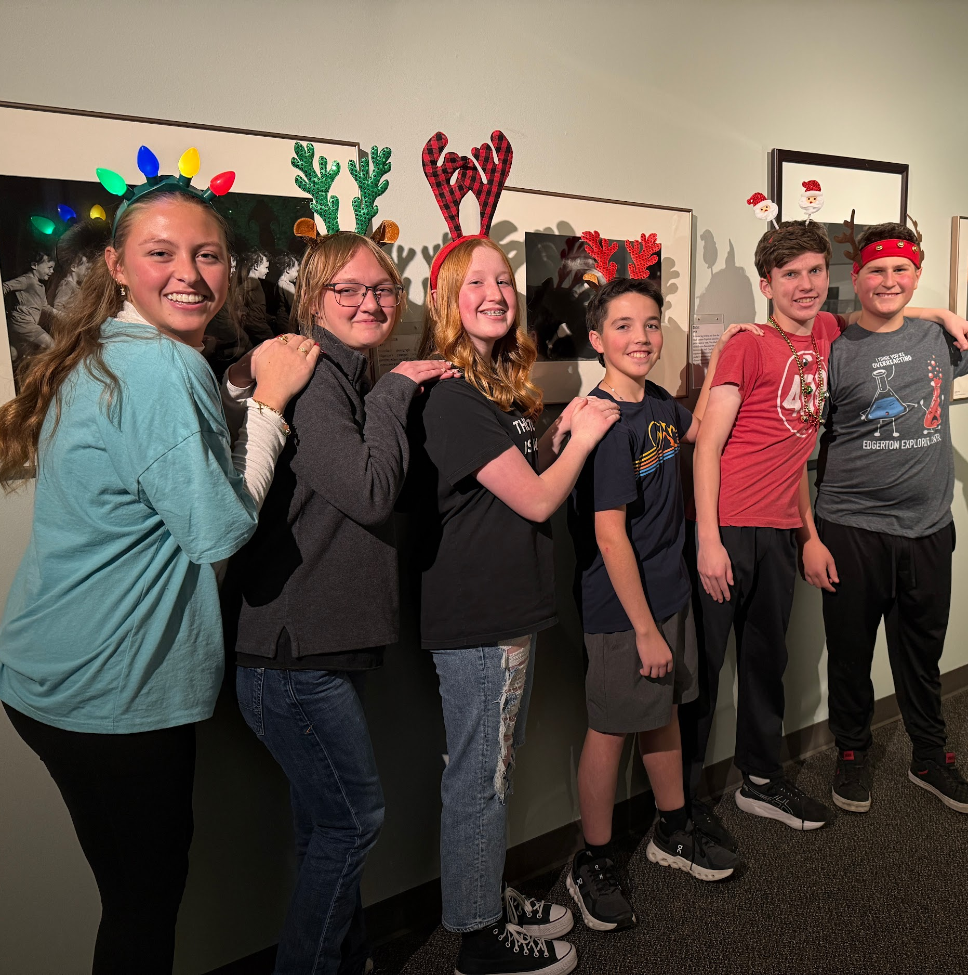
Relationships
With Their Leaders
With Their Peers
With the Students
Notes:
Leaders: As an instructor it's important to make sure that you come across as approachable and easy to come to if they need. Making sure that as instructors you have a good relationship with your Highschool helpers is super important. It's a lot easier to listen and want to help someone that you get along with and respect than it is someone that you don't necessarily have a good relationship with. While making sure that you still keep a boundary between friend and boss.
Peers: Encouraging them and providing opportunities for them to build bonds with their classmates and peers is important as it allows them to have someone their age to bond with and ask questions that they may not need to bring to you. It can also help keep them accountable. They know what is expected of them and every now and then they may stray from that, as high schoolers tends to do, sometimes it's better to get a reminder from a friend than your boss to get back on track.
Students: Encouraging them to build bonds with the students is one of the most important parts in my opinion. When they get to know the kids better they will start to want to be around them and helping out. It will also help keep them involved as the students will look to them when they need help or have questions. One of my favorite parts of working at our afterschool program is getting to see the kids faces light up when they see you and getting to spend time working with them each week.

Slide 16
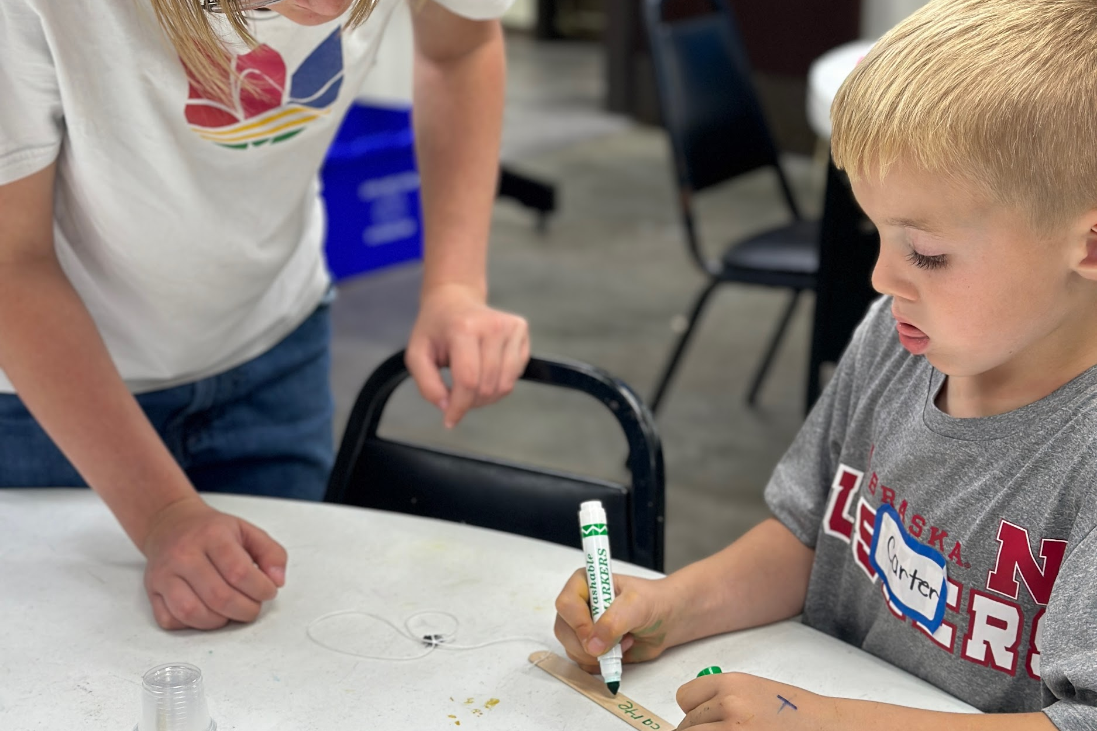
Activities
Give them some responsibilities
Let them do some of the teaching
Pair them one on one
Notes:
First bullet: Allow them to have some freedom. Give them some responsibilities that they can repeat each week. Things like passing out the needed supplies for the days activities or helping the kids clean up in between. Things that they know that they have to do each week and making sure that they know that their job is important and that things could not run as smoothly as they do if they weren't there.
Second Bullet: Whether it's just a time filler activity or a smaller activity either way. It could even be for a smaller group of kids. You could let them teach their own station so that they are still in the room with the lead instructor so they will have some supervision but it allows to interact and be involved in the program.
Third Bullet: Have them walk around while someone else is teaching and watch for if one of the younger kids needs help with cutting or things that require more fine motor skills. One on one scenarios allow them to get involved with the students on a personal level. This helps them want to interact and stay involved.

Slide 17
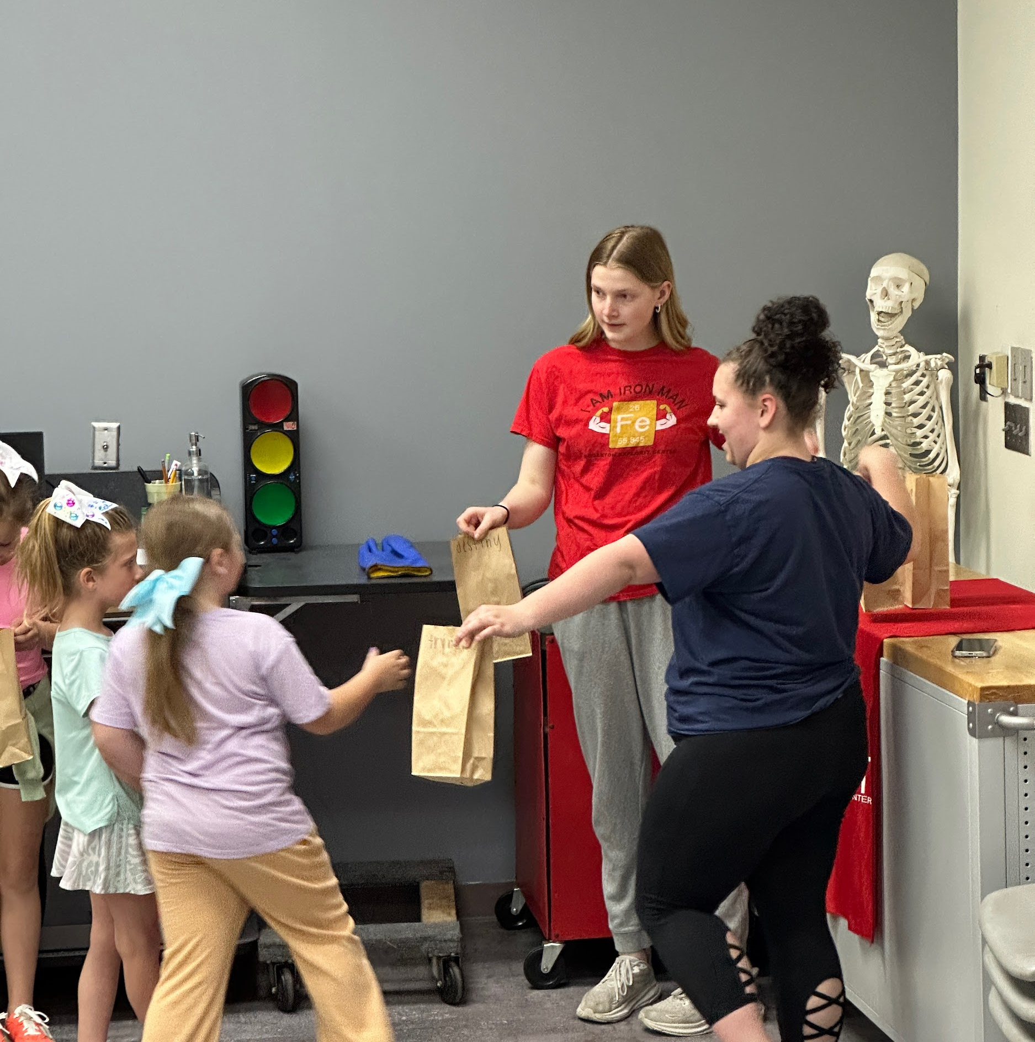
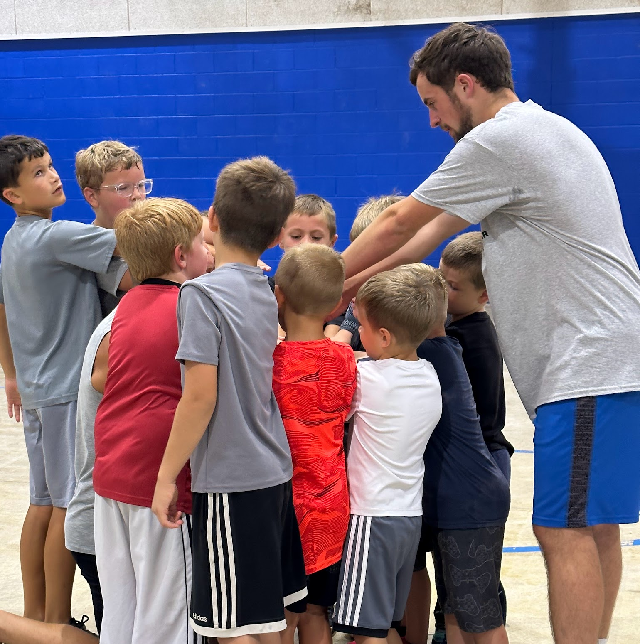
Freedom
Let them make some decisions
Give them a short lesson
Let them do the task how they want to
Notes:
First Bullet: When it comes to some of the smaller decisions that need to be made its okay to trust them to handle it every now and then. Especially once they've earned your trust. Things like letting kids use the restroom or get up to throw something away or get a drink. Even the small things like these allow your helpers to feel like they are apart of the decision making process which will keep them interested and wanting to be involved.
Second Bullet: Every now and then you could give them a little mini lesson or let them teach one activity or lead the kids in a game while you get set up for the next activity. Letting them have this little bit of freedom to do things the way they think it would work not only has them interacting but also has them wanting to be apart of the teaching more and more often.
Third Bullet: When giving them a task that you need done you could try letting them do the task how they see fit. If they don't do it the way it needs to be done then you can help them adjust, but letting them do it the way they think it should be done first shows them that you trust them to get the job done. This will help them stay motivated to show you that they are doing a good job and that they are a good member of the team.

Slide 18
SLIME
Notes:
Teach slime to them & finish by asking them what they learned

Slide 19
Instructions:
activity
Grab slime kit
Follow printed instructions
Finish slime & take home!

Slide 20
Q&A
Notes:
While introducing the Q&A also take this time to accept feedback from the participants whether that is on this slideshow, or our activity!

Slide 21
Thank you!
We hope that you learned something valuable

