Slide 1
FROm DATA to Dollars: How to Leverage Data for SUstainability

Slide 2
Why worry about funding?
Federal funding is often insufficient
Enhance program offerings
Staff wages are one of the main reasons for turnover
Grant funds are rarely long-term sources of d funding

Slide 3
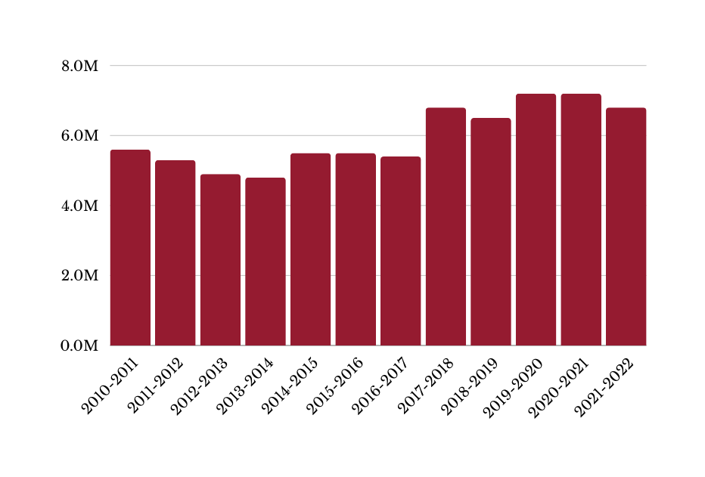
Program
Funding
21st CCLC annual grant awards
Daily Rate: Afterschool (3-4 hours)
Cost of a loaf of bread (US)
$5.00
$5.00
$0.99
$1.97
6.8M
7.2M
7.2M
6.8M
6.5M
Daily Rate: School not in session days (4+ hours)
Cost of a gallon of unleaded gas (US, September)
5.6M
5.3M
5.5M
5.5M
5.4M
4.9M
4.8M
$7.50
$7.50
$1.73
$3.99
Daily Rate: Summer days (4+ hours)
Nebraska minimum wage
$7.50
$7.50
$5.15
$10.50
Minimum grant award per program
Cost of a gallon of milk (US)
$50,000
$50,000
$2.90
$3.97
A 21st CCLC program that received a $50,000 grant
in September 2003 would need to receive $82,525 in
September 2023 to have the same buying power.
2003 vs. 2023; Source: Bureau of Labor Statistics

Slide 4
Agenda
Using data
Look at two sample
Critique them
Taking Stock
Be proactive and prepared
Crafting the communication
Take 2-3 pieces and put them together

Slide 5
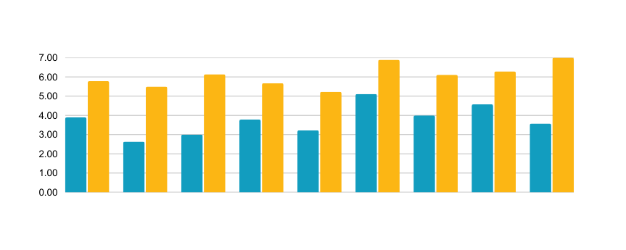
Find Your Future
2023 Student Survey
Participants completed surveys each day to provide feedback on the career field presentations. Response rates varied between 7 and 9 per survey. Participants were asked to provide numerical ratings between 0 and 10 to show their interest in each field before and after the sessions.
Participants' average interest in each field increased after sessions
Pre-session interest Post-session interest
Developmental Disorders
Occupational Therapy
Speech-
Language
Pathology
Behavior Disorders
Neuro-developmental disorders
Psychology
Recreation Therapy
Genetic Medicine
Pediatric Feeding
Participants were asked to indicate their agreement with statements about each session using a 5-point Likert-type scale (1=low, 5=high). Reported percentages reflect participants who said they "somewhat agreed" or "strongly agreed." Each survey invited participants to provide comments about the sessions.
Monday, June 19
My knowledge level of
Developmental Disorders increased.
"I greatly enjoyed learning about what goes into helping such field and I wish to further help with volunteer work."
"I would love to learn more about the technology games they make
for [children with disabilities] or
learn more about moving
power wheelchairs."
My knowledge about potential careers
in Developmental Disorders increased.
I want to learn more about this area.
= Participants who "somewhat agreed" or "strongly agreed"

Slide 6
ISPARK Summer 2024 Findings
Indigenous Summer Program for Advancing Research Knowledge
Who We Served
Eleven Students participated in the 2024 Summer Long ISPARK Program. More than half of the participants were enrolled at Omaha Public Schools high schools. Students were asked about their participation in other programs, such as the Health Care Academy at their school, the YES STEAM Club, and the High School Alliance at UNMC. Most participants reported previous participation in at least one other program.
Participants by School District
82%
Reported participating in at least one other program
Omaha
Public Schools
Millard
Public Schools
Papillion La Vista Community Schools
64%
Participants by Grade Level
Participated in the MMI Find Your Future Shadowing Experience
36%
9th Grade
10th Grade
11th Grade
12th Grade
Participated in the YES Summer Internship
Pre-Program Expectations
Participants were asked to share the expectations they had before their involvement with ISPARK. Most participants expected to learn about science—particularly medicine, biology, and chemistry—and careers in healthcare. Some participants shared their expectations about the activities they would experience. Most of their ideas involved hands-on or active work (e.g., practicing with tools or procedures, writing, problem-solving exercises, and campus or laboratory tours). A few participants expected to learn primarily through lectures, reading, or observations. Some participants expressed personal worries about learning and building relationships with a group of unfamiliar peers.
“I expect to learn about new career opportunities in healthcare and science. I also want to get more experience in the lab and learn more about science and specific techniques.”
“I want to do something with helping people, so I think ISPARK will help me figure out what career I want to do in my life.”

Slide 7
Questions and Comparisons
Sample #1
Sample #2
Are the data understandable?
What do you think the point of the report is?
Does it tell a story?
What stands out?
What is missing?
Would you fund this project? Why or why not?
Are the data understandable?
What do you think the point of the report is?
Does it tell a story?
What stands out?
What is missing?
Would you fund this project? Why or why not?

Slide 8
Taking Stock
Purpose of Program
Impacts
Benefits

Slide 9
StRENGTHS of the Program
What are you most proud of?
What does your program do well?
What evidence supports those strengths?

Slide 10
Let’s practice
Strength #1
Evidence
Strength #2
Evidence
Strength #3
Evidence

Slide 11
Summarize your accomplishments
How long has your program served students and the community?
What have been the benefits?
What has been the overall impact?

Slide 12
Incorporate qualitative data
Stories are effective.
Make the point that you can support with other data.
Draws people in and makes them want more.
Think about your program –
What do you have available OR what can you collect before the deadline?

Slide 13
Who is the audience?
State or federal sources
Private funders
Partners
Parents

Slide 14
Funders look for….
Proven record of success
Strong leadership and organizational capacity
Positive outcomes that demonstrate long-term impact
Benefits to the community
Clear plan to measure success and collect data

Slide 15
Develop a 3-4 sentence summary
Take what you just did. Develop the summary.
Modify it for 2 audiences

Slide 16
Parent
Survey
Parent survey results
310 surveys completed
6447 surveys completed
6817 surveys completed
2003-2004*
2013-2014
2022-2023
The afterschool program is a benefit to my child.
3.6
3.89
3.90
The 21st CCLC program is a safe place, physically and emotionally.
3.7
3.87
3.84
On the 2022-2023 Parent Survey,
88% of respondents indicated that academic support and homework are important or very important factors for their child's participation in the afterschool program.
I am satisfied with the communication level from the program.
3.5
3.54
3.75
Scale: 1=Not at all true, 2= Somewhat true, 3=Mostly true, 4=Completely true
*Items on the 2003-2004 Parent Survey used different phrasing than the 2013-2014 and 2022-2023 surveys.

Slide 17
Summer 2023 Student survey N=2,544; 46% return rate
Summer Student Survey Items (all grades) | Statewide 21st CCLC
I learned something new during this summer program. | 4.26
This summer program was fun. | 4.44
I had friends and/or made new friends during the summer program. | 4.40
Summer program staff were good leaders (friendly, prepared, and energetic). | 4.42
I would recommend the summer program to other students. | 4.32

Slide 18
3rd-5th Grade Student Survey Domains by Attendance Levels
 | Domain 1: Academic Self-Efficacy | Domain 2: Persistence | Domain 3: Mastery Orientation | Domain 4: Self-Control | Domain 5: Program Belonging and Engagement
< 15 hours | 2.87 | 3.10 | 3.08 | 3.25 | 3.32
15-44 hours | 2.88 | 3.08 | 3.06 | 3.28 | 3.39
45-89 hours | 2.84 | 3.09 | 3.07 | 3.27 | 3.39
90-179 hours | 2.78 | 3.03 | 2.96 | 3.20 | 3.35
180-269 hours | 2.81 | 3.03 | 2.96 | 3.20 | 3.39
270 + hours | 2.78 | 3.00 | 2.86 | 3.13 | 3.42

Slide 19
NAQCIS
Observations
Most activities observed in 2021-2022 and 2022-2023 met or exceeded the 21st CCLC goal of maturing for overall Evidence of Preparation, Student Response, and Instructional Engagement and Practices.
EVIDENCE OF PREPARATION
STUDENT RESPONSES
INSTRUCTIONAL ENGAGEMENT AND PRACTICES
Overall section score
Overall section score
Overall section score
Size of the group is manageable
Students demonstrate
interest in the activity
Activities are hands-on
Activity is suitable for the age group
Materials are ready for use
Students interact with leader, materials, and each other
Activities designed for student interaction with each other,
leader, and materials
Leader appears to follow a plan
Student responses indicate learning

Slide 20
Quotes from Staff
“I want to help underserved students in my community excel academically and to gain confidence and self-awareness”
“Every week I have very valuable teaching experiences, and I feel much more prepared to graduate with my degree in elem/special ed”

Slide 21
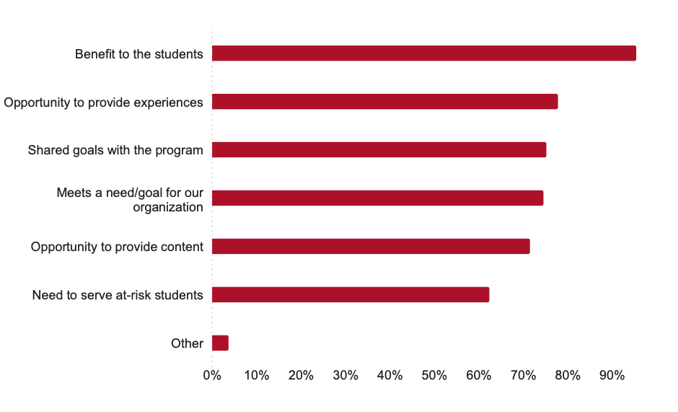
Partners work with SiTES for Many reasons
94 % say their mission is aligned with goals of 21st CCLC

Slide 22
Community Partners
33% of responses were from community-based organizations
Most (56%) provided 21or more contact hours with individual sitesduring the school year
Most (56%) do not serve 21st CCLC programs during the summer
27% provided 6-20 contact hours during the 2023 summer

Slide 23
Craft a proposal
Select 3 pieces of data.
Develop a quick 2-3 sentece. Tell us about your program. Provide the context AND slip in an accomplishment.
Outline a basic proposal and answer the following questions using the data.
Determine what else would have been helpful.
How has the program impacted the community?
What evidence do you have that supports long-term impacts?
What will you collect to show evidence of the impact of new funding?

Slide 24
Final tips & takeaways

Slide 25
Thank you

