Slide 1











Preventing Negative Behaviors
In After School Settings

Slide 2

What are some Student Precipitating Factors
leading to negative behaviors?
Put your answers in the chat...
Notes:
Precipitating factors are events or triggers that cause the onset of a behavioral response.
Examples:
Bad day at school
Traumatic experiences
Domestic Violence at home
Parent in jail
in foster care
was in a fight during school day
Doesn't have any friends
Fear, anxiety, stress.
Unmet physical needs (hunger) or emotional needs (recognition, love)
Pain

Slide 3
How about you or your Staff members?
Type your responses in chat
Notes:
Low pay- so worried about paying bills.
Relationship problems
The paper they have to write after work that is due at midnight.
Tired from working the entire school day.
Yes, this is all stuff your staff are dealing with when arriving at your after school program.
I think its important to acknowledge this, get to know your staff, support them to be their best selves and help them grow.
Ways to show your staff you care: Regular check ins with them, staff training, a note saying how thankful you are for them, and the obvious... food!!! I always had a snack drawer in my office for staff and I bet that is the one thing they will remember about me in 20 years.
In the chat, write things you do to grow and support your staff.

Slide 4
Kids that have experienced trauma need:
Structure and routines
They like to know what's coming next
They need to feel safe
They need you to act calm (tone and volume)
Help them enjoy themselves!
Acknowledge their feelings- Listen to them.
Help them relax with breathing exercises
Notes:
Understanding trauma helps us gain empathy for kids, including our staff. I have had so much training on this that I treat all kids like they have experienced trauma. Its just a good way to work with kids.
Structure and Routines- you are probably already doing this. For example: Kids know when they get to after school program, they hang up their backpack, grab their badge and scan it, then walk out to recess, when the whistle blows they line up, then they go inside to get snack...
They like to know what is coming next. If you offer daily clubs, how do your students know these? Some programs have charts and bulletin boards where these are displayed, some send out monthly calendars to parents. Some programs do theme days like every Monday is Sports, Tuesday is STEM, Wednesday is Arts and Crafts day, Thursday is Music, and Friday is Cooking or Agriculture.
They need to feel safe- think about how this looks in your program. Do you think students feel safe in your program?
They need you to act calm. This is very important. Adults can make the situation worst when they lose control. How is your tone and volume when talking with kids. Are you getting at their level? We'll talk more about this in a little while.
Kids that have experienced trauma have a hard time having fun. You may need to help them along the way, or ask them what they like, how they can feel important or apart of the group.
Acknowledge their feelings and listen to them. Truly sit next to them and listen to what they have to say before you talk. This goes along way.
Help them relax with breathing exercises. This could be just doing some slow breathing.

Slide 5








Unmet Needs
Before engaging a kid, HALT...
Is the kid...
H
Hungry
A
Angry
L
Lonely
T
Tired
Notes:
Think about those precipitating factors, when kids are walking through your doors to your after school program, are they HALT?

Slide 6
How can you re-name
Behavior Management to make it sound more positive?
Type your responses in chat
Notes:
Guiding positive choices

Slide 7
What is the most important thing YOU can do to prevent
Negative behaviors?
Notes:
Relationships as Key Predictors of Success: Studies repeatedly emphasize that the quality of relationships youth form in programs is a stronger determinant of positive outcomes than the specific content of the program. Trusting relationships with mentors, staff, or peers promote emotional safety, which enhances engagement and learning.
Next we will talk about expectations, which is also very important.

Slide 8
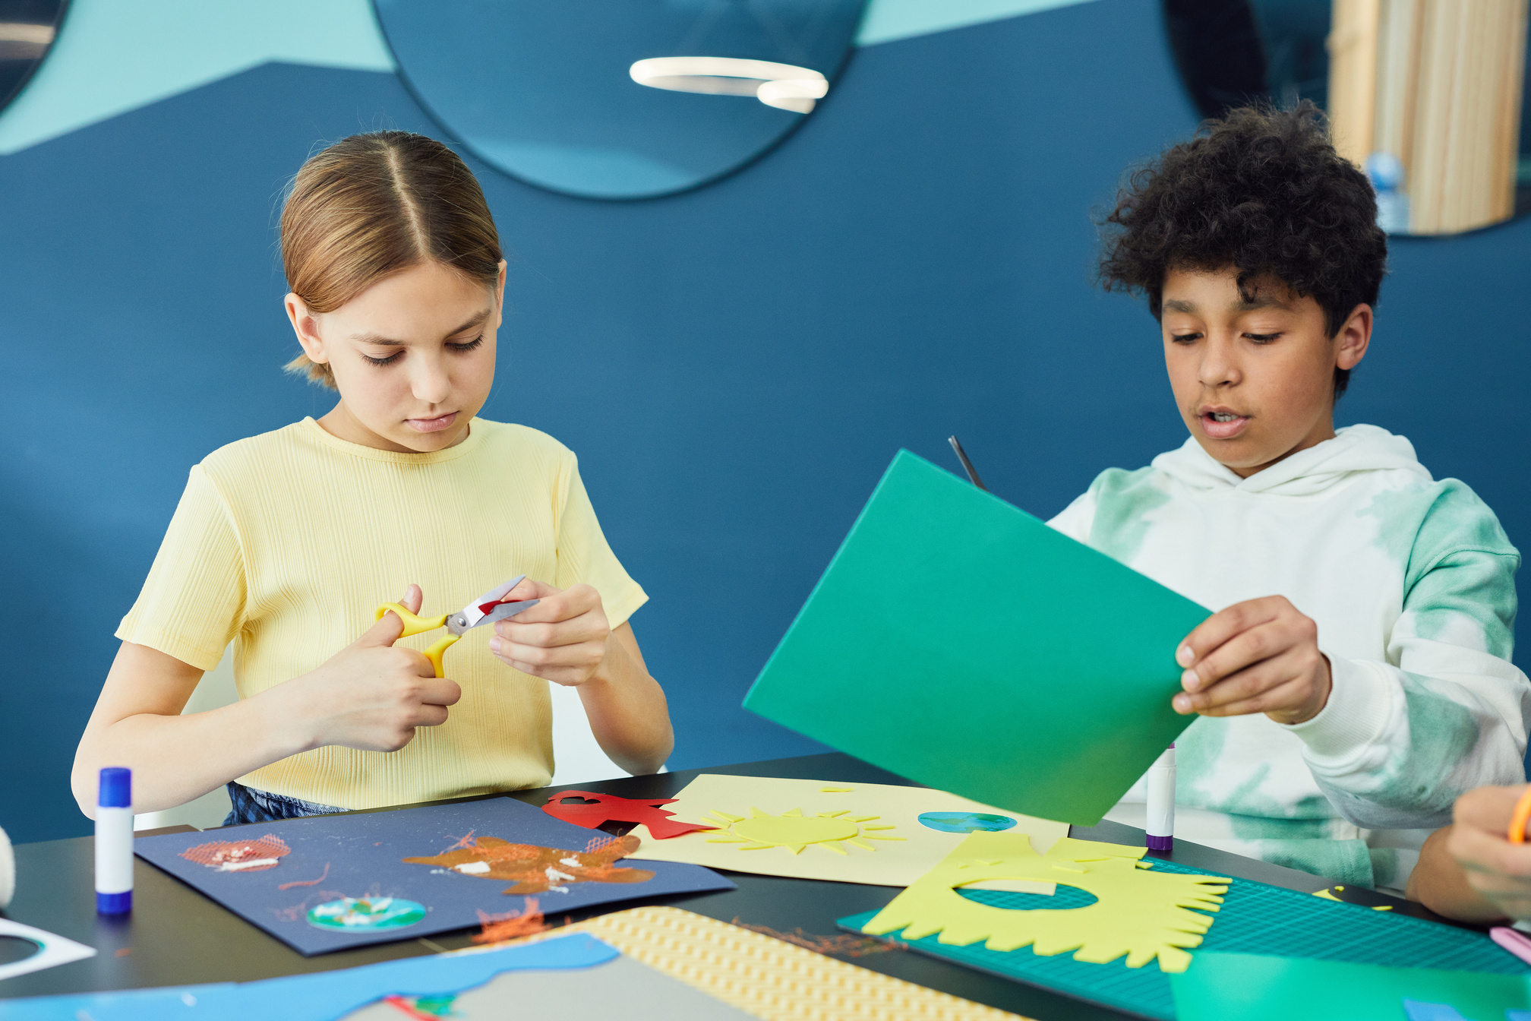

Expectations
After School needs to feel different than the school day, but....
Make sure students know these and review often, especially after long breaks.
Do ALL staff understand and enforce these?
Parents- are they aware of your program expectations?
Notes:
If you are a school based program, you may follow the same expectations as during the day. If you are a community based program, you probably have created your own set of expectations for kids when they are with you.
Having clear expectations for students is vital to the success of your program and preventing negative behaviors.
After school needs to feel different than the school day, but kids still need structure and routines.
Do students know these, if so reviewing often is not a bad idea. Kids need to hear things multiple times in order to remember them, and lots of reminders or re-teaching.
How about all of your staff, do they know these and enforce these? If not, this could be an entire training you do with your staff. If you do this at the beginning of the school year, consider doing this after holiday break.
Are parents aware? Some programs go through the handbook with parents at enrollment and go over program expectations. This not only builds a connection with them, but ensures they get this information. Reminders of your program's expectations can also be sent out via your messaging system, such as Remind.
Watch the next slide you tube video on rules vs. expectations.

Slide 9

Notes:
Stephanie go next.

Slide 10
Group Agreements
Why
Examples
Students help create these for your program
How
Create for a weekly club-
put on flipchart
Students more likely to follow if they help create these
Notes:
Sometimes group agreements are done in a school day classroom or for an after school club, if the teacher is there consistently. For example: Your 5th grade Science teacher leads a weekly STEM club, they might have a group agreement with their students for that particular club, for example, handle hot glue guns with care, pick up after self, and use materials wisely. This can be visible on a flipchart or bulletin board so the kids can see it and its easy to refer to.

Slide 11
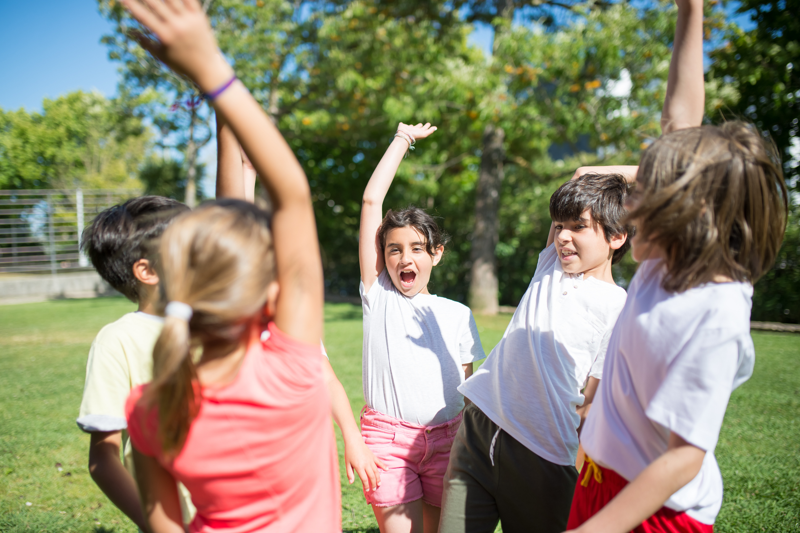

Give Choices!
Notes:
Kids feel empowered when given choices. Do you have a way to gather student input for activity ideas? Some programs complete the youth brainstorming sheets and implement programming based on what students enjoy. Others have student advisory groups that help lead or set up activities.
Some kids might intentionally act out because they hate the activity. For example, I had a kindergartener in Marathon Kids, a running club. He would purposely throw his scanning badge in the bleachers so he didn't have to do it. I talked to him about this and learned that he hated running. I told them he could walk, or skip or do cartwheels, that gave him something to do. I made him complete the quarter but took note of that for the future and put him in activities that he enjoyed.
Have you ever had kids in your program be teachers and lead an activity with kids? This is a great way to engage them.
Give Greta and Hogwarts example.

Slide 12



Prevention
Engaged
Staff
Understand Trauma
Pro-Active TEACHING
RELATIONSHIPS!!!
1 on 1 conversations before and after incident.
Notes:
Engaged staff should be a top goal for preventing negative behaviors. Some ways to build relationships with kids include learning their names and using them often, for example, when a new staff started I would print off a list of student pictures and names from the school database (office staff can help), laminated them, then put on the staff's clipboard. I asked that staff to make it a priority to learn the kids names.
asking kids about their lives (green light questions like do you have any pets, what do you like to do on the weekends, what is your favorite class at school and why, etc.)
Challenge your staff to this: Lets say you have recess for the first 20 minutes of program. Ask staff to choose 1 student they don't know very well and spend time talking to that student for 2 minutes each day for 10 days. Then check back in with them at a later time to ask about how this went for them. This is something you could do in between staff meetings and have staff report back to the group. You really get to know kids when you ask them questions.
Encourage pro-active teaching vs just giving students consequences for misbehavior. Oftentimes, negative behaviors result from social skill deficiencies. For Example, I had a student that would do annoying things to other kids like touch their heads and pull another kids hair then run off and the victims would get so mad. They could never explain why they did those things, and they weren't the worst behaviors in the world, but they would happen everyday. I made a note to greet that student at the door each day, walk out to recess with them and asked them about their day. Having that 1 on 1 conversation with that student and building that relationship helped decrease those behaviors. For that student, it was really about getting attention, so if we can teach kids to get attention in a good way, like holding doors, helping clean up, etc. Giving kids jobs works! It makes them feel important.

Slide 13

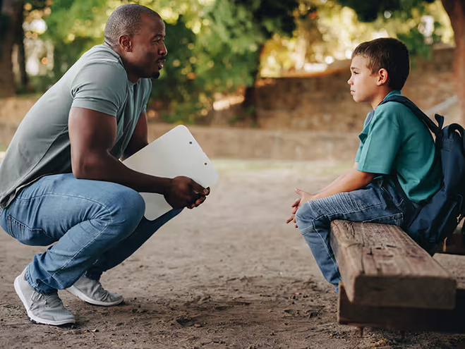
Help Kids feel respected
K
P
L
Kid
Level
A
Praise the Positive
S
Listen
Ask
Questions
Say what you mean, with care

Slide 14
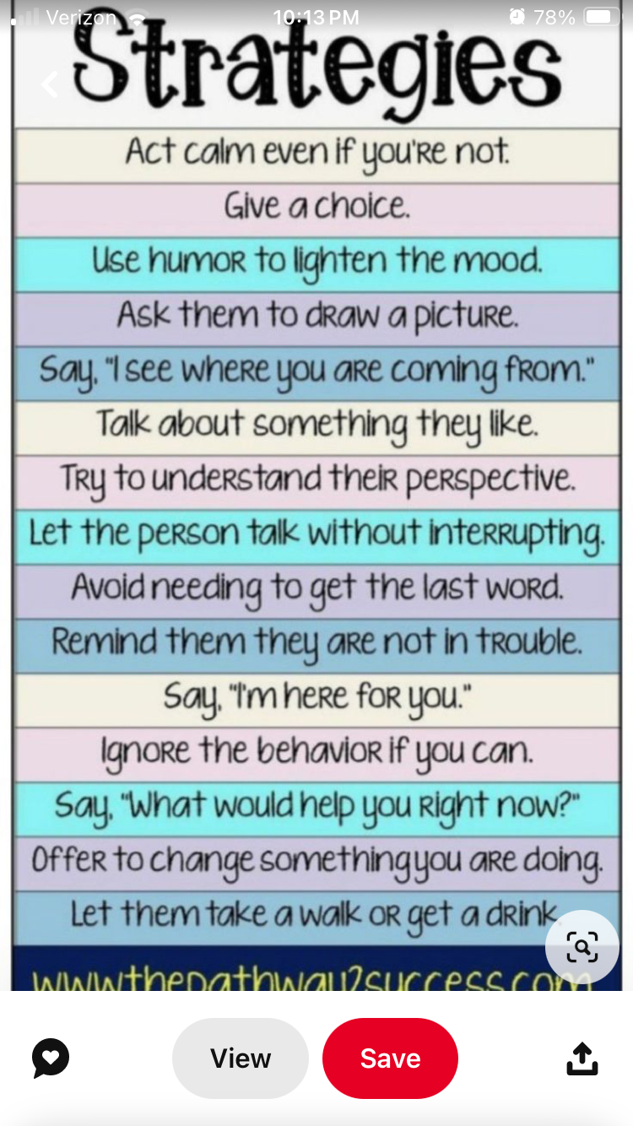

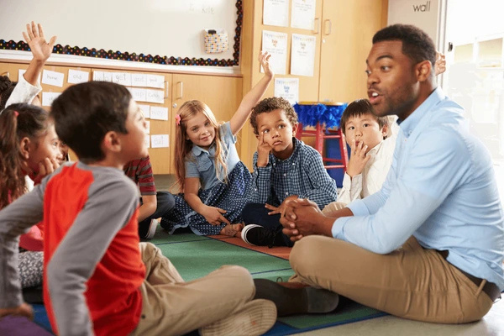

Slide 15
UNL Extension
ESU
Local Behavior Supports
If you ask, may be able to provide training, especially around PYD, relationships, and engagment.
If your program is school based- they may be able to provide you training as apart of your school wide plan.
School trainings
Better Kids Care
Advocate for staff to be included in these:
Examples: CPI, Cultural Classroom, etc.
Online, Self Paced professional development modules.
Notes:
UNL Extension- work with your local staff to see if they can provide some training for you. I created a list of training needs for my staff and ask extension to come lead a training for me.
ESU- if your program is school based you may be able to tap into this resource. Talk about my experience with para training.
School trainings- If you have school wide PD days, advocate for your staff (including high school staff) to be included in these. Examples include CPI, Cultural classroom, PBIS,
Better Kids Care: These are online, self paced modules your staff can do either at program or at home. Directors can look at the PYD mastery videos. I'd encourage you to take these courses before you have your staff take them, then you can follow up with them after.

Slide 16
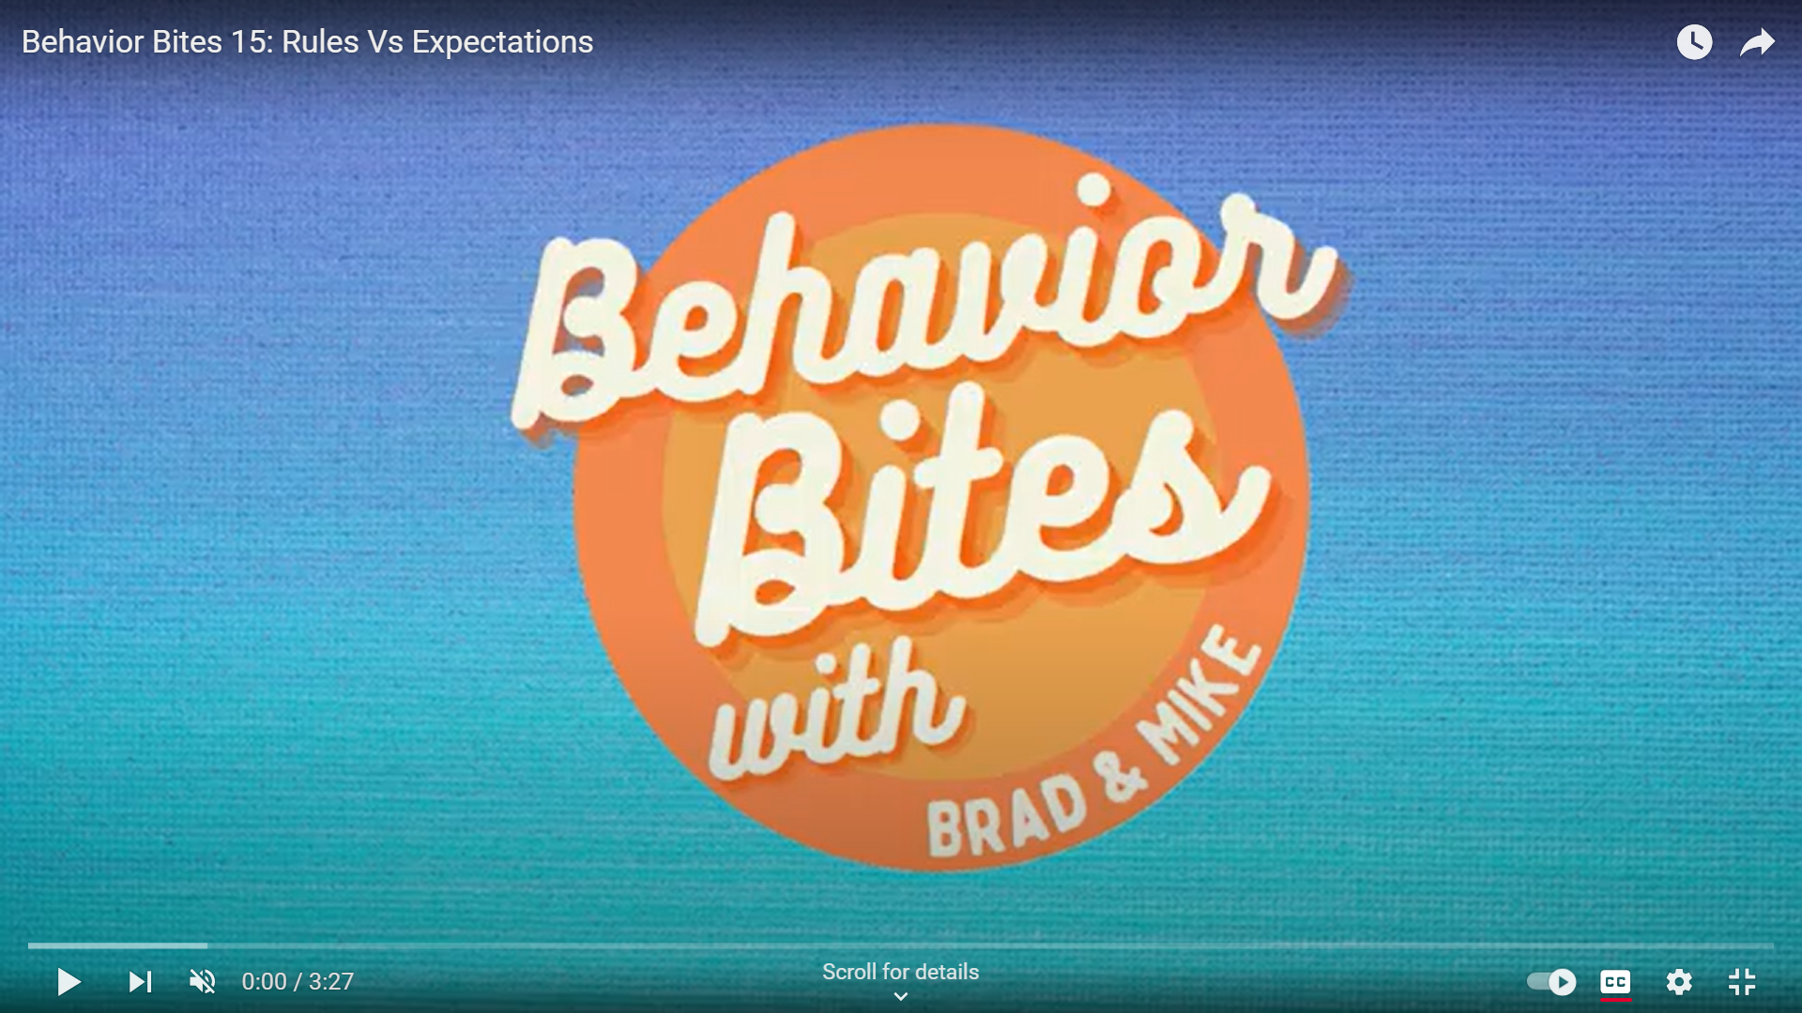
YouTube
Educational Service Unit 2

Slide 17
Resources
Norms & Expectations Planner:
https://turnaroundusa.org/toolbox/corepractices/expectations-norms-routines/ding
OST Training that “Sticks”
https://osttraining.com/
Notes:
I'd love to hear from you about what you learned today, or if I missed something, or if you have ideas on how we can share this more widely. If you are like, this is great, but I don't know how to train my staff on this, please reach out to me.
I know Halley Jackson did a similar presentation at Get Connected and I plan on working with her on how we can do more training at Innovation Invitational.
I'd love to hear from you, please call or email me with your ideas.

Slide 18
Take Aways:
Help kids feel a sense of belonging in your program
Teach your staff how to engage with kids and why its important
Students should know what is expected of them!

Slide 19
Thank you!
Alana Pearson
Email: apearson@nebraskachildren.org
Phone: 402-380-4552
Notes:
I'd love to hear from you about what you learned today, or if I missed something, or if you have ideas on how we can share this more widely. If you are like, this is great, but I don't know how to train my staff on this, please reach out to me.
I know Halley Jackson did a similar presentation at Get Connected and I plan on working with her on how we can do more training at Innovation Invitational.
I'd love to hear from you, please call or email me with your ideas.

