Slide 1
Challenging behaviors & student engagement
How do we get kids engaged while keeping our sanity?
Hayley Jackson Perez, M.S.
Early Childhood Extension Educator
Notes:
Erin

Slide 2
Today's Agenda
Introductions
Relationships
Challenging Behaviors
Engagement
Tips & Tricks
Notes:
Erin

Slide 3
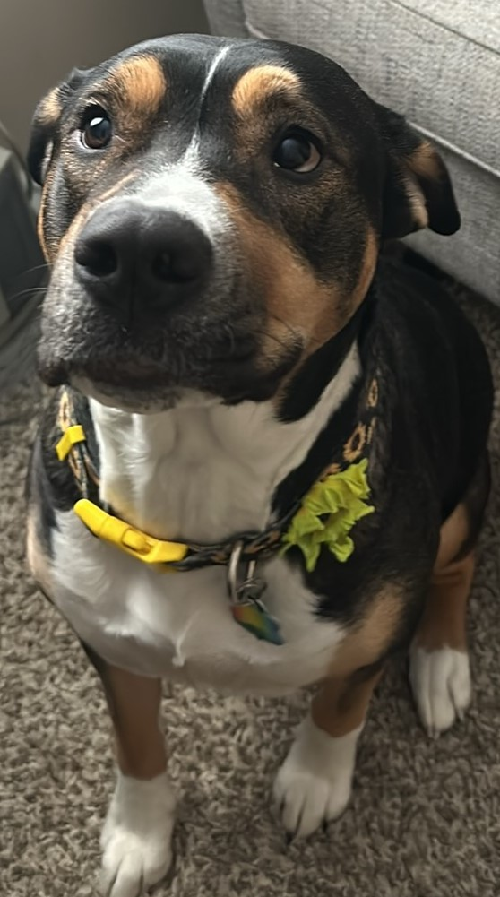
A little bit about me...
Notes:
Erin

Slide 4
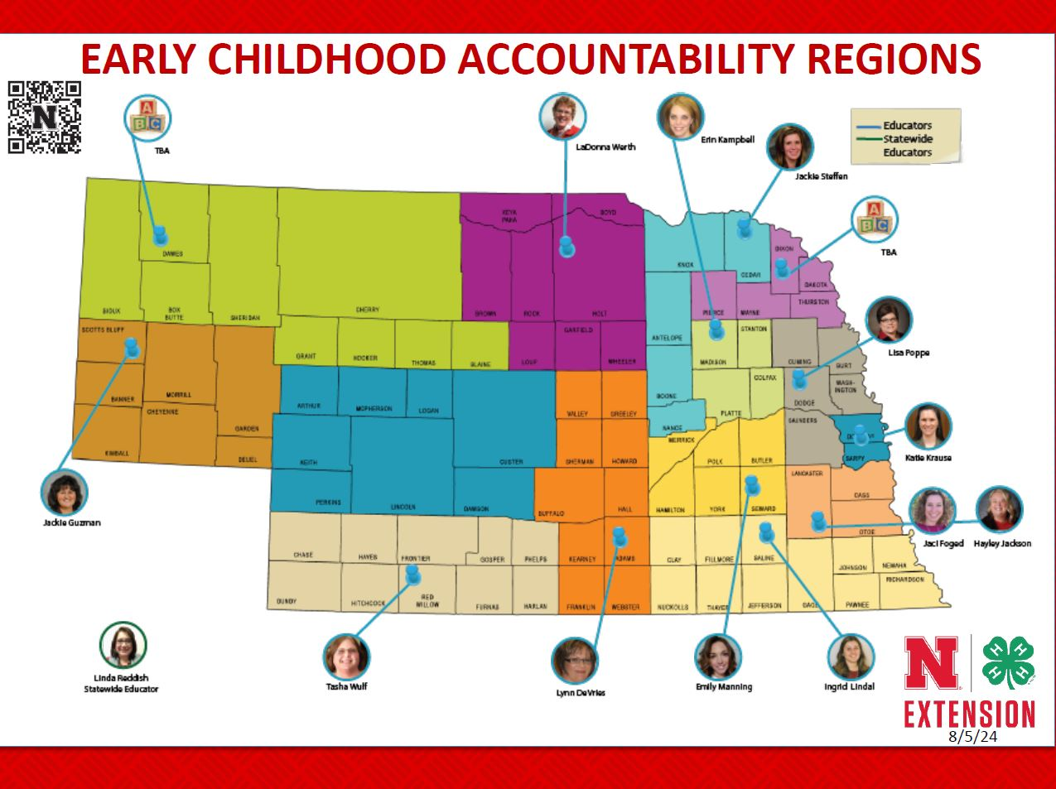
Notes:
Erin

Slide 5
Who is in the room?
Notes:
Erin
Introduce themselves, age groups they work with- how long they've worked there/with students

Slide 6
Relationship Building
Children learn in the context of a relationship that is responsive, consistent, & nurturing
Relationships are the foundation of everything we do in working with students
Notes:
Hayley

Slide 7
Foundations in relationship building
Empathy drives connection
Notes:
Hayley

Slide 8
How do we build relationships with our students?
Establish connection
1
Prioritize being with students vs. supervising students
2
Listen without judgment
3
Notes:
Hayley

Slide 9
Let's Reflect...
How are you currently building relationships with the students in your program?
Think to a student that you struggle with:
What do you know about this student?
What has worked to build a connection, even if just a little bit?
What other ways might you try and connect with this student?
Notes:
Hayley

Slide 10
What do challenging behaviors look like in your world?
Defiance
Refusal to participate
Distracting other students
What else?
Notes:
Erin

Slide 11
Behaviors can be FRUSTRATING.
Regardless of the why, it can be hard to handle as an educator
Notes:
For both the teachers and the children!

Slide 12
Reframe the way we see challenging behavior
All behavior is communicating a message
Challenging behaviors happen when students have an unmet need or missing skill
It is our job to figure out what the behavior is communicating
Notes:
Erin
We want to change the way we see challenging behaviors and we want to think about behavior as another way our students communicate with us. So the way that we view behaviors is that all behavior is a form of communication and that even the challenging behaviors are communicating a message to us. It is our job as the adults in the scenario to try and figure out what the message is trying to communicate. We know that challenging behaviors happen when a student has an unmet need or is missing a skill. Once we figure out (or have an educated guess) on the WHY behind the behavior, then we as educators are better equipped to help support the student. We can support that student by teaching them the skill they are needing or modifying the environment in a way to meet the student's need. This might sound confusing, but let's go through a few examples

Slide 13
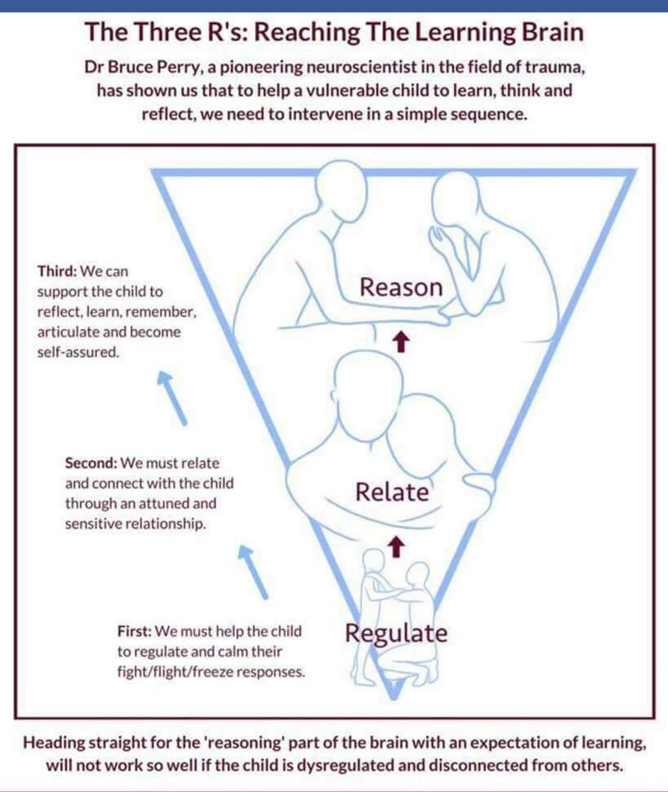
Framework for Adult-First Intervention
Notes:
Hayley
Dr. Bruce Perry, a renowned neuroscientist in the field of trauma, developed the 3R theory to guide interaction with someone who is dysregulated, upset, or traumatized. The 3Rs stand for:
Regulate: This involves helping the person calm down and regain control of their emotions. This might involve deep breathing exercises, offering comfort, or providing a safe space.
Relate: Once the person is calmer, you can build a connection with them. This means showing empathy, acknowledging their feelings, and letting them know you're there for them.
Reason: Finally, when the person is regulated and feels safe, you can start to talk things through and help them learn from the experience. This might involve problem-solving or teaching them coping mechanisms.
The key to the 3Rs is the order. Logic and reasoning won't be effective if someone is overwhelmed by emotions. By helping them regulate first, you create a foundation for connection and eventually, learning.

Slide 14
When the adult is stressed or dysregulated...
They are not able to help students regulate their own emotions
They are more likely to perceive ambiguous actions as negative
They have less cognitive "space" to build and maintain positive relationships with children
Notes:
Hayley
These are some of the reasons it is so important to ensure the adults are regulated.

Slide 15
Regulate
Regulate
Things that help regulate:
Deep breathing
Moving our bodies
Doodling
We need to regulate our nervous system so the higher order parts of our brain can activate.
Notes:
Hayley

Slide 16
Ways to Support our own Regulation
Regulate
Strategies for Self-Regulation
We need to regulate our nervous system so the higher order parts of our brain can activate.
Self-soothing touch (Dreisoerner et al., 2021)
A body "shake out"
Reframe the situation; add positive affirmation
Listen to your favorite song
Notes:
Hayley
As we are describing these techniques we will have participants stand and try each one with us. Point out that each of these strategies were chosen because they are able to be done "in the moment" while in the classroom or while working with children
-Self-soothing touch: place 1 hand on heart the other hand on your belly and breathe in and out- breathe for 3 ; can couple this with a positive affirmation "I can do hard things"
-A body shake out- quick touch of your own shoulders and neck, and then "shake out" your body.
-Cross arms and pull down on shoulders (right hand pulls down on left shoulder, left hand pulls down on right shoulder.)
-Squeeze hands together or squeeze opposite arms. Can breathe deeply while squeezing or hold breath for 3-5 counts and then let out in a whoosh while completely relaxing.
-Similar to above, tense a muscle group while holding your breath for no more than 3-5 seconds, then release breath in a whoosh while completely relaxing the muscles (hands into fists, pull in stomach, lift shoulders, etc.)
-Reframe the situation in positive or neutral terms. For example: if a child is in the midst of a tantrum: “This child is overwhelmed by strong emotions and does not know how best to communicate them.” Pair with positive affirmation: “I am an adult and I know how to handle myself around children who are upset.”

Slide 17
Support the Child's Regulation
Co-Regulation
Ways to help a child regulate:
Taking a drink of water
Blowing bubbles with a straw
Firm, secure hug
Blowing up balloons
Young children need support in regulating their emotions from the trusted caregivers in their life
As children get older, they will (theoretically) need less support from adults to regulate
Notes:
Hayley
After we make sure we ourselves are regulated we need to help the child calm down. Each child is different and will respond differently to these ways to support so don't get discouraged if one of these strategies doesn't work- just try another!

Slide 18
Supporting Older Students' Regulation
Older Students
Strategies Students Can Use:
Although they might need less support, students still may need prompting or different strategies to regulate their emotions
Taking a walk
Getting outside & grounding
Focused outlet for aggression- punching bag, pillow
Listening to a favorite song
Guided meditation

Slide 19
Let's go through an example...
Babysitting clinic
Washing dishes as a calm down technique
Tiktok
Notes:
Hayley
14 year old boy at the babysitting clinic- did NOT want to be there. Could tell early on in the day. Noticed the way he was building with the infant blocks I had put on the table. At a break, went back and got more of the smaller wooden blocks (keva blocks), marbles, magnatiles, open mail tubes, small matchbox cars and challenged him to build something cool that might interest a younger child he was babysitting. Got the other kids involved, ended up engaged with the material and also acting as a leader for the younger kids in the workshop

Slide 20
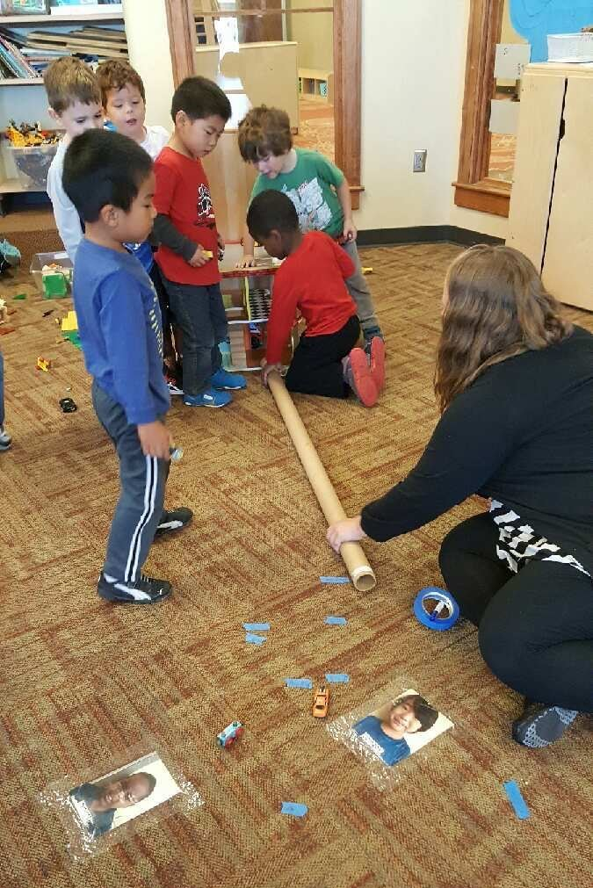
Engagement is the best way to prevent challenging behaviors
What do your students like to do? Are there ways you can expand on those interests to increase engagement?
Do you have enough options of experiences for all student interests?
After school context: is there a balance of student directed vs. Adult directed options?
Notes:
Hayley

Slide 21
How does this translate to your students?
Let's get into small groups and discuss:
What are your students currently interested in? What do they talk about? What materials do they engage with?
How could we expand on these interests? How could we use what we know about our students to increase engagement?
Notes:
Hayley

Slide 22
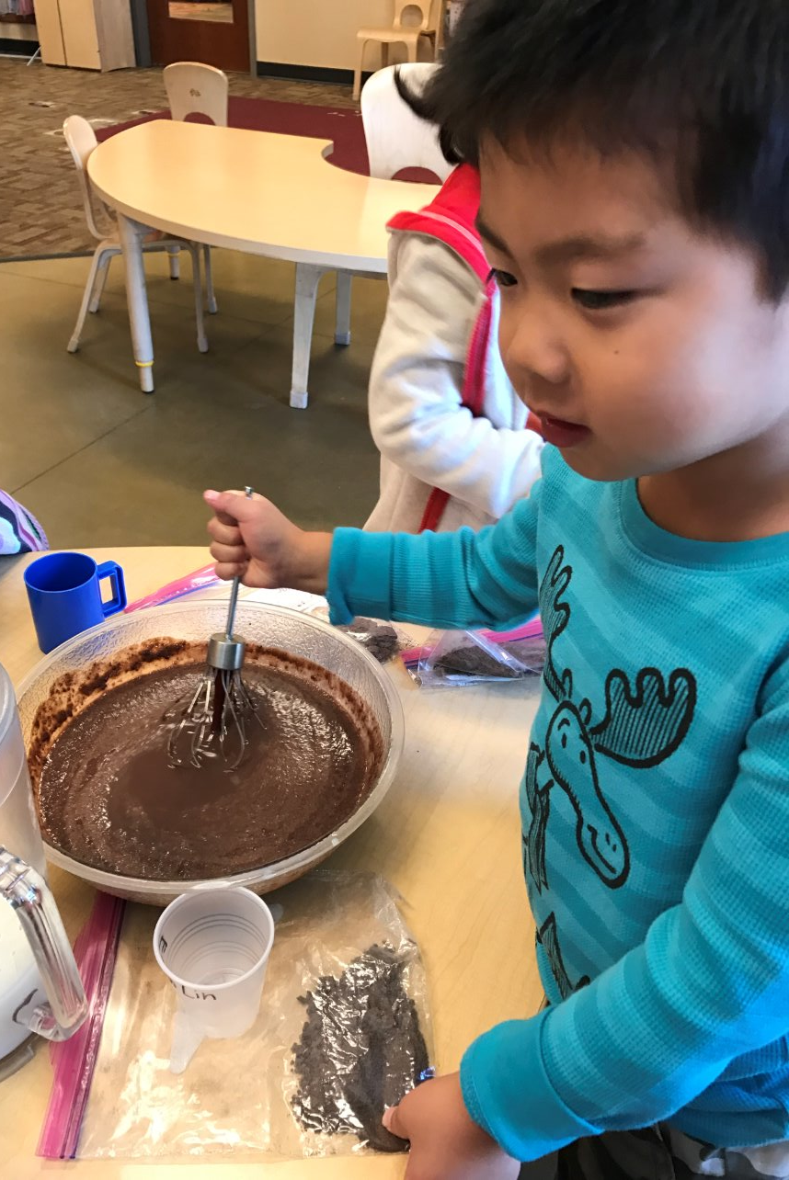
During Teacher-Directed Experiences...
Give clear, specific instructions
Avoid/eliminate wait time
Think about how you will introduce the activity
Have enough materials
Provide alternative activities for students who finish the experience early
Reflection after the fact
Notes:
Erin
When facilitating experiences with students, typically smaller groups make the experience more hands on for students and easier to manage for the teachers. If there is a way to split the group up and do the activity in smaller groups, do that! It is also helpful in those instances to have enough materials for each small group- for example, in the pudding activity shown in the picture, there are actually three groups of kids at three separate tables- but each table has all of the ingredients and materials to make the pudding (that was set out before I brought the students to the table) so there was less wait time overall for the activity

Slide 23
Tips & Tricks cont'd
Physical Proximity
Use close physical proximity for students who need additional support
Reward Behavior
Reward appropriate behavior when possible
Interest based
Special jobs & responsibilities
Relationship
When in doubt, go back to the relationship
Notes:
Erin

Slide 24
Reflect for a minute...
What challenging behaviors are you experiencing in your program?
What is one thing that we talked about today that you could try to reduce those challenging behaviors?
Notes:
Erin

Slide 25
What questions do you have ?
Hayley Jackson Perez
Hayley.Jackson@unl.edu

Slide 26
References
Brown, B. (2013, December 10). Brené Brown on Empathy [Video]. RSA. Retrieved from https://www.youtube.com/watch?v=T4t2U-Q-p9I
Dunlap, G., & Fox, L. (2011). Function-based interventions for children with challenging behavior. Exceptional Children, 77(3), 232-248.
Fredricks, J. A., & Brophy, J. E. (2001). Promoting student engagement: A synthesis of research. Educational Psychology Review, 13(2), 141-165.
Hemmeter, M.L. (2023). The Impact of Teacher-Child Relationships on Early Childhood Development. Early Childhood Research Quarterly, 67, 123-145.

