Slide 1
Innovation Invitational 2025
Nebraska Department of Education: Farm to School

Slide 2
Sarah Meyer
Nebraska Department of Education
Farm to School Specialist
sarah.m.meyer@nebraska.gov
Emily Hulse
Nebraska Department of Education
Farm to School Specialist
emily.hulse@nebraska.gov

Slide 3
Food Memory
Who was there?
Was it a special occasion?
What was the weather/season?
Flavors, aromas, sounds, textures, feelings?

Slide 4
Session Agenda
Farm to (After) School Introduction
Harvest of the Month After School Lessons
Upcoming Opportunities & Resources
Wrap Up

Slide 5
Community Agreements
Choose to be present
Take space, make space
No one knows everything, but together we know a lot
Acknowledge the dynamics in the room. We have differing careers, programs, experience levels, cultures, backgrounds, and opinions.

Slide 6
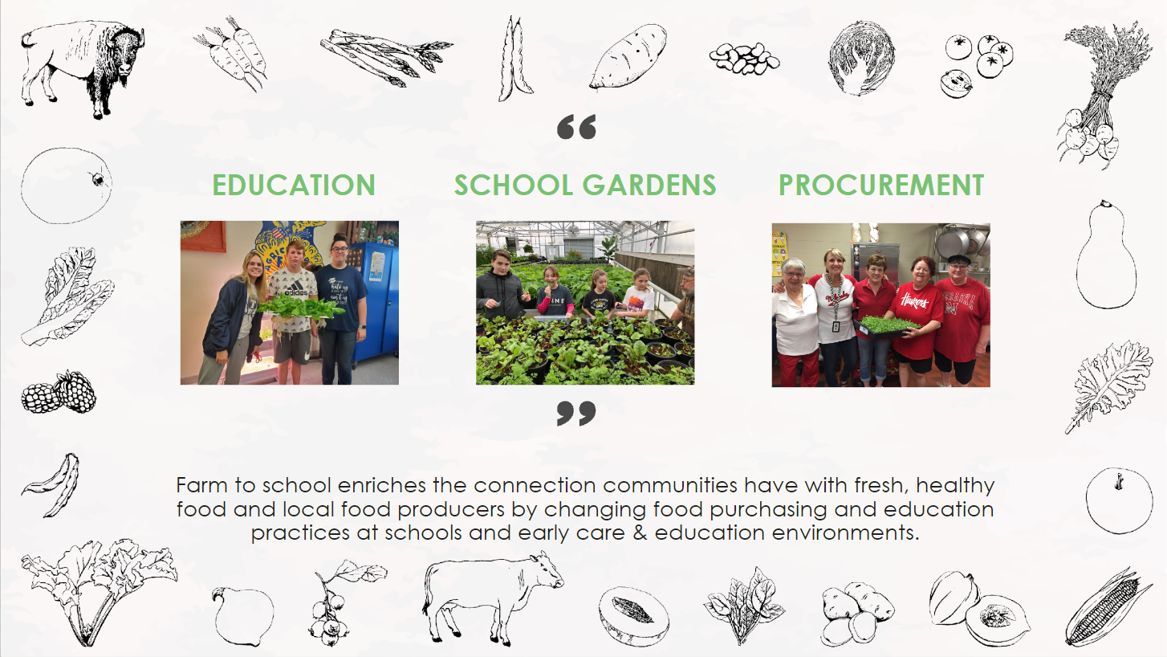

Slide 7
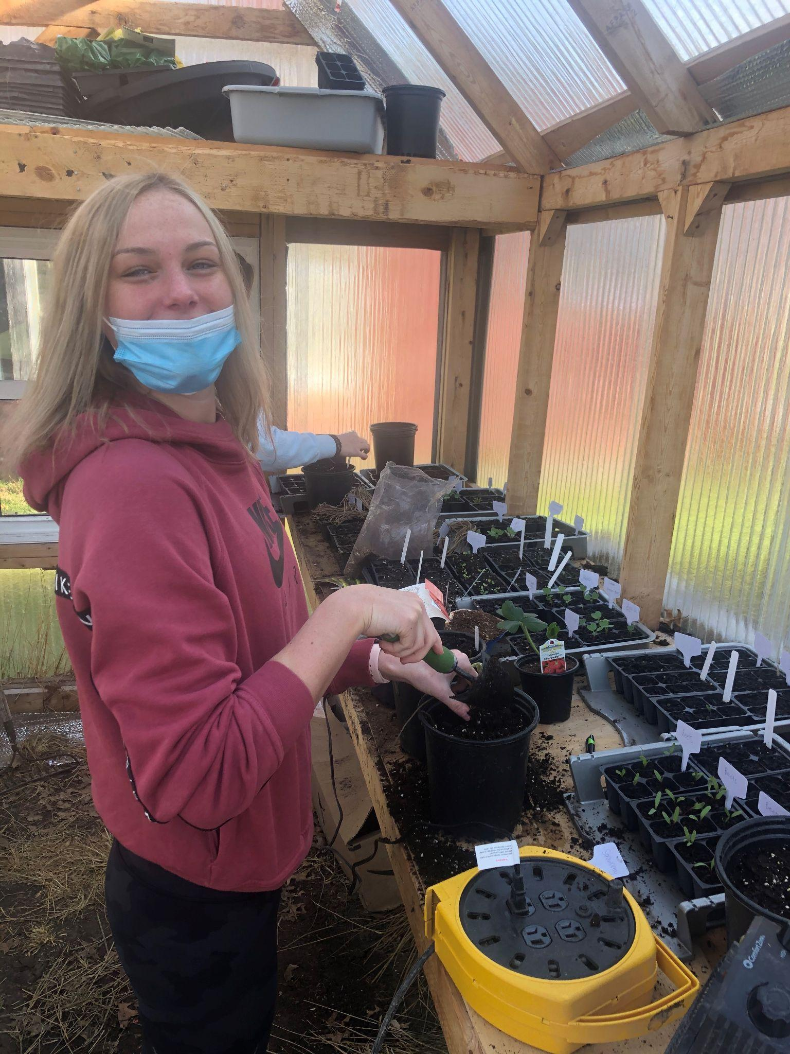
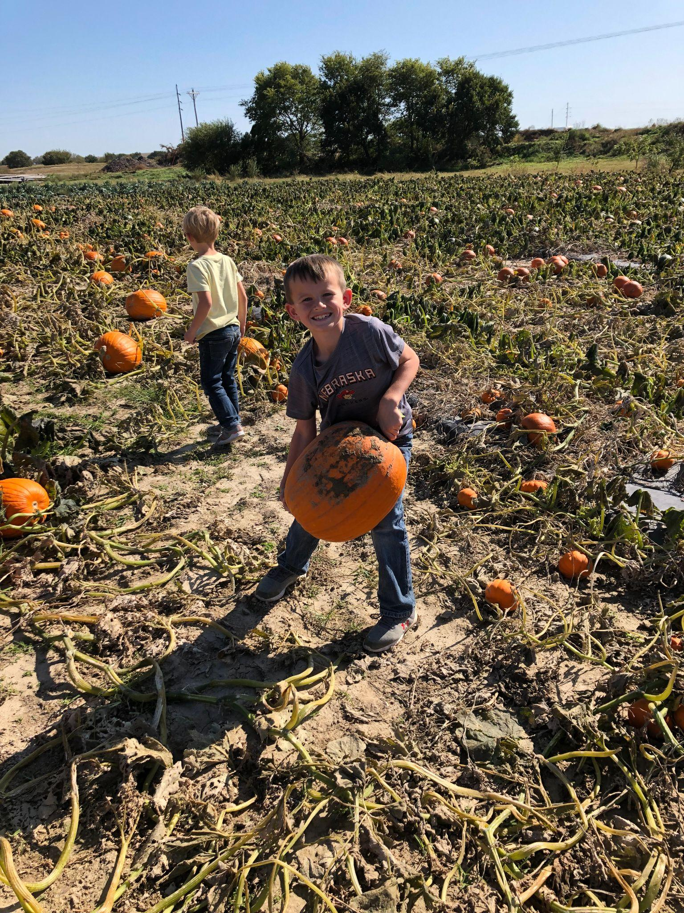
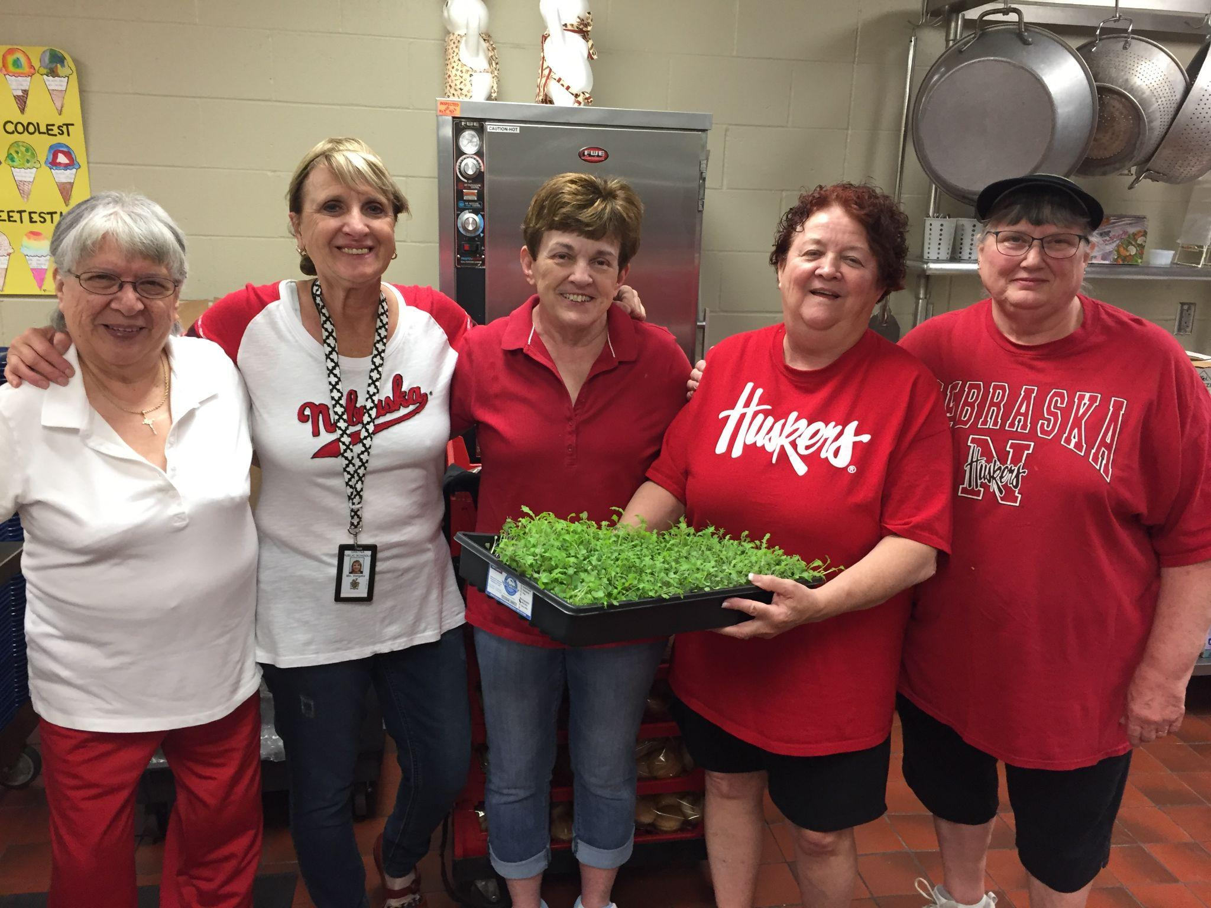
Building Integrated Farm to School Programs that connect…
CLASSROOM
COMMUNITY
CAFETERIA

Slide 8
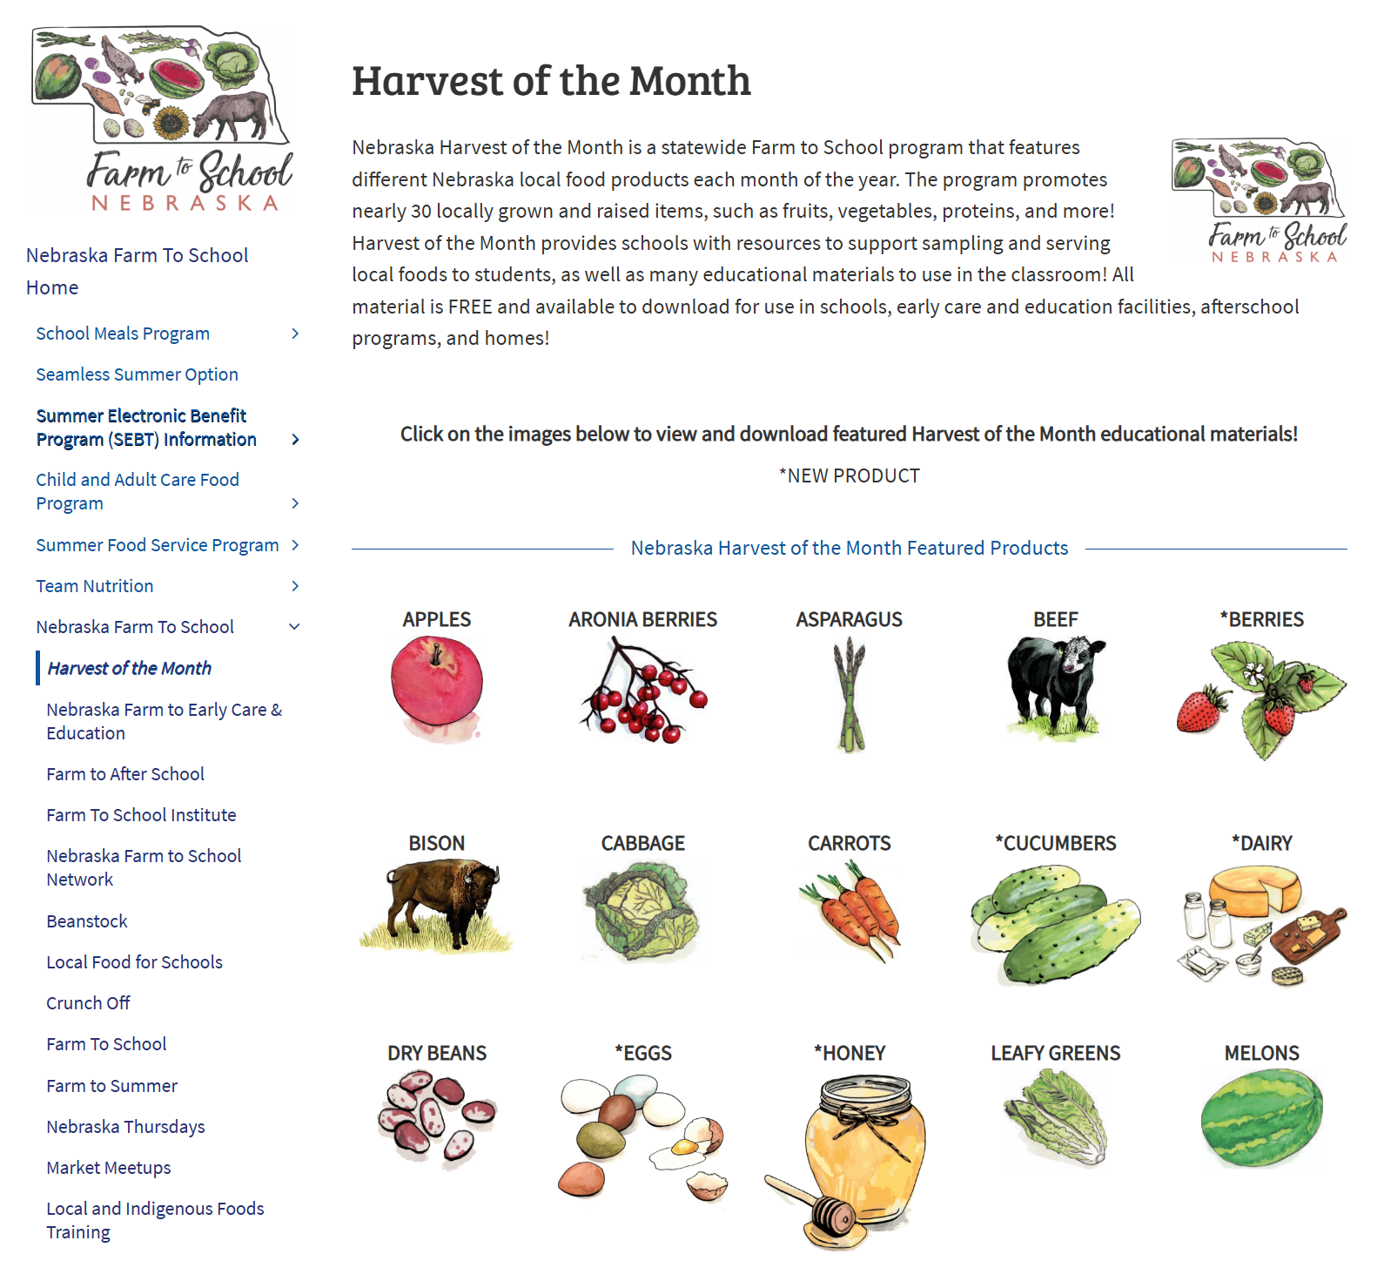
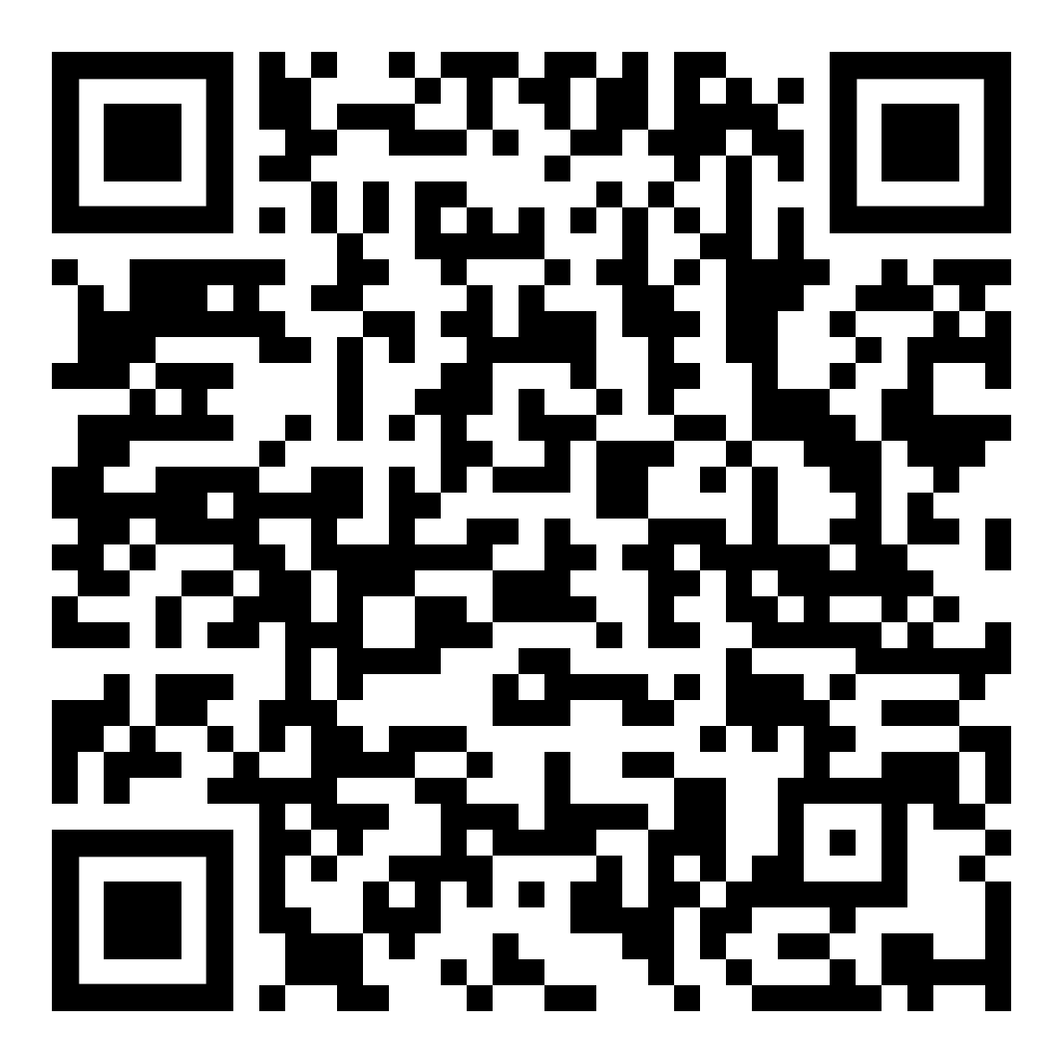

Slide 9
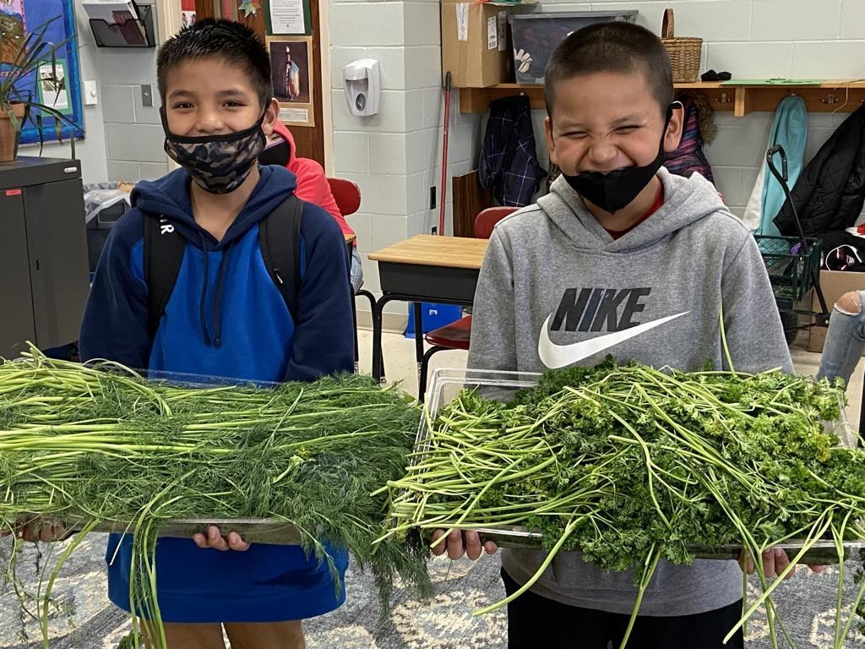
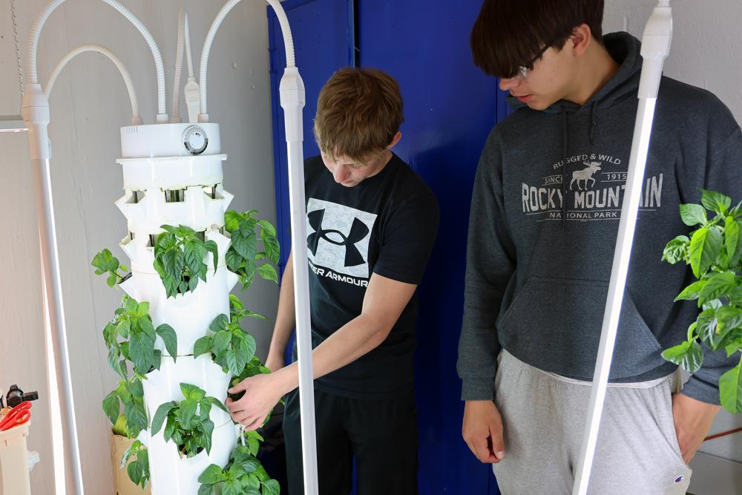
On a scale of 1 to 5…
How familiar are you with
Farm to School and our programs?
1 2 3 4 5
Farm to School? Never heard of it.
I could give this presentation.

Slide 10
Procurement

Slide 11
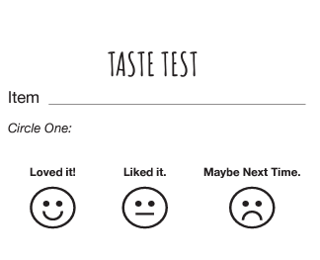
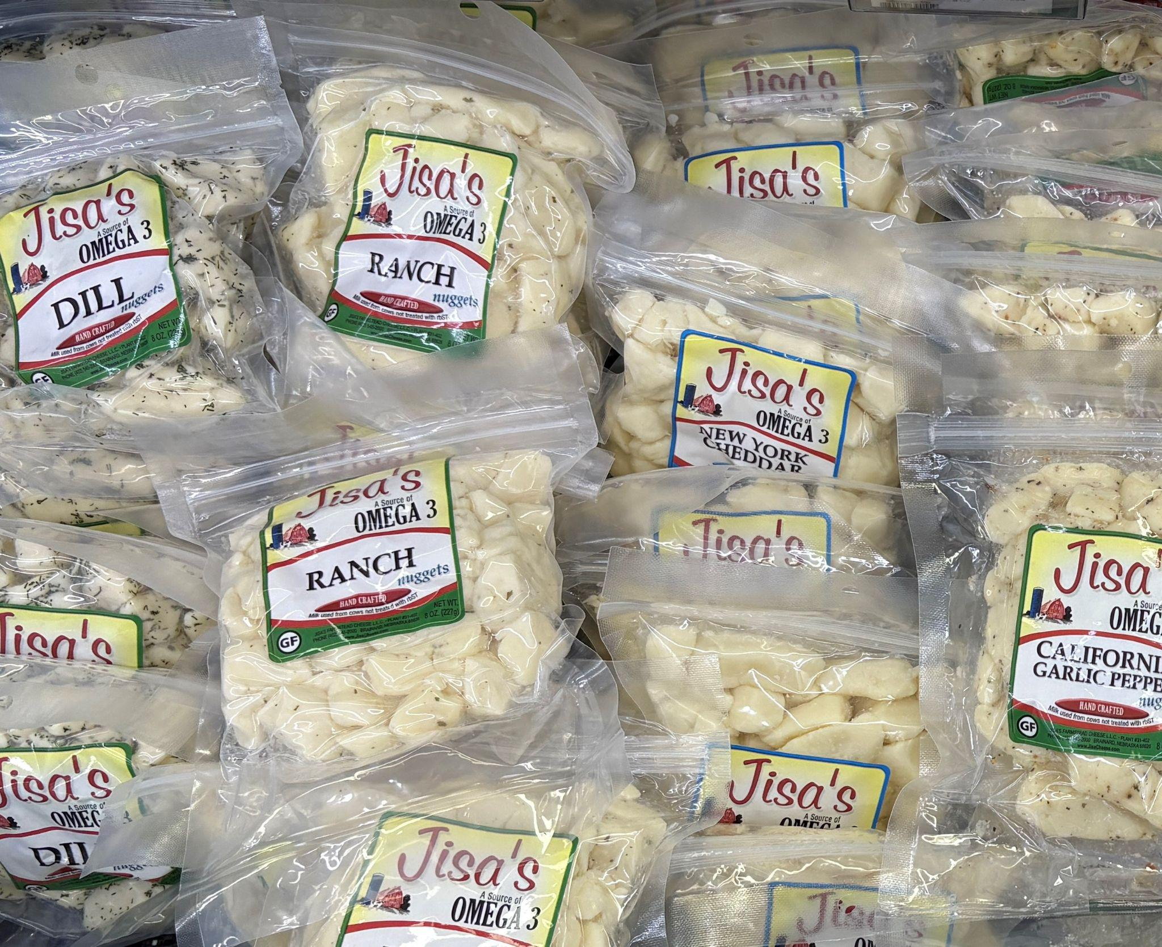
Taste Test

Slide 12
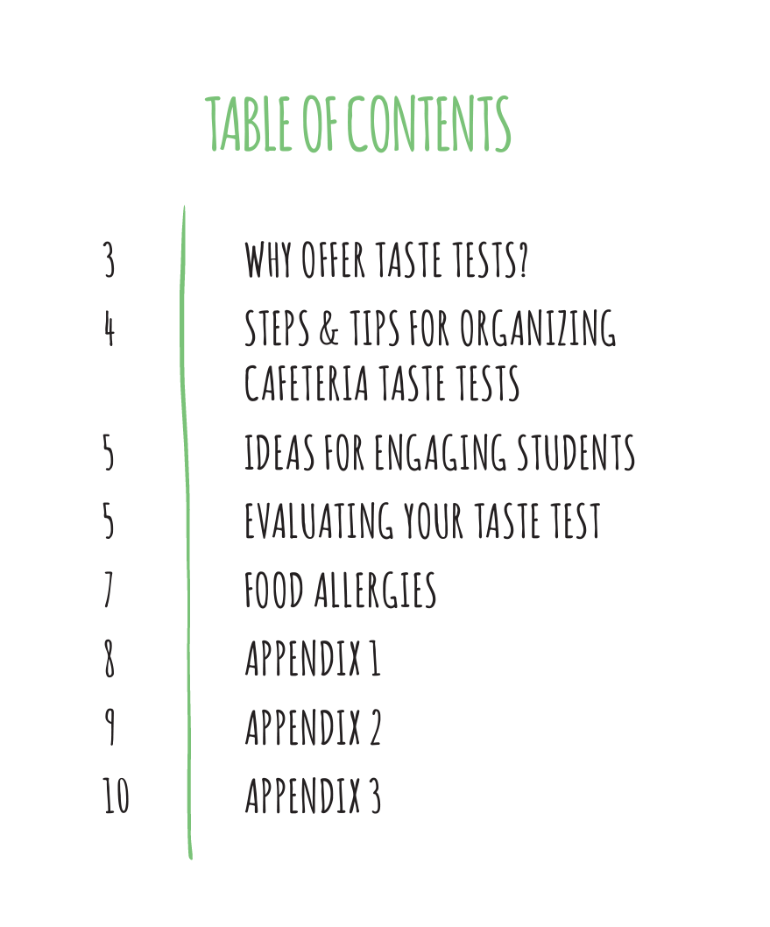
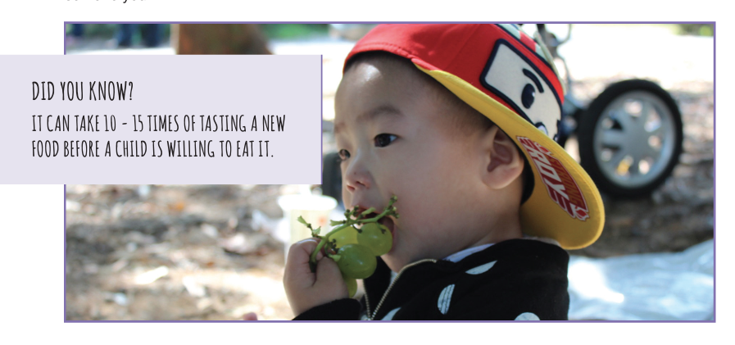
Taste Test Guide

Slide 13
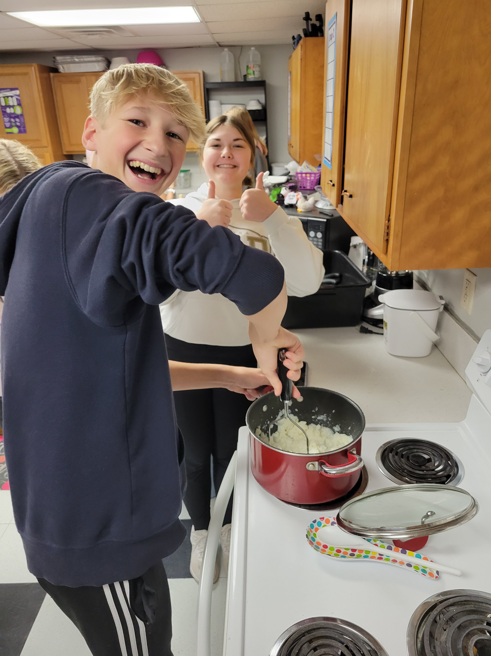
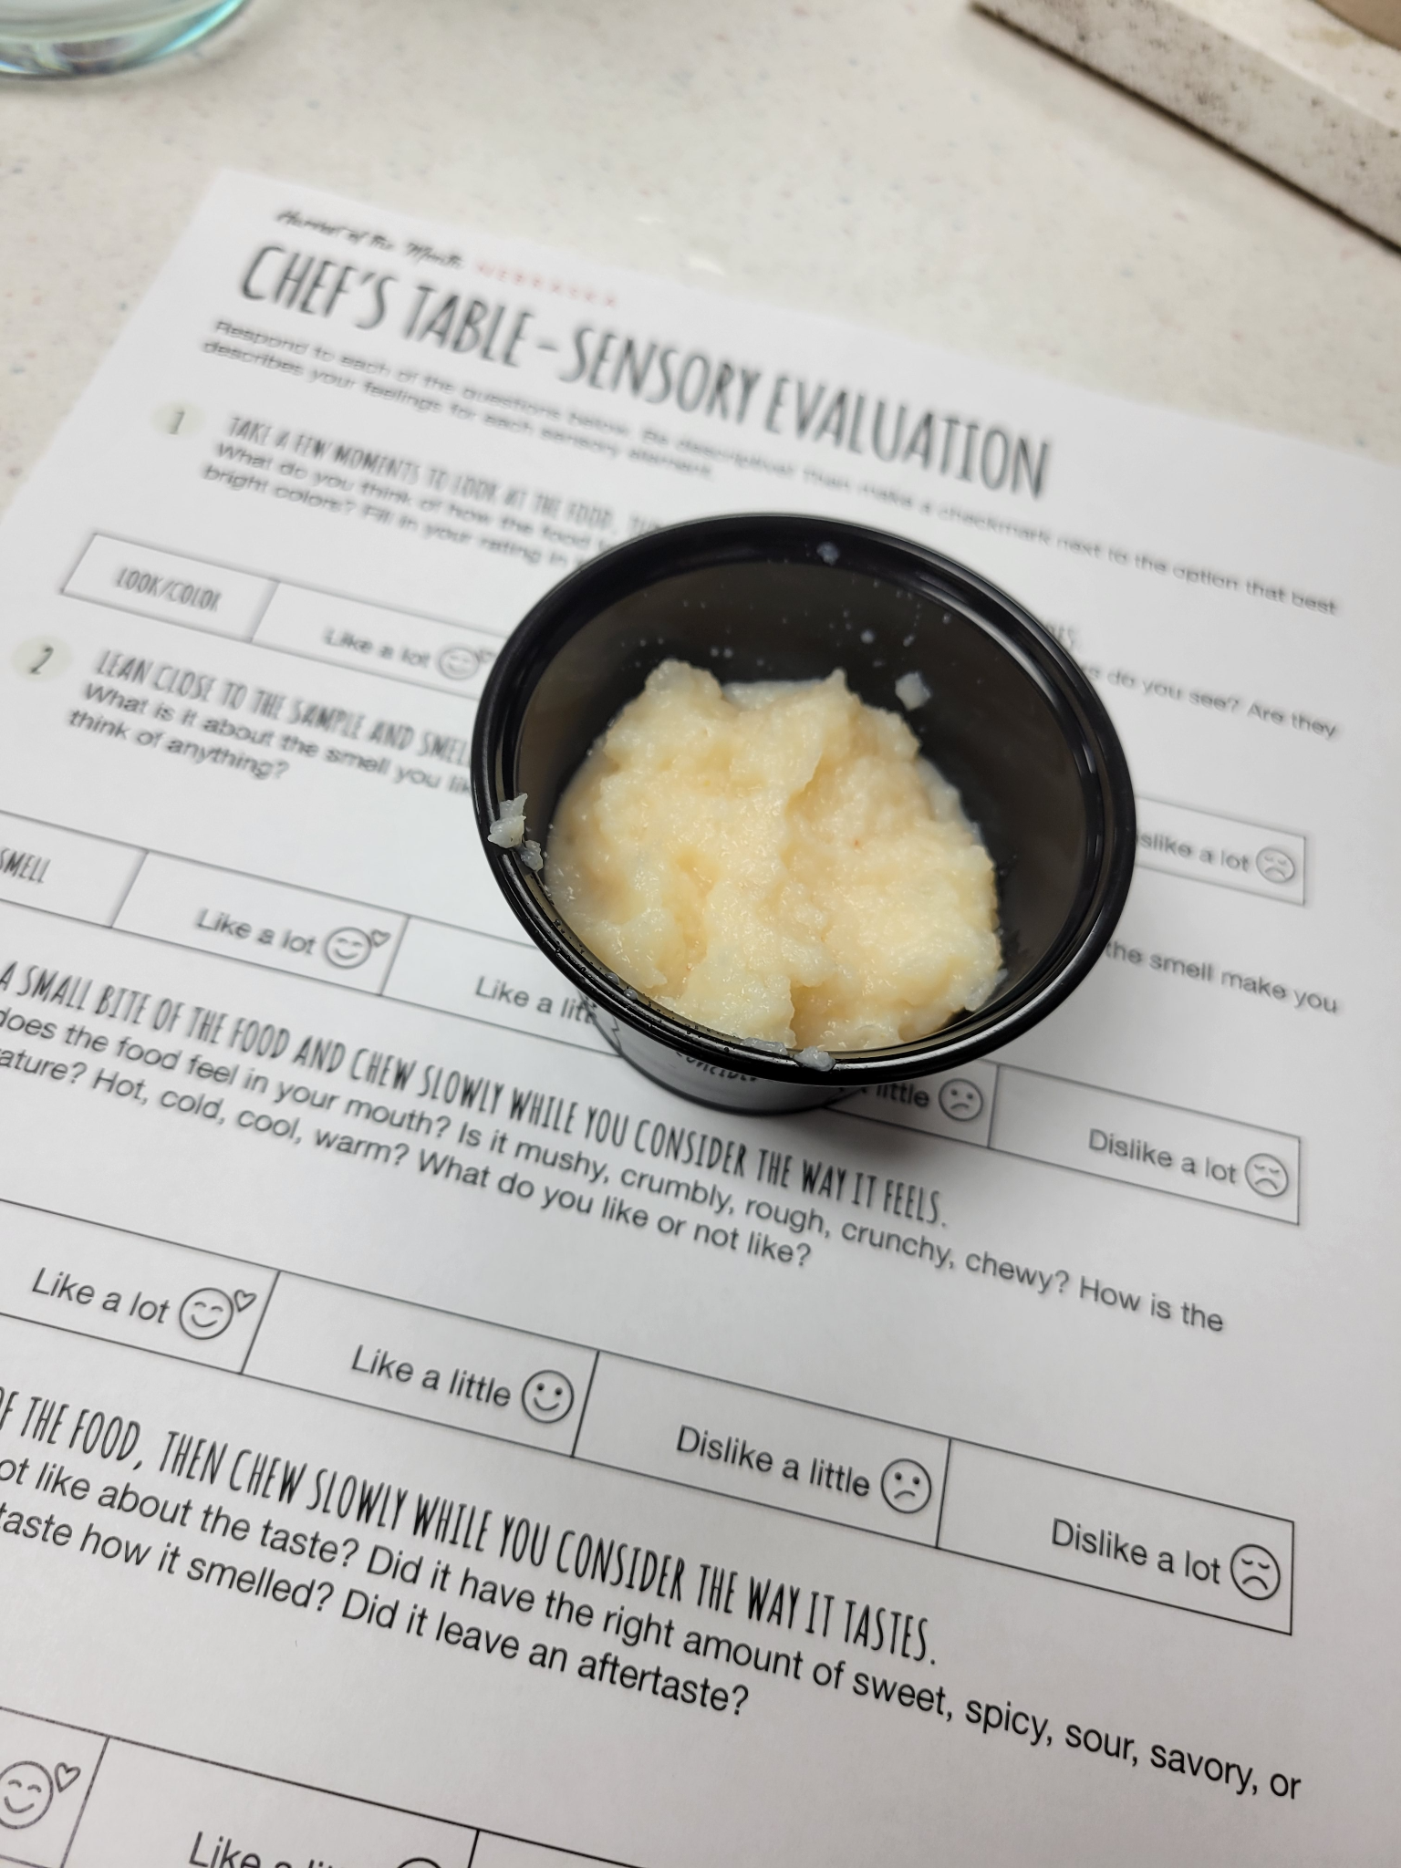
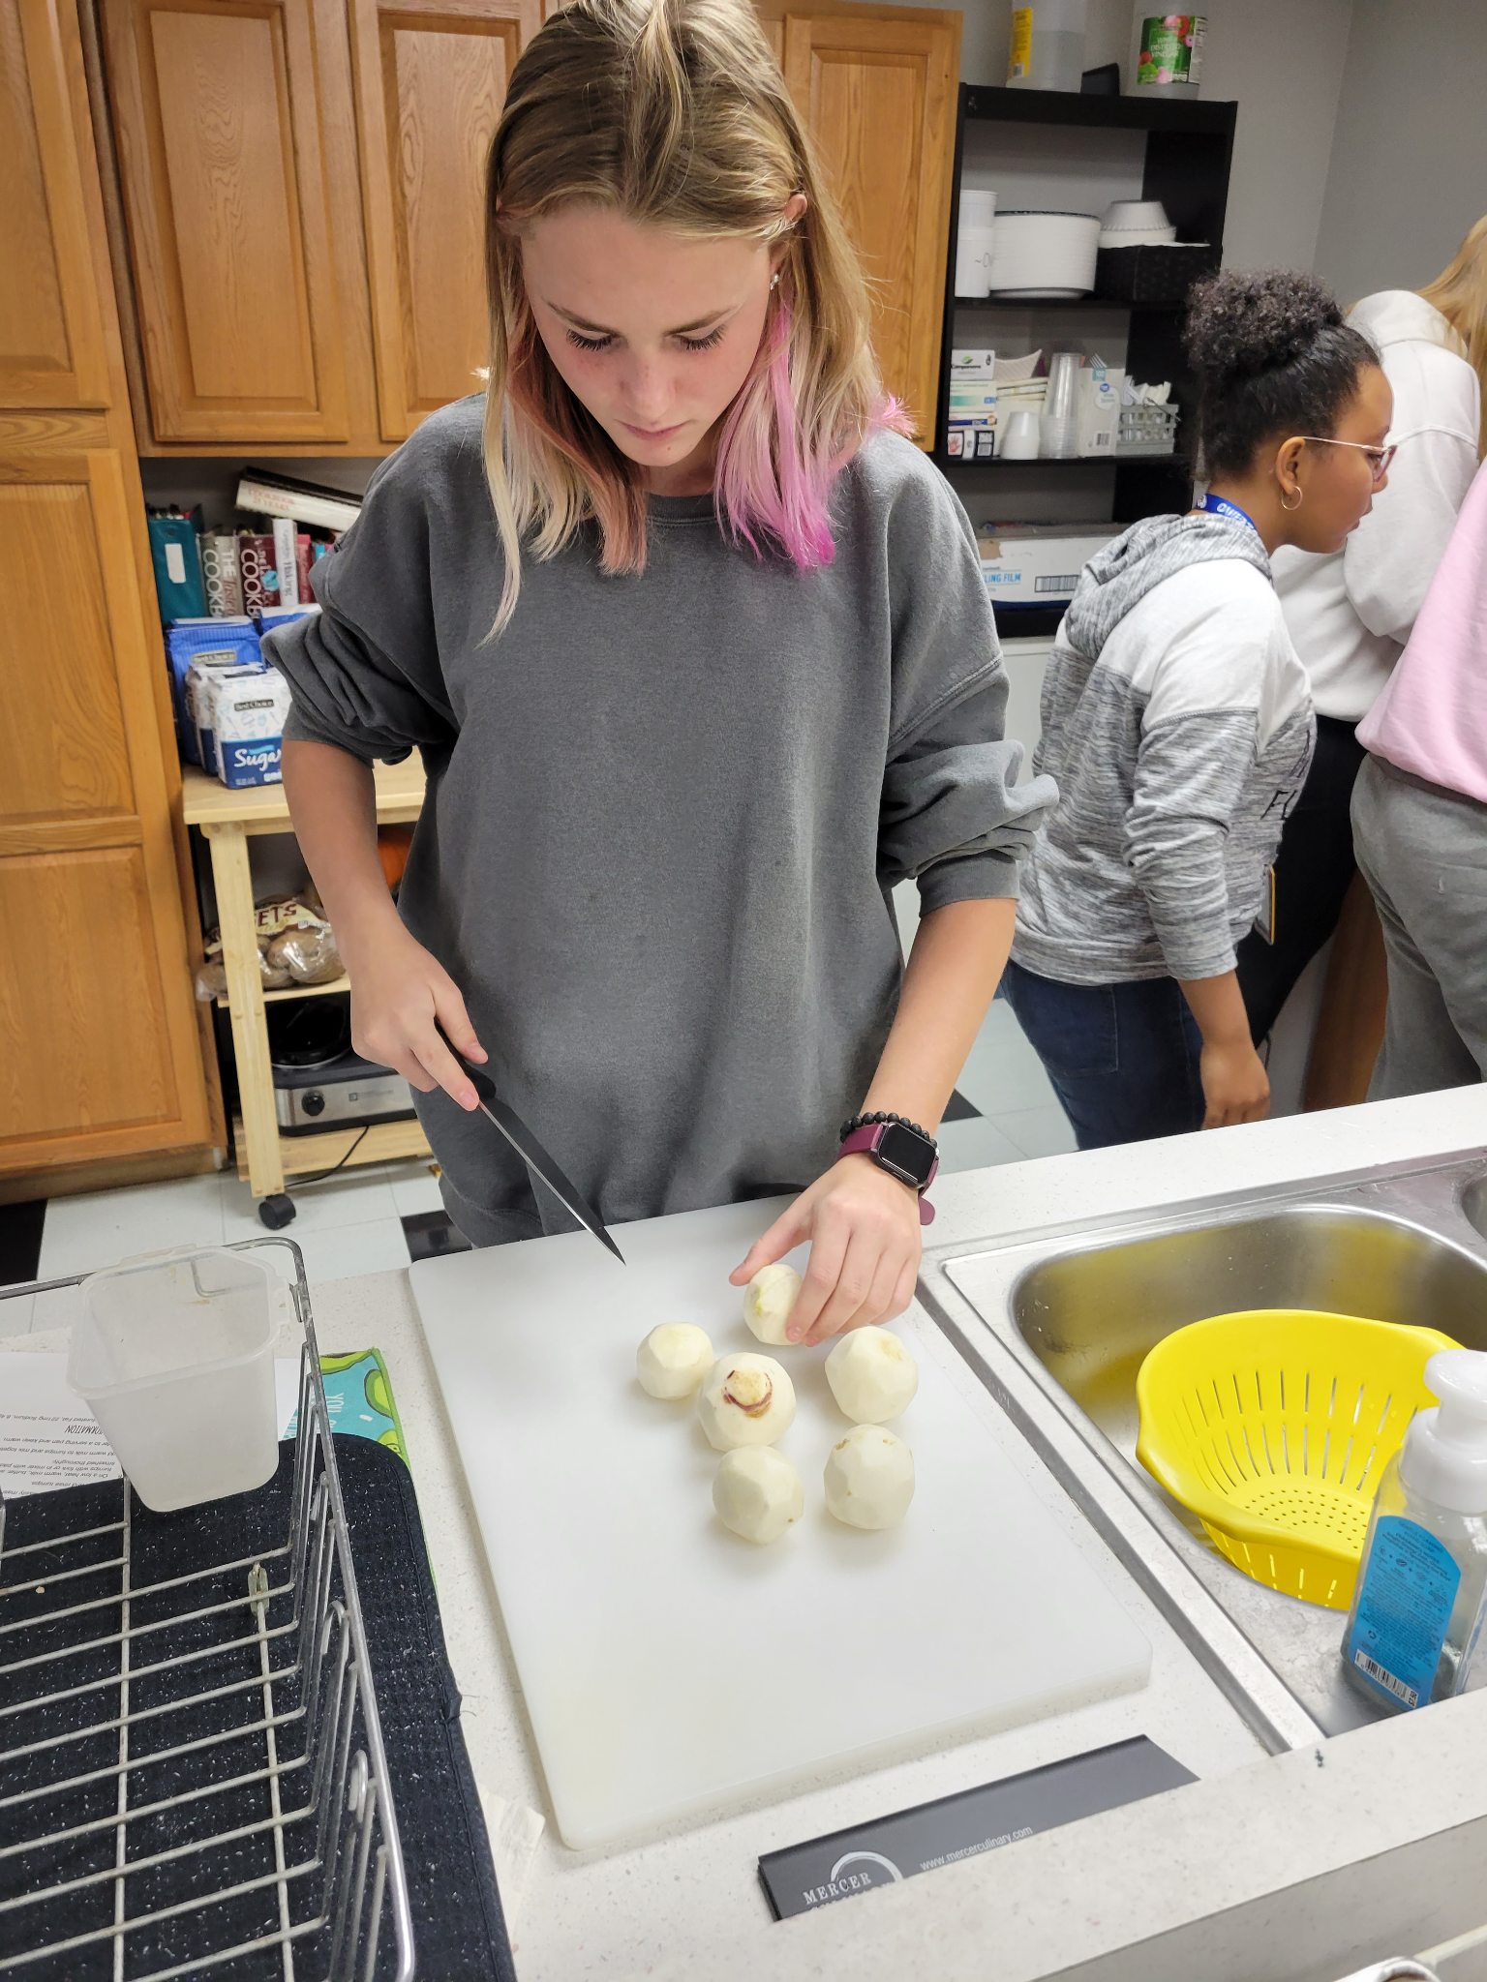
Taste Test (Chef’s Table) In Action
Jordan Luxa, Nebraska Extension
PowerPoint presentation is a great intro to the item you’ll be testing out! And an easy way to really incorporate that ‘farm to school’ lesson
Sensory evaluation really gets them engaged and avoids them immediately dismissing a food they aren’t eager to try
DON'T YUCK MY YUM!
While recipe is cooking (or any down time), do a taste test with the raw item
example: if you’re featuring apples, have the students taste test different variety of apples

Slide 14
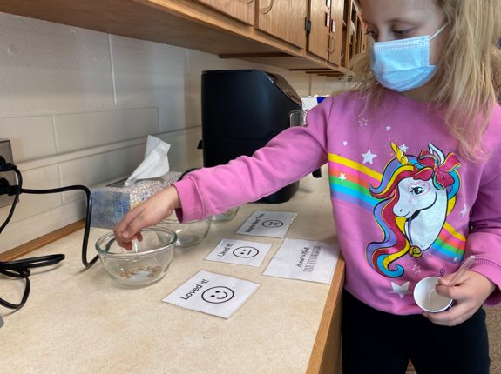
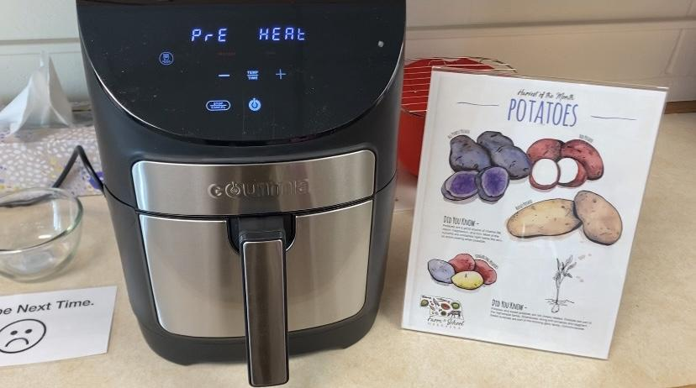
Harvest of the Month at Wellness Clubs
Partnership for a Healthy Lincoln
12 Elementary schools in Lincoln, NE
Occurs every month at afterschool wellness clubs (WeCook, SPARK, Tower Garden)
Use air fryers and blenders to prepare
Utilize the supported materials provided by NDE (trivia cards, newsletters, posters and stickers)
Voting (“liked it,” “loved it” or “maybe next time”)

Slide 15
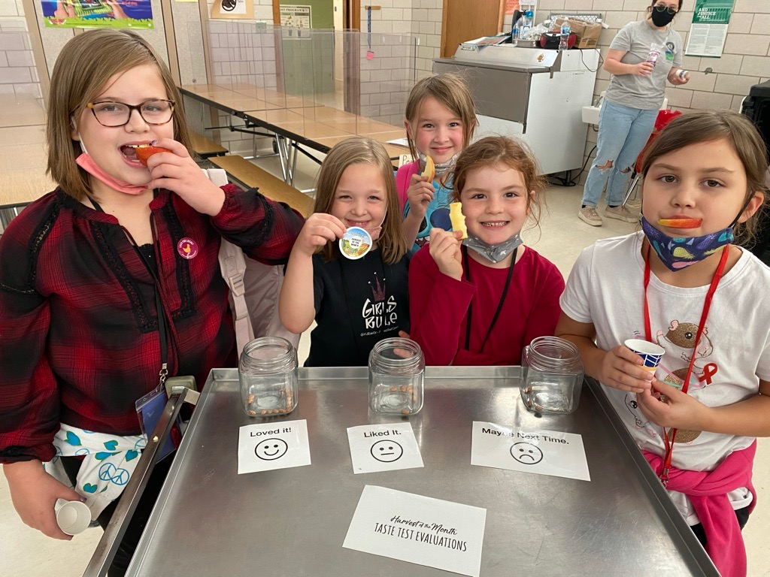
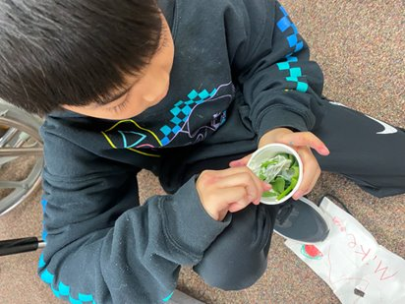

Slide 16
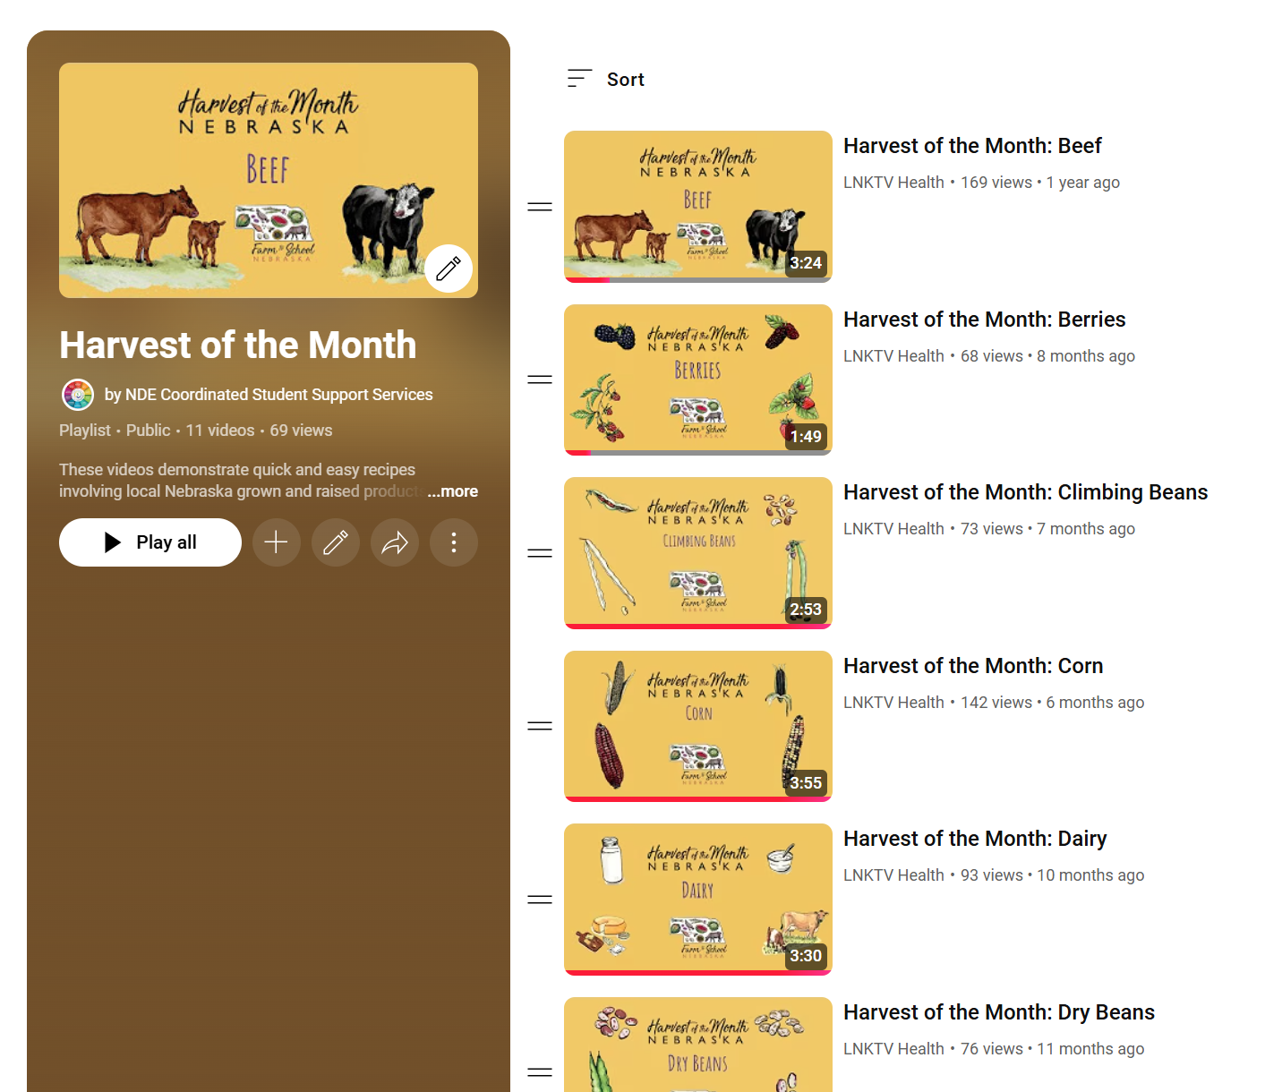
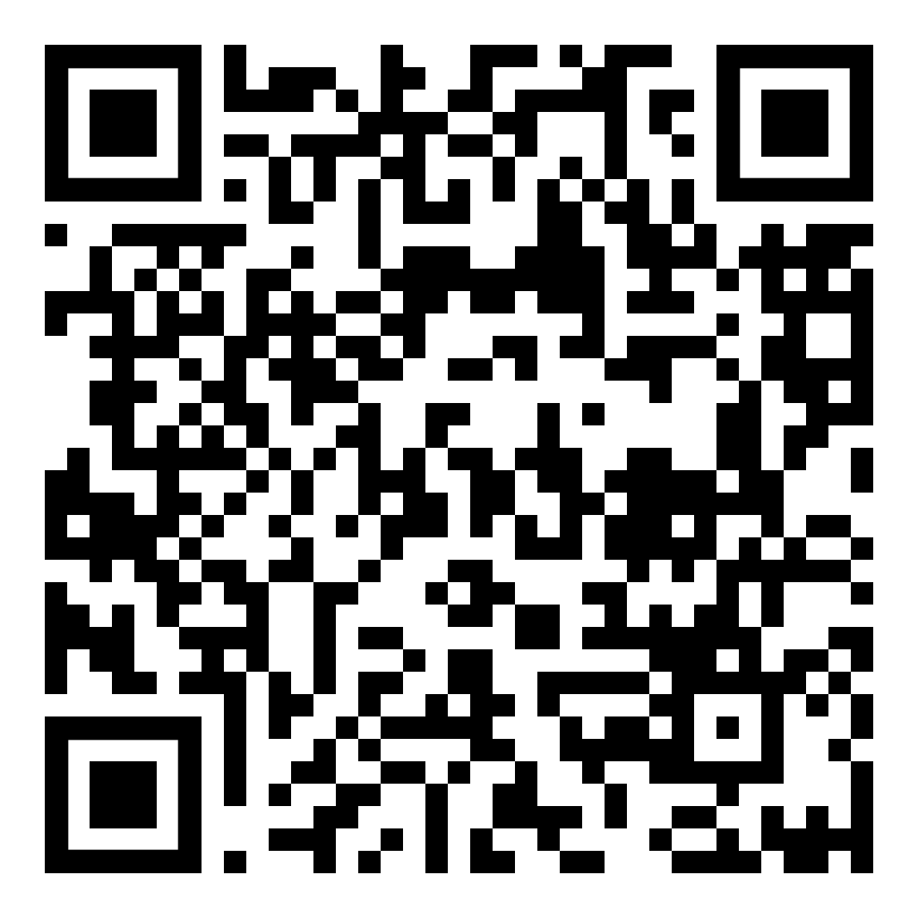
Harvest of the Month
Food Demo Series

Slide 18
Education

Slide 20
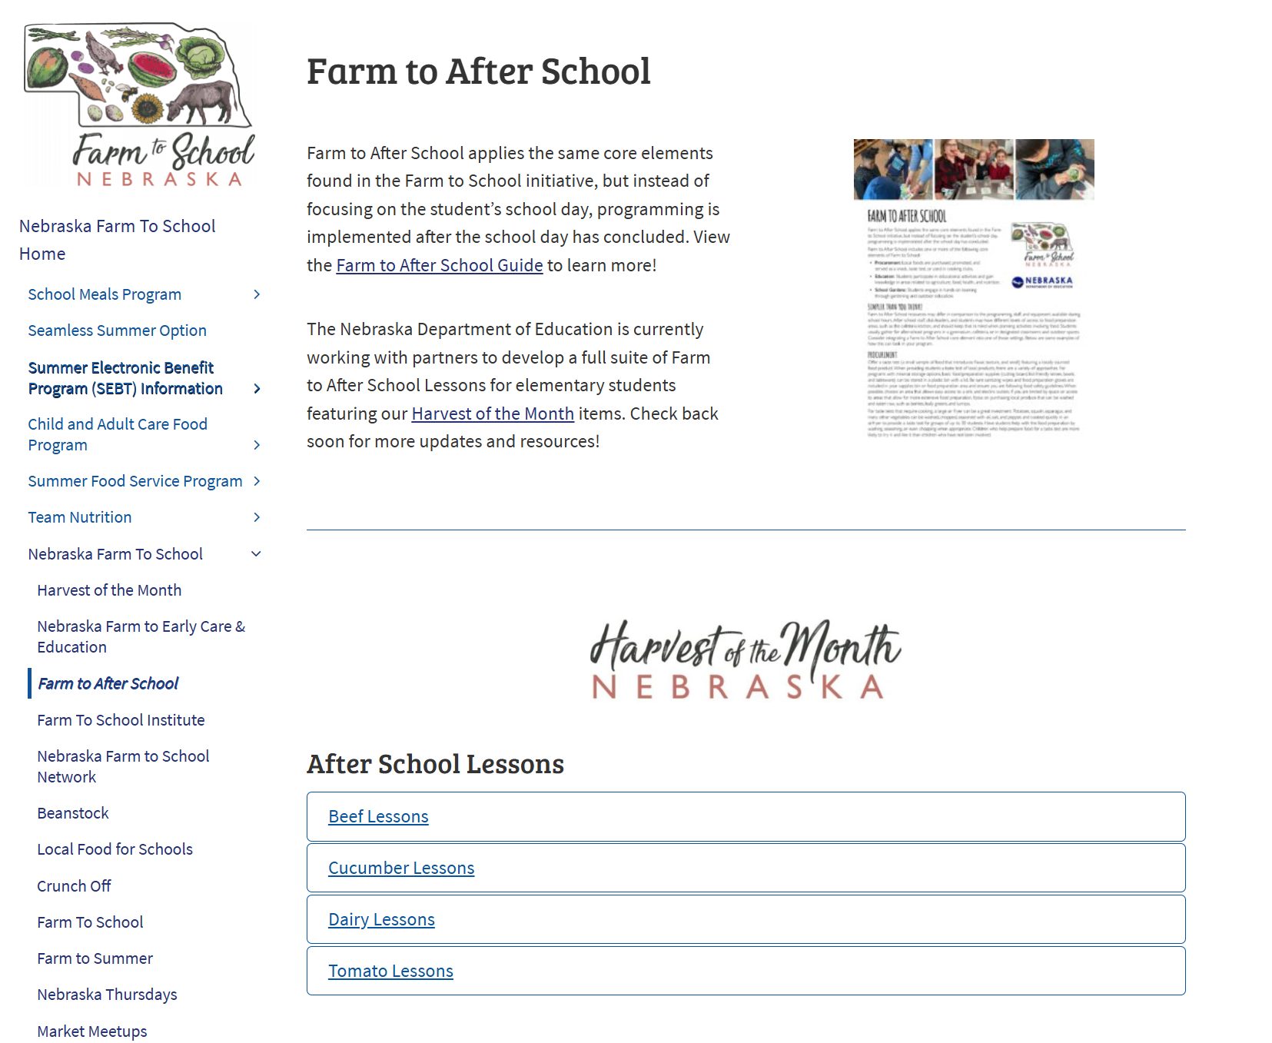
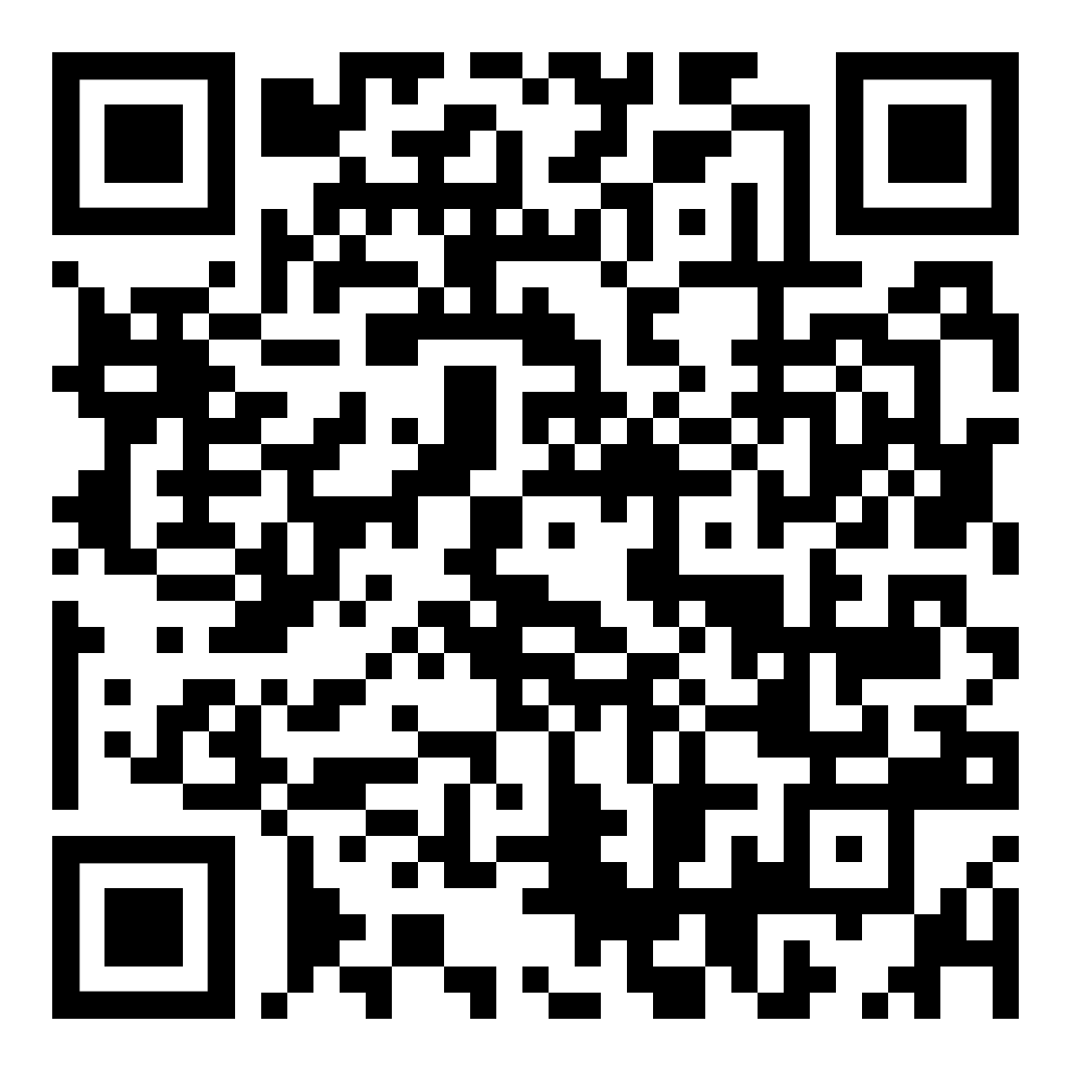

Slide 21
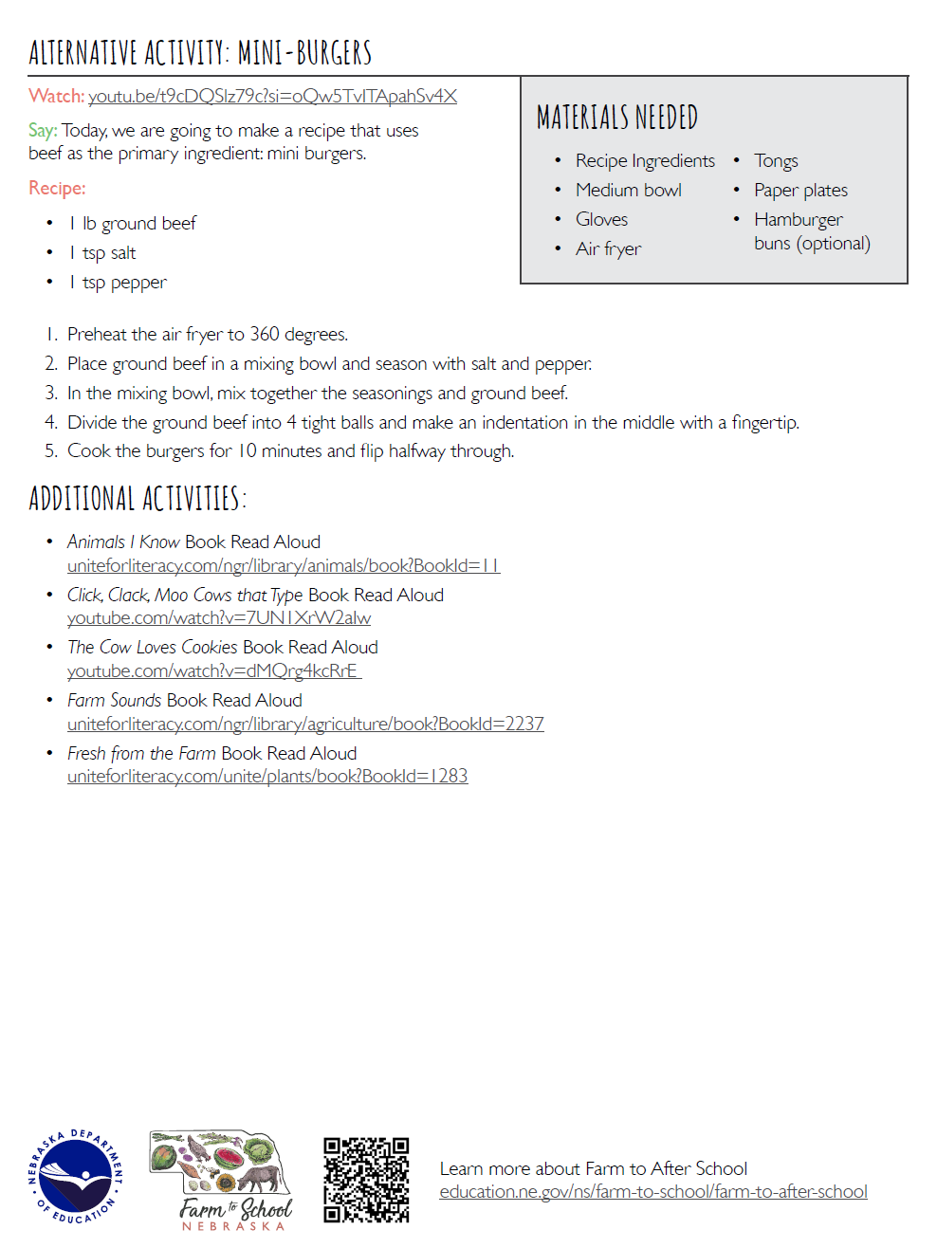
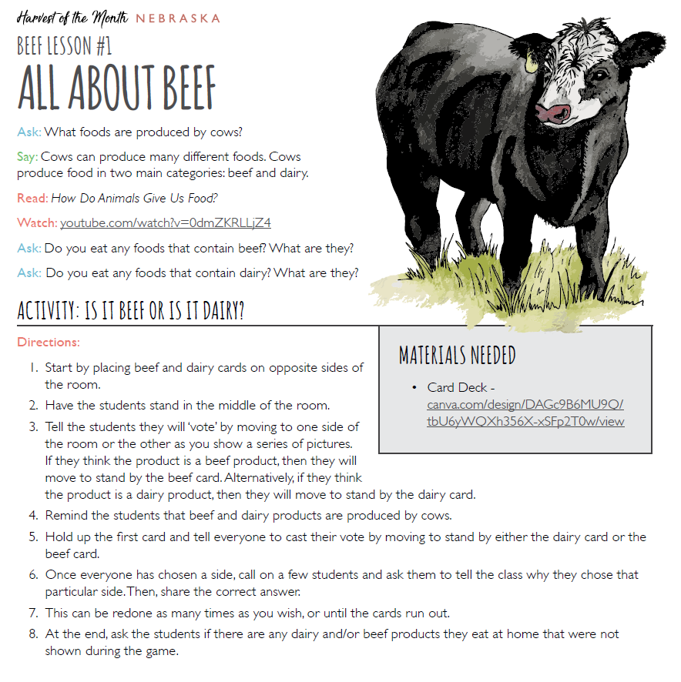
Harvest of the Month After School Lessons
Current Line Up!
Beef (1)
Cucumbers (2)
Dairy (3)
Tomatoes (2)
Coming Soon!
Honey (3)

Slide 22
Discussion:
How do you see this lesson working in your program?
How would you potentially adapt this lesson to better fit your program?
What excites you about the lesson?
How do you think your students would respond to this lesson?

Slide 23
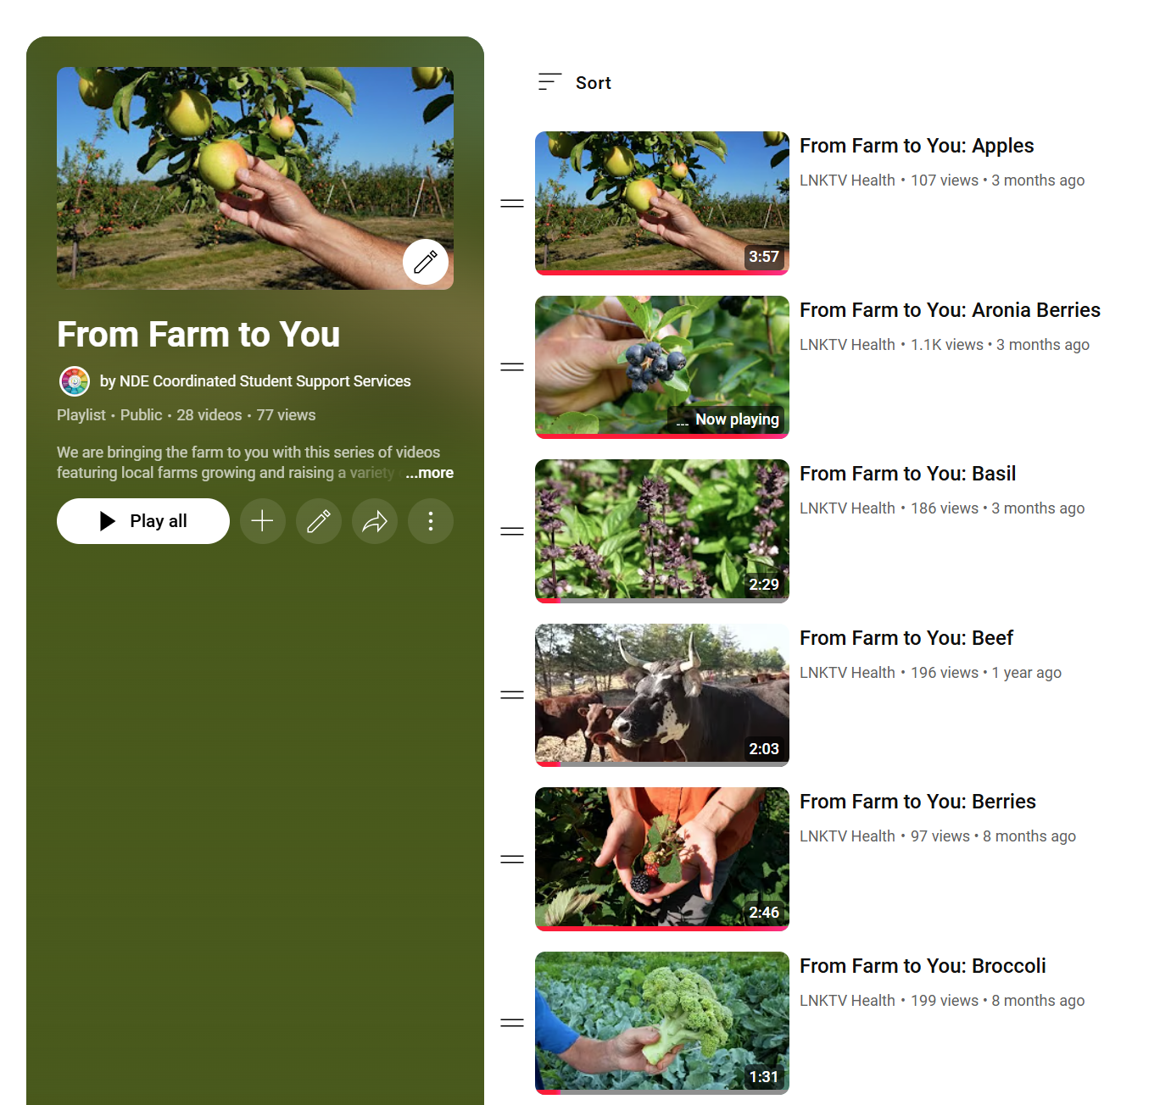
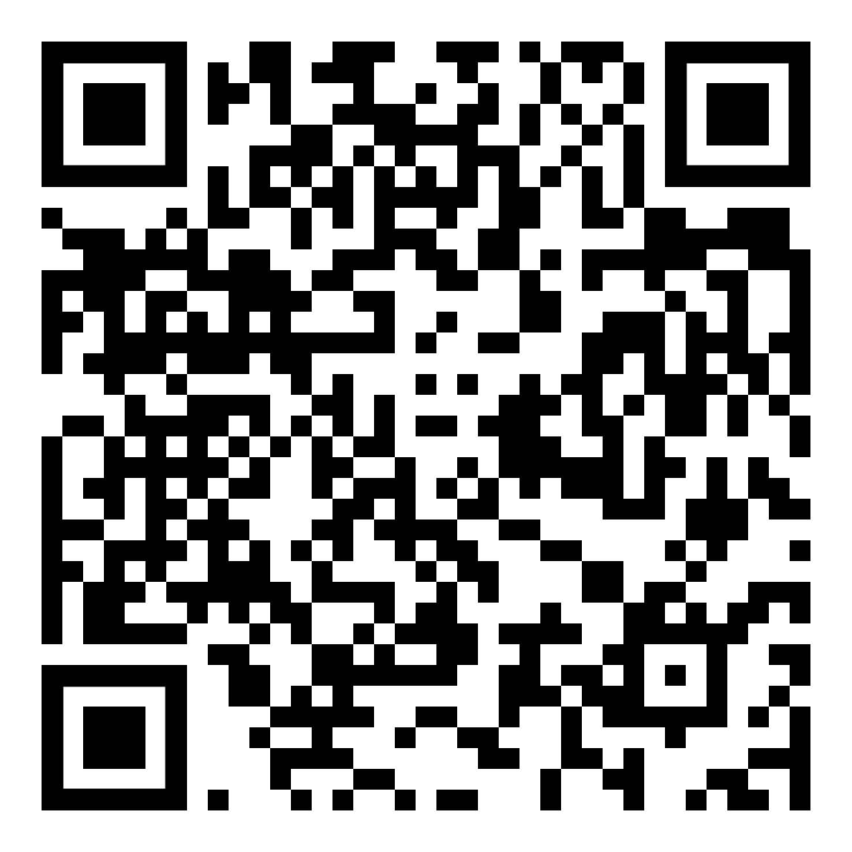
Harvest of the Month
From Farm to You

Slide 25
School Gardens

Slide 26
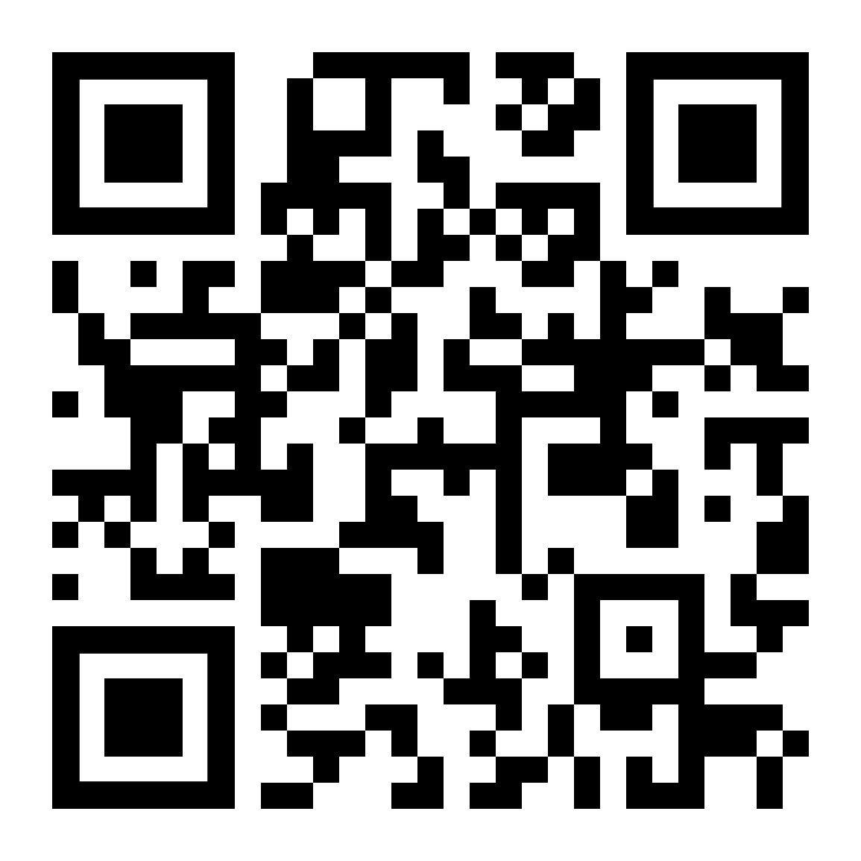
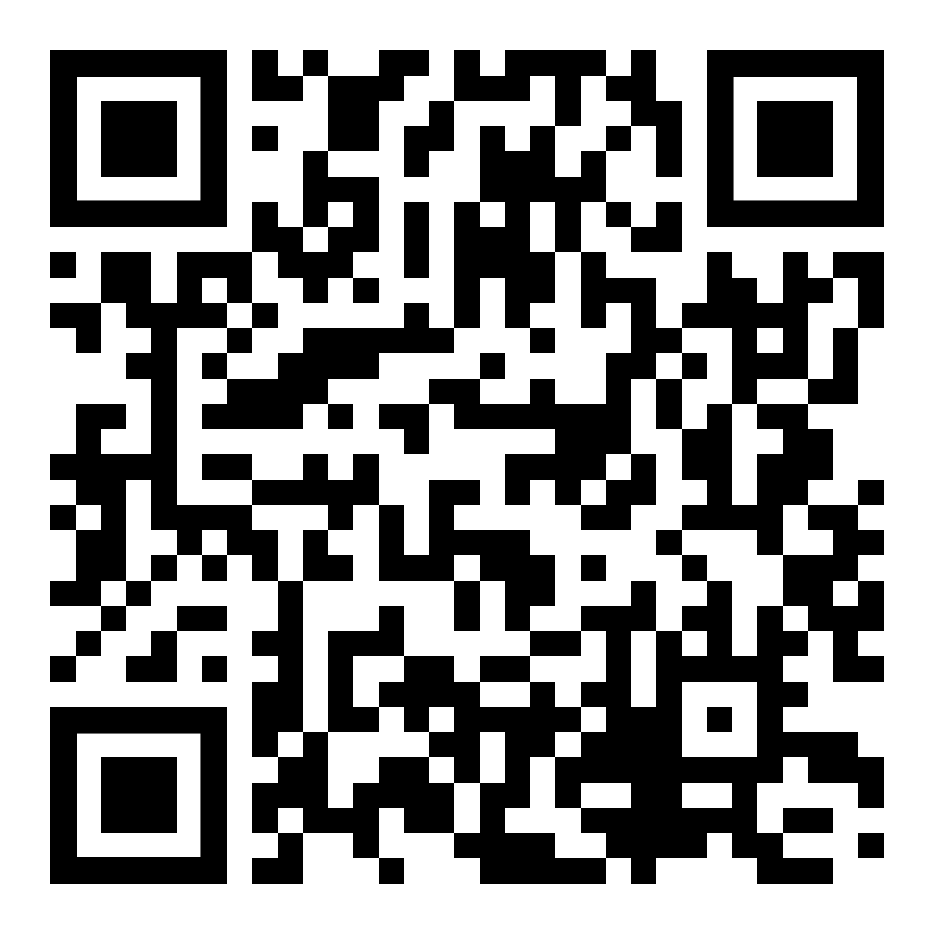
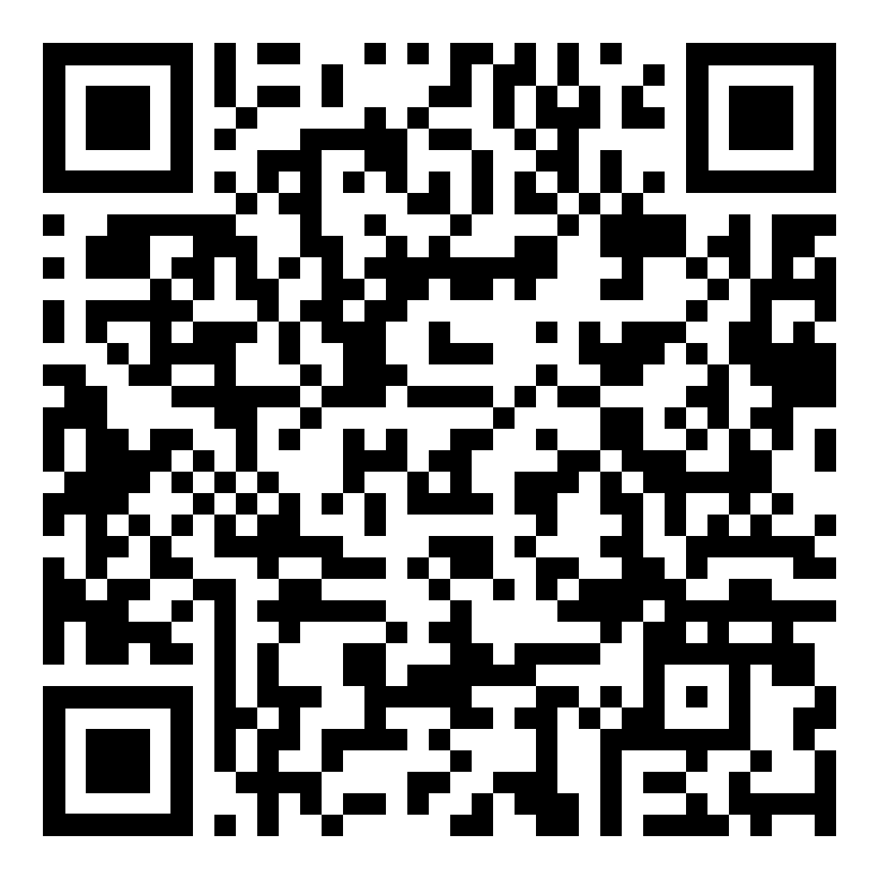
USDA Garden Resources
Grow It, Try It, Like It!
(Ages 3-5)
The Great Garden Detective
(Grades 3-4)
Dig In!
(Grades 5-6)
https://www.fns.usda.gov/f2s/farm-school-resources

Slide 27
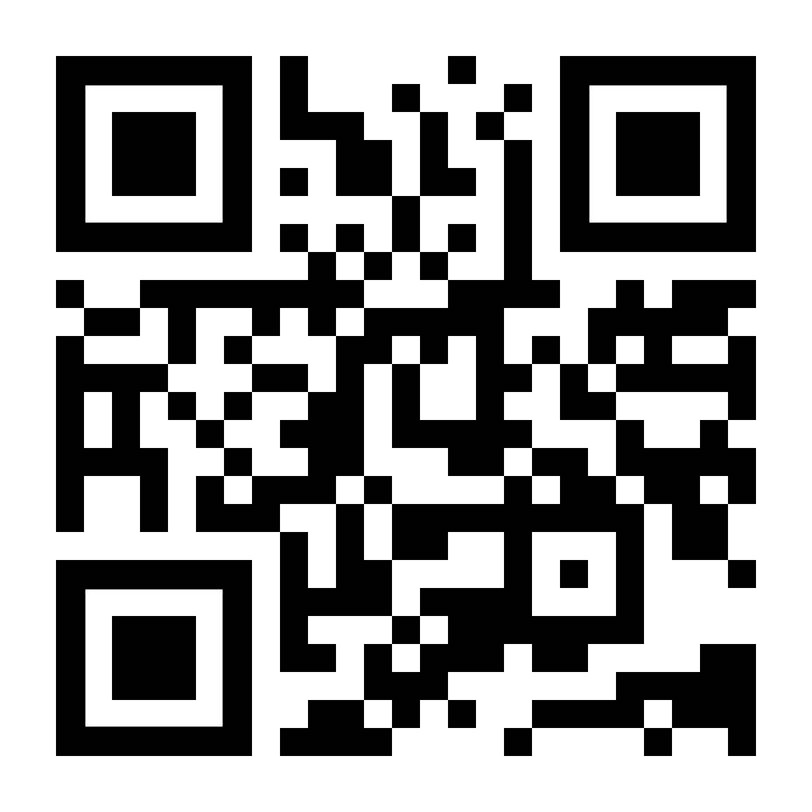

Slide 28
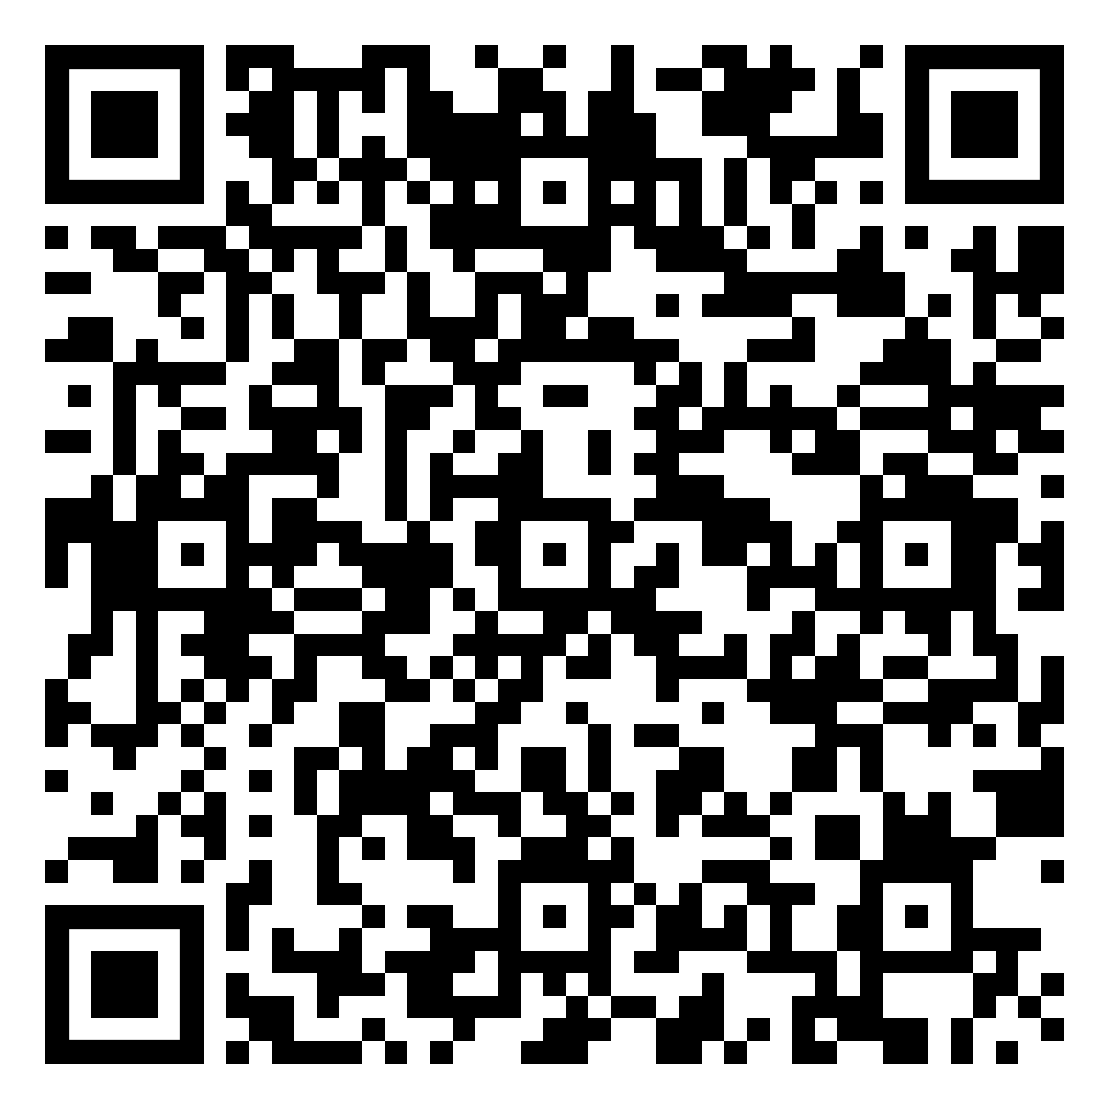
From Greenhouse to Cafeteria: A Toolkit for Creating and Revamping Greenhouse Programs in Nebraska Schools

Slide 29
Upcoming Opportunities & Resources

Slide 30
Coming Soon!
Farm to After School Lesson Expansion
(Ongoing)
Five NEW Harvest of the Month Items (Late 2025)
Walk to Unlock Partnership
(Ongoing)

Slide 31
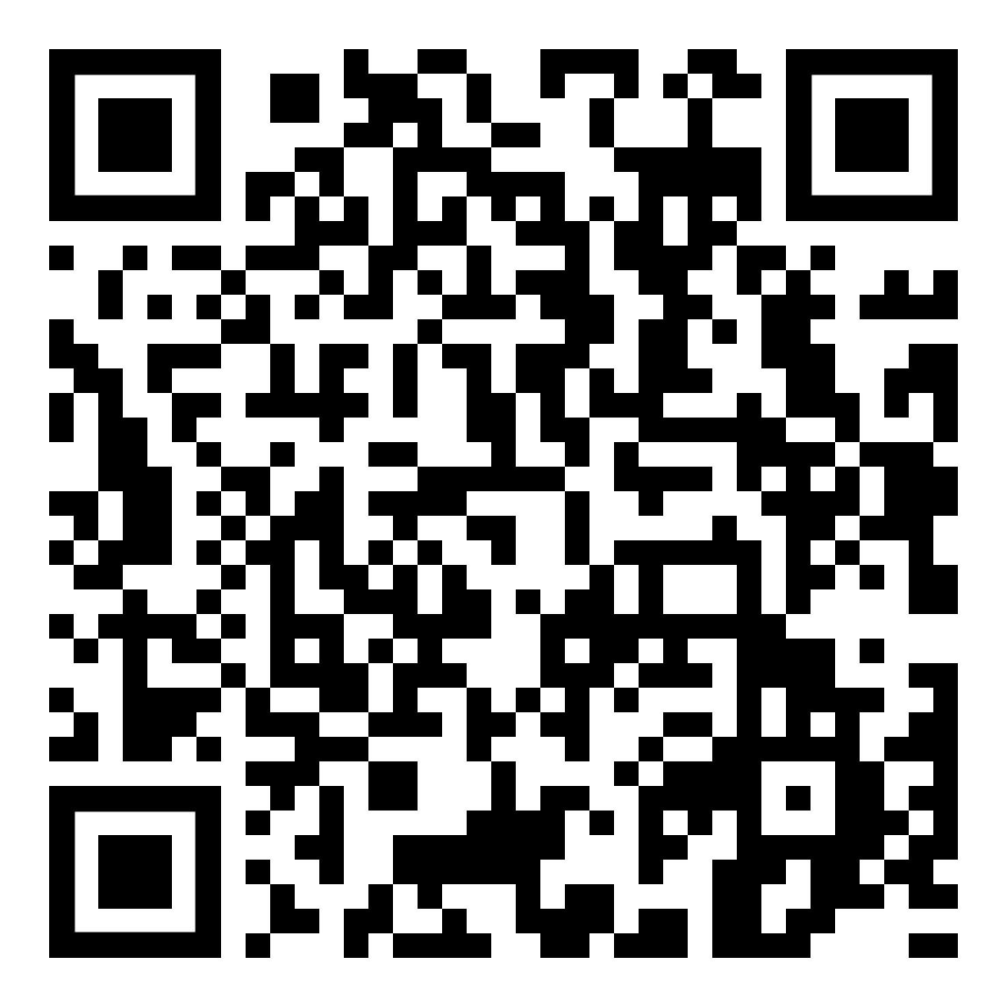
How do I start with Farm to School??
Who: Your Program
What: Nebraska Crunch Off!
Register your event
Crunch into local foods
Send us photos and videos
When: Anytime in the month of October
Where: Your Site
How: Visit our Crunch Web Page for a wide variety of resources
www.education.ne.gov/ns/farm-to-school/mountain-plains-crunch/

Slide 32
HARVEST OF THE MONTH
MATERIALS
www.education.ne.gov/ns/
farm-to-school/harvest-of-the-month/

Slide 33
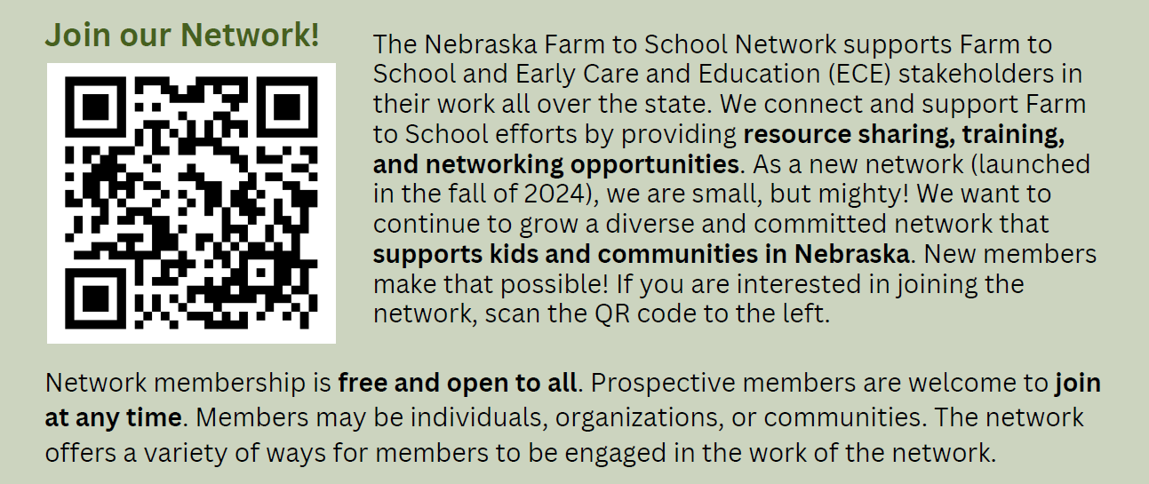
Nebraska Farm to School Network

Slide 34
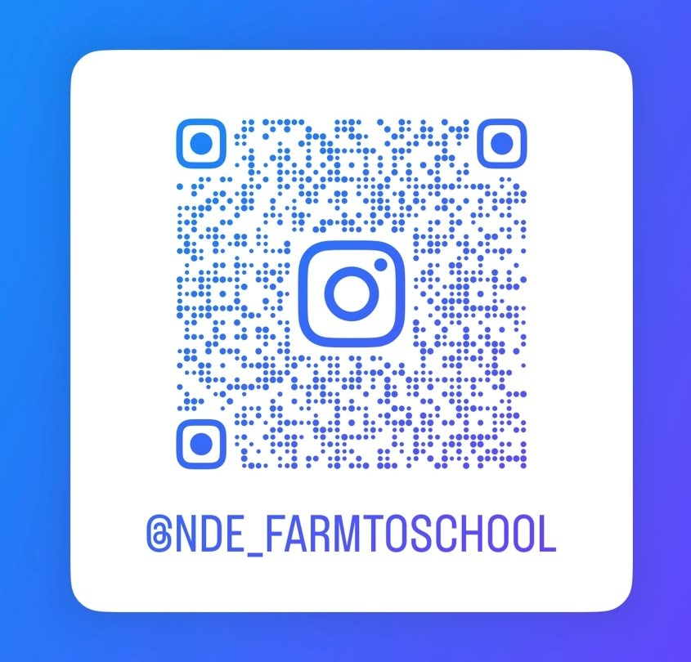
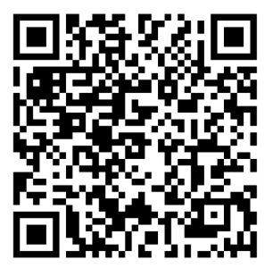
Follow us on Instagram!
Sign-up for our Monthly Newsletter!
Questions?
Nebraska Department of Education
Farm to School
nde.f2s@nebraska.gov

