Slide 1
TEENS AS TEACHERS
GROWING LEADERS IN THE AFTERSCHOOL SPACE

Slide 2
INTRODUCTIONS

Slide 3
INTRODUCTIONS

Slide 4
ENGAGE YOUTH, EDUCATORS, AND THE GENERAL PUBLIC TO PROMOTE AN UNDERSTANDING OF THE VITAL IMPORTANCE OF AGRICULTURE IN THE LIVES OF ALL NEBRASKANS.

Slide 5
TRIVIA
WHAT IS NEBRASKA’S TOP AGRICULTURAL COMMODITY?
A. CORN
B. SOYBEANS
C. CATTLE & CALVES
D. WHEAT

Slide 6
OBJECTIVES
Explore Teens As Teacher Program
Discover Hands-on Resources for Afterschool Programs

Slide 7
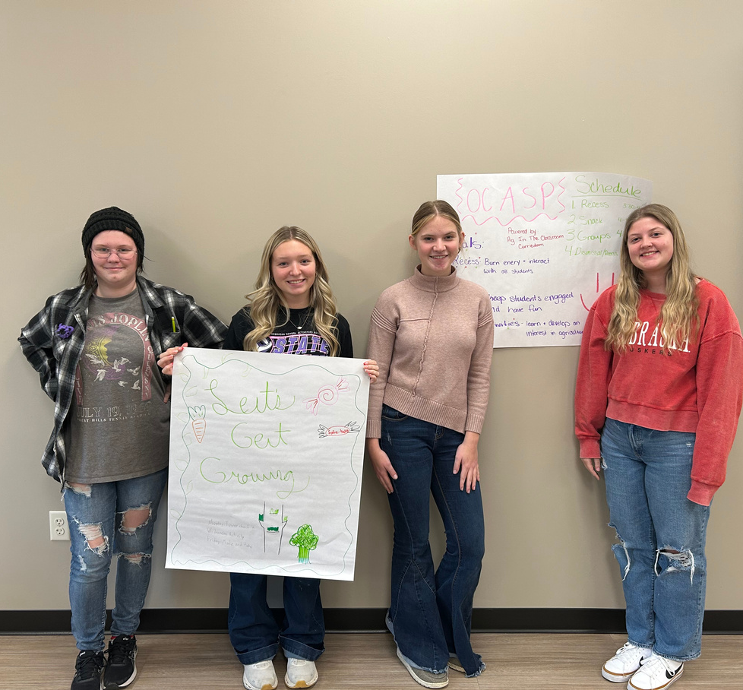
TEENS AS TEACHERS
OBJECTIVES
1️⃣ Understand Agriculture Literacy: High school students will define agriculture literacy and explain its importance in elementary education.
2️⃣ Explore Hands-On Activities: Students will participate in and evaluate interactive agriculture-related activities suitable for elementary-aged children using the Let’s Get Growing Curriculum.
3️⃣ Develop Leadership Skills: Students will practice effective communication and facilitation techniques to confidently lead agriculture literacy lessons.
4️⃣ Plan and Deliver Lessons: Students will design and present an agriculture literacy activity, demonstrating their ability to engage younger learners.
5️⃣ Apply Knowledge in After-School Programs: Students will identify opportunities to implement agriculture literacy lessons in their local after-school programs.

Slide 8
THE TRAINGING
Gallery Walk

Slide 9
THE TRAINGING
AN AGRICULTURALLY LITERATE PERSON UNDERSTANDS THE RELATIONSHIP BETWEEN AGRICULTURE AND THE ENVIRONMENT, FOOD, FIBER, AND ENERGY, ANIMALS, LIFESTYLE, THE ECONOMY AND TECHNOLOGY.
AN AGRICULTURAL LITERACY PROGRAM PROMOTES AN UNDERSTANDING OF THE CONNECTION AND VALUE OF AGRICULTURE IN THE LIVES OF ALL PEOPLE.

Slide 10
THE TRAINGING
TODAY’S OBJECTIVES

Slide 11
TRIVIA
WHAT PERCENTAGE OF NEBRASKA’S LAND IS USED FOR FARMING AND RANCHING?
A. 50%
B. 70%
C. 89%
D. 92%

Slide 12
THE TRAINGING
THE GOALS OF THE CURRICULUM ARE TO TAKE STUDENTS ON A JOURNEY TO UNDERSTAND FOOD SCALABILITY AND FOR STUDENTS TO BEGIN GROWING ENOUGH FOOD TO SUPPLEMENT A SCHOOL LUNCH, SELL AT A FARMER’S MARKET, OR PROVIDE TO STUDENTS AND THEIR FAMILIES.
THIS CURRICULUM IS AN OUT-OF-SCHOOL CURRICULUM DESIGNED TO EXPLORE FOOD, SCIENCE, ENGINEERING, TECHNOLOGY, AND INNOVATION IN PLANT PRODUCTION.

Slide 13
THE TRAINGING
HOW TO READ A BOOK

Slide 14
THE TRAINGING
BREAKING DOWN A LESSON

Slide 15
THE TRAINGING

Slide 16
THE TRAINGING
HOW TO PREPARE FOR AN ACTIVITY

Slide 17
TRIVIA
WHICH NEBRASKA-GROWN CROP IS A KEY INGREDIENT IN ETHANOL PRODUCTION?
A. SOYBEANS
B. CORN
C. WHEAT
D. SORGHUM

Slide 18
THE TRAINGING
ESTABLISH A ROUTINE

Slide 19
THE TRAINGING
CREATING AN ENVIRONMENT

Slide 20
THE TRAINGING
BUILD A BILLBOARD

Slide 21
THE TRAINGING
INVOLVING FAMILIES
FAMILY-CENTRIC IDEAS
SALAD PARTY (SUGGESTED AFTER LESSON 10)
POSTER PRESENTATION
FACEBOOK PAGE – PROGRESS REPORT

Slide 22
TRIVIA
WHAT RIVER IS CRUCIAL FOR NEBRASKA AGRICULTURE AND IRRIGATION?
A. MISSOURI RIVER
B. PLATTE RIVER
C. NIOBRARA RIVER
D. ELKHORN RIVER

Slide 23
AFTERSCHOOL CLUB EXPERIENCE

Slide 24
AFTERSCHOOL
CLUB

Slide 25
AFTERSCHOOL
CLUB

Slide 26
AFTERSCHOOL
CLUB

Slide 27
AFTERSCHOOL
CLUB

Slide 28
AFTERSCHOOL
CLUB

Slide 29
TRIVIA
NEBRASKA IS THE TOP U.S. PRODUCER OF WHICH CROP USED IN LIVESTOCK FEED AND EXPORTS?
A. SOYBEANS
B. WHEAT
C. BARLEY
D. CORN

Slide 30
AFTERSCHOOL
CLUB LESSONS

Slide 31
ADDITIONAL
RESOURCES

Slide 32
ADDITIONAL
RESOURCES

Slide 33
TRIVIA
WHAT PORTION OF JOBS IN NEBRASKA ARE DIRECTLY TIED TO AGRICULTURE?
A. 1 IN 4
B. 1 IN 5
C. 1 IN 6
D. 1 IN 8

Slide 34
HANDS-ON ACTIVITY
Shining a Light on Sunlight

Slide 35
THANK YOU!
CONTACT: BROOKE CARPENTER
EMAIL: BROOKET@NEFB.ORG
PHONE: (402) 646-5325
CONTACT: DAKOTA STAGGS
EMAIL: DSTAGGS@NEBRASKACHILDREN.ORG
PHONE: (602) 769-0033

Slide 36
Teens As Teachers
Kits

