Slide 1
Expanding the Entrepreneurial Mindset
Molly Brandt
Nebraska 4-H Extension Educator
University of Nebraska – Lincoln
ELO Innovation Invitational
March 11, 2025

Slide 2
30 Circles Challenge

Slide 3
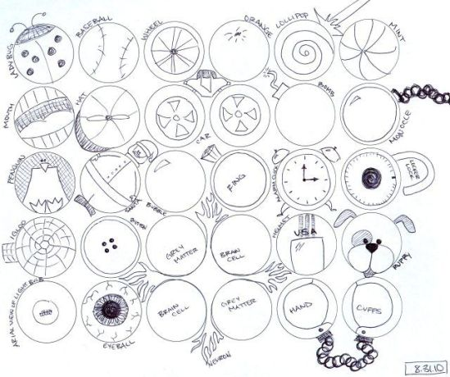
30 Circles Challenge

Slide 4
Objectives
Discuss the definition and process of entrepreneurship.
Review the components of an entrepreneurial mindset.
Brainstorm ideas to recognize and implement entrepreneurship in our work.
How do we expand the entrepreneurial mindset in our young people?
Notes:
How do we expand the entrepreneurial mindset in our young people?

Slide 5
Entrepreneurship
More than just starting a business – it is a mindset!
An entrepreneurial mindset is about being creative, innovating, making your ideas a reality, overcoming challenges, communicating and collaborating with others.
It is a way of thinking that can be learned and practiced.
Entrepreneurship is not as complicated as it sounds.

Slide 6
Process of Entrepreneurship
Entrepreneurship is a continuous process of capturing an opportunity in changing environment.
Opportunity Recognition
Opportunity Evaluation
Opportunity Exploitation
New Business or Program
Established Growth

Slide 7
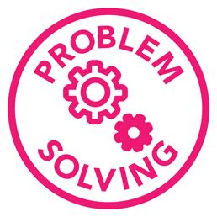
Entrepreneurial Mindset
An entrepreneurial mindset is the ability to detect opportunities, show resilience in light of challenges, and mobilize resources to succeed. Someone with this mindset is sensitive to change and can respond in ways that identify opportunities and maximize success.

Slide 8
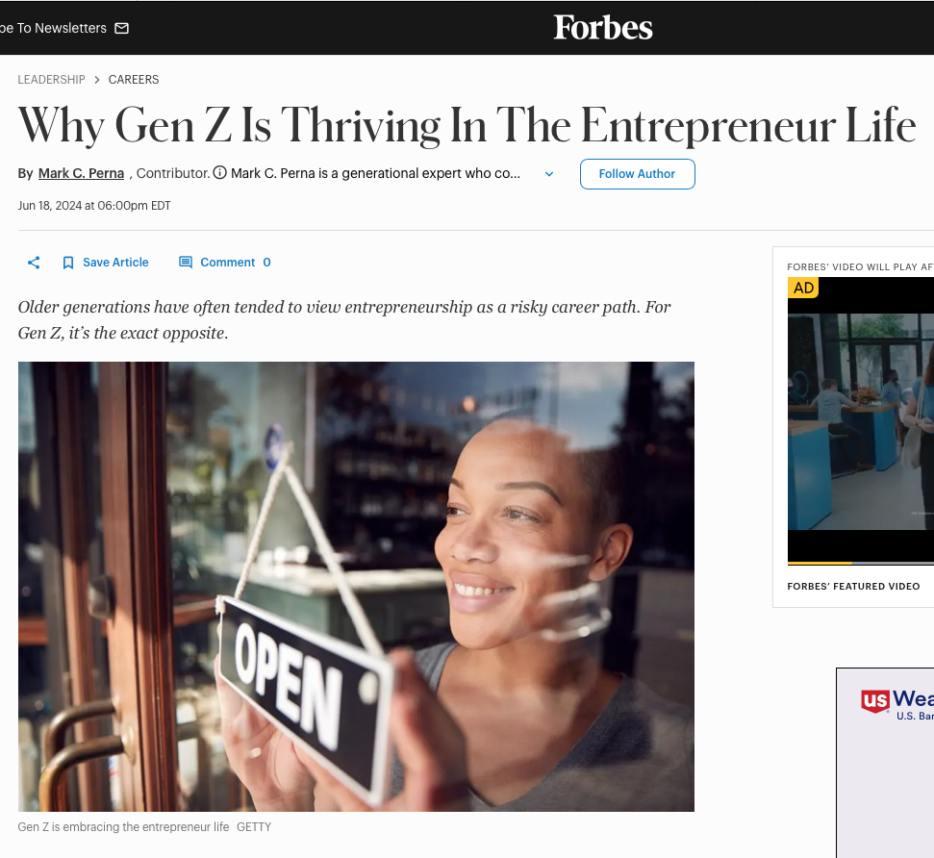
Youth Entrepreneurship Today
Many Generation Z youths have the qualities necessary to become entrepreneurs (Kim, Guzman, & Taylor, 2018).
What’s different?
A difference in values
Willingness to take risks
Desire to make a positive impact in their
community
The job economy
Freelancing vs. “side gig”.
The creator economy
Ability to control their own schedules
Notes:
While Millennials use the gig economy to test the waters of entrepreneurship through “side hustles,” Gen Zers are a little more willing to take bigger risks—like completely replacing a full-time job with freelancing or content creation—especially with how much more accessible it has become.

Slide 9
Importance of Entrepreneurship
Encourages Problem-Solving and Innovation
Promotes Creativity and Critical Thinking
Develops a Growth Mindset
Prepares for Future Career Success
Encourages Leadership and Teamwork
Teaches Resourcefulness and Self-Reliance
Empowers Future Generations to Drive Change

Slide 10
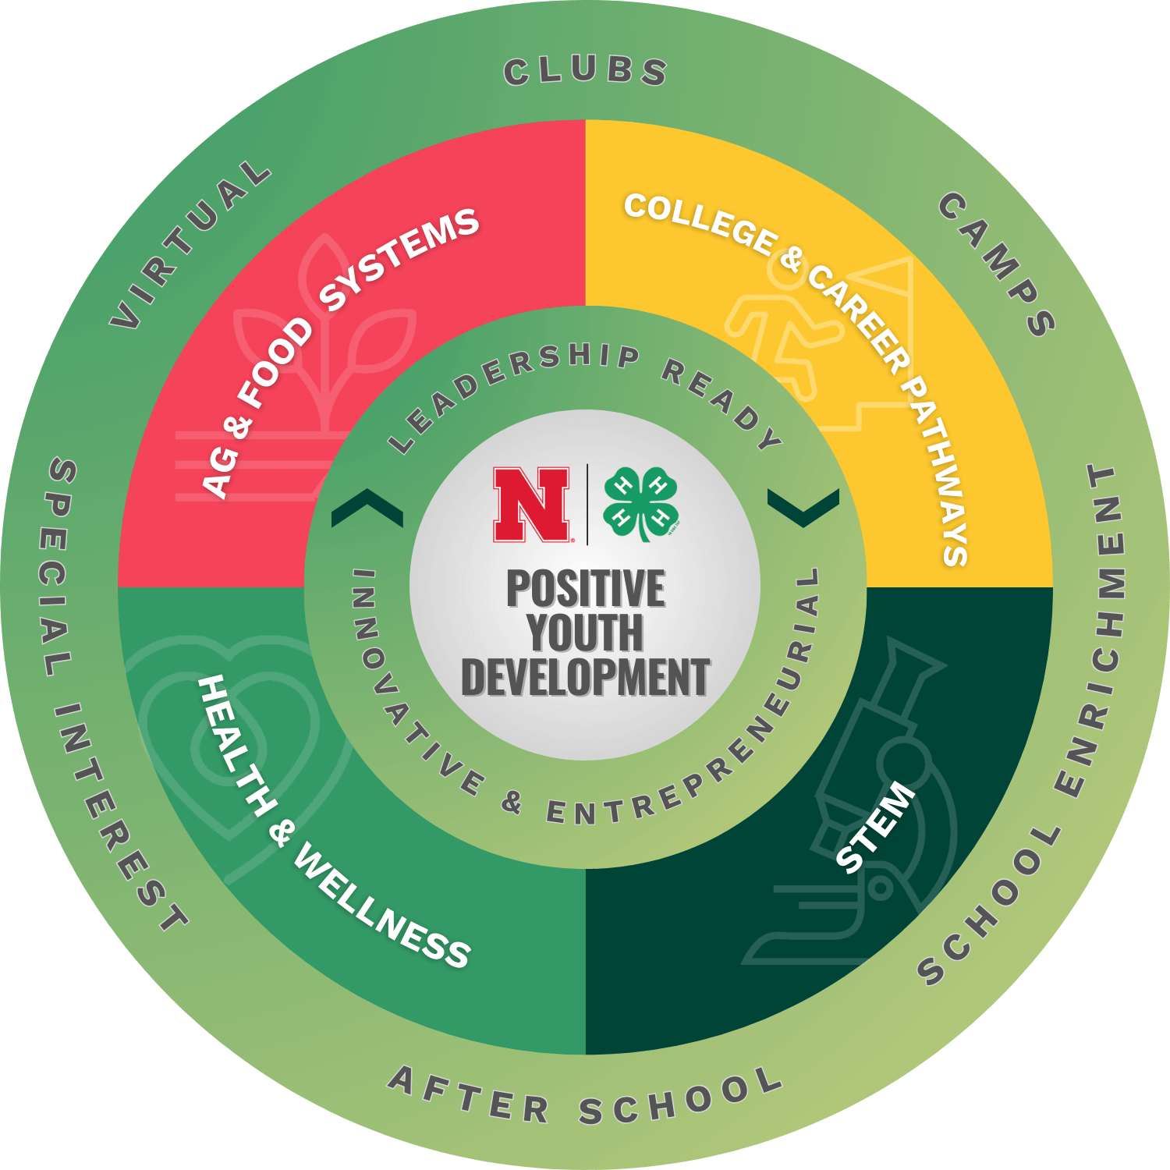
Nebraska 4-H Framework
Notes:
While Millennials use the gig economy to test the waters of entrepreneurship through “side hustles,” Gen Zers are a little more willing to take bigger risks—like completely replacing a full-time job with freelancing or content creation—especially with how much more accessible it has become.

Slide 11
Small Group Activity Time
Notes:
While Millennials use the gig economy to test the waters of entrepreneurship through “side hustles,” Gen Zers are a little more willing to take bigger risks—like completely replacing a full-time job with freelancing or content creation—especially with how much more accessible it has become.

Slide 12
Reflection Questions
How do we expand the entrepreneurial mindset in our young people?
What are we doing now that connects to entrepreneurship?
How could this be highlighted and prioritized?
What could we do this summer to get started?

Slide 13
Questions?
Molly Brandt
University of Nebraska - Lincoln
molly.brandt@unl.edu

