Slide 1
Bringing iCivics to your Community!
March 11, 2025
1:15 - 2:00 pm
Presented by
Mya Baker, Chief Learning Services Officer
Ryan New, Director of Professional Learning
Notes:
SLIDE 1: Title Slide
PURPOSE:
CONTENT:

Slide 2
Mya Baker
Ryan New
Chief Learning
Services Officer
Director of
Professional Learning
Notes:
SLIDE 2
PURPOSE: Presenter Introductions
Timing Breakdown
Ryan - Game Intro is 4 minutes.
Mya - Act I (Intro to iCivics) is 4 minutes
Mya - Act II (Research connections and making the case) is 5 minutes
Ryan - Act III (introduction to games) 25 minutes (10 min for the game)
Ryan - Closing with other offering (2 minutes)
Mya - Question (5 minutes)

Slide 3
Notes:
Ryan
SLIDE 2
PURPOSE: Introduce participants to the folks that think about the current and future state of civic education.

Slide 4
What percentage of Americans know we have three branches of government?
67%
From: US Chamber Foundation (2024) New Study Finds Alarming Lack of Civic Literacy Among Americans.
Notes:
Ryan
SLIDE 4
PURPOSE: To demonstrate gaps in student knowledge that are problematic for living in a democracy.
https://www.uschamberfoundation.org/civics/new-study-finds-alarming-lack-of-civic-literacy-among-americans

Slide 5
What percentage of Americans aged 18-29 know the term lengths of Senators?
39%
From: Pew Research (2023). “What Americans Know about their Government?”
Notes:
Ryan
SLIDE 5
PURPOSE: To demonstrate gaps in student knowledge that are problematic for living in a democracy.
https://www.pewresearch.org/short-reads/2023/11/07/what-americans-know-about-their-government/

Slide 6
How many 18-24 year olds planned to *participate civically in 2024?
33%
*Note: This could include voting, political volunteerism, donating, event attendance, and digital content creation.
From: Citizens and Scholars (2023) Civic Outlook of Young Adults
Notes:
Ryan
SLIDE 6
PURPOSE: To demonstrate gaps in student knowledge that are problematic for living in a democracy.
Note: 33% of respondents indicate no intention to participate civically in 2024. This could include voting, political volunteerism, donating, event attendance, and digital content creation. https://citizensandscholars.org/research/civic-outlook-of-young-adults/

Slide 7
What percentage of 18-24 year old Nebraskans voted in 2020 …2022?*
40%
…12%
From: Your Voice Matters (2023). Youth and the Vote: Nebraska
Notes:
Ryan
SLIDE 7
PURPOSE: To demonstrate that Nebraskans are actually ahead of the game compared nationally….
https://yourvoicematters.vote/youth-state/nebraska/

Slide 8
Notes:
Ryan
SLIDE 8
PURPOSE: To wrap up and not lose heart. These are issues that we think about and try to combat. It’s the purpose of education and the fundamental push for iCivics.

Slide 9
Agenda
Here’s what we’ll explore together:
Who is
iCivics?
Why use
iCivics in afterschool programs?
How can iCivics support afterschool programs?
Notes:
Mya
SLIDE 9
PURPOSE: To set up the day as a three act play. Who we are, why iCivics is suited for afterschool programs, and what games look like.

Slide 10
Agenda
Here’s what we’ll explore together:
Who is
iCivics?
Why use
iCivics in afterschool programs?
How can iCivics support afterschool programs?
Notes:
Mya
SLIDE 10
PURPOSE: To frame Act I.

Slide 11
iCivics is a nonpartisan organization dedicated to advancing civic learning so young people have the confidence to shape the world around them and believe in our country’s future.
We are…
FREE Resources
High-quality
Easy to Implement
Spanish grade levels
Immersive Learning
Accessible for English Language Learners
Notes:
Mya
SLIDE 11
PURPOSE:
Founded in 2009 by Supreme Court Justice Sandra Day O’Connor, iCivics is a nonpartisan organization dedicated to advancing civic learning by providing educators and students with the knowledge, skills, and resources needed to embrace and engage in our civic life together.
We empower educators and lead the movement to make civic education a nationwide priority so all young people have the confidence to shape the world around them and believe in our country’s future.

Slide 12
“The practice of democracy is not passed down through the gene pool. It must be taught and learned by each new generation.”
- Justice Sandra Day O’Connor
Notes:
Mya
SLIDE 12
PURPOSE: As we dive into our workshop today, we always like to ground ourselves in our founder Justice Sandra Day O’Connor’s belief that ….

Slide 13
Agenda
Here’s what we’ll explore together:
Who is
iCivics?
Why use
iCivics in afterschool programs?
How can iCivics support afterschool programs?
Notes:
Mya
SLIDE 12
PURPOSE: Set up Act II

Slide 14
Involvement in civic engagement has been linked to positive short-term outcomes, including improvements in academics and behavior, connection to the community, and overall well being. In the long term, youth who
are civically engaged are more likely to remain civically engaged as adults, are less likely to be arrested, and are found to have higher educational attainment, income level, and satisfaction with their lives.
Afterschool Alliance, Promoting Civic Engagement
Through Afterschool Programs, 2018
Notes:
Mya
SLIDE 15
PURPOSE: To offer research. And to call back to the opening game.
CONTENT: Afterschool Programing is well suited for civic engagement and vice versa–both in the short and long term.
https://afterschoolalliance.org/documents/issue_briefs/issue_civic_engagement_73.pdf

Slide 15
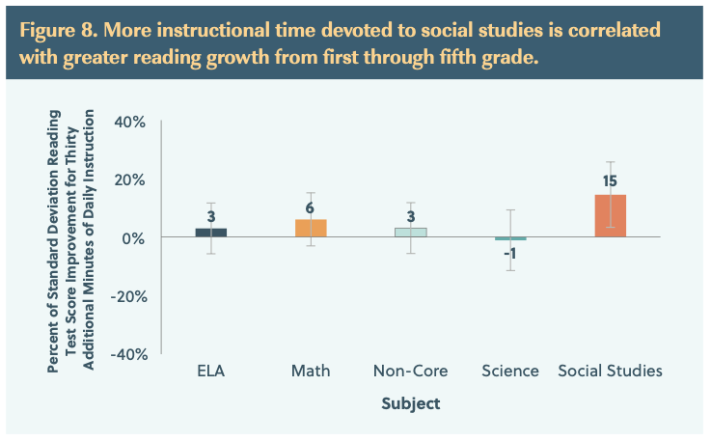
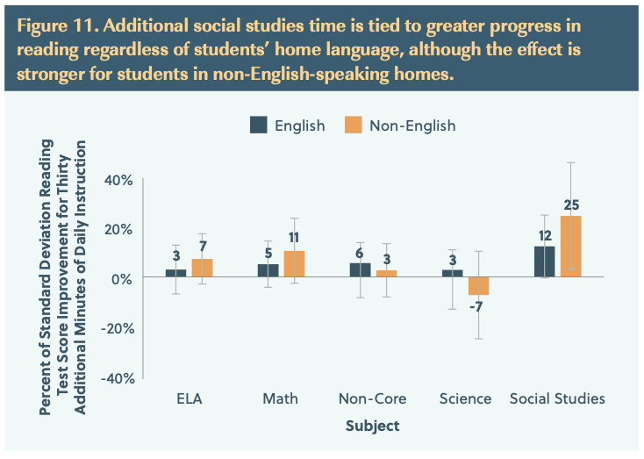
Social Studies (Civics) and Literacy
Notes:
Mya
SLIDE 16
PURPOSE: To demonstrate that we are not a one act play. There are serious benefits, onf of which is literacy rate. Regardless of how you slice it, the Fordham institute demonstrated the more time in social studies resulted in greater gains across gender, class, race, and language.
CONTENT: Literacy wins.

Slide 16
iCivics and Student Growth
Notes:
Mya
SLIDE 17
PURPOSE: To offer research about iCivics’ proven record. And to call back to the opening game.

Slide 17
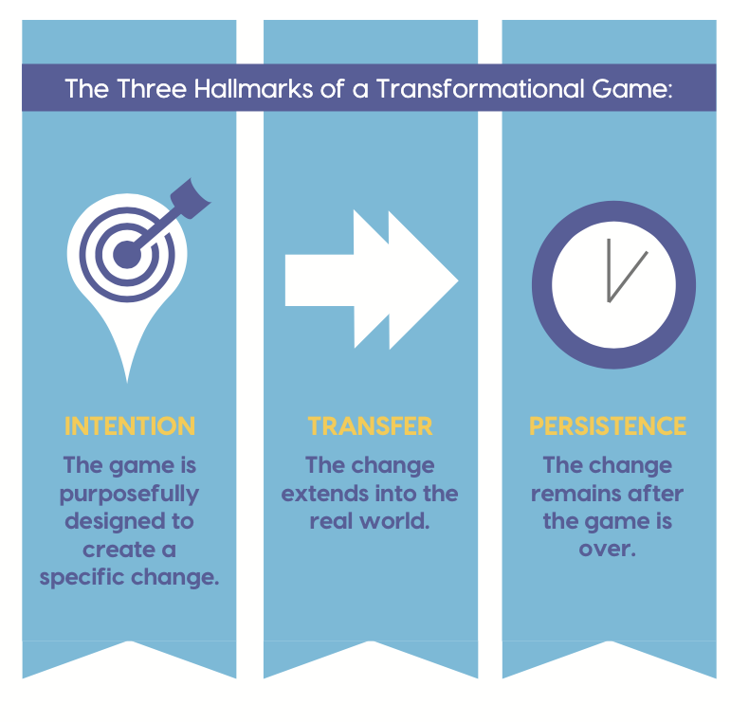
iCivics, Games, and Afterschool
Transformational Games are those games developed with the intention of changing players in a specific way that transfers and persists beyond the game.
Notes:
Mya
SLIDE 15
PURPOSE: To offer research. And to call back to the opening game with games of our own. Short and long term connections.
Culyba (2018). The Transformational Framework. Pittsburgh, PA: ETC Press

Slide 18
Civic Education and Afterschool Programs
Civic engagement leads to positive outcomes for youth and society.
Civic engagement is essential for a healthy democracy, but current levels are lacking, especially among young people.
Afterschool programs are uniquely positioned to promote civic engagement by providing hands-on experiences and fostering civic dispositions.
Notes:
Mya
SLIDE 19
PURPOSE: To recap. These are elements well known and now let’s show a bit of how iCivics fits.

Slide 19
Agenda
Here’s what we’ll explore together:
Who is
iCivics?
Why use
iCivics in afterschool programs?
How can iCivics support afterschool programs?
Notes:
Ryan
SLIDE 20
PURPOSE: Setting up Act III

Slide 20
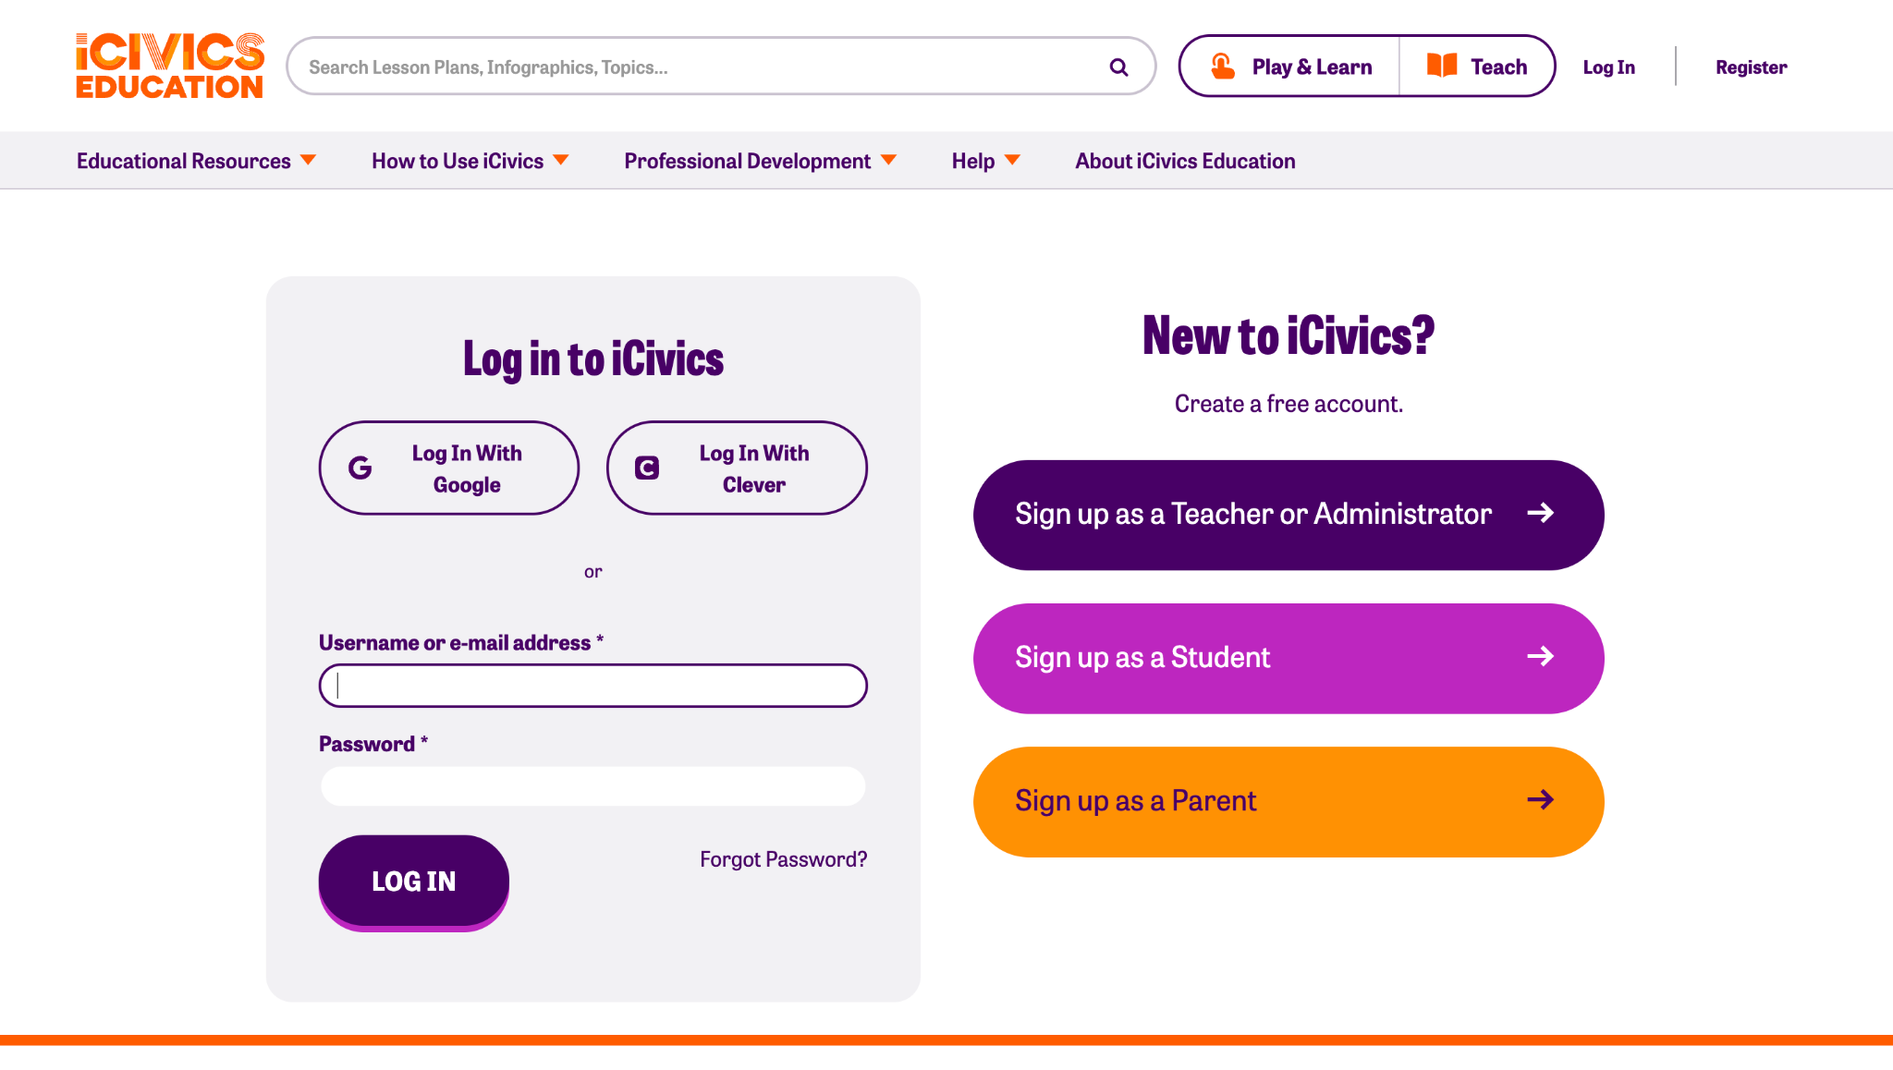
Register for your FREE account today!
Want to Sign in with Google?
Click Here!
Click “Log In”
Notes:
Ryan
SLIDE 21
PURPOSE: An iCivics Account is free, and you’ll be able to access all of the instructional resources online!

Slide 21
Units
Lesson Plans
Games
Videos
WebQuests
Simulations
Infographics
DBQuests
Notes:
We have more!

Slide 22
Units
Lesson Plans
Games
Videos
WebQuests
Simulations
Infographics
DBQuests
Notes:
We have more!

Slide 23
Let’s play some GAMES!
Notes:
Ryan
SLIDE 22
PURPOSE: We’ll start with the games

Slide 24
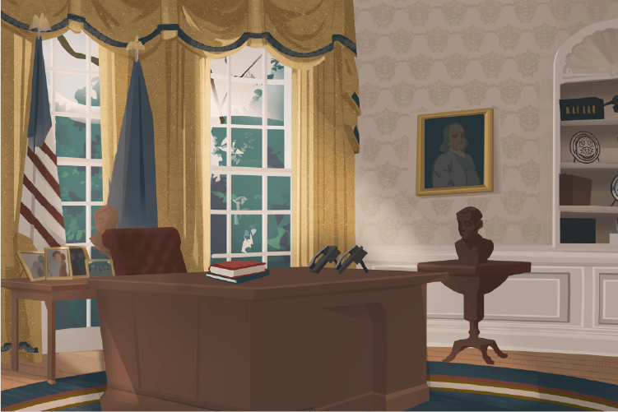
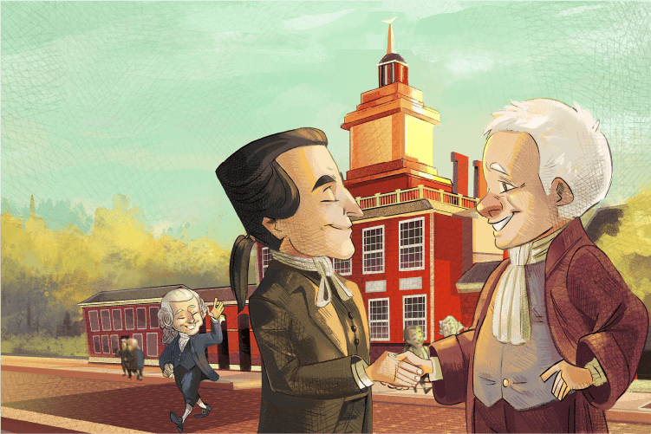
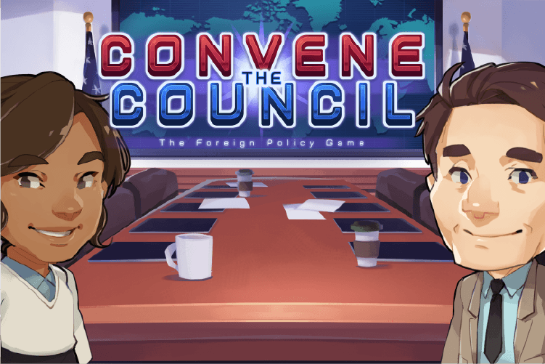
Argument Wars
Branches of Power
Brief the Chief
Cast Your Vote
Constitutional Compromise
Convene the Council
Counties Work
Court Quest
Do I Have a Right?
Executive Command
Immigration Nation
Law Craft
Neighborhood Good
NewsFeed Defenders
People’s Pie
Race to Ratify
Sortify: U.S. Citizenship
Win the White House
Notes:
Ryan
SLIDE 23
PURPOSE: A host of games with different goals. Students can work individually or together. Can play multiple times with different outcomes.

Slide 25
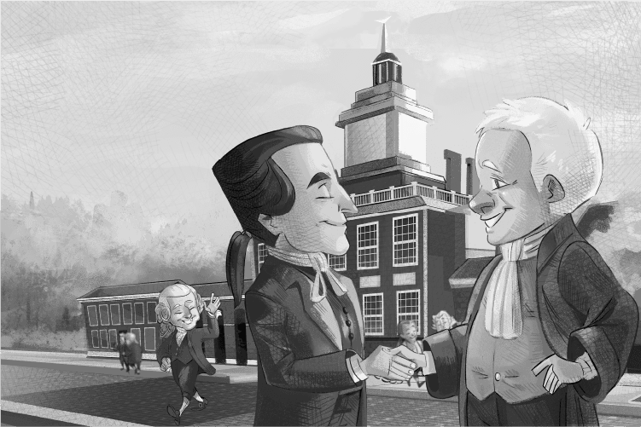
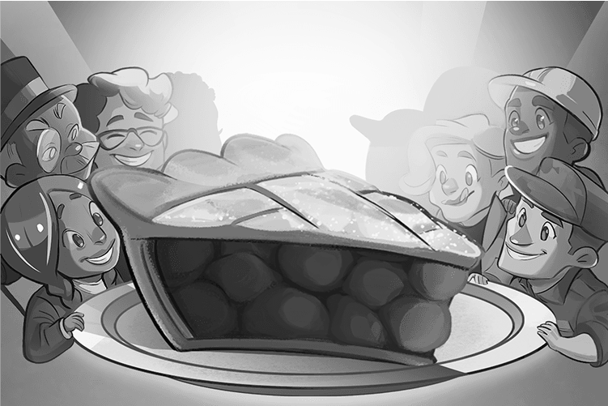
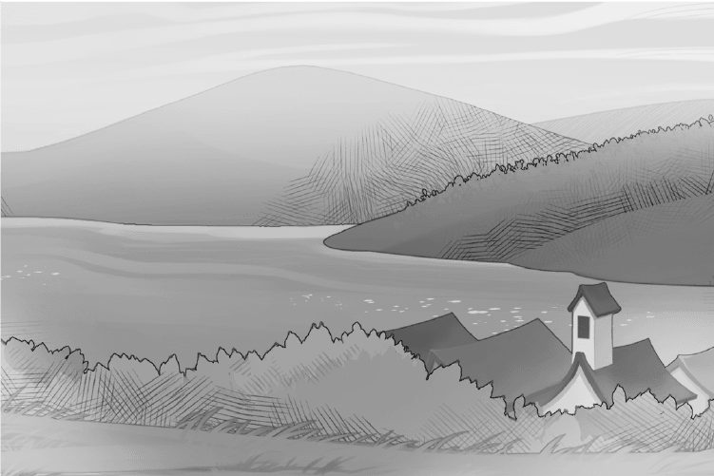
Argument Wars
Branches of Power
Brief the Chief
Cast Your Vote
Constitutional Compromise
Convene the Council
Counties Work
Court Quest
Do I Have a Right?
Executive Command
Immigration Nation
Law Craft
Neighborhood Good
NewsFeed Defenders
People’s Pie
Race to Ratify
Sortify: U.S. Citizenship
Win the White House
Notes:
Ryan
SLIDE 24
PURPOSE: Narrowing down to three to select for yourselves!

Slide 26
Games
Neighborhood Good
(Grades K-12)
Challenge your students to solve familiar problems and discover how they can impact their community by playing Neighborhood Good. Students will select issues within a fictional community that resonates with them, speak with neighbors to better understand the issue, and develop a plan of action. Students can address three different challenges or revisit a challenge to try different solutions. Show your students how civic engagement works as they discover the level of impact they can make.
Notes:
Ryan
SLIDE 25
PURPOSE: Door number 1: Intro the game!

Slide 27
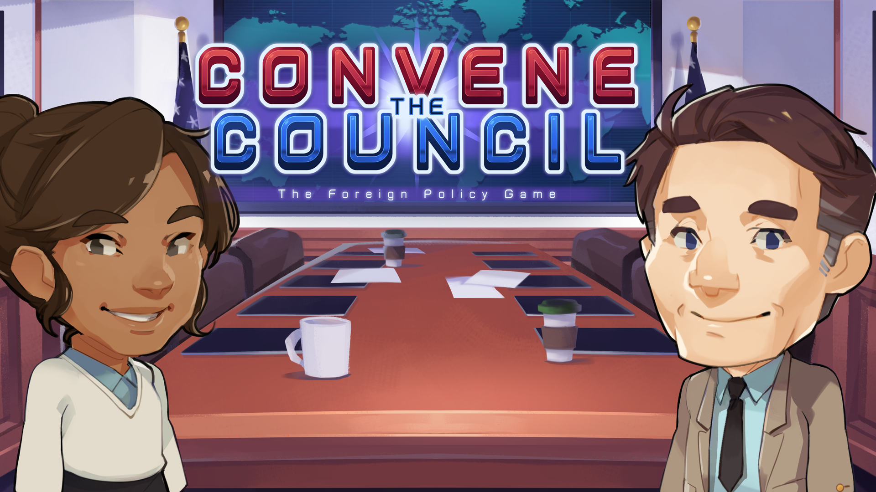
Games
Convene the Council
(Grades 6-12)
In Convene the Council, your students will take on the role of president of the United States and discover why foreign policy matters. They will engage with members of the National Security Council to weigh the pros and cons of various policy options and make foreign policy decisions. They will address international crises through strategic action and work to improve core metrics of U.S. prosperity, values, security, and world health.
Notes:
Ryan
SLIDE 26
PURPOSE: Door Number 2…. Intro the game!

Slide 28
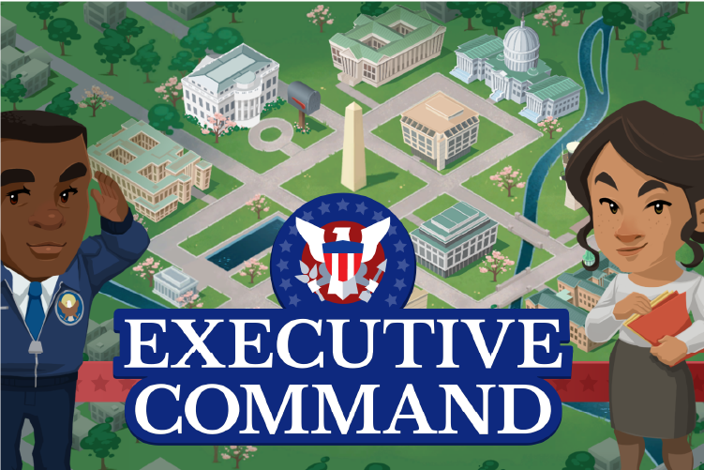
Games
Executive Command
(Grades 6-12)
In Executive Command, they can be president for four years! Being commander in chief and chief executive is no easy job! Students must strategically balance running a government and accomplishing their agenda with the challenges and responsibilities that crop up along the way. They will propose an agenda to Congress, sign bills into law, delegate new laws to the appropriate federal agency, handle international diplomacy, and command the military during times of war.
Notes:
Ryan
SLIDE 27
PURPOSE: Door Number 3…. Intro the game!

Slide 29
Games
Neighborhood Good
(Grades K-12)
Convene the Council
(Grades 6-12)
Executive Command
(Grades 6-12)
Notes:
Ryan
SLIDE 28
PURPOSE: Quick Recap of the three.

Slide 30
Small Group Exploration!
Pick a partner(s)
Select 1 game to play test.
Play for 10 min.
Reflect on the following questions (5 min.)
What was your experience like?
What do you think your afterschool students will like?
Notes:
Ryan
SLIDE 29
PURPOSE: To dig in!

Slide 31
Questions
& Answers
Notes:
Mya/Ryan
SLIDE 30
PURPOSE: Door Number 2…. Intro the game!

Slide 32
Come for the games…
Stay for the 400+
fun, effective,
and free
learning resources
Notes:
Often we see our teachers fall in love with iCivics for our games, but we want to make sure you mind them that there are so many additional resources to truly support their classroom instruction. I’m going to walk through our different types of resources,

Slide 33
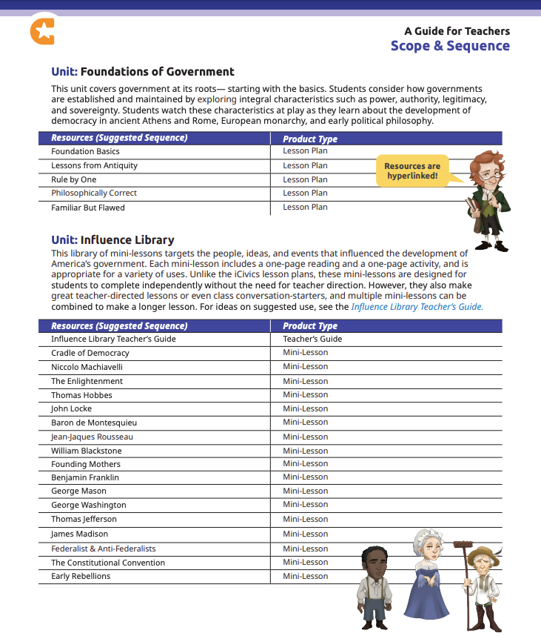
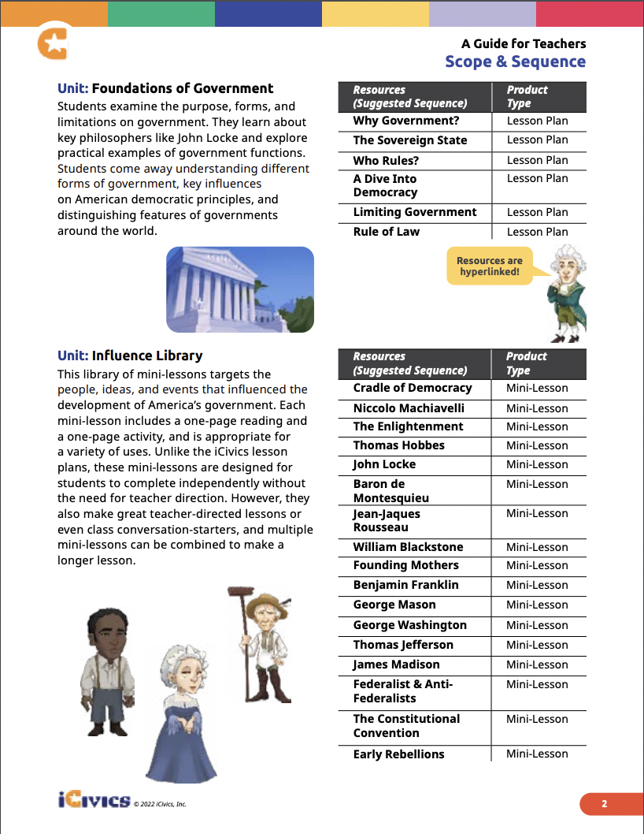
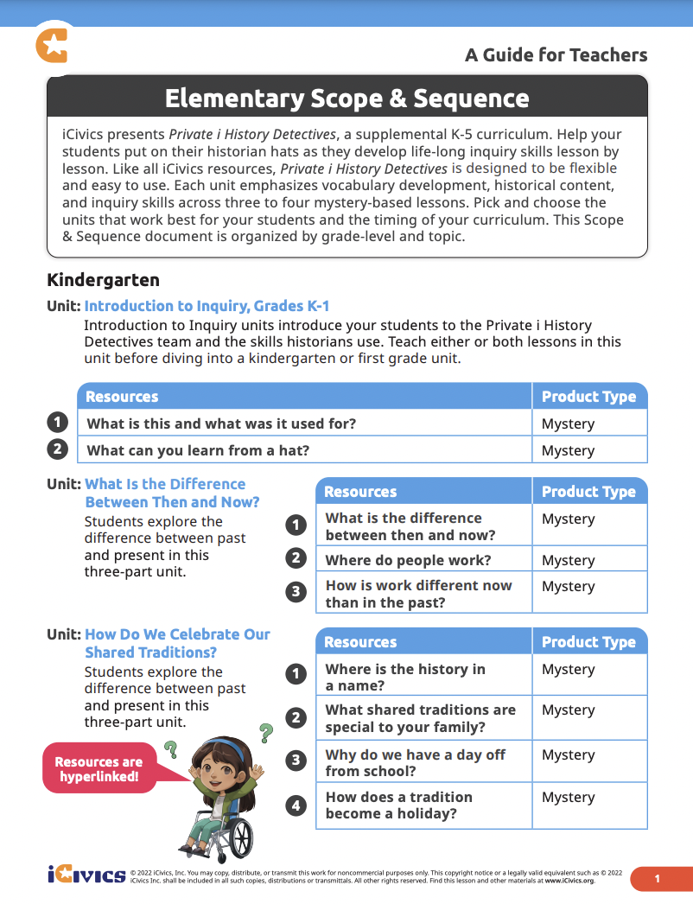
Explore Our Scope & Sequence
Lists all of our resources organized into units
ELEM: over 50 mystery lessons
MS: over 250 lesson plans into 21 units
HS: over 100 lesson plans into 17 units
All resources are hyperlinked
Pick & choose what works best for your students!
icivics.org/scope-sequence
Notes:
Ryan
SLIDE 30
PURPOSE: Show wrap around support.

Slide 34
Mark your calendar (immediately)!

Slide 35
Join our community!
Search for iCivics

Slide 36
Thank You!

