Slide 1

Celebrating Afterschool Professionals and Advocating for Your Program

Slide 2

Shining the Light on Afterschool Professionals
Celebrate Afterschool Professionals
April 21-25, 2025
Afterschool Professionals Appreciation Week (APAW) is a time to recognize, appreciate and advocate for those who work with young people during out-of-school hours.

Slide 3

Shining the Light on Afterschool Professionals
The week is marked by celebrations, public relations, and advocacy efforts encouraging appreciation and support for afterschool professionals who make a profound difference in the lives of youth.

Slide 4
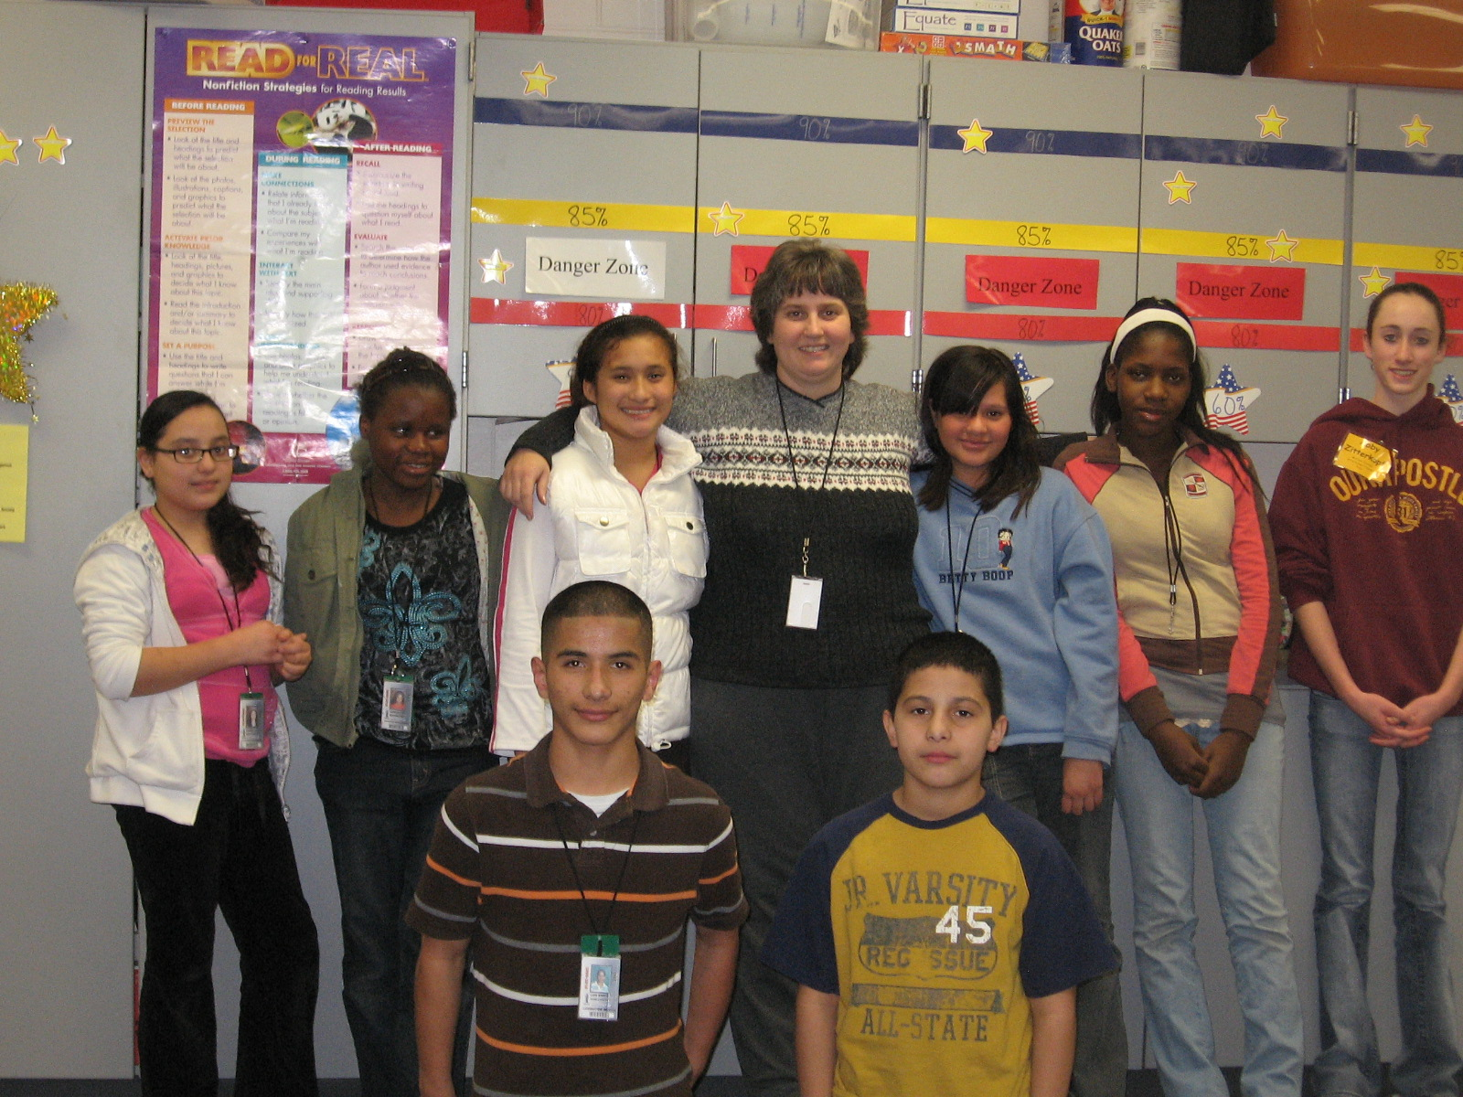
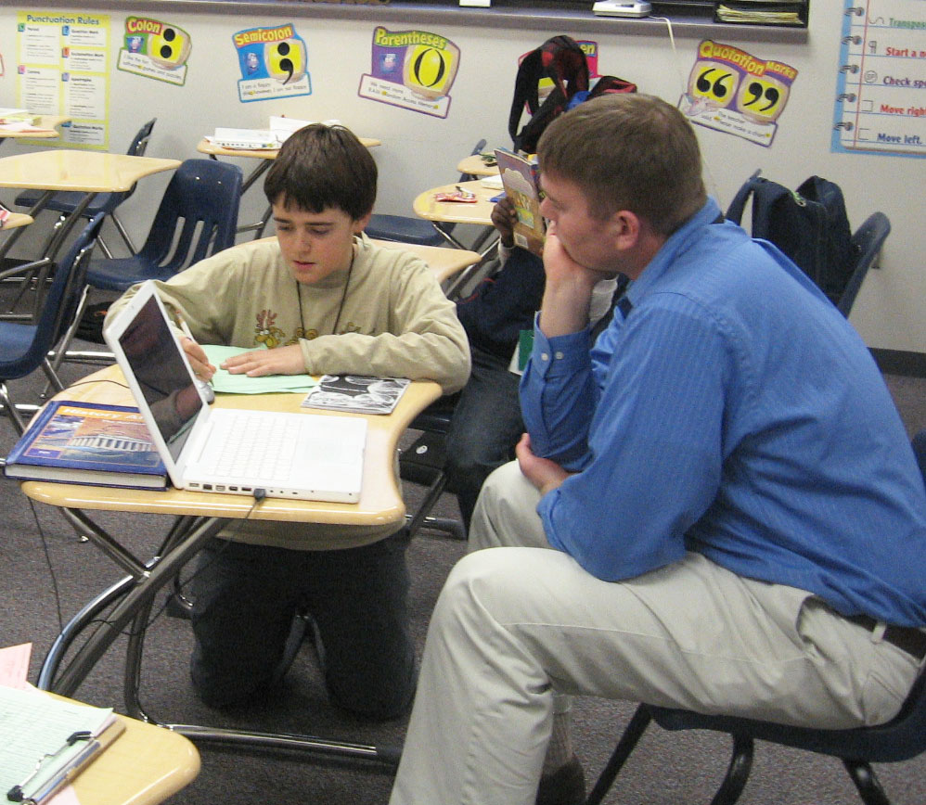
Shining the Light on Afterschool Professionals
Celebrating Afterchool Professionals Week in April is a great way for afterschool programs to recognize and appreciate the dedicated staff who make a difference in student’s lives everyday!

Slide 5
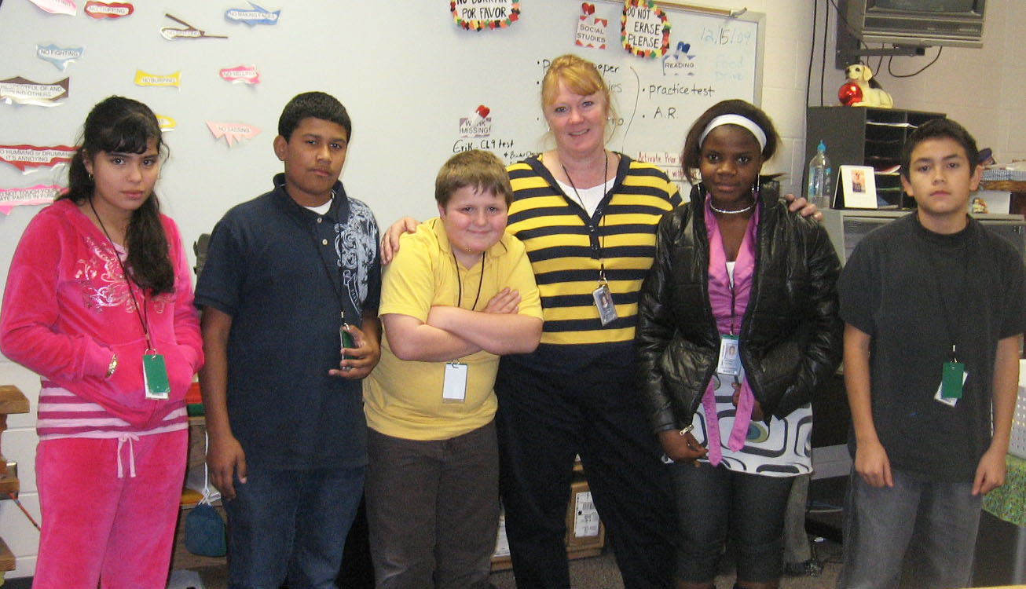
Why Celebrate?
Recognize and appreciate afterschool professionals
Helps with staff retention and motivation
Raises awareness as it helps shine a light on their contributions
Helps strengthen community engagement by bringing attention to the role afterschool staff play
Helps inspire staff to consider careers in education or youth development

Slide 6
Q. What creative ways have you recognized afterschool professionals?
Q. What keeps you from celebrating Afterschool Professionals Week?
Q. If you have recognized your staff, what difference has it made?

Slide 7
Ways to Celebrate…
Host a staff appreciation event or luncheon
Share “thank you” messages from students and parents
Feature staff spotlights on social media
Provide small tokens of appreciation (certificates, gift cards, etc.)
Encourage local officials to use a proclamation recognizing the week.

Slide 8
Resources:
*Thank you card.
*Flyers/graphics on NAA website.

Slide 9

Lights on Afterschool…. start planning now
Launched in October 2000, Lights On Afterschool is the only nationwide event celebrating afterschool programs and their important role in the lives of children, families and communities.

Slide 10
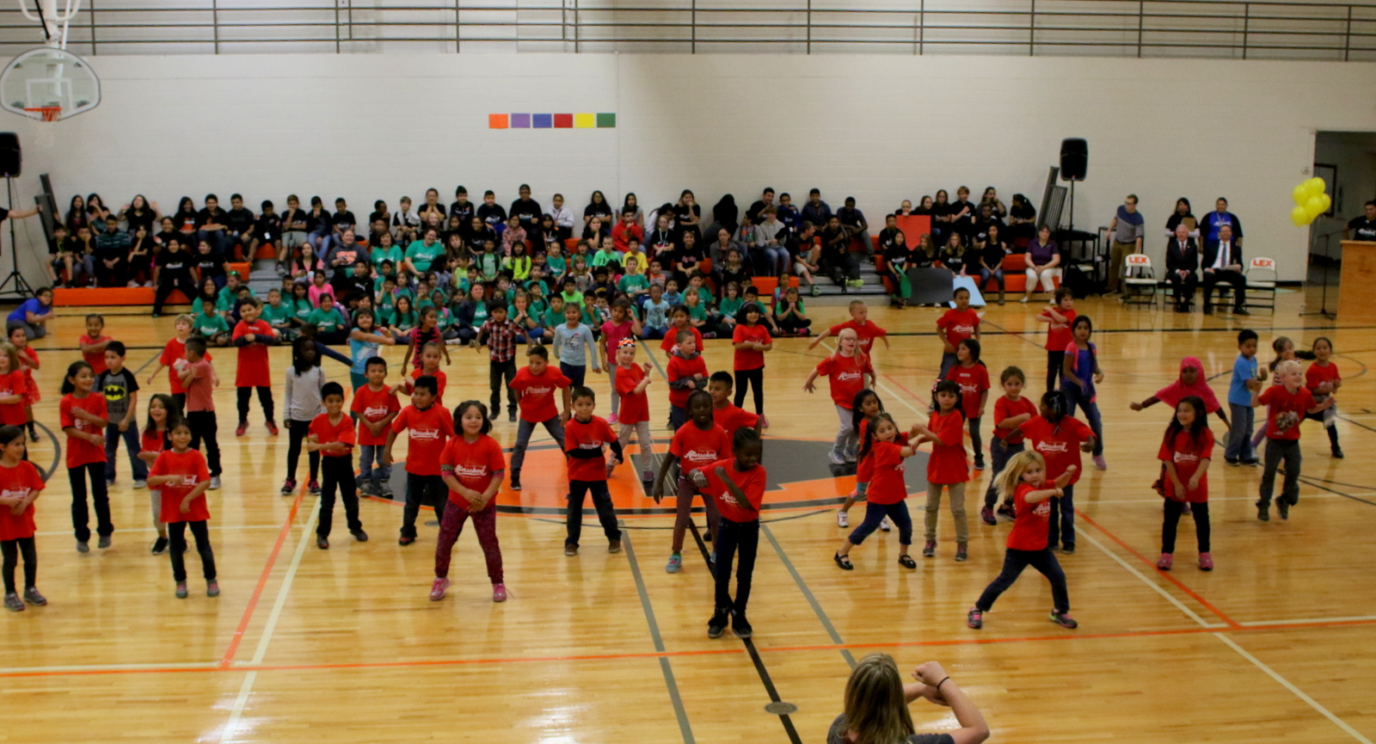
Lights on Afterschool…. start planning now
The Afterschool Alliance organizes Lights On Afterschool to draw attention to the many ways afterschool programs support students by offering them opportunities to learn new things! The events send a powerful message that millions more kids need quality afterschool programs.

Slide 11
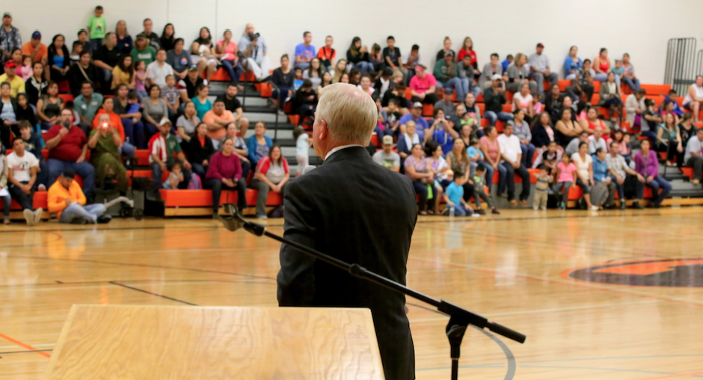
Lights on Afterschool…. start planning now
We want to encourage you to use Lights On Afterschool to raise awareness about the importance of afterschool programs and feature policymakers, local officials who advocate for increased funding and policy support!
Family Night or Lights on Afterschool?

Slide 12

Planning a Lights on Afterschool Event….
1. Set Clear Goals
Setting clear goals is crucial for ensuring your LOA event has direction and purpose.
Q. What objectives do you have for your LOA based on your desired outcomes?

Slide 13

Afterschool Rally:
Give Big Lexington

Slide 14
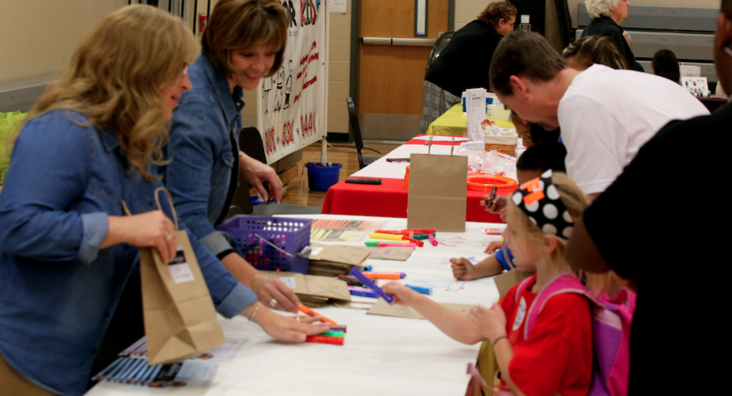
Expo:
Goal=Seek New Partners

Slide 15
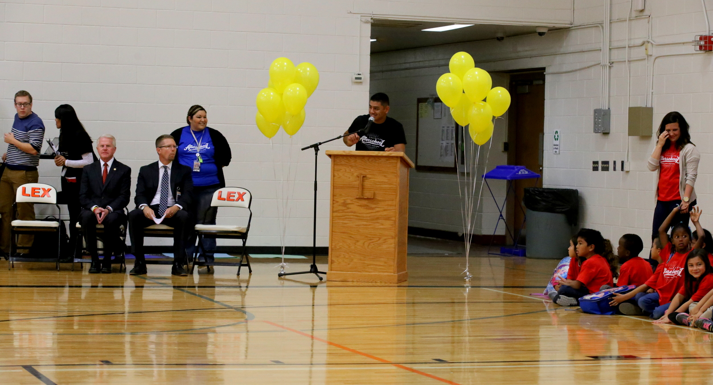
Planning a Lights on Afterschool Event….
2. Choose the Event Format
Q. What are some creative formats do you have to engage your community and showcase the impact of afterschool programs?

Slide 16

Planning a Lights on Afterschool Event….
3. Pick the Right Date and Time
*LOA typically happens in October, but make sure the date works for your community and school schedules
Q. Has anyone hosted a LOA on different day other than the fourth Thursday in October? If yes, did was it successful?

Slide 17
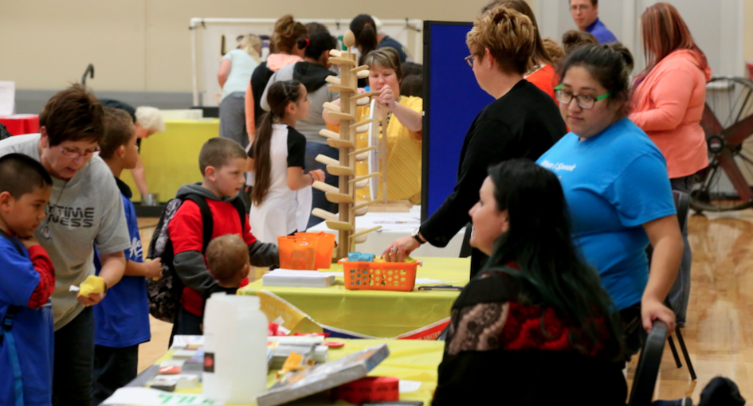
Planning a Lights on Afterschool Event….
4. Plan the Logistics
Planning the logistics is crucial in making sure everything runs smoothly.
Q. Using the planning guide, what other logistics should be considered when planning a LOA event?

Slide 18
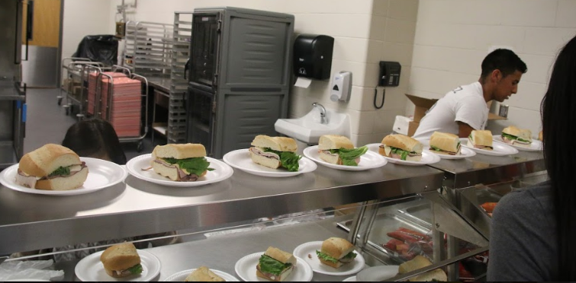
Reception:
Easy-to-Serve Meal
(sandwich, chips, cookie, drink)

Slide 19
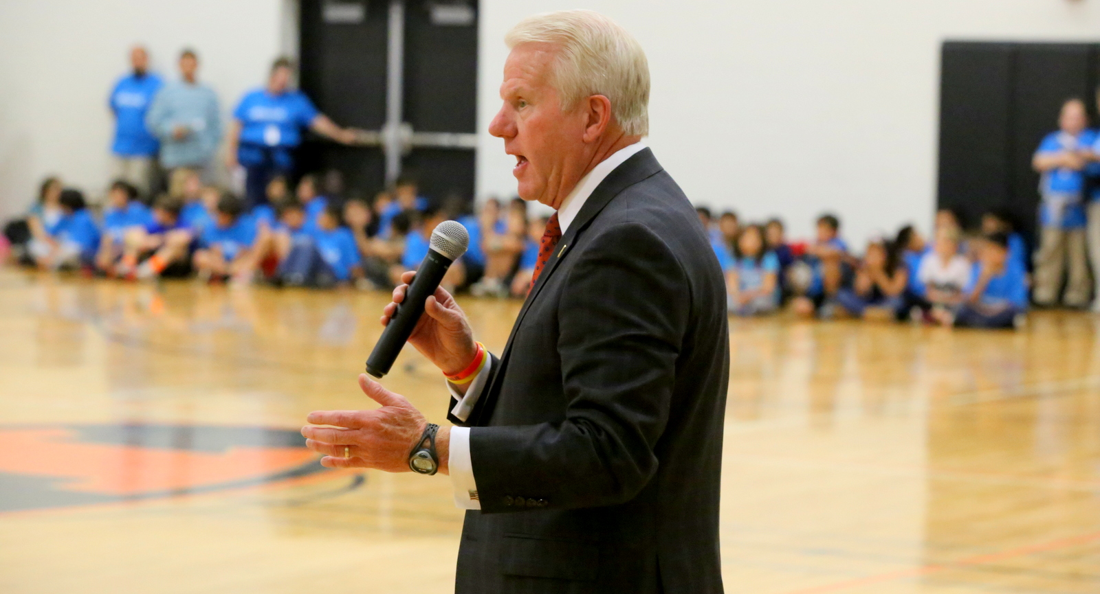
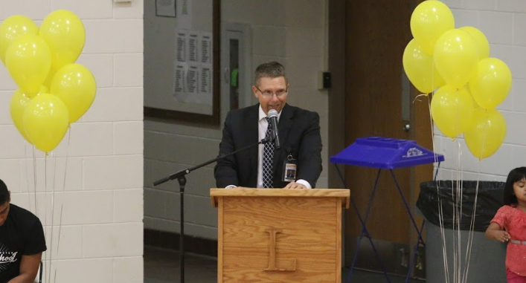
Planning a Lights on Afterschool Event….
5. Engage Stakeholder and Partners
Q. What approaches have you taken to engage local leaders or organizations in your event?

Slide 20
Planning a Lights on Afterschool Event….
6. Promote the Event
Promoting a LOA is key to ensuring strong attendance and community involvement.
Q. What successful strategies have you implemented to promote any event in your community?

Slide 21
Planning a Lights on Afterschool Event….
7. Involve the Students
Involving students in the planning and execution of a LOA is a great way to empower them and showcase their talents.
Q. How can we engage our students in a future LOA event?

Slide 22
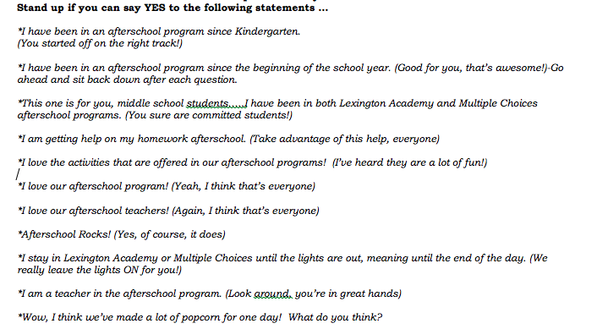
Afterschool Rally:
“Popcorn Activity”

Slide 23
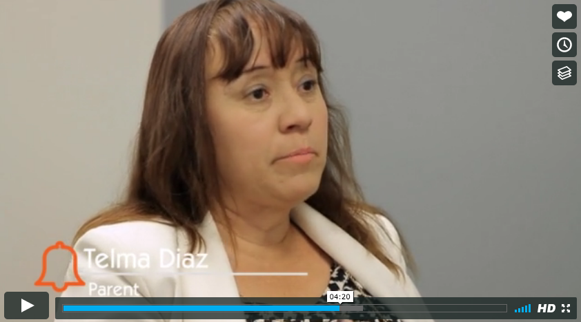
Planning a Lights on Afterschool Event….
8. Celebrate Success and Impact
Celebrating the success and impact of afterschool programs during an LOA is a great way to highlight the value of your program.
Q. What are some ways you can celebrate and highlight the impact?

Slide 24
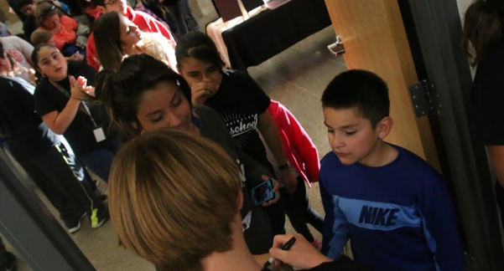
Reception:
Track Attendees=Meals Served
600+ participants

Slide 25
Planning a Lights on Afterschool Event….
9. Evaluate the Event
Evaluating your LOA event is important to understand what worked well, what could be improved and how the event impacted your goals.
Q. What are some ideas on you can evaluate your event effectively?

Slide 26
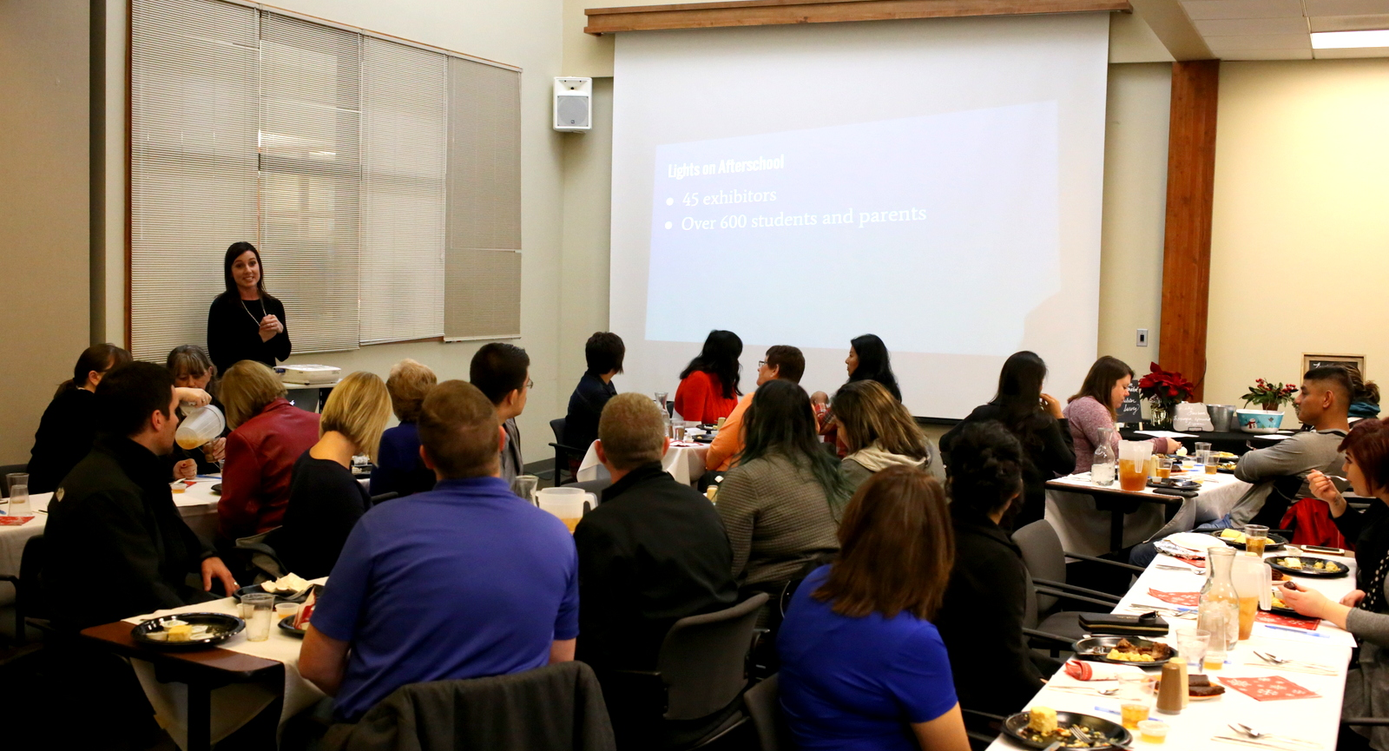
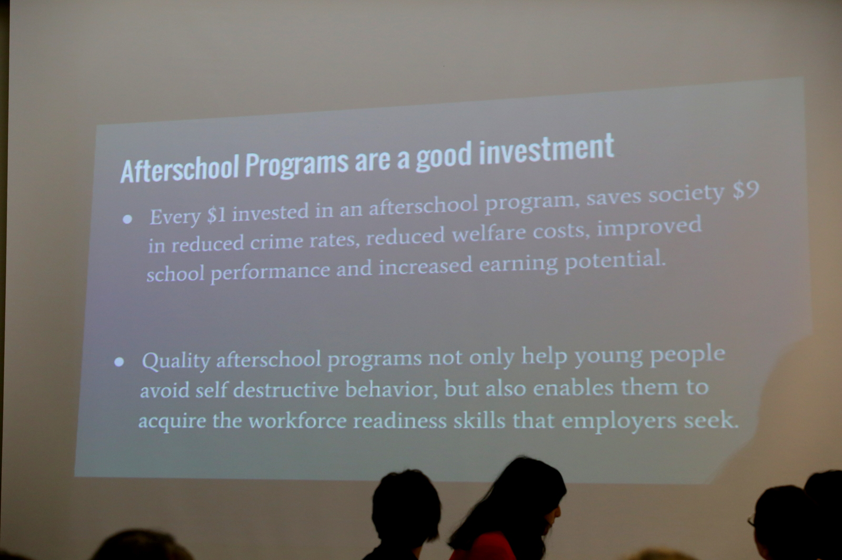
Planning a Lights on Afterschool Event….
10. Document the Event
Documenting your LOA event is great way to capture the impact of the event and use the materials for future promotion or reporting.
Q. What ideas do you have to effectively document the event?

Slide 27
Why was it worth it?
Builds awareness of the importance of afterschool programs to all stakeholders.
Able to inform all stakeholders your program needs.
Brings the school-community together.
Increases family time with children.
Increased community support.

Slide 28
Questions?
Patricia Sanchez-Stewart, Beyond School Bells

