Slide 1


Promoting
PHYSICAL HEALTH and teaching
POSITIVE VALUES through Future Kids programs
RESPECT-RESPONSIBILITY-TEAMWORK-SPORTSMANSHIP
LEADERSHIP-DETERMINATION

Slide 2
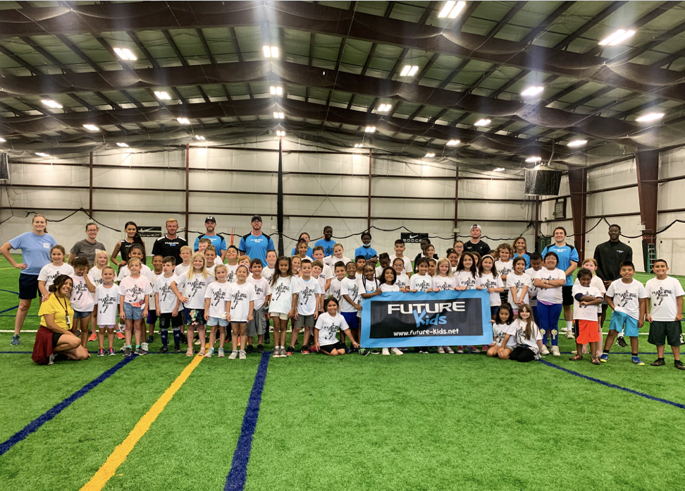
Welcome
Nebraska’s largest after school sports program.
Soccer, Tennis, Fitness and Esports
Over 60 schools, serving 1,000 youth
*Meet the team*

Slide 3
The Start of Future Kids
2017 – 1st Omaha school programs
New sports added
Expansion into rural communities
Physical activity and values

Slide 4
The value of Sports
Sports activity helps children develop and improve:
Cognitive skills
Academic achievement
Grades, test scores
Attitudes and academic behavior
Concentration, attention, and improved classroom behavior.
*Nationwide Study by Piche, 2014.

Slide 5
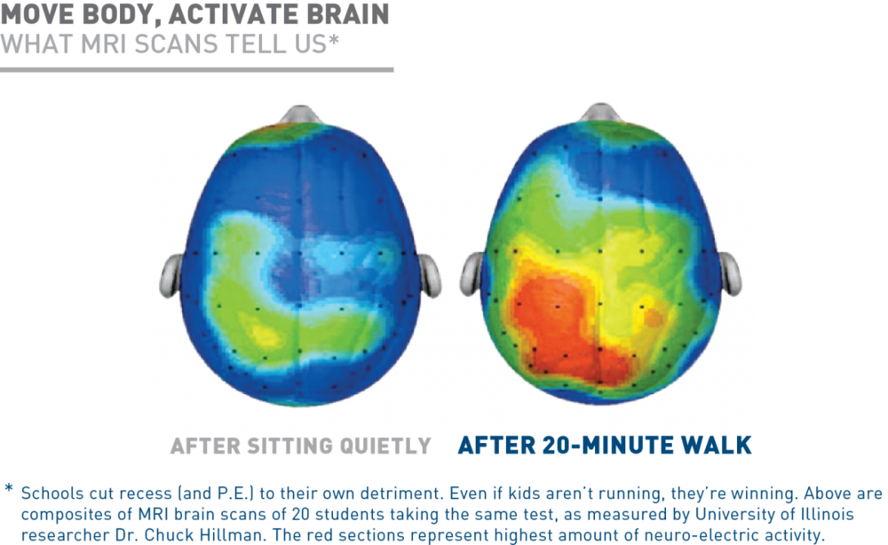

Slide 6
How does exercise impact kids
Exercise improves alertness, attention, and motivation.
It prepares nerve cells for logging in new information.
It spurs the development of new nerve cells from stem cells in the hippocampus.
In short, not only does exercise help the brain get ready to learn but it makes retaining information easier.
*Dr. John Ratey – Harvard Medical School

Slide 7
Habits for life
Youth Sports participation is a significant predictor of further adult participation in sports and physical fitness activities.
Children who play sports are eight times as likely to be active at age 24 as children who do not play sports*.
* Sports Participation as Predictors of Participation in Sports and Physical Fitness Activities in Young Adulthood, Perkins, 2004.

Slide 8
The value of Exercise
Regular exercise helps build and maintain healthy bones, muscles, and joints; controls weight, reduces fat; lowers blood pressure.
A nationwide study found that physical activity is associated with reduced risk of 13 different types of cancer*.
*National Institutes of Health, 2016

Slide 9
Childhood obesity
In the past 30 years, the rate of childhood obesity has increased considerably, almost tripling for children aged 6 to 11 years.
A study in the Journal of American Health also shows that sport motivates people to be physically active more than individual exercise plans.*
*Kilpatrick, Journal of American Health

Slide 10
Building Self Esteem
Participation in sports can positively affect aspects of personal development among young people, such as self-esteem, goal-setting, resilience and leadership.
However, government studies show that the quality of coaching is a key factor in maximizing these positive effects*.
* Government Accountability office 2012

Slide 11
Creating a positive future
Future Kids believes that all children, regardless of zip code or ability, should have access to regular sport activities, quality coaching, and positive role models.
The physical, mental, social, emotional, cognitive and academic benefits associated with youth sports are clearly documented.
Schools and their communities thrive when they promote policies and develop infrastructure that encourage sport and recreation activity.*
* Aspen Institute Project Play

Slide 12
Why do we need to teach kids positive values?
Now, more than ever, our children need guidance to make good decisions, be considerate of others needs, and to become respectful, reliable members of society.
Societal values are changing.
Dual working parents with less time to educate their kids.
Kids increasingly influenced by what they see on TV, online and in social media.
Underfunded and understaffed schools.
Lack of positive role models in underserved areas.

Slide 13
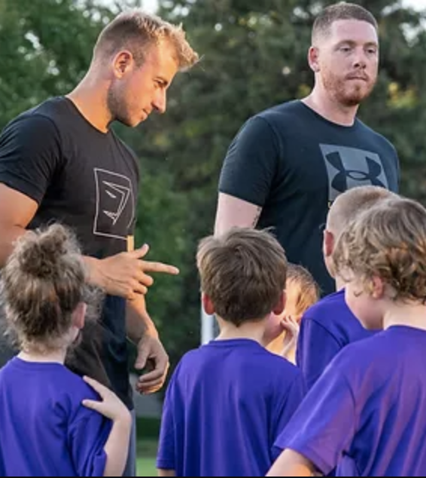
Sports gives us the vehicle to teach values, but……
Kids will not necessarily learn positive values and good character traits just by taking part in a sporting event.
Coaches need to intentionally explain and interpret positive moments, actions and decisions in a language that the kids can understand.

Slide 14
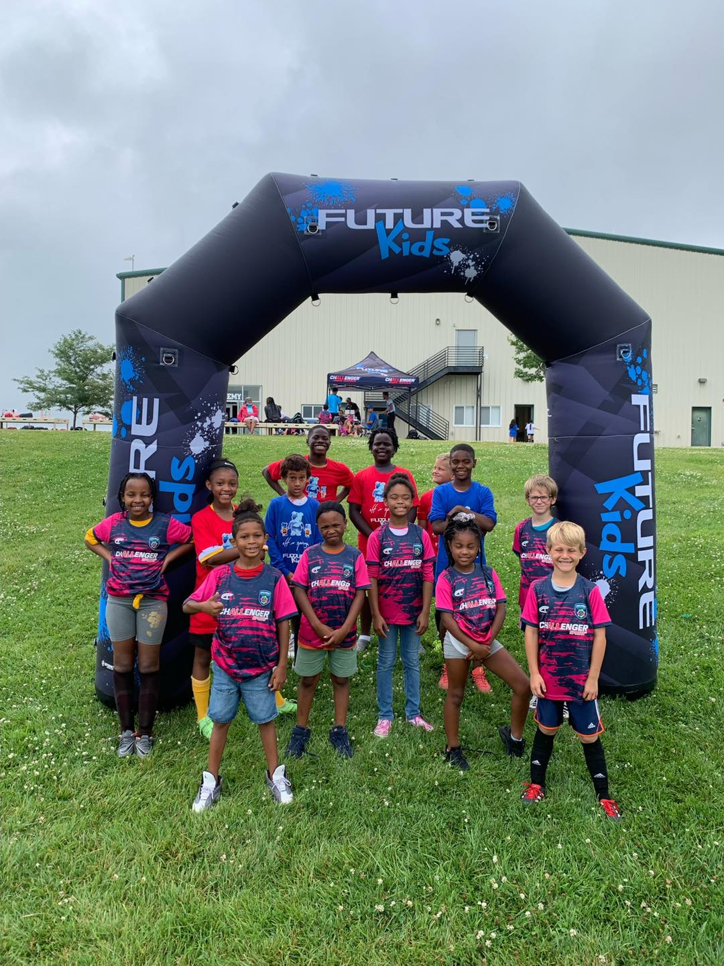
Through Sports, Future Kids teaches kids positive values
Engage kids in a fun and healthy sports activity.
Explain values in kid friendly terms that they will understand.
Reinforce positive values and behaviors within each session.

Slide 15

FUTURE KIDS VALUES FOR LIFE
RESPECT
RESPONSIBILITY
TEAMWORK
SPORTSMANSHIP
LEADERSHIP
DETERMINATION
Inspired by the NAIA Champions of Character initiative.

Slide 16
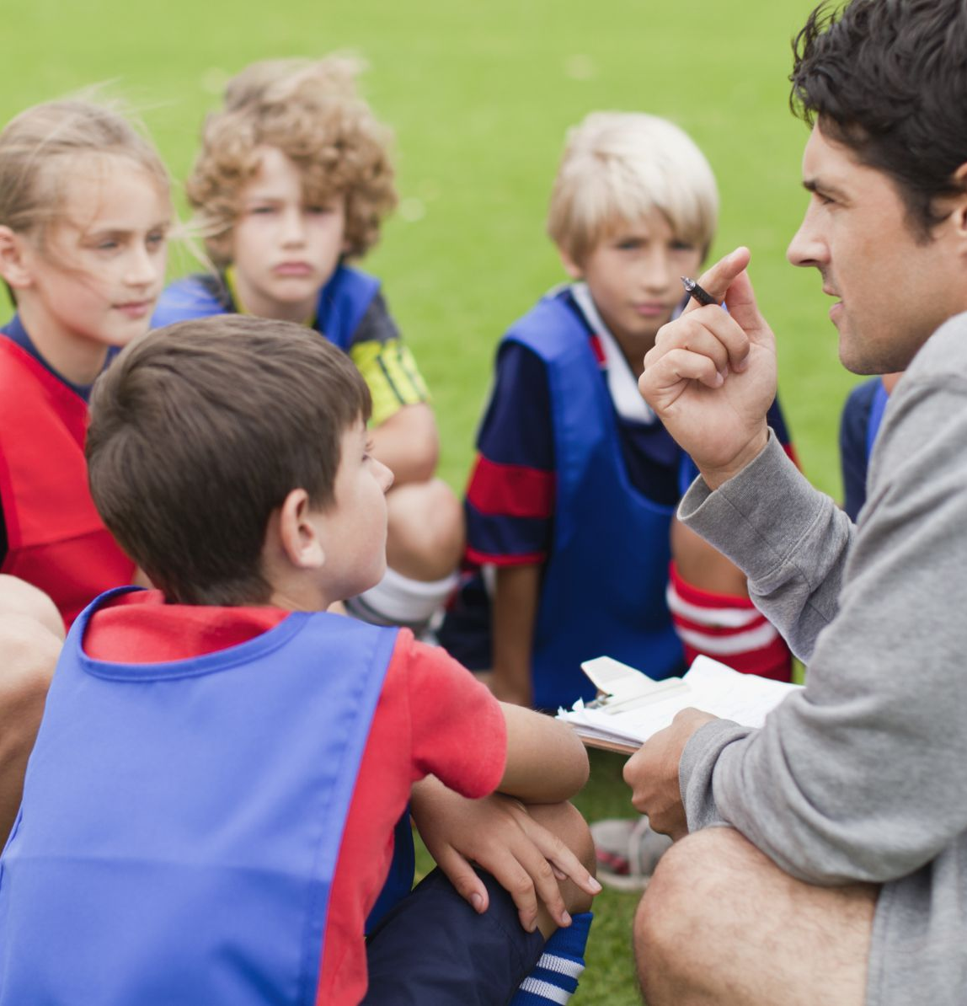
RESPECT
Definition: Treat people with courtesy, politeness, and kindness.
Example: Say “Please” when asking for something and “Thank You” when receiving it.
Future Kids Example: Look at your coach and don’t bounce your ball when they are talking to you.

Slide 17
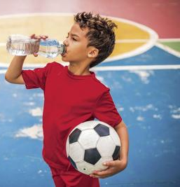
RESPONSIBILITY
Definition: Being dependable, making good choices, and taking accountability for your actions.
Example: Making your bed and brushing your teeth in the morning.
Future Kids Example: Showing up on time for practice with your ball, shin-guards and water bottle.

Slide 18
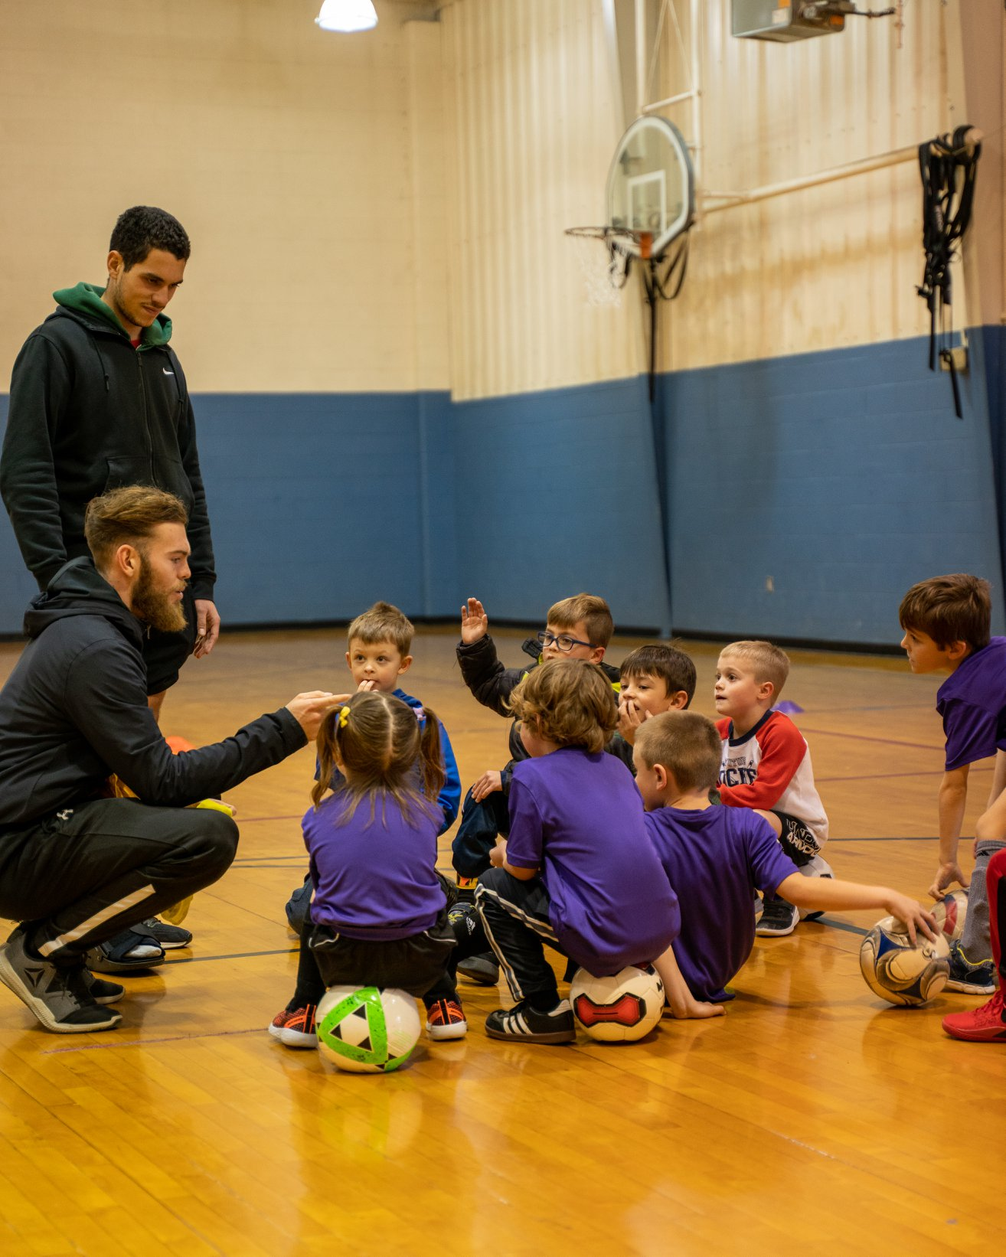
TEAMWORK
Definition: The process of working together with a group of people in order to achieve a common goal.
Example: Working with your friends collaboratively on a class project.
Future Kids Example: Even though you like to dribble the ball all the time, passing the ball to a teammate who is in space can can help your team score more goals.

Slide 19
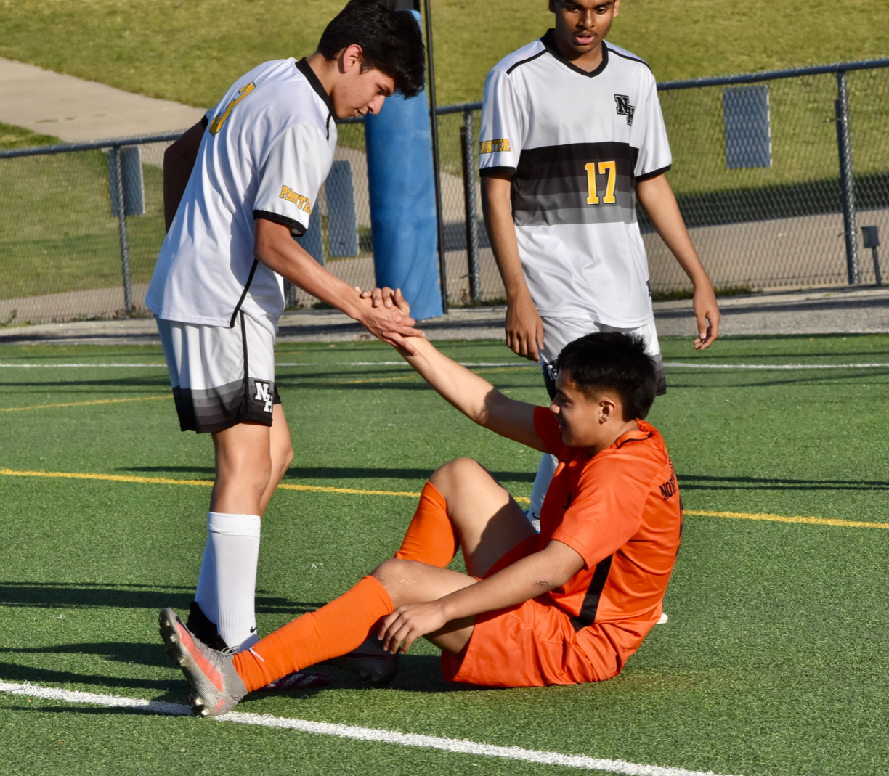
SPORTSMANSHIP
Definition: Fair and generous behavior, or treatment of others.
Example: Congratulating a classmate for winning the Spelling Bee or Science Fair, when you wanted to win.
Future Kids Example: Offering to help an opponent up after they have fallen during play.

Slide 20
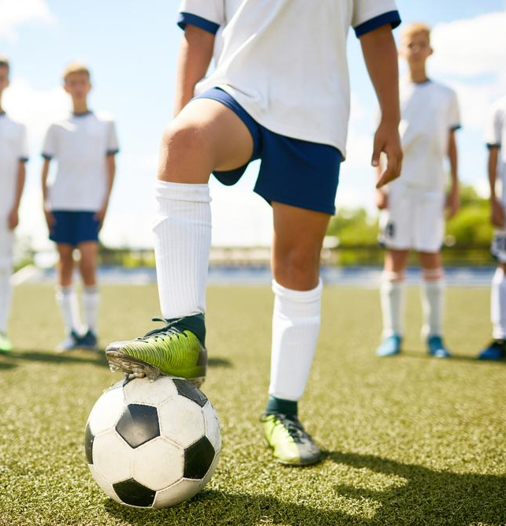
LEADERSHIP
Definition: Influence others to do better through your own examples and actions.
Example: Influence others to do better through your own examples and actions.
Future Kids Example: Set a good example with your behavior and effort at every practice and encourage your teammates.

Slide 21
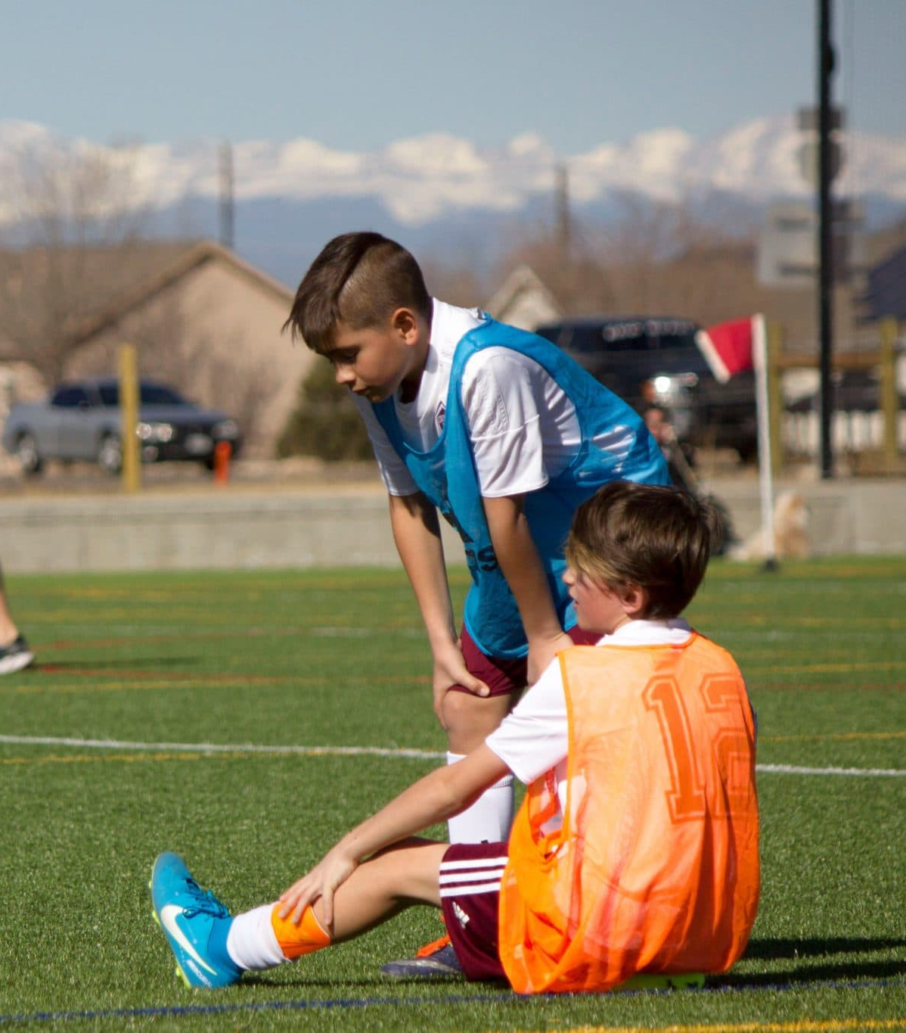
DETERMINATION
Definition: The will to work hard and not give up, even when things get tough.
Example: Be determined when you learn a new skill, or musical instrument – you will make mistakes at first but will master it in the end.
Future Kids Example: Keep running and trying your hardest even when your team is losing.

Slide 22
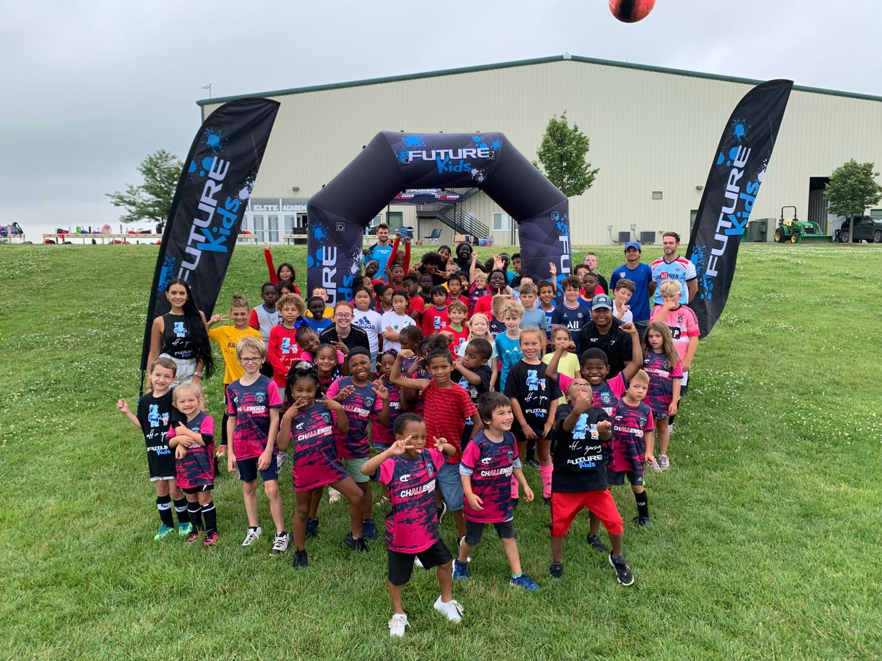
FUTURE KIDS PROGRAMS
Summer Camps
Spring/Fall/Winter Break Camps
School Fitness/Soccer/Sports Days
Physical Education Classes
After School Programs

Slide 23
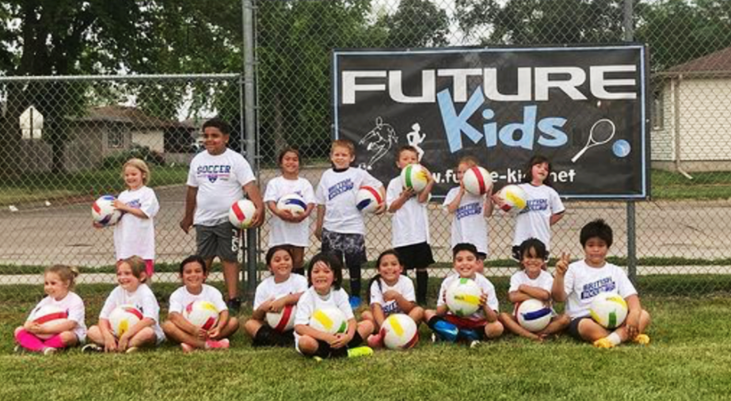
Q&A
Ask us anything!

Slide 24
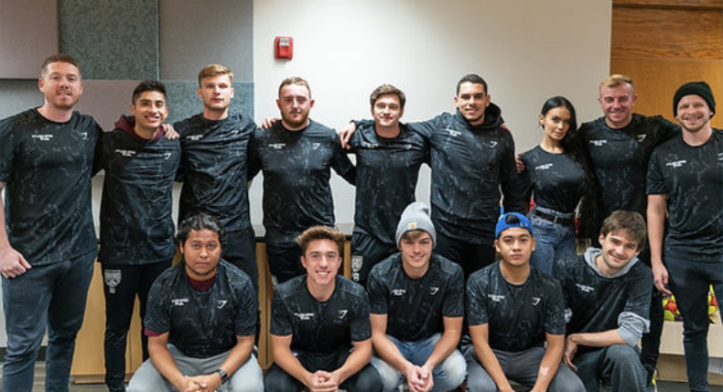
Contact Us
Phone: 402-215-3634
E-mail: graeme.eaglesham@future-kids.org
Website: www.future-kids.net

