Slide 1

WOODS TENNIS CENTER
LITERACY & LOBS FOR A LIFETIME
Kaitlin Roselius, PhD | Director of Community Outreach & Evaluation
Niki Figard | Youth Engagement Coordinator

Slide 2

AN OVERVIEW
  Who We Are - Woods Tennis Center
    Taking the Game to the Community Since 2008
  The Data - What We Know
  Introductions - Icebreaker
  Curriculum Teaser
    Literacy in the Classroom
    Movement on the Court
  Wrap-Up & Resources

Slide 3
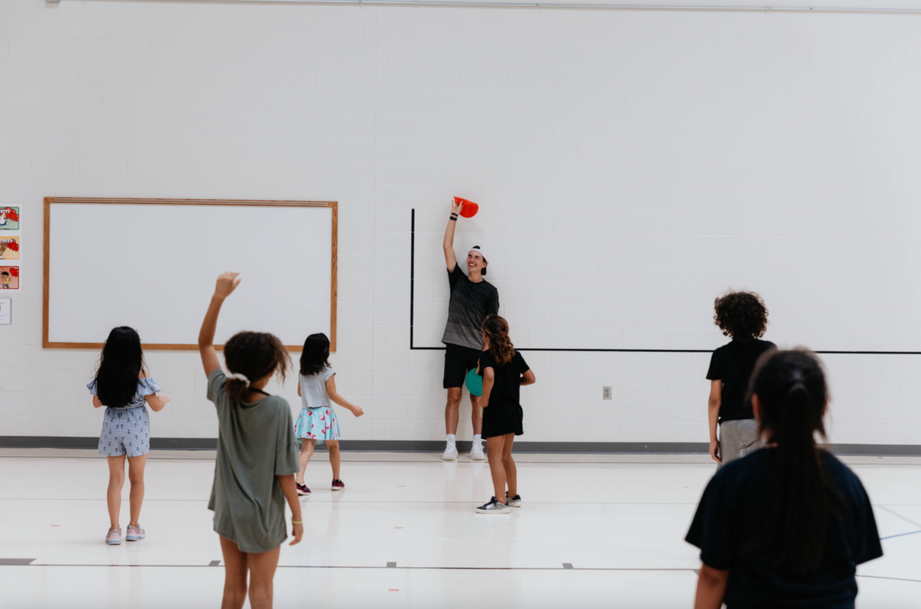
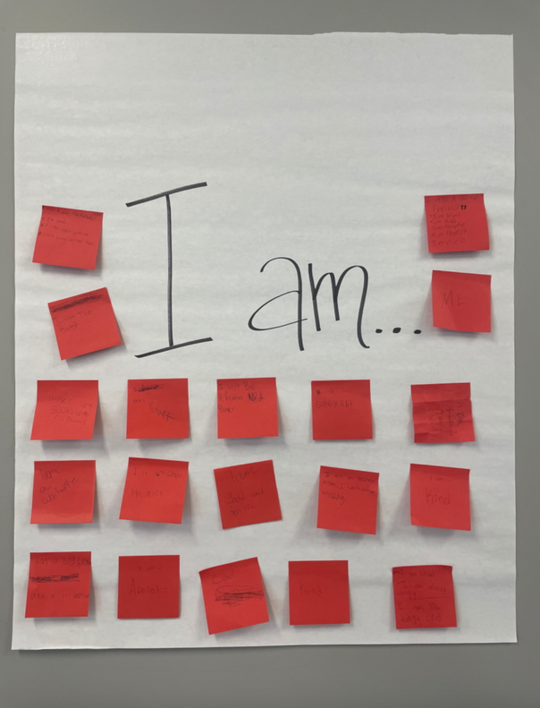
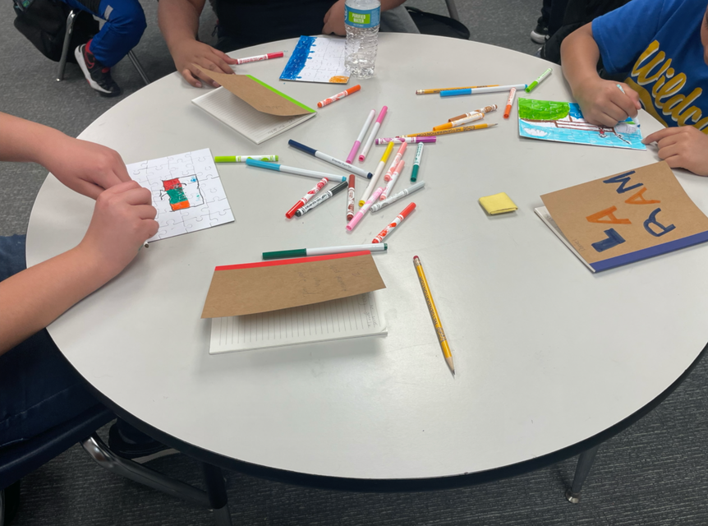
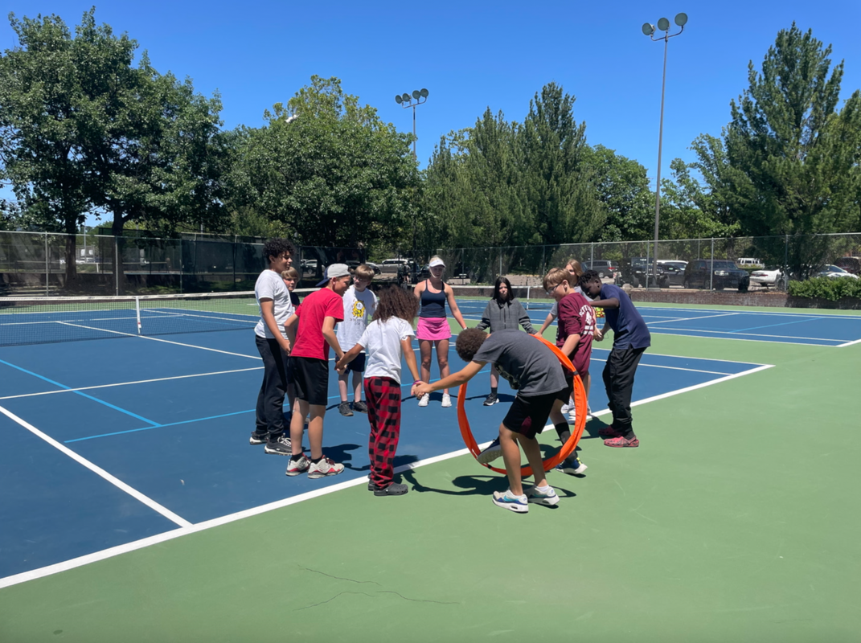
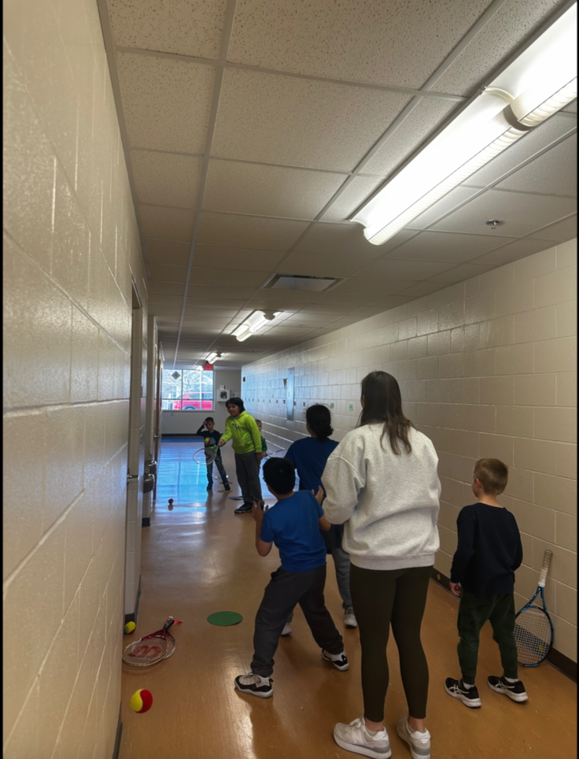
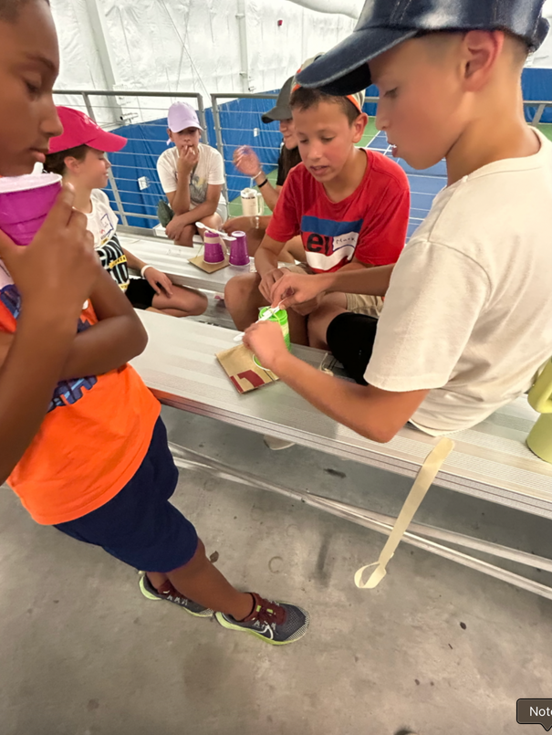
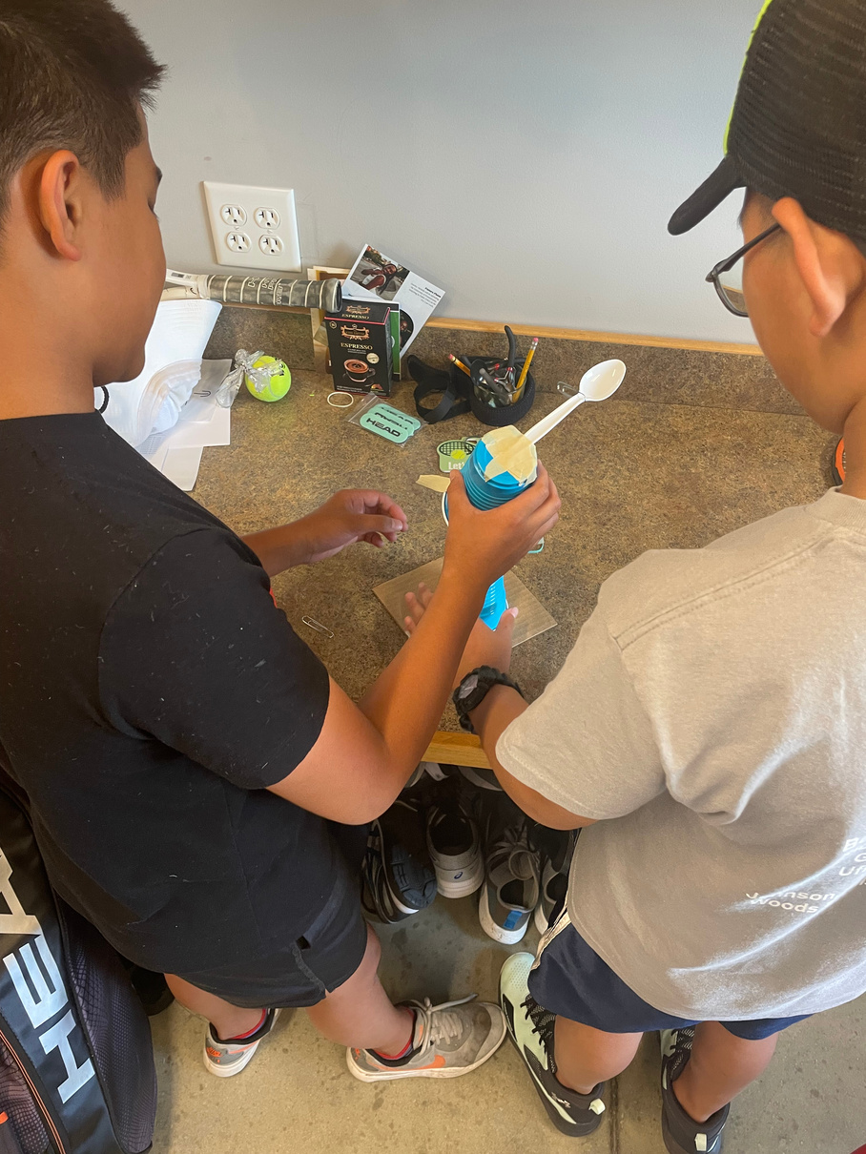

Slide 4

THE DATA
STATE OF LITERACY
A LIFETIME SPORT
  Only 59% of Nebraska students were found “On Track”
NSCAS in English Language Arts
  Improved physical, mental, and social health benefits
  Increased life expectancy
  For Youth:
    Character Development
    Decreased Risky Behaviors
    Better Academic Outcomes
    Increased Generativity
Benefits influence youth across all socioeconomic levels
STATE OF HEALTH
  Only 16.9% of census tracts met the goal of 80% of children passing the PACER
Lincoln, NE 2022-2023 year

Slide 5


STEP TO THE LINE IF...
You can count to ten in another language.
You like pancakes more than waffles.
You prefer reading a physical book over an e-book.
You have never played tennis before.
You participated in an afterschool program when you were a student.
You are excited to learn new ways to engage your students in literacy and movement.
ICEBREAKER - WHO IS IN THE ROOM?

Slide 6

TENNIS + LITERACY
=
AFTERSCHOOL FUN!
TEASER TIME!
CLASSROOM:
ON-COURT:
March Madness Meets
Monumental Models
Movement &
Tennis Basics

Slide 7

QUESTIONS?
LET’S CONNECT!
KAITLIN ROSELIUS | DIRECTOR OF OUTREACH & EVALUATION
kaitlin.roselius@gmail.com | (402) 304-3433
woodstenniscenter.com | (402) 441-7095
NIKI FIGARD | YOUTH ENGAGEMENT COORDINATOR
nikifigard@gmail.com

