Slide 1
Empowering Families with Findhelp:
Session #
Room C
Google Drive Folder #7
Empowering Families with Findhelp:
Connecting to Community Collaboratives

Slide 2
QUICK INTRO:
About Me:
Jen Hale
4.5 years at NCFF
Bring Up Nebraska Team
Findhelp Implementation TA Lead, Training Facilitator & Collaborative Sustainability Focus
Little known fact:
About Me:
Leonor Fuhrer
2.5 years at NCFF
Bring Up Nebraska Team
Central Navigation TA Lead, System Alignment for Tribal Systems, Prevention Systems Focus
Little known fact:

Slide 3
AGENDA:
Collective Impact
Strength in Numbers Activity
Community Collaboratives
Central Navigation
Findhelp Overview
How to Connect to Collaboratives using Findhelp

Slide 4
What is Collective Impact?
Collective impact is a very specific type of collaboration that brings together organizations and individuals to solve complex social issues.
“The secret…is to gang up on the problem, rather than each other.” - Thomas Stallkamp

Slide 5
Key Principals of Collective Impact
Common Goal or Agenda
Data-driven decision making/ Shared measurement
Mutually Reinforcing Activities
Continuous communication
Backbone Organization

Slide 6
Strength in Numbers Activity
Notes:
It takes a collective network of services working together to fully support families in crisis. Let’s see what that looks like in action! But first, I need a volunteer! You will be a food pantry organization for this example and the next.

Slide 7
Meet the Arreguin Family
Leonor is a single mom working part-time, because she recently lost her main job. She has two children. Leonor is primarily Spanish speaking.

Slide 8
Meet the Arreguin Family
Leonor is a single mom working part-time, because she recently lost her main job. She has two children. Leonor is primarily Spanish speaking.
Jordan (15), who’s been struggling with mental health and skipping school.

Slide 9
Meet the Arreguin Family
Leonor is a single mom working part-time, because she recently lost her main job. She has two children. Leonor is primarily Spanish speaking.
Jordan (15), who’s been struggling with mental health and skipping school.
Ava (8), who has asthma and needs medication Leonor can’t afford.

Slide 10
Meet the Arreguin Family
Leonor is a single mom working part-time, because she recently lost her main job. She has two children. Leonor is primarily Spanish speaking.
Jordan (15), who’s been struggling with mental health and skipping school.
Ava (8), who has asthma and needs medication Leonor can’t afford.
Leonor is behind on rent, worried about feeding and transporting her kids to school, and is feeling overwhelmed by the challenges piling up.

Slide 11
The Solo Approach: Meet the Arreguin Family
Leonor is a single mom working part-time, because she recently lost her main job. She has two children. Leonor is primarily Spanish speaking.
Jordan (15), who’s been struggling with mental health and skipping school.
Ava (8), who has asthma and needs medication Leonor can’t afford.
Leonor is behind on rent, worried about feeding and transporting her kids to school, and is feeling overwhelmed by the challenges piling up.
Notes:
Food Pantry Volunteer: How would you serve the Arregiuin Family? What gaps are still left unaddressed?

Slide 12
The Collective Impact Approach: Meet the Arreguin Family
Leonor is a single mom working part-time, because she recently lost her main job. She has two children. Leonor is primarily Spanish speaking.
Jordan (15), who’s been struggling with mental health and skipping school.
Ava (8), who has asthma and needs medication Leonor can’t afford.
Leonor is behind on rent, worried about feeding and transporting her kids to school, and is feeling overwhelmed by the challenges piling up.
Notes:
Round 2- Collective Impact: If you have an organization card, please let us all know how you would support the Thompson Family and then toss the ball of yarn (make a referral) to the next organization.

Slide 13
Strength in Numbers Activity Reflection:
How strong did the family safety net feel in Round 1 versus Round 2?

Slide 14
Strength in Numbers Activity Reflection:
In Round 2, what would happen if one organization couldn’t show up?

Slide 15
Strength in Numbers Activity Reflection:
How does Collective Impact prevent collapse?

Slide 16
Collective Impact Matters
Collective impact matters, because it moves us beyond isolated efforts to create a coordinated, systematic approach to drive lasting change.
These reasons, are why Findhelp is the closed loop referral platform Collaboratives utilize to connect families to resources.
Speaking of Collaboratives….
“You can do what I cannot do. I can do what you cannot do. Together we can do great things.”- Mother Teresa

Slide 17
Community Collaboratives
Notes:
Connecting to Community Collaboratives via Findhelp works like the web you just created- breaking down siols so that families like the Thompsons: Lisa, Jordan and Ava, don’t have to navigate support systems alone.

Slide 18
What are Community Collaboratives?
Community Collaboratives are part of Bring Up Nebraska, a network of changemakers who believe every family and young person deserves the chance to thrive.

Slide 19
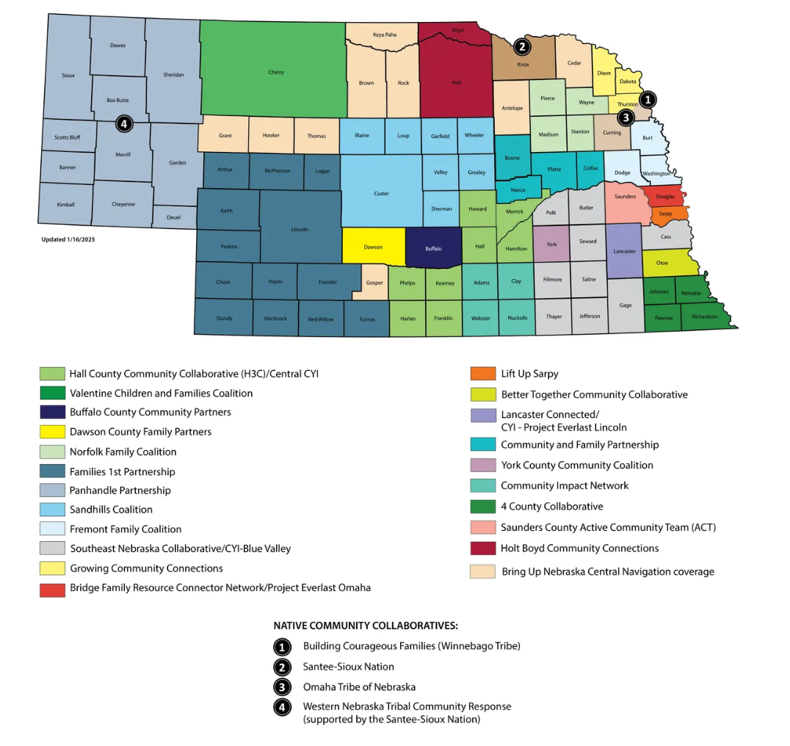
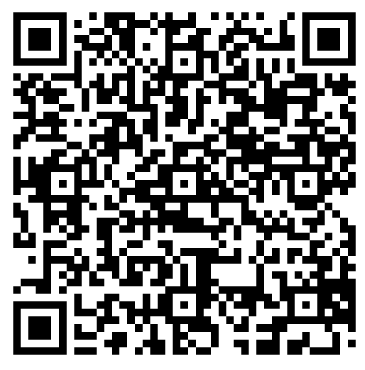
Community Collaboratives:

Slide 20
Central Navigation

Slide 21
What is Central Navigation
Central Navigation is a coordinated, collaborative approach that ensures community members can access needed community-based services. It enhances the prevention system by assessing service system needs, gaps, and barriers and identifying strategies to address these community issues.

Slide 22
Central Navigation
Central Navigation's prevention system assessment makes it the hub of Collective Impact. It provides a common understanding of community issues and drives solutions, identifying shared measures and implementing the work required to achieve the collaboratives goals.

Slide 23
Central Navigation
In the 2023-2024 evaluation year, local community-based prevention systems served 14,280 participants and 11,815 children statewide.
Central Navigation also provides access to Support Services Funds. These funds offer youth and families access to an array of basic needs services and support in emergency instances where support is not available through other sources. The gaps met by providing these funds further drive identifying, prioritizing, and solution-making conversations in communities.
Over 1.2 million dollars in Support Service Funds were distributed through 3,276 requests.

Slide 24
C
Central Navigation & Schools
"Two in every three students carry a second, invisible backpack..."
-Theresa Melito-Conners

Slide 25
Findhelp

Slide 26
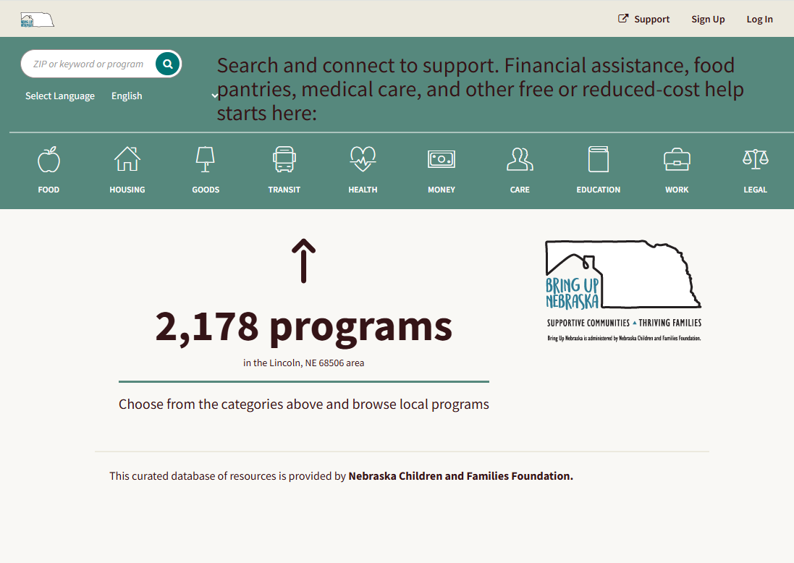
What is Findhelp
Findhelp is a free, online platform designed to connect people with community resources.

Slide 27
What is Findhelp
Findhelp is a free, online platform designed to connect people with community resources.
The goal is to make it easier for help seekers to find the support needed without having to search multiple websites or call numerous organizations.

Slide 28
Why it Matters:
Findhelp’ s approach was the only closed-loop referral system, that compliments values of prevention, opportunity & collective impact:
Centering the help-seeker

Slide 29
Why it Matters:
Findhelp’ s approach was the only closed-loop referral system, that compliments values of prevention, opportunity & collective impact:
Centering the help-seeker
Digital accessibility

Slide 30
Why it Matters:
Findhelp’ s approach was the only closed-loop referral system, that compliments values of prevention, opportunity & collective impact:
Centering the help-seeker
Digital accessibility
Preferred Language Centering

Slide 31
Why it Matters:
Findhelp’ s approach was the only closed-loop referral system, that compliments values of prevention, opportunity & collective impact:
Centering the help-seeker
Digital accessibility
Preferred Language Centering
Consent

Slide 32
Findhelp Supports Families
A true ‘No wrong door’ avenue for the help seeker..

Slide 33
Findhelp Supports Families
A true ‘No wrong door’ avenue for the help seeker.
Proactively connects families to local resources before crisis, no matter the ‘door’.
After school providers
(Individuals) / self-referrals
Community Collaborative
Central Navigators

Slide 34
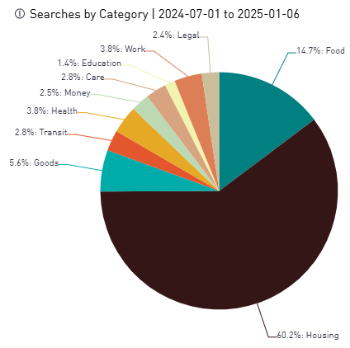
Findhelp Supports Collective Impact with real-time data insights
Identifies services and needs through data insights, helping you as a Collaborative wrap around the areas of need in real time.
See example: Search Activity Report:

Slide 35
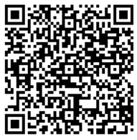
Questions?
Find your local Community Collaborative Findhelp Landing Page here:

Slide 36
Steps to connect Families Using Findhelp
Demo:

Slide 37
Questions

Slide 38
Thank you
Thank You!
Jen Hale
jhale@nebraskachildren.org
findhelp@nebraskachildren.org
Leonor Fuhrer
lfuhrer@nebraskachildren.org

