Slide 1

FORMING A MORE PERFECT UNION
Kent & Sandy Day
GetConnected 9/10/21
sday@nebraskachildren.org
kent.day@civicnebraska.org

Slide 2
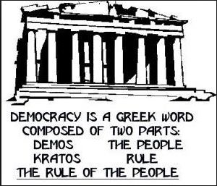
Unit Grade Bands
Kindergarten to Grade 2
Grades 3-5
Grades 6-8
Grades 9-12
This Photo by Unknown Author is licensed under CC BY-NC-ND

Slide 3

Themes for Each Grade Band
Confidence in Institutions
What is your community?
What parts of town are fun to be in?
What natural or man-made places do you like to be in?
What public events do you enjoy?
Where do people gather and what do they like to do?
If you were a city guide, what and how would you show off your city?
What talent would you like to share with your community?
What events bring people together throughout the year.
How do people from different ethnicities meet and learn about each other?
What events celebrate diversity in your community?
This Photo by Unknown Author is licensed under CC BY-NC-ND

Slide 4
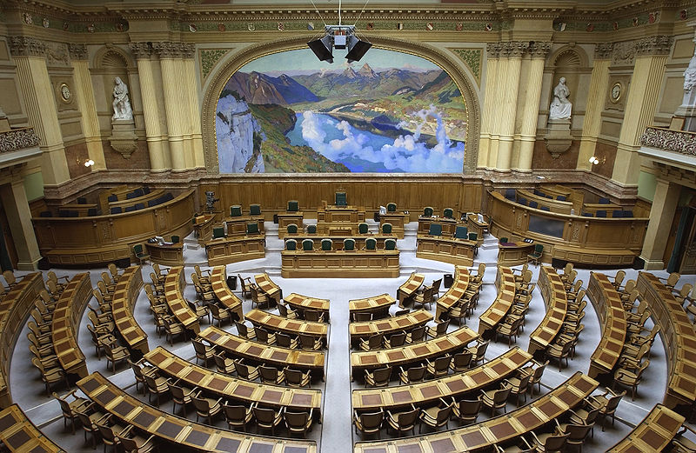
Themes for Each Grade Band
Community Engagement
Levels of Government: City, County, State, and Federal
What makes a good neighbor?
What foundations, donors, funding sources in your community?
What opportunities exist to collaborate with others to solve problems?
Who - boards, councils, people - make decisions in your community?
Support of new residents and transient communities
This Photo by Unknown Author is licensed under CC BY-SA

Slide 5
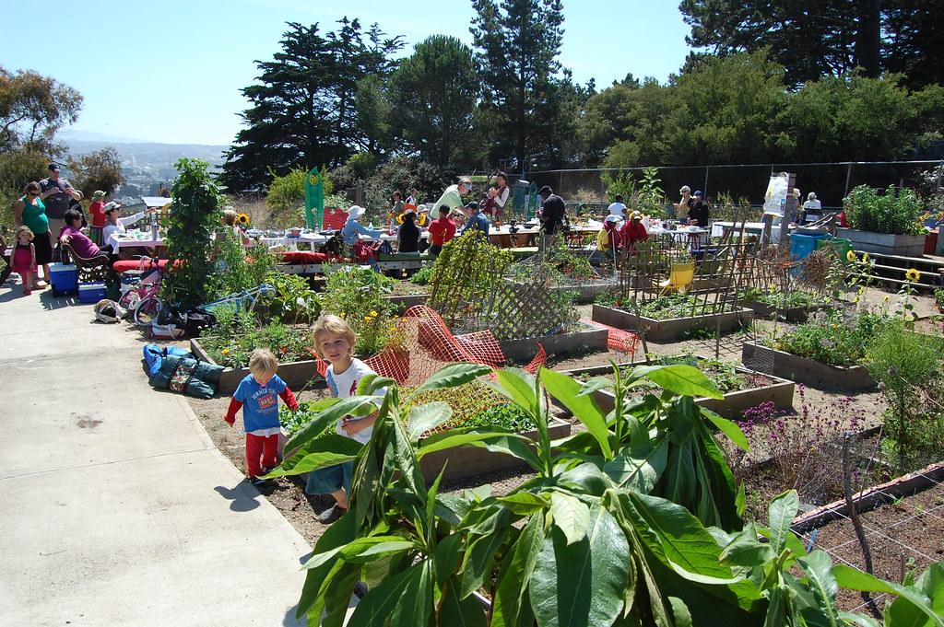
Themes for Each Grade Band
Social Connectedness
Knowing your community - define it
Important people in the community
What do you want your community to look like in 20 years?
What does Civil discourse look like?
What are the free public places in your community?
What businesses are in your community
What makes your community stand out?
What makes you feel engaged in your community?
What is your favorite place in your community? Why?
This Photo by Unknown Author is licensed under CC BY

Slide 6
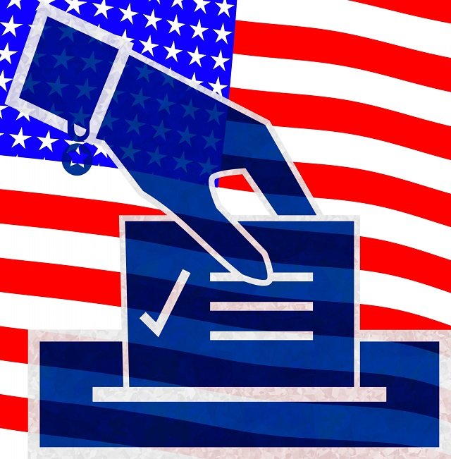
Themes for Each Grade Band
Political Action
Attend local city council meeting
Testify at one
Attend protest or rally
Send a letter to an elected official
Volunteer to be active in an issue
Inform self on issues
Vote
Run for office

Slide 7
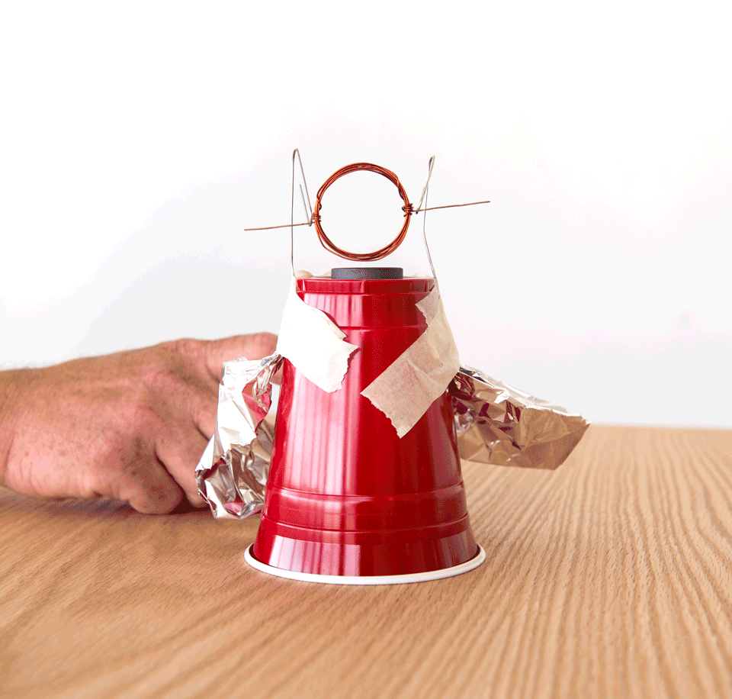
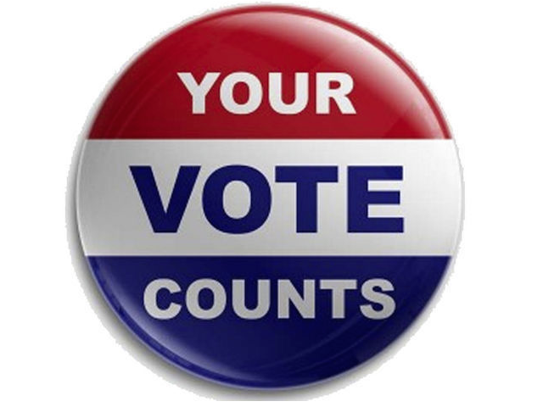
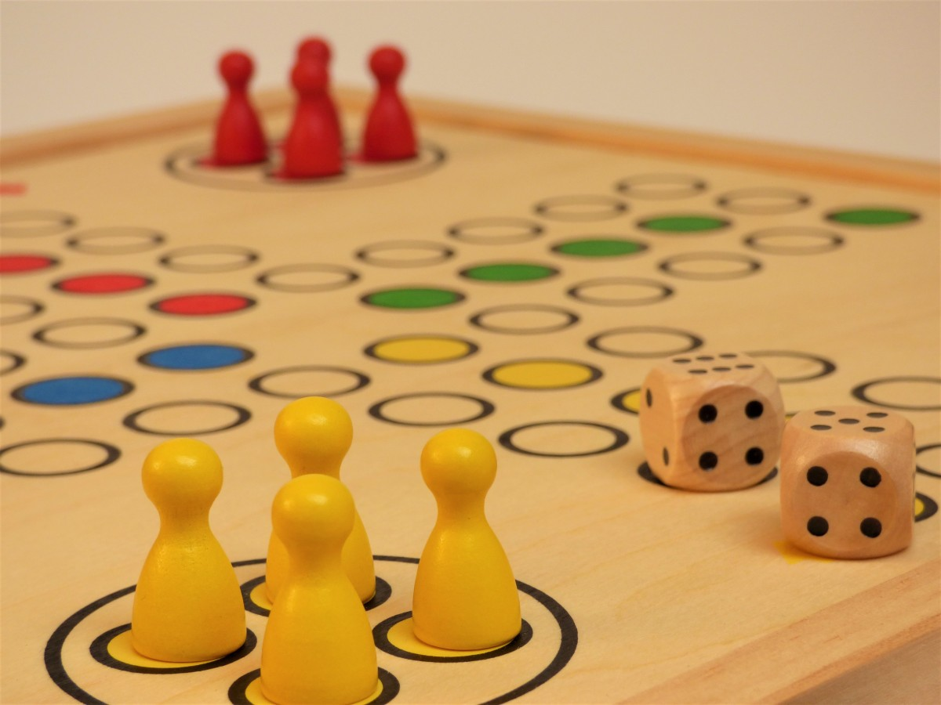
Three Lesson Types
ACTIVITY
VOTING
GAME

Slide 8
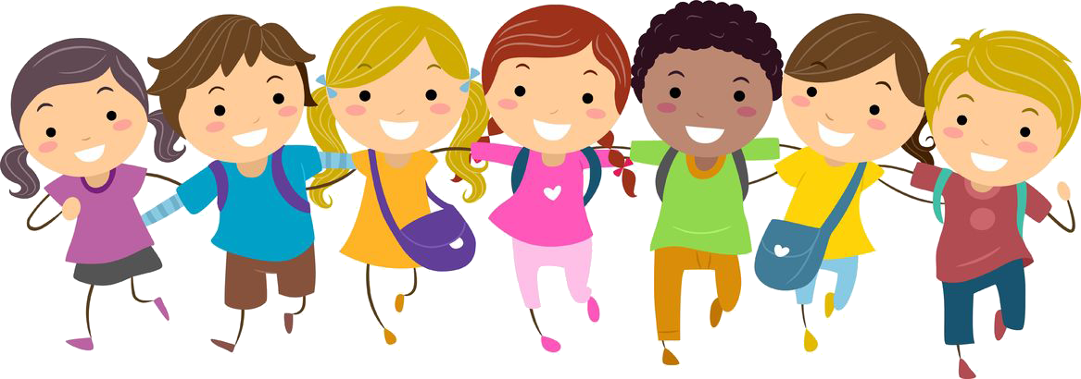
…and finally!
Things to consider –
Awarding students with a certificate of completion at closing.
Organizing a community/family night so that kids can demonstrate what they have learned.
Having near-peer grade bands assist in teaching a lesson.
This Photo by Unknown Author is licensed under CC BY-NC

Slide 9
Access “Forming…” here
https://beyondschoolbells.org/resources/profdev/get-connected-2021-pd.html

