Slide 1

Engaging Families Through STEM Backpacks

Slide 2
Agenda
Introduce STEM Backpack project
Feedback from families
Think about a STEM activity to do with your program
Let’s be an Engineer
Discuss how other programs are using the backpacks

Slide 3
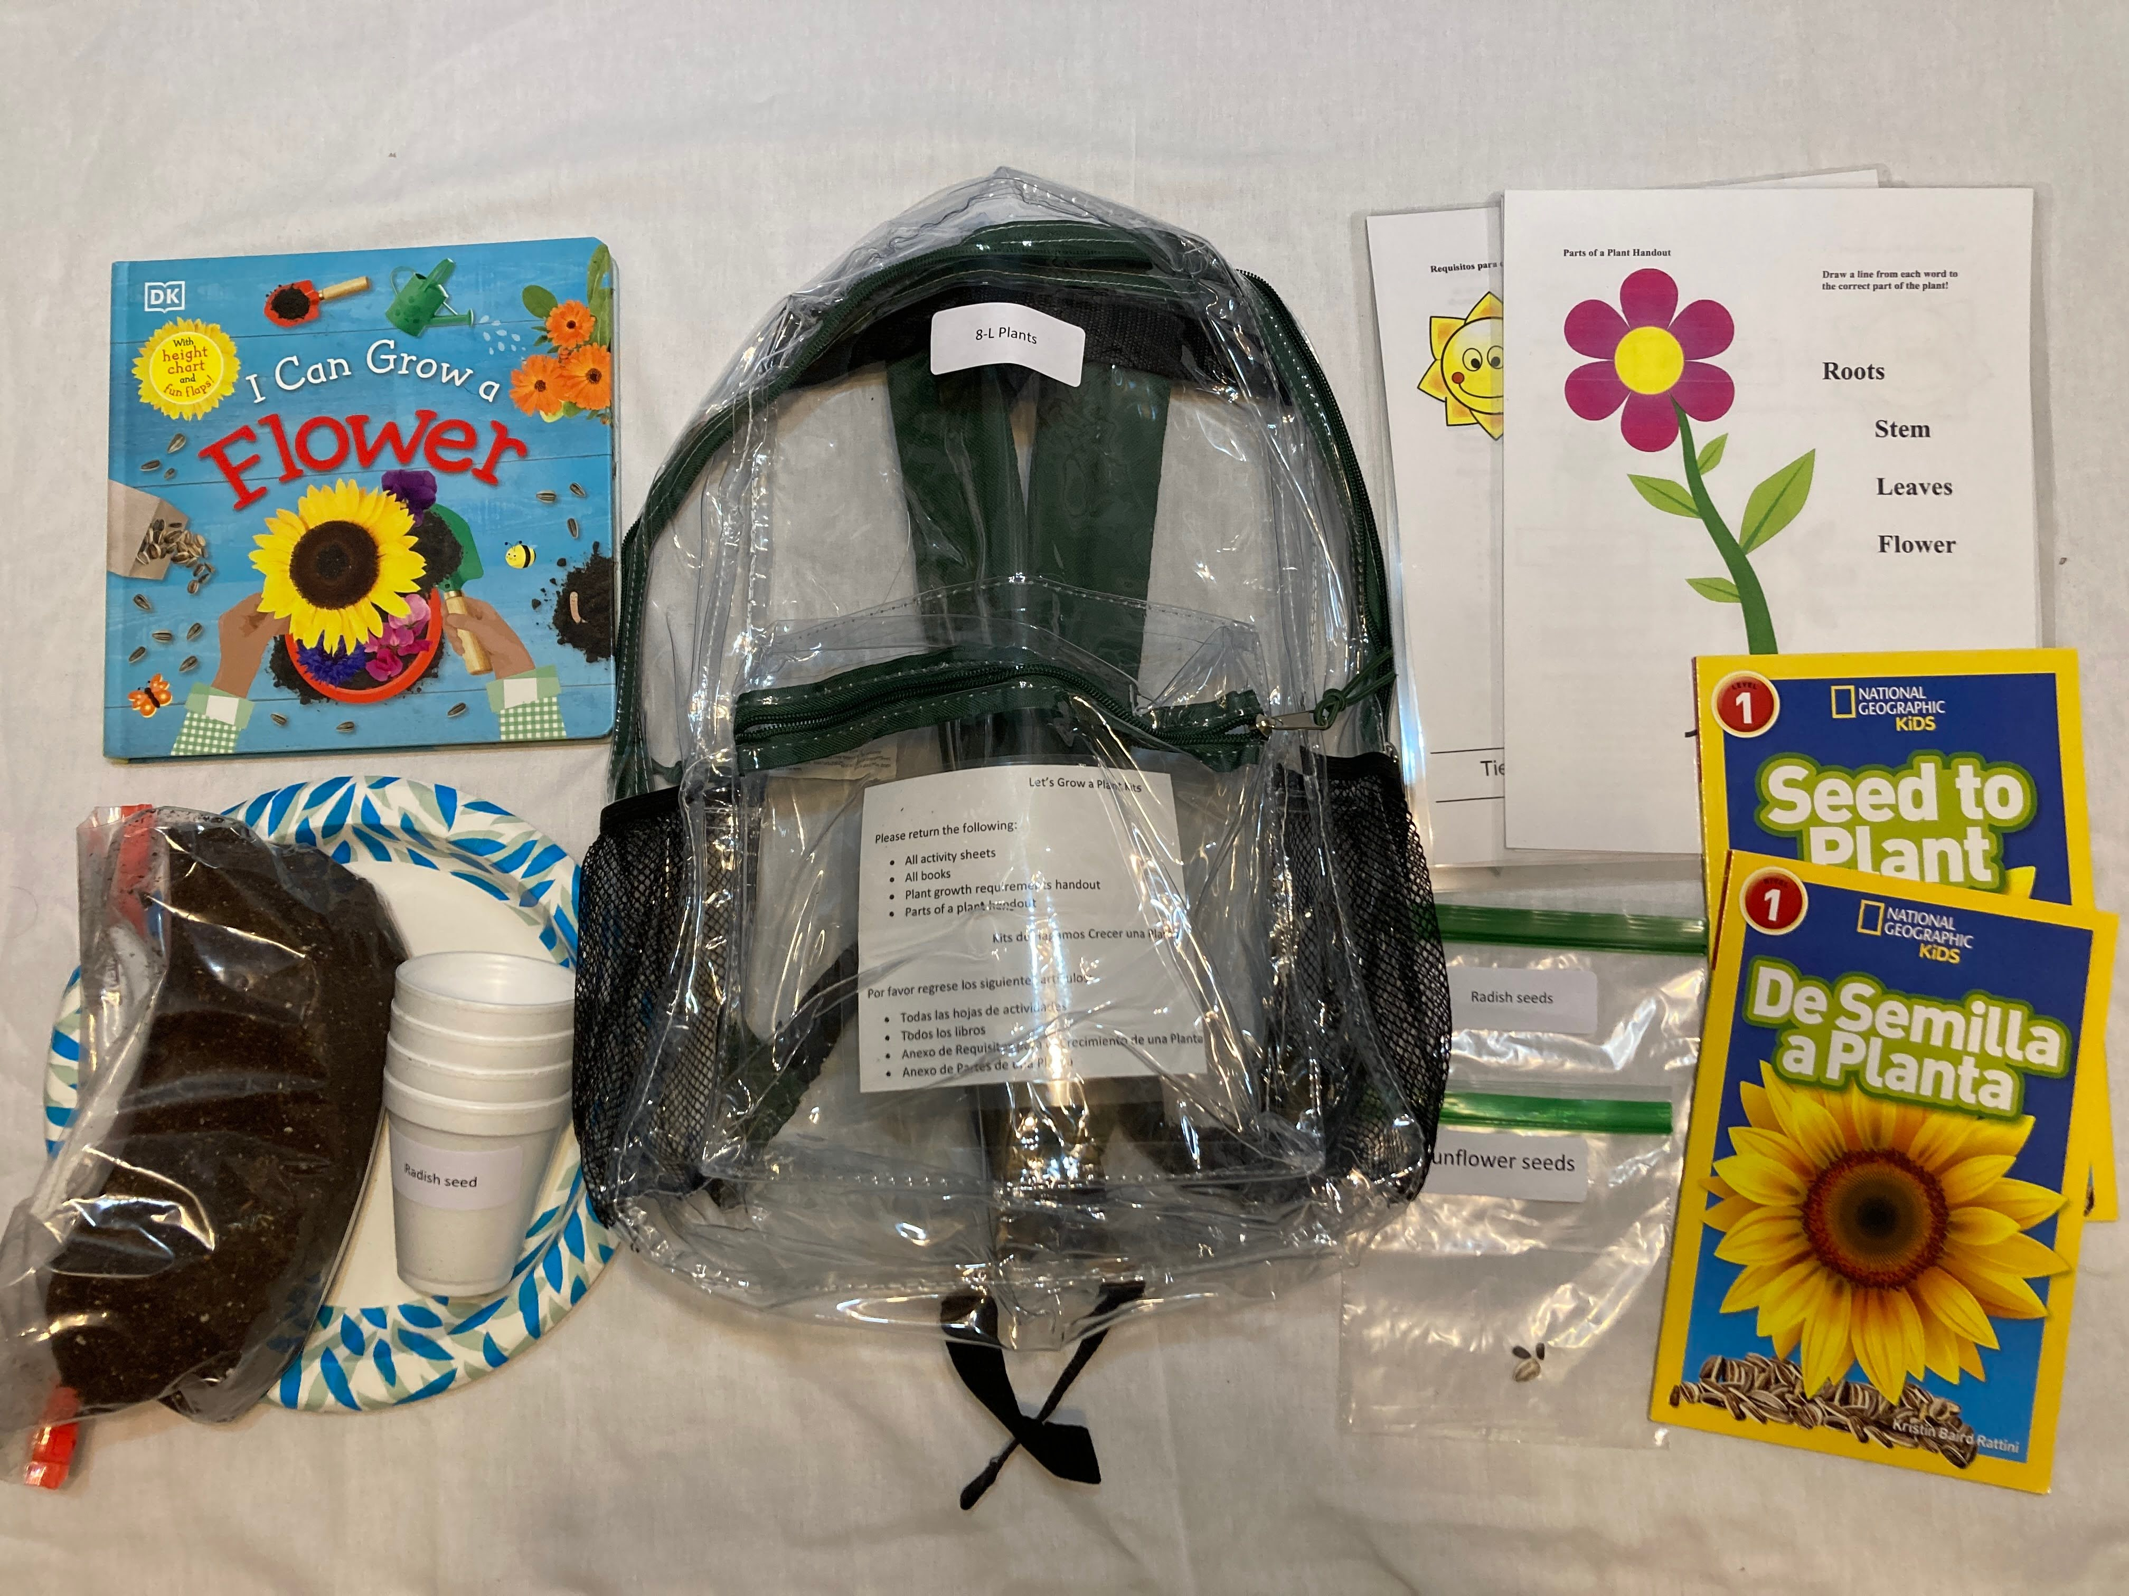
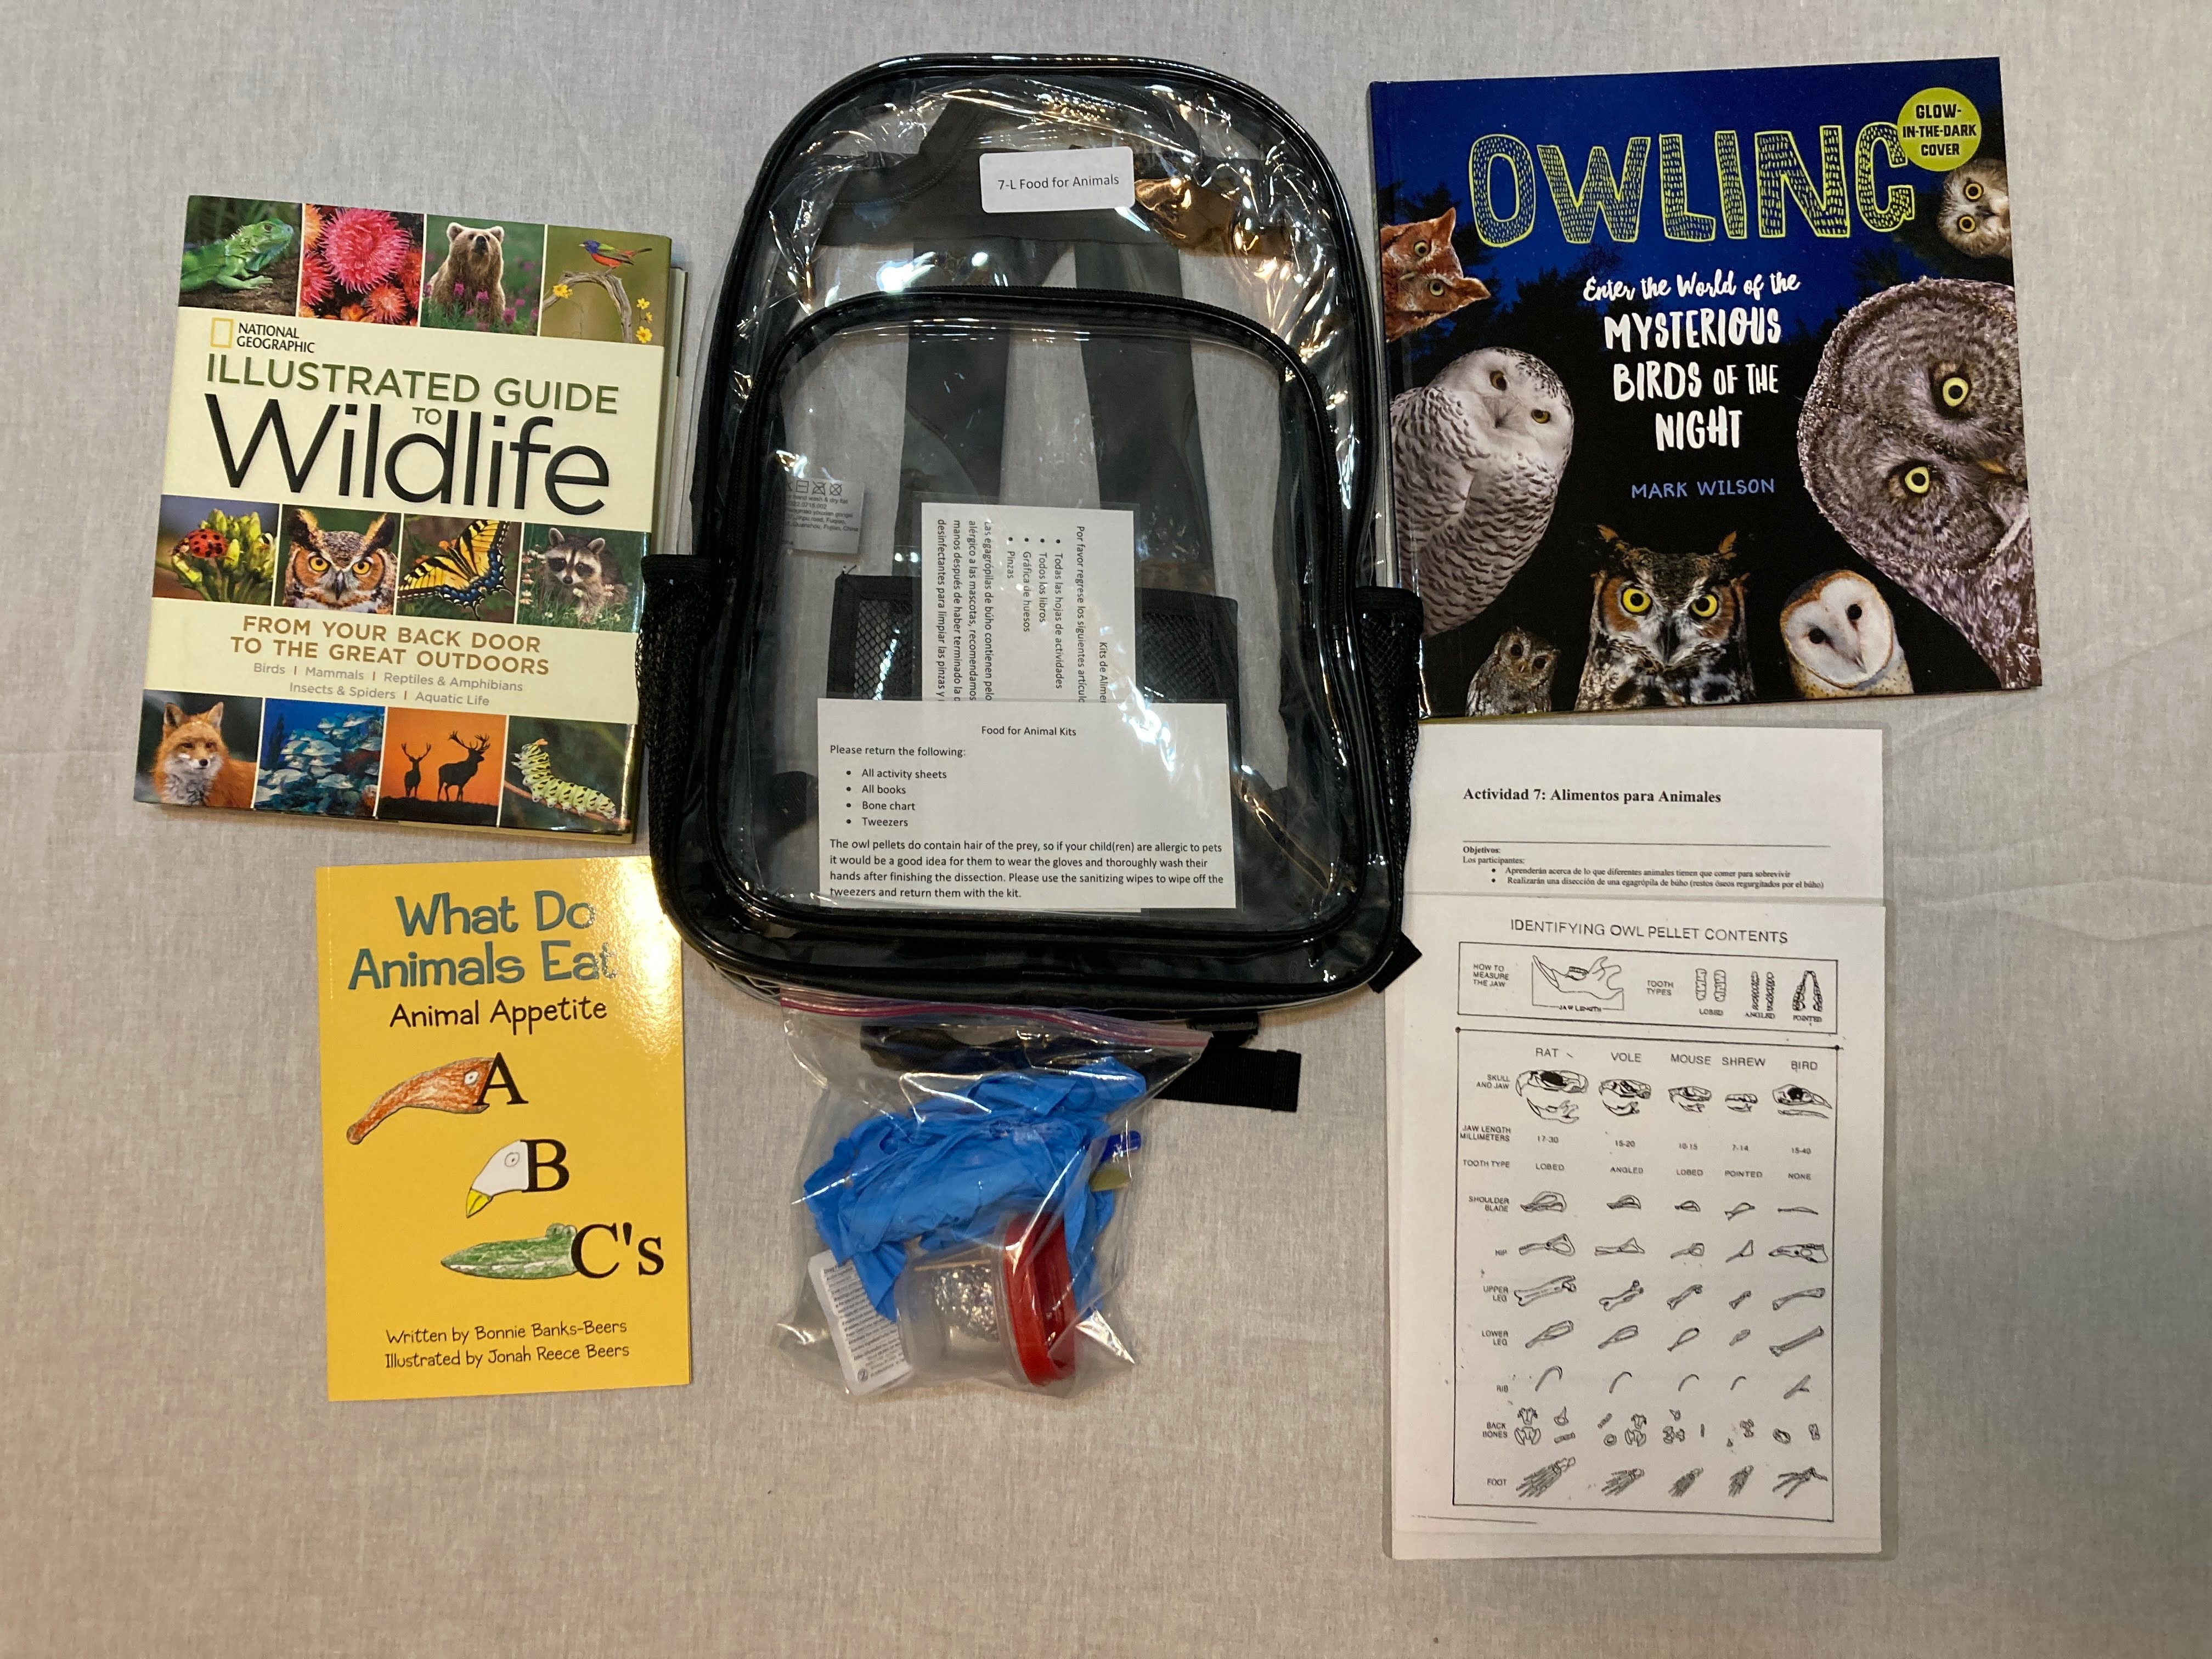
What are STEM Backpacks?
Notes:
Goals, purposes, structure – books, activity and all supplies needed to do activity

Slide 4

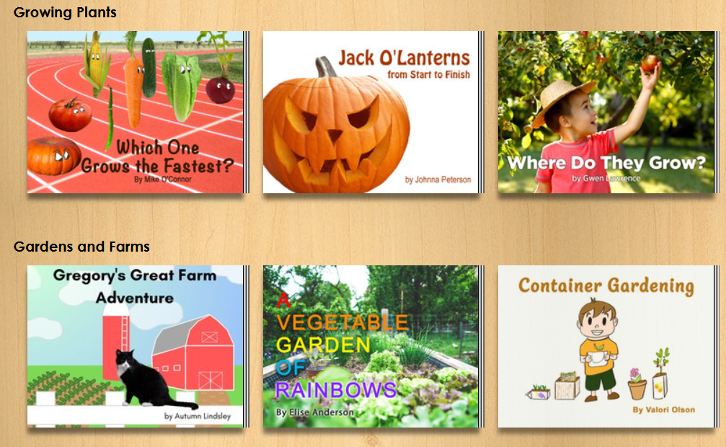
Unite for Literacy Bookshelf Page https://www.uniteforliteracy.com/bsbne/library

Slide 5
Backpack Topics
All About Tornados | Butterfly Metamorphosis | Bugs and more Bugs
Cloud in a Jar (water cycle) | DNA | Engineer It
Erupting Volcanos | Food for Animals | Let’s be an Engineer
How Plants Grow | Pollinators – Bee Mine | The Magic of Yeast
Notes:
Topics, designed for multiple ages, but activities are more specific to an age, backpacks for younger child are on the left of the screen, upper elementary are in the middle and middle school is on right (darkest part of table)

Slide 6
Pilot Backpack Topics
All About Leaves
Animal Tracks
Birds
Electricity
Photosynthesis
Renewable Energy
Slime
Starry Skies

Slide 7
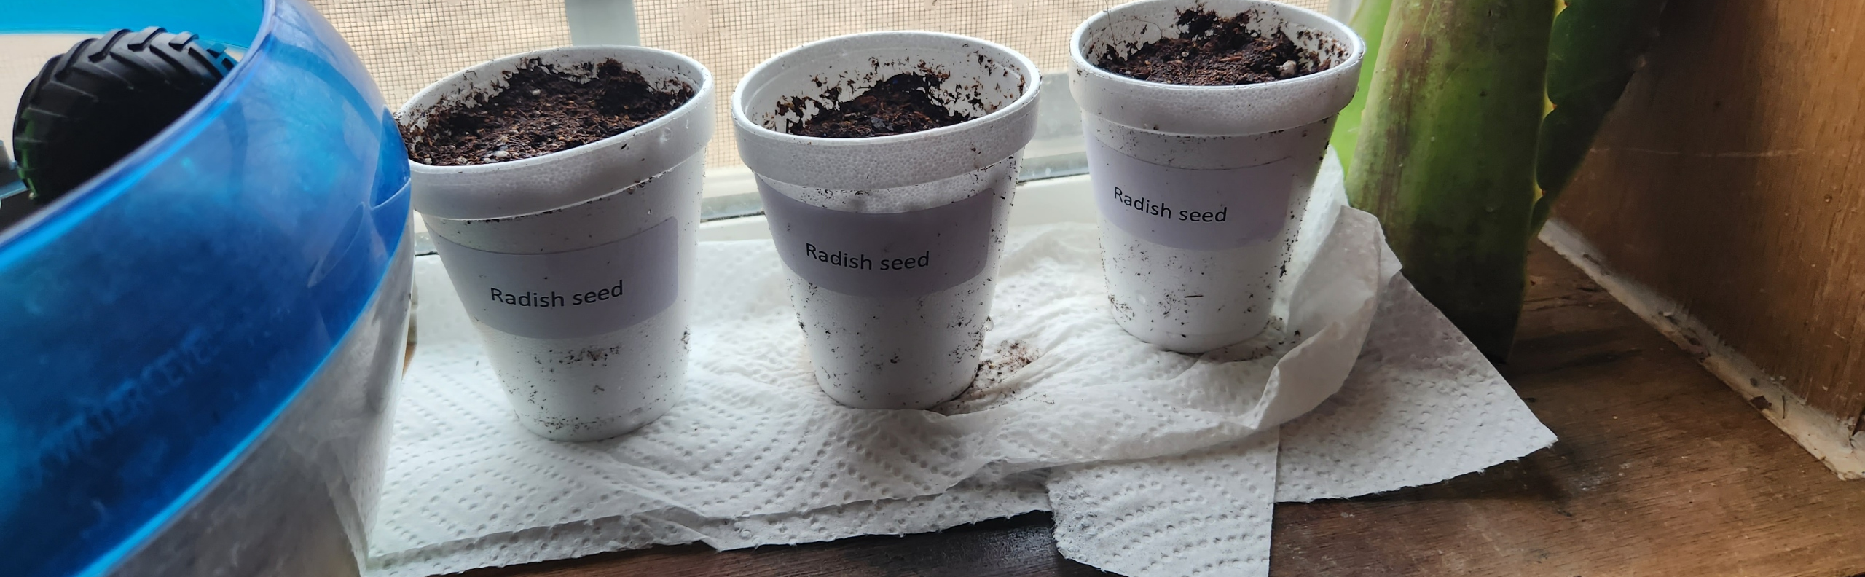
Goals
Engage families in high quality STEM activities
Provide opportunities to learn together
Develop partnerships

Slide 8
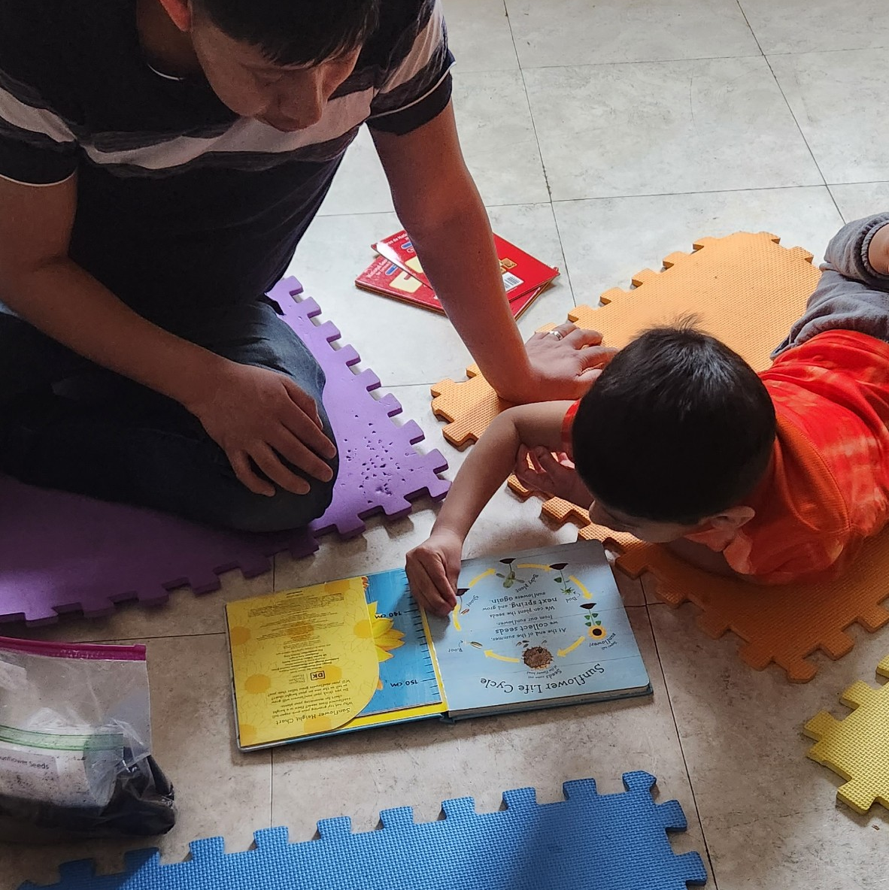
Most Popular Backpacks
Tornados
Bugs
Volcanos
Water
DNA
Butterflies

Slide 9
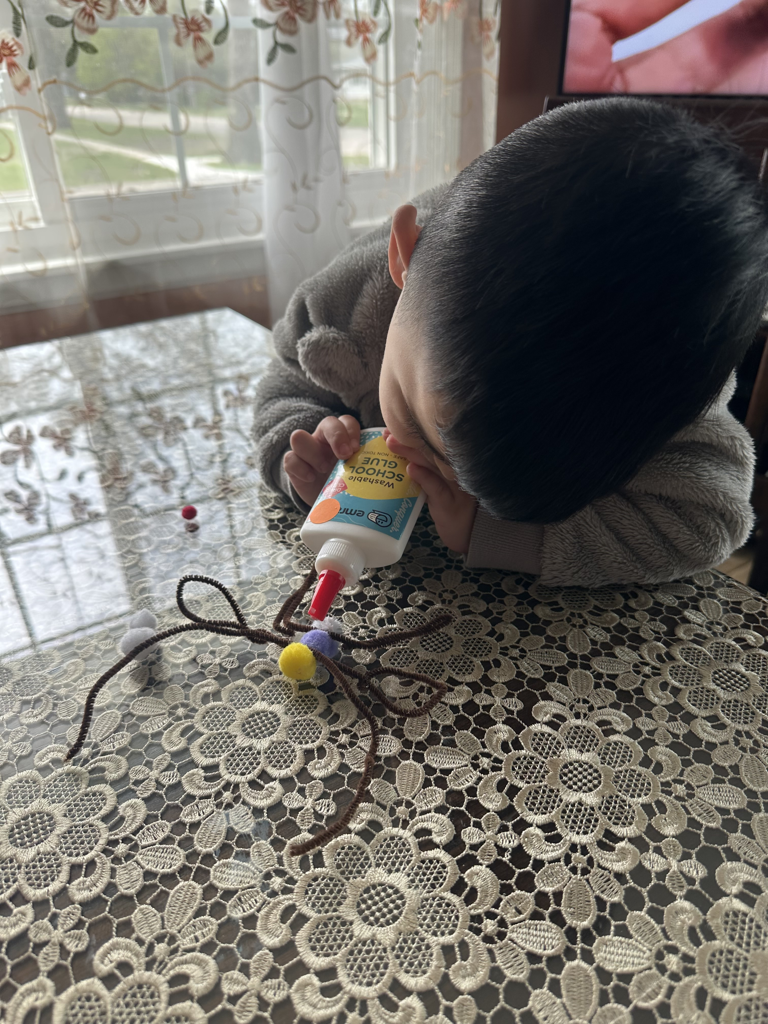
Statistics
526 backpacks produced
16 sites with 181 backpacks reported 543 checkouts
Rating of 4.74 out of 5
Total of 98 minutes doing activity and reading books

Slide 10
Finding an Engineering activity

Slide 11
Let’s be an Engineer Activity

Slide 12
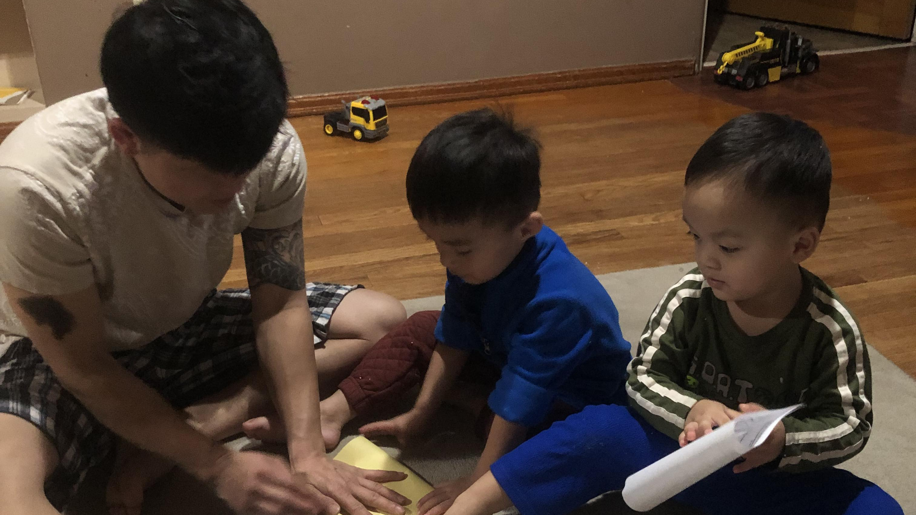
Putting it all together

Slide 13
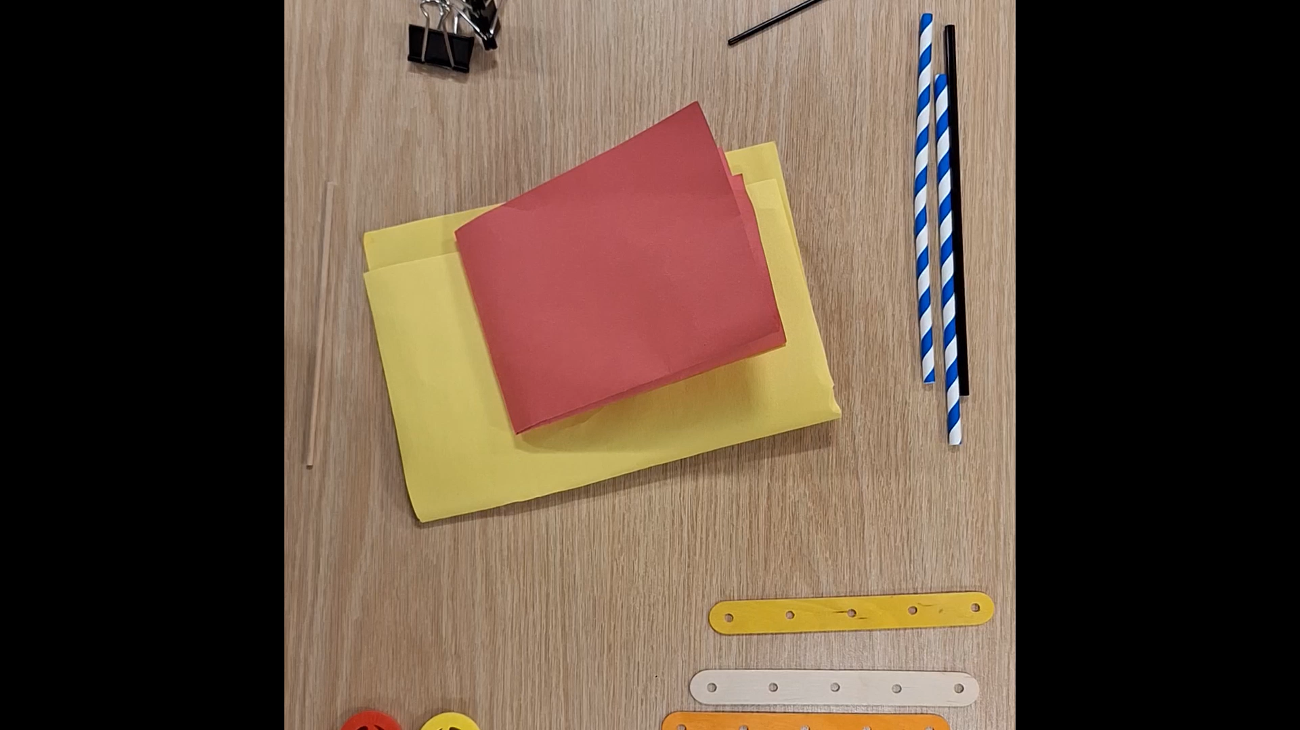

Slide 14
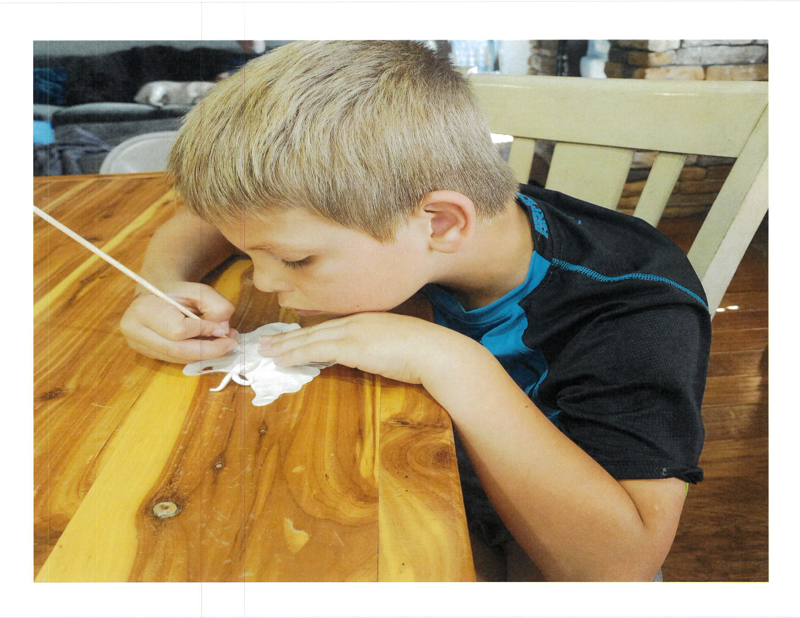
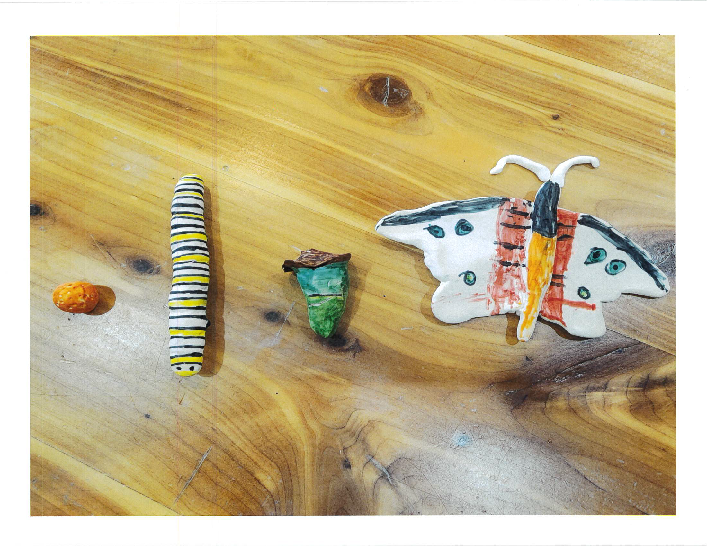
Using the backpacks with programming

Slide 15
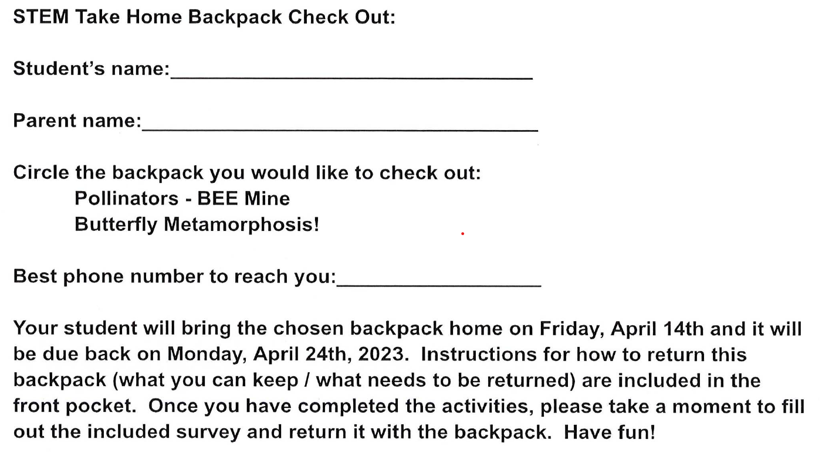

Slide 16
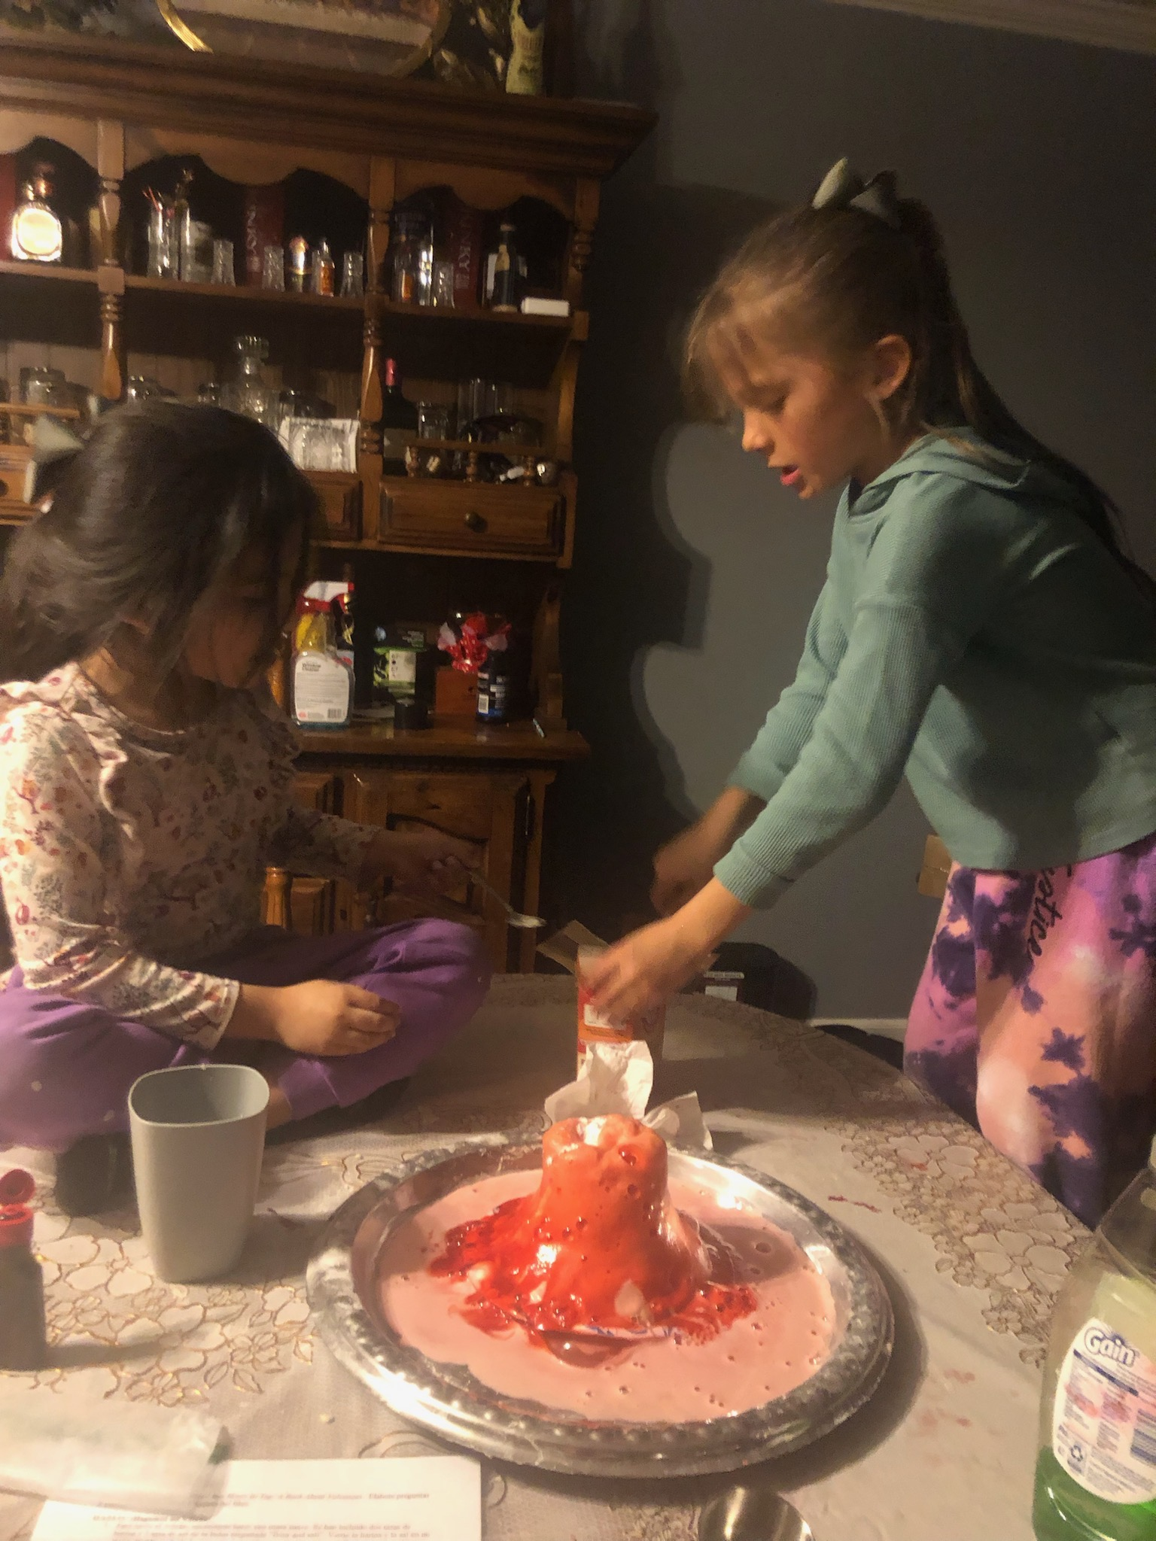
Notes:
New additions, read a fictional book, then do the activity and process the experience. Then there is a nonfiction book for younger children and one for older children. Family can read both books together or older child could go read their book and the younger children could be read to by caregivers. Tried to help visual learners or people who don’t read English by adding the illustrations. Designed based on the supplies in the backpack so families can identify the supplies in the illustrations

Slide 17



