Slide 1
Afterschool Programs:
Fostering Youth Development AND
Reducing Achievement Gaps
Deborah Lowe Vandell
Society for Research in Child Development
Biennial Meeting, Philadelphia, PA
March 19, 2015

Slide 2
Exciting Times
1. Key ingredients of powerful afterschool programming have been identified
2. Robust short-term effects are well documented
3. Evidence of meaningful long-term outcomes of afterschool programs
4. Emerging evidence that early child care and afterschool programs play unique and complementary roles

Slide 3
1. Key Ingredients That Make a Difference

Slide 4
Program Quality
Key elements: Engaging, challenging, interesting activities; Choice & voice; Relationships with staff; Relationships with peers
Program Intensity
Hrs/wk & days/yr
Program Duration
Sustained participation over time

Slide 5
2. Robust Short-Term Effects of High-Quality Programs

Slide 6
Meta-Analysis Documenting Short-Term Effects of High-Quality Programs Durlak, Weissberg, & Pachan

Slide 7
Meta-Analysis Documenting Short-Term Effects of High-Quality Programs Durlak, Weissberg, & Pachan

Slide 8
Meta-Analysis Documenting Short-Term Effects of High-Quality Programs Durlak, Weissberg, & Pachan

Slide 9
Meta-Analysis Documenting Short-Term Effects of High-Quality Programs Durlak, Weissberg, & Pachan

Slide 10
More Evidence of Robust Short-Term Effects of High-Quality Programs
Study of Promising Afterschool Programs
(Vandell, Reisner, Pierce, & Bolt)
Phase 1: A 3-year longitudinal study
35 high-quality programs, serving high-poverty communities in 8 states (CA, CT, MI, MT, NY, OR, RI, WI)
Includes rural areas, small towns, mid-size cities, large cities
3,000 low-income, ethnically diverse elementary and middle school students

Slide 11
Features of High-Quality Programs
Positive social relationships
Staff-child relationships
Relationships with peers
Connections with families and communities
Program content and activities
Mix of academic and non-academic skill building activities
Encouragement of student engagement
Content delivery strategies
Structured and unstructured learning opportunities
Opportunities for mastery
Opportunities for autonomy and choice
These processes were assessed using observations, interviews, and survey instruments.

Slide 12
Findings: Study of Promising Afterschool Programs
ELEMENTARY SCHOOL OUTCOMES
 | ONE YEAR
 | Program Only
Work habits | .17
Misconduct reductions | .58
Math achievement | .61

Slide 13
Findings: Study of Promising Afterschool Programs
ELEMENTARY SCHOOL OUTCOMES
 | ONE YEAR
 | Program Only | Program Plus
Work habits | .17 | .36
Misconduct reductions | .58 | .43
Math achievement | .61

Slide 14
Findings: Study of Promising Afterschool Programs
ELEMENTARY SCHOOL OUTCOMES
 | ONE YEAR |  | TWO YEARS
 | Program Only | Program Plus | Program Only | Program Plus
Work habits | .17 | .36 | .24 | .41
Misconduct reductions | .58 | .43 | .66 | .51
Math achievement | .61 |  | .52 | .73

Slide 15
Findings: Study of Promising Afterschool Programs
MIDDLE SCHOOL OUTCOMES
 | ONE YEAR
 | Program Only | Program Plus
Work habits
Misconduct reductions | .32 | .31
Math achievement

Slide 16
Findings: Study of Promising Afterschool Programs
MIDDLE SCHOOL OUTCOMES
 | ONE YEAR |  | TWO YEARS
 | Program Only | Program Plus | Program Only | Program Plus
Work habits |  |  | .20 | .33
Misconduct reductions | .32 | .31 | .56 | .67
Math achievement |  |  | .55 | .57

Slide 17
Isolating Effects of Specific Quality Components: Changes in Adolescent Development
Kataoka & Vandell (2013)
Reports by Classroom Teachers

Slide 18
3. Cumulative and Long-Term Effects of Afterschool Programs

Slide 19
Phase 2: Study of Promising Afterschool Programs (5 years later)
 | Work Habits | Task Persistence | Misconduct | GPA | School Absences
Program attendance days in phase 1 |  | ↗ .08 |  |  | ↘ .14

Slide 20
Phase 2: Study of Promising Afterschool Programs (5 years later)
 | Work Habits | Task Persistence | Misconduct | GPA | School Absences
Program attendance days in phase 1 |  | ↗ .08 |  |  | ↘ .14
Unsupervised time in phase 1 |  |  |  | ↘ .16 | ↗ .13

Slide 21
Phase 2: Study of Promising Afterschool Programs (5 years later)
 | Work Habits | Task Persistence | Misconduct | GPA | School Absences
Program attendance days in phase 1 |  | ↗ .08 |  |  | ↘ .14
Unsupervised time in phase 1 |  |  |  | ↘ .16 | ↗ .13
ELO phase 2 | ↗ .19 | ↗ .16 |  | ↗ .10

Slide 22
Phase 2: Study of Promising Afterschool Programs (5 years later)
 | Work Habits | Task Persistence | Misconduct | GPA | School Absences
Program attendance days in phase 1 |  | ↗ .08 |  |  | ↘ .14
Unsupervised time in phase 1 |  |  |  | ↘ .16 | ↗ .13
ELO phase 2 | ↗ .19 | ↗ .16 |  | ↗ .10
Unsupervised Phase 2 | ↘ .13 | ↘ .17 | ↗ .22

Slide 23
Study of Early Child Care and Youth Development (SECCYD)
Birth cohort (n = 1360, 23% low income; 25% students of color) recruited in 1991; 10 sites
Children studied from birth through end-of-high-school
Measures of out-of-school time participation collected from kindergarten to end-of-high-school
Child cognitive, academic, social, and behavioral outcomes
Extensive set of family, early child care, & school covariates

Slide 24
Participation in Afterschool Activities Linked to Academic Gains in Elementary School
Consistent Participation | Student Outcomes
Paper 1: K – 1st (ECCRN, 2004) % epochs | G1 Math achievement ↗ .25

Slide 25
Participation in Afterschool Activities Linked to Academic Gains in Elementary School
Consistent Participation | Student Outcomes
Paper 1: K – 1st (ECCRN, 2004) % epochs | G1 Math achievement ↗ .25
Paper 2: K – 3rd (Pierce, Auger, % epochs ^{& Vandell, 2014)} | G3 Academic grades ↗ .07 G3 Work habits ↗ .09

Slide 26
Participation in Afterschool Activities Linked to Academic Gains in Elementary School
Consistent Participation | Student Outcomes
Paper 1: K – 1st (ECCRN, 2004) % epochs | G1 Math achievement ↗ .25
Paper 2: K – 3rd (Pierce, Auger, % epochs ^{& Vandell, 2014)} | G3 Academic grades ↗ .07 G3 Work habits ↗ .09
K – 5th ^{% epochs} | G5 Academic grades ↗ .07 G5 Work habits ↗ .11 G5 Math achievement ↗ .09

Slide 27
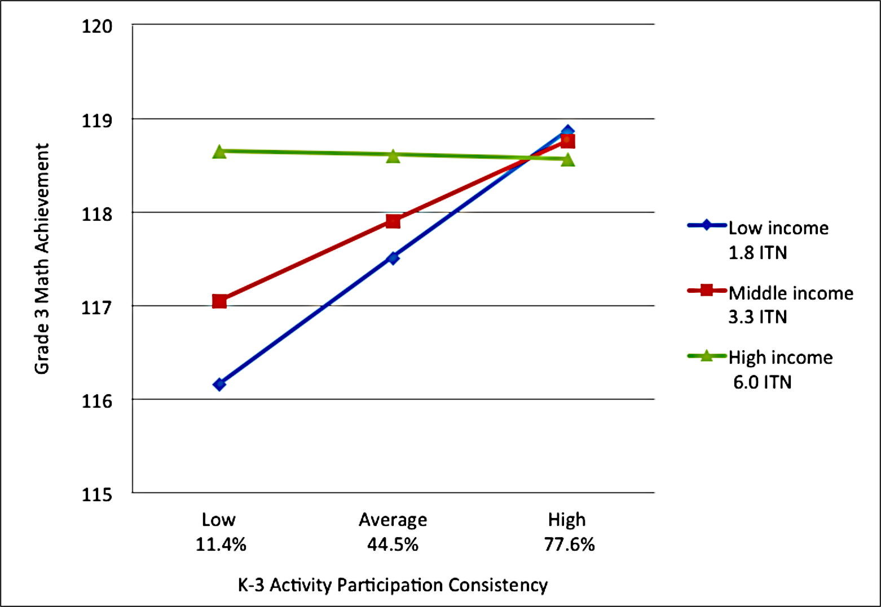
Narrowing the math achievement gap in GRADE 3
K-3 Participation:

Slide 28
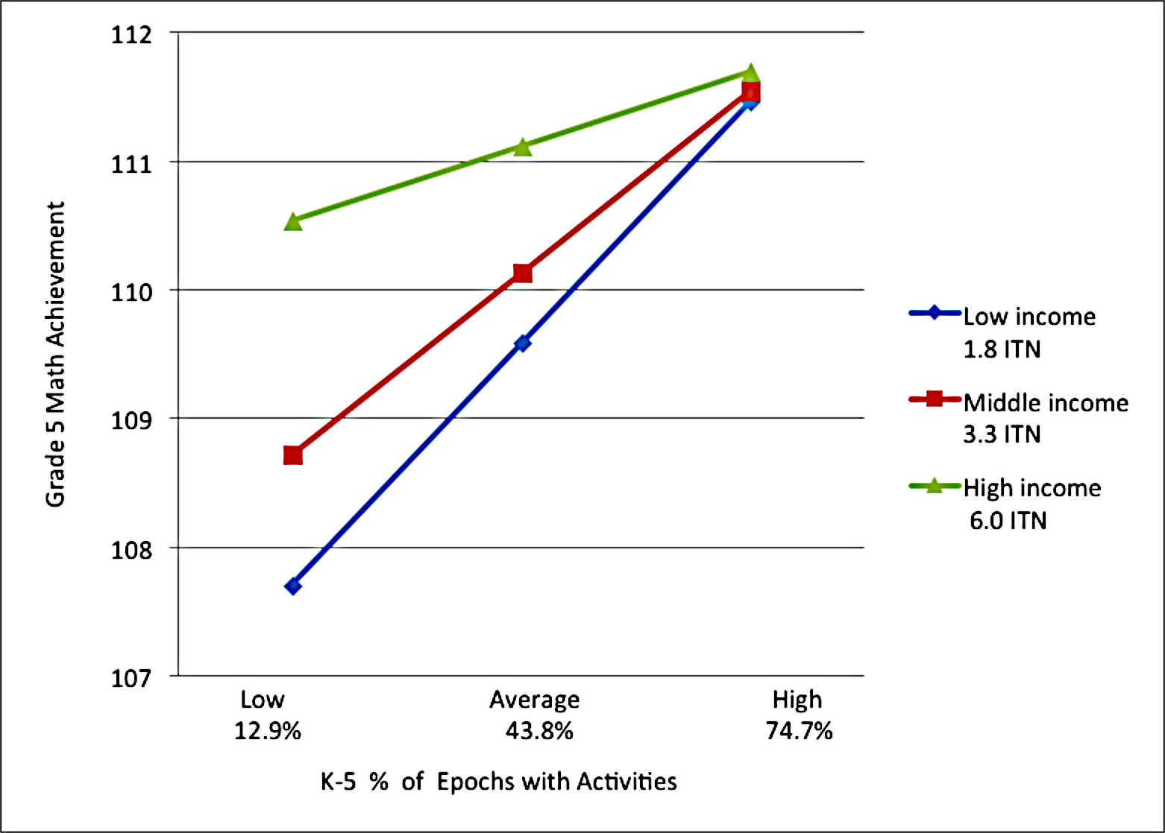
Narrowing the math achievement gap in GRADE 5
K-5 Participation:

Slide 29
Long-term Relations between Quality & Intensity of Middle School Activities and High School Functioning
Li & Vandell (2013)
Grade 6 Activities | High School Outcomes
Quality of Activities | Confident/Assertive ↗ .09 Substance use ↘ .08 Externalizing problems ↘ .06 Internalizing problems ↘ .08
Intensity Hours/week | Confident/Assertive ↗ .08 Higher math achievement ↗ .06

Slide 30
4. Contrasting the Effects of Early Childhood and Afterschool Programs

Slide 31
Historically, ECE and afterschool researchers have worked in their own silos.
Separate communities of practice also exist (for the most part) among practitioners and advocates who focus on one developmental period.
This needs to change …

Slide 32
Examining Long-Term Effects of Both ECE and OST
Vandell, Pierce, Auger, & Lee (2014)
Because of its design, the SECCYD is well suited to assessing BOTH early child care and afterschool experiences.
Early Child Care Measures: Quality, Hours, Type
Out-of-School Time Measures: Participation Epochs
Academic and social-behavioral outcomes
Extensive covariates (parenting, home, income, parent education, parent depression, PPRT)

Slide 33
Making a Case for Early Childhood AND Afterschool Programs
Performance at Age 15 | Quality of Early Childcare | K-5 Consistent Participation
Math Achievement | ↗ .07 | ↗ .07

Slide 34
Making a Case for Early Childhood AND Afterschool Programs
Performance at Age 15 | Quality of Early Childcare | K-5 Consistent Participation
Math Achievement | ↗ .07 | ↗ .07
Reading Comprehension | ↗ .08 | ↗ .08

Slide 35
Making a Case for Early Childhood AND Afterschool Programs
Performance at Age 15 | Quality of Early Childcare | K-5 Consistent Participation
Math Achievement | ↗ .07 | ↗ .07
Reading Comprehension | ↗ .08 | ↗ .08
Impulse Control | ↗ .12

Slide 36
Making a Case for Early Childhood AND Afterschool Programs
Performance at Age 15 | Quality of Early Childcare | K-5 Consistent Participation
Math Achievement | ↗ .07 | ↗ .07
Reading Comprehension | ↗ .08 | ↗ .08
Impulse Control | ↗ .12
Assertive/Confident |  | ↗ .11

Slide 37
Final Reflections
Unprecedented opportunities for afterschool programs to make a difference
Afterschool programs are linked to a wide array of academic, social, and behavioral outcomes
For these benefits to be realized, activities have to be of high quality, of sufficient intensity, and sustained over time.
Early childhood and afterschool programs both play important roles in children’s development and both are needed.

Slide 38
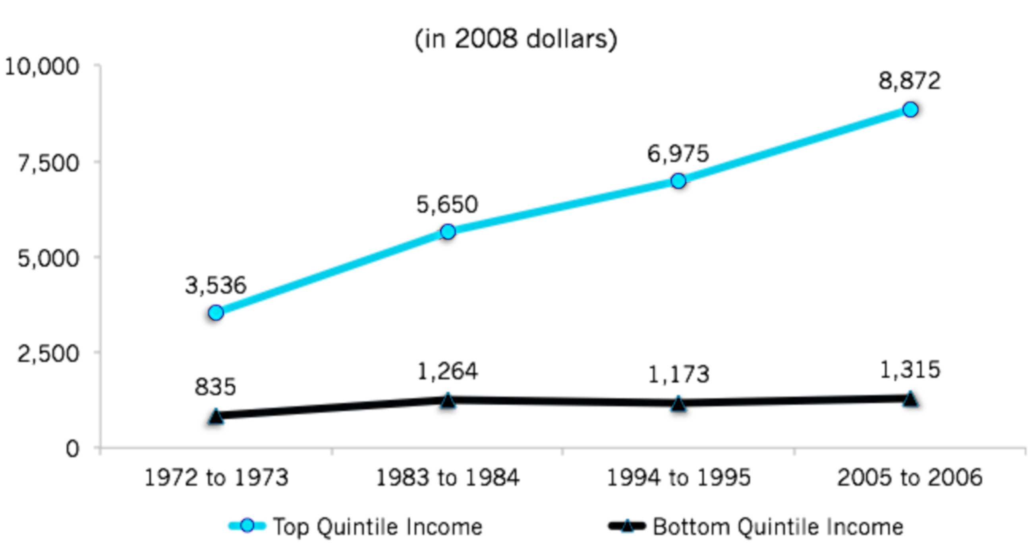
Duncan and Murnane (2011). Whither Opportunity?
Increasing Opportunity Gap:
Spending on enrichment (1972-2008)

Slide 39
Final Reflections
Low-income youth are less likely to have access to afterschool enrichment programs, even though these youth may benefit most from these programs
These findings underscore the potential value of expanding investments in high quality programming for low-income youth

