Slide 1
Engaging Caregivers in Planning a
STEM Family Engagement Event
Dayna Krannawitter
School Community Coordinator
Arnold Community Learning Center

Slide 2
Introductions
Program Information
STEM Family Engagement CoP
Forming the Team
STEM Event
Using the Planning Tool
Agenda

Slide 3
Introductions

Slide 4
Arnold Community Learning Center
THREE GOALS:
SUCCESSFUL YOUTH, THRIVING FAMILIES, STRONG NEIGHBORHOODS
Arnold Elementary - 677 students, pre-K through 5th grade / CLC - 261 students (23-24 school year)
64% F/R lunch, 43% minority, 7% EL, 21% SE
Lead Agency - Lincoln Housing Authority, Lead Program Provider - Lincoln Parks & Recreation

Slide 5
Beyond School Bells & STEM Next Opportunity Fund
Community of Practice
Grant funds to complete a STEM family engagement project
Met monthly with BSB staff and three other sites
Professional development to help expand capacity for family engagement
From Reimagining Family Engagement: How Out-of-School Time STEM Programs “CARE”, an ISRY Report by Patricia J. Allen, PHD &
Gil G. Noam, EdD, PhD. In partnership with STEM Next Opportunity Fund & Million Girls Moonshot, March 2023

Slide 6
Forming the Team
Who do I know? (Connect)
Current program families
Families who attend FE activities
PTO, SNAC, other leadership groups
EL teachers who are connected to families
Bilingual Liaisons
Planning Time (Act & Reflect)
Meeting time convenient for caregivers
Food/snacks
Materials
Event (Empower)
Caregivers have active roles in event
Caregivers greet families
Caregivers provide interpretation
From Reimagining Family Engagement: How Out-of-School Time STEM Programs “CARE”, an ISRY Report by Patricia J. Allen, PHD &
Gil G. Noam, EdD, PhD. In partnership with STEM Next Opportunity Fund & Million Girls Moonshot, March 2023

Slide 7
STEM AROUND THE WORLD
Event held 6:00-7:30pm with a free meal in the cafeteria and activity stations in the gym
Members of planning team at sign-in table
Each family received a STEM Passport
8 activity stations
Build your home country’s flag with Legoes
Build a structure or landmark from your country/culture/city
Make a rainmaker to create music in the Native American culture
Fold an origami crane as you visit Japan
Make a paper airplane to fly to another country
Make a boat that floats around the Mediterranean Sea
Make maracas to play in Brazil
Create a roller coaster to ride in the United States
Once passport completed they could trade it in for a goodie bag

Slide 8
STEM AROUND THE WORLD

Slide 9
Impact
35 families and a total of 129 people attended
Five non-English speaking families with requests for Vietnamese, Karen, and Spanish interpreters
According to the survey, the favorite activity was making a rainstick, followed by making an airplane and origami art.
Comments from families included the activities were fun and they enjoyed the cultural focus while also learning about STEM.

Slide 10
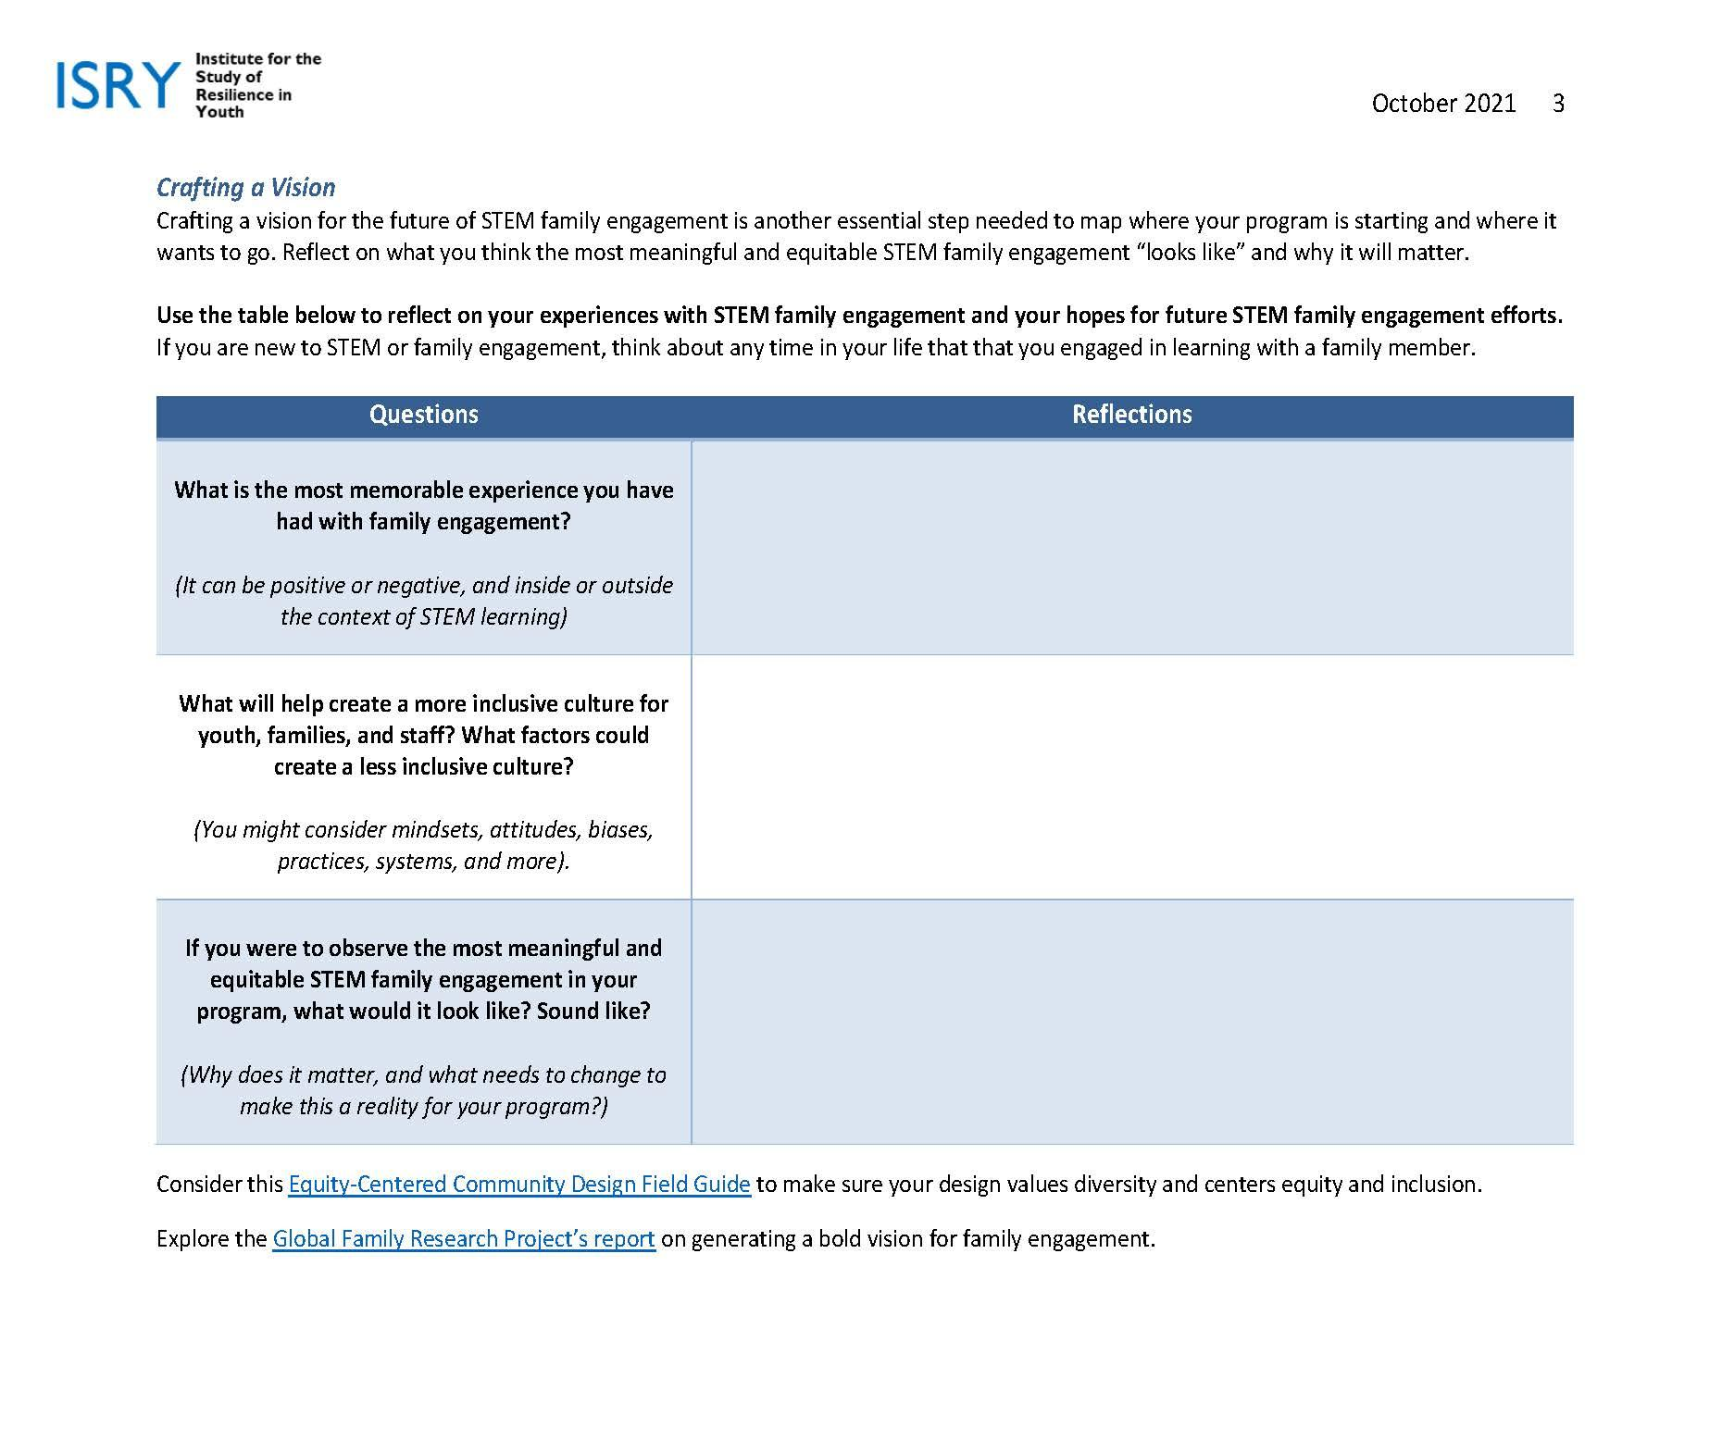
Using the Planning Tool

Slide 11
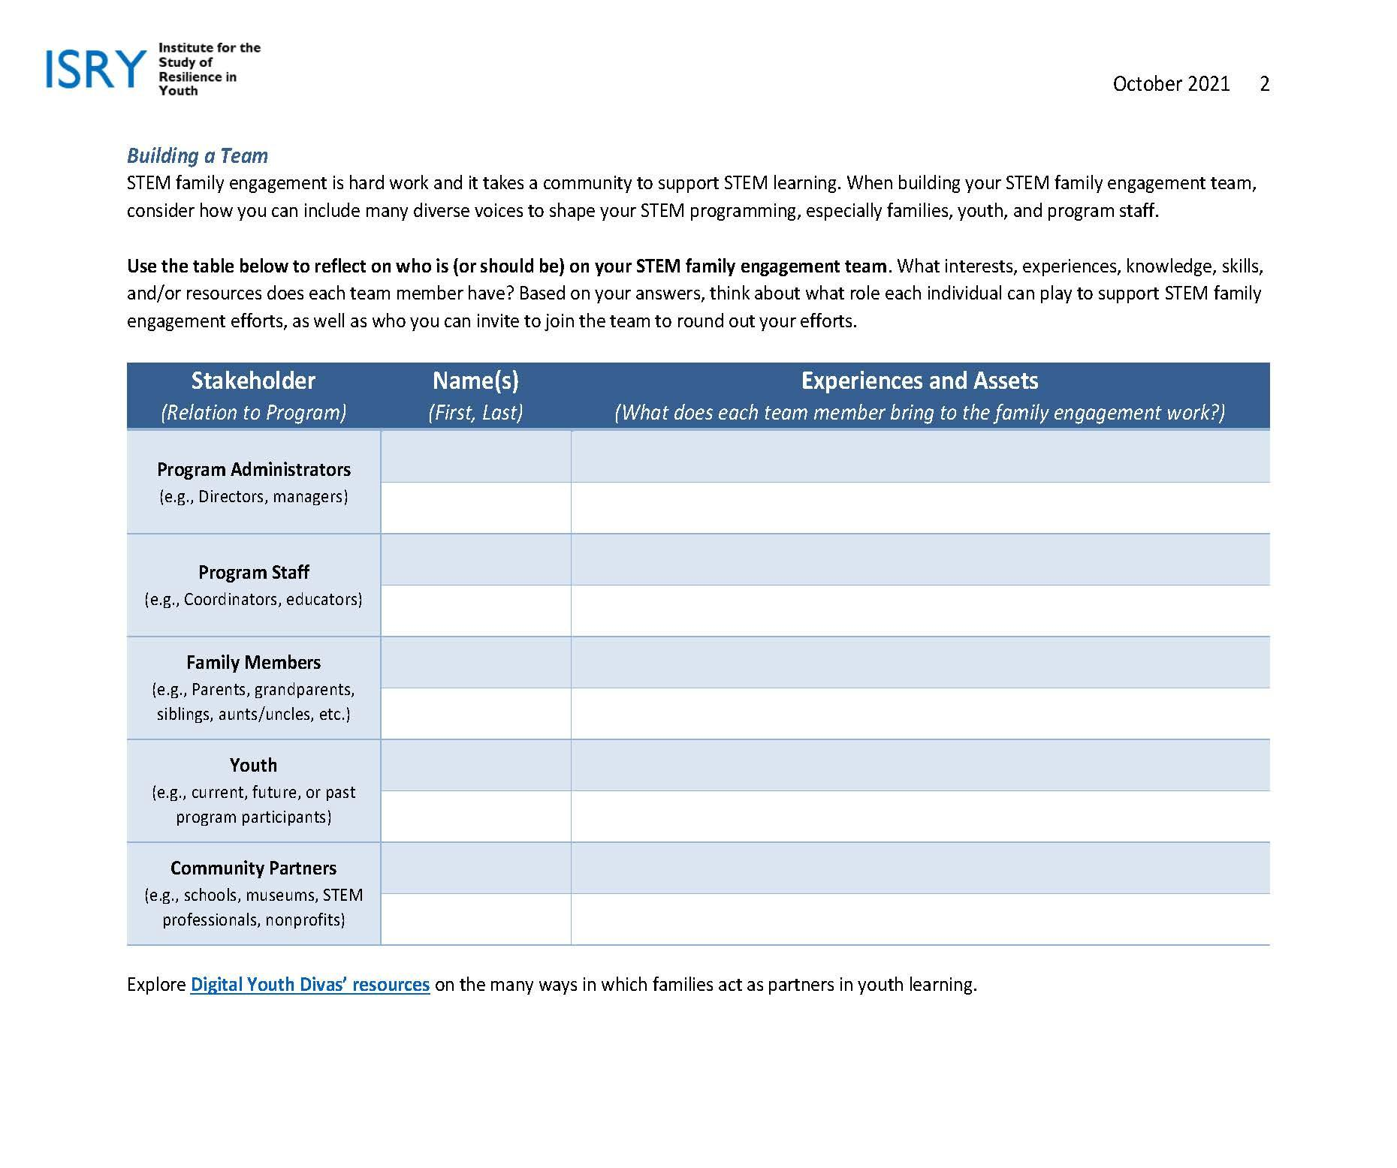
Using the Planning Tool

Slide 12
Questions??
Dayna Krannawitter
School Community Coordinator
Arnold Community Learning Center
dkranna@Lps.org
402-436-1120 ext. 5

